Slide 1
Life Sciences 11
Kingdoms Protista and Plantae:
Algae and Bryophyta

Slide 2
Objectives
By the end of the lesson you should be able to:
State the 3 types of algae
Explain why we believe land plants developed from algae
Draw and explain the lifecycle of a bryophyte
Give examples of bryophytes

Slide 3
The First “Plants”
Were not truly plants!
For more than 3 billion years, Earth’s terrestrial surface was lifeless
  life evolved in the seas
  plant life evolved in the seas from algae
  1st photosynthetic organisms were aquatic green algae
Chlamydomonas

Slide 4
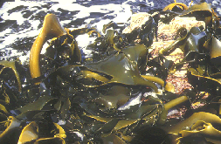
Brown Algae
Kingdom Protista
Phylum Heterokontophyta
Mostly marine and temperate.
Kelp

Slide 5
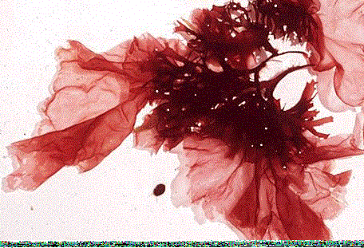
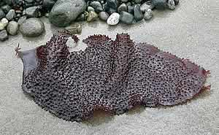
Red Algae
Kingdom Protista
Phylum Rhodophyta
Most common in warmer tropical waters
In temperate zones, found in deeper water
Turkish Wash Cloth

Slide 6
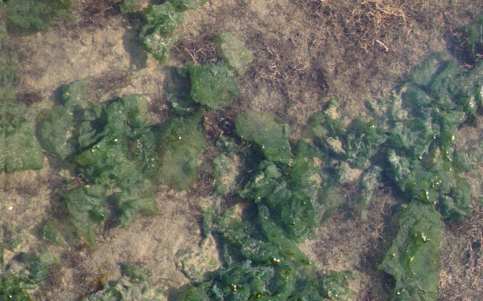
Green Algae
Kingdom Protista
Phylum Chlorophyta
Very diverse group
Include 3 forms:
  unicellular
  colonial
  multicellular
Live in all environments: fresh and salt water, soil
Ulva sp. Sea lettuce

Slide 7
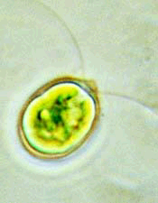
A) Unicellular Green Algae
Very common in fresh water as part of phytoplankton.
Ex. Chlamydomonas sp.

Slide 8
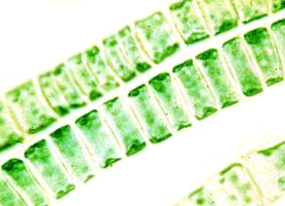
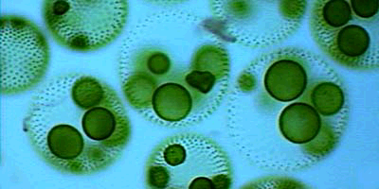
B) Colonial Green Algae
Live in long filaments or as colonial spheres.
Filamentous green algae
Volvox, spherical colonial

Slide 9
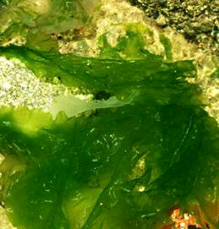
C) Multicellular Green Algae
Mostly marine.
Ancestors of land plants
Ex. Ulva – sea lettuce

Slide 10
Evolution of Land Plants
500 mya land plants evolved special adaptations for life on dry land
    protection from drying = desiccation
      waxy cuticle
    gas exchange (through cuticle)
      stomatas
    water & nutrient conducting systems
      xylem & phloem
    protection for embryo
      seeds

Slide 11
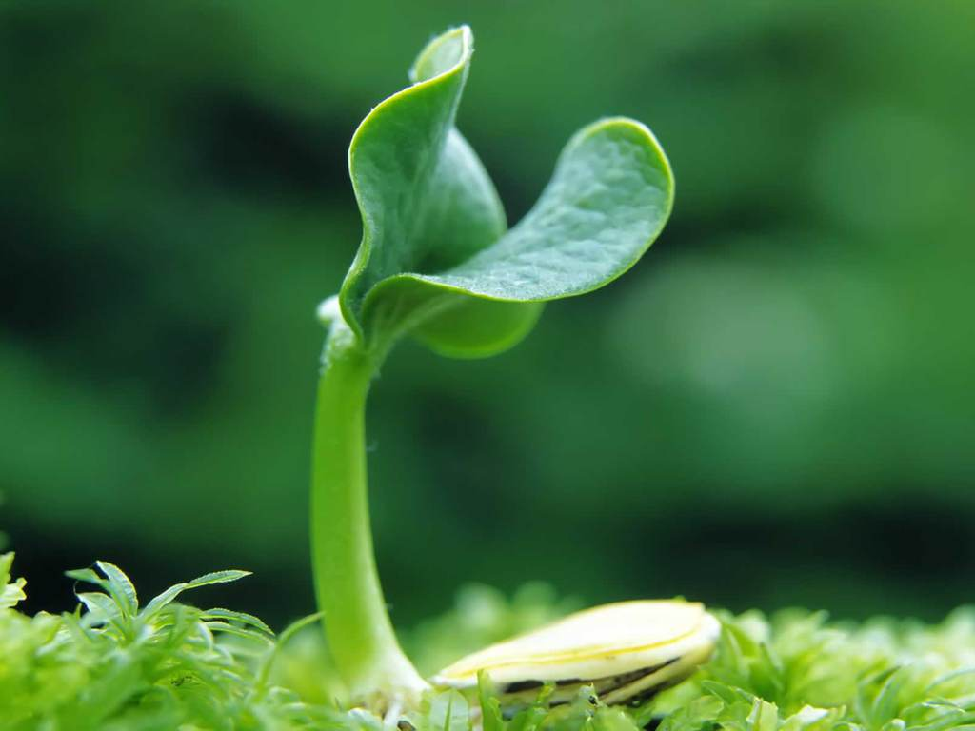
Kingdom Plantae
Eukaryotic
Autotrophic
Photosynthetic
Cells contain chloroplasts
Multi-cellular
Sexual and asexual reproduction
Cell wall – cellulose
Alternation of Generations

Slide 12
Animal vs. Plant life cycle
Animal
Plant
diploid
multicellular
2n
diploid
multicellular
sporophyte
2n
mitosis
meiosis
fertilization
meiosis
gametes
1n
spores
1n
fertilization
mitosis
mitosis
haploid
unicellular
gametes
1n
haploid
multicellular
gametophyte
1n
alternation of generations

Slide 13
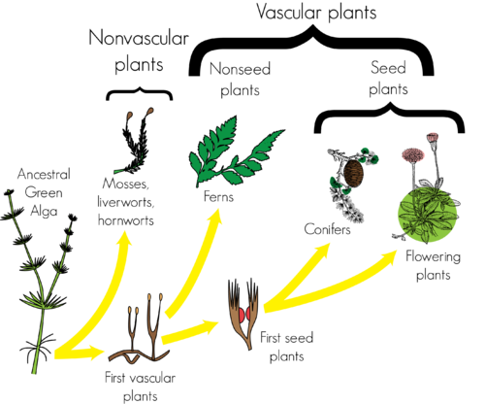
Bryophytes
Pteridophytes
Gymnosperms
Angiosperms

Slide 14
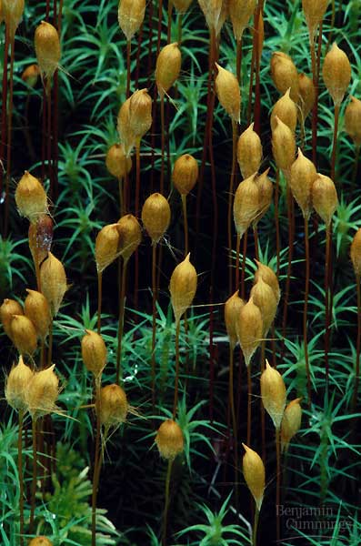
First land plants
Bryophytes: mosses & liverworts
  non-vascular
    no water transport system
    no true roots
  swimming sperm
    flagellated sperm
  lifecycle dominated by
  haploid gametophyte stage
    fuzzy moss plant you are
    familiar with is haploid
  spores for reproduction
    haploid cells which sprout
    to form gametophyte
haploid
diploid
Where must
mosses live?

Slide 15
The Bryophytes
Includes: mosses, liverworts and hornworts
Called “non-vascular plants” because their dominant stage (gametophyte) lacks vascular tissues
Show many of the characteristics believed to be in the first land plants
What problems did the Bryophytes face when moving onto land from water?
embryo drying out
dessication
proliferation

Slide 16
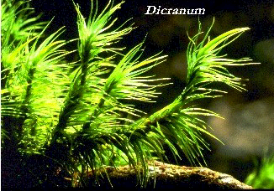
The Bryophytes
Their Solutions:
Protect the embryo
Thin waxy cuticle
Utilizing air for species distribution

Slide 17
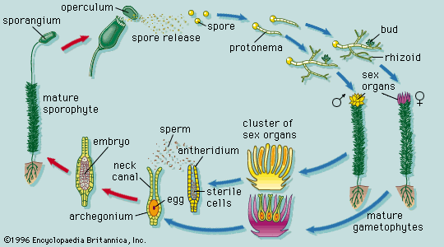
Typical Life Cycle
Video

Slide 18
The Bryophyte Life Cycle
Utilize Alternation of Generations from algae
Gametophyte (n) shows two distinct sexes: the male antheridium and the female archegonium
This is the dominant stage (gametophyte) and is involved in sexual reproduction

Slide 19
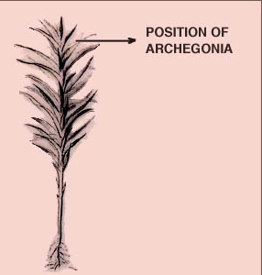
The Archegonium
This is the female shoot
It contains the archegonium (at the top of the shoot) which is:
- dominant
- haploid (n)
- produced by mitosis and contains the egg

Slide 20
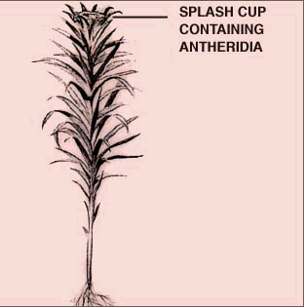
The Antheridium
The male gametophyte, the antheridium (top of shoot), is:
- dominant
- haploid (n)
- produces motile sperm by mitosis
Fertilization occurs when there is enough water for the sperm to swim to the egg (in the archegonium)

Slide 21
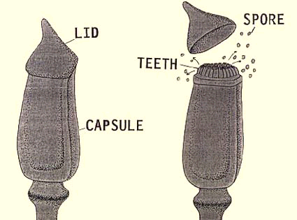
The Sporophyte
Fertilization results in a diploid sporophyte which grows out of the archegonium and forms a spore capsule
Sporophyte contains vascular tissue
It produces haploid, wind borne spores by meiosis
These spores then germinate to form the gametophytes

Slide 22
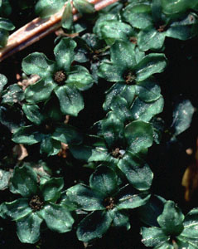
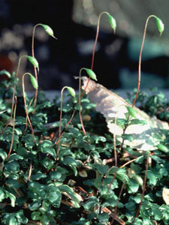
Gametophyte and Sporophyte

Slide 23
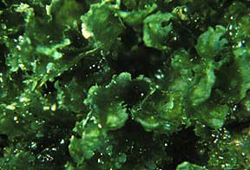
Other Bryophytes
The Liverworts
There are about 8500 species of liverworts
Live from the arctic to the tropics
Leafy, close to the ground. Gametophyte is dominant

Slide 24
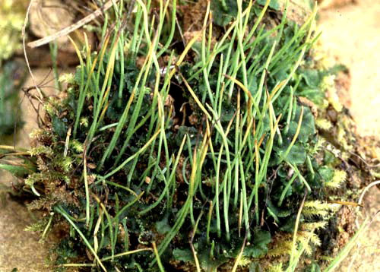
Other Bryophytes
The Hornworts
Less common but similar in habitats
Gametophyte is dominant with sporophyte containing a stalk with primitive vascular tissue
Sporophyte of a hornwort

Slide 25
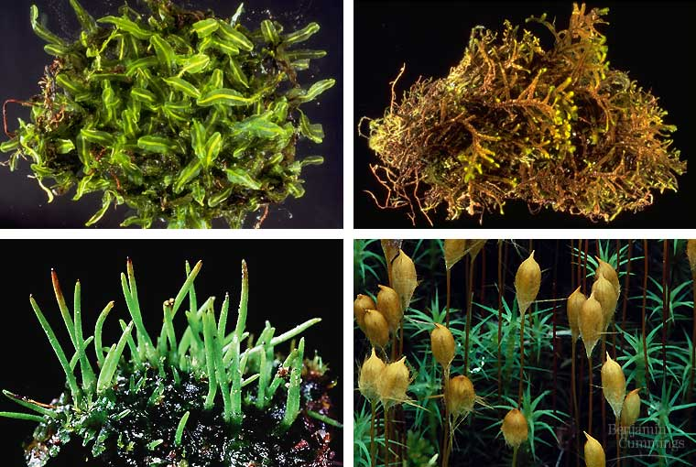
Bryophytes: mosses & liverworts

Slide 26
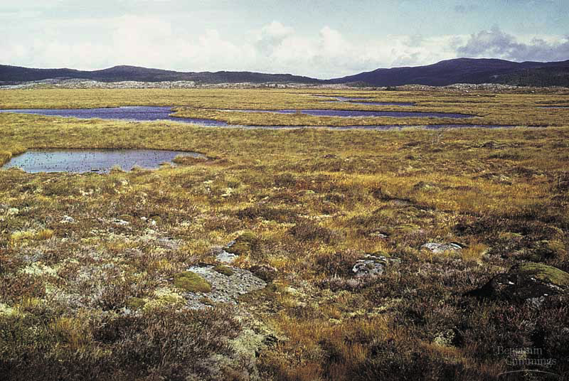
Peat Bog
“Peat Moss”

Slide 27
Can You …
… state the 3 types of algae?
… explain why we believe land plants developed from algae?
… draw and explain the lifecycle of a bryophyte?
… give examples of bryophytes?

