Slide 1
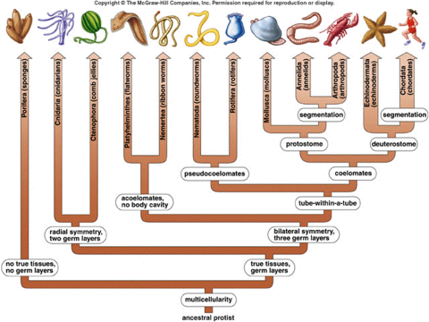
Life Sciences 11
The Kingdom Animalia

Slide 2
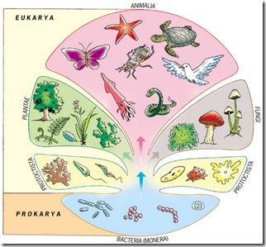
Objectives
By the end of the lesson you should be able to:
Describe the 5 ways we classify animals
Symmetry
Germ layers
Body plan
Segmentation
Animal Evolution & Early Development Pattern
Identify the most and least advanced forms within each classification

Slide 3
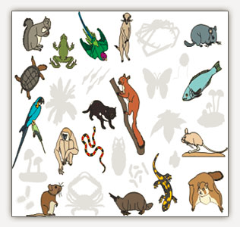
Introduction
Animal Characteristics
Multicellular – highly specialized.
Eukaryotic.
Heterotrophic by ingestion.
Cells lack cell walls.

Slide 4
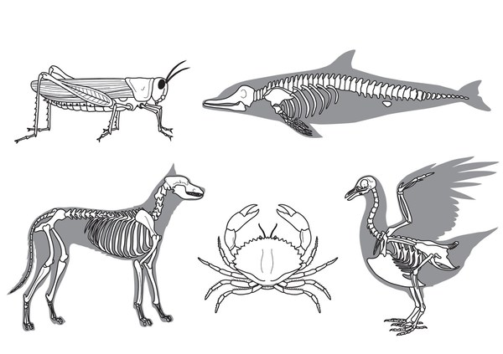
Did you know?
Over 95% of all animal species are often grouped in a single, informal category: Invertebrates
No backbone or vertebral column
Dust mites, sea stars, worms, jellyfish, insects, giant squid
The other 5% of animals are vertebrates
Fish, amphibians, reptiles, birds, mammals
They all have a backbone

Slide 5
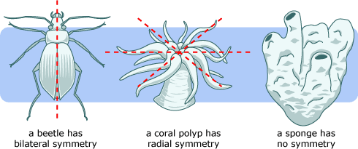
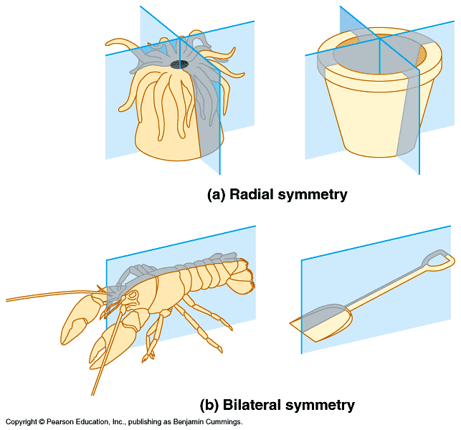
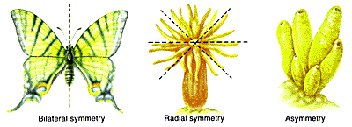
Classification Criteria
Symmetry (body axis)
With the exception of some sponges, every kind of animal exhibits some type of body symmetry.
Two types: Radial and Bilateral

Slide 6
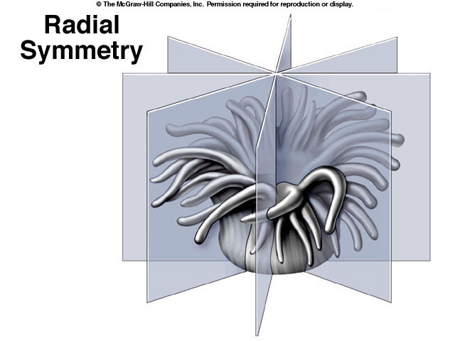
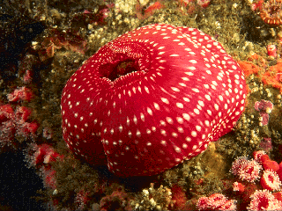
Classification Criteria
A. Radial Symmetry
Can be divided into many planes through central axis
These have a cylindrical shape
Think of a bicycle wheel
As a result, they have no head, front, or back, like this sea anemone.

Slide 7
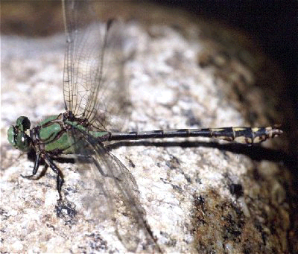
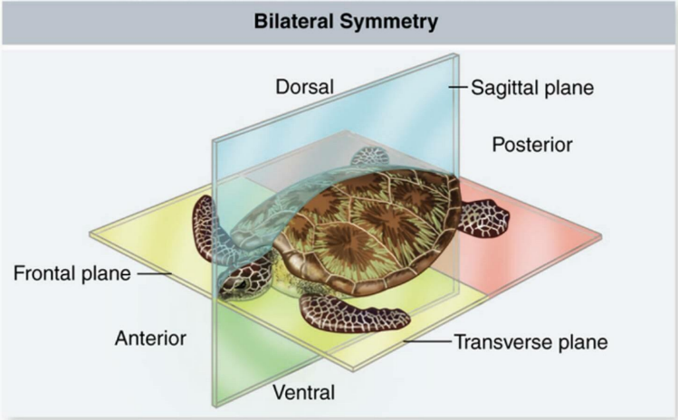
Classification Criteria
B.Bilateral Symmetry
Can be cut into two equal halves only one way, through the mid dorsal line.
Results in anterior, posterior, ventral, dorsal, left and right
Allows for cephalization

Slide 8
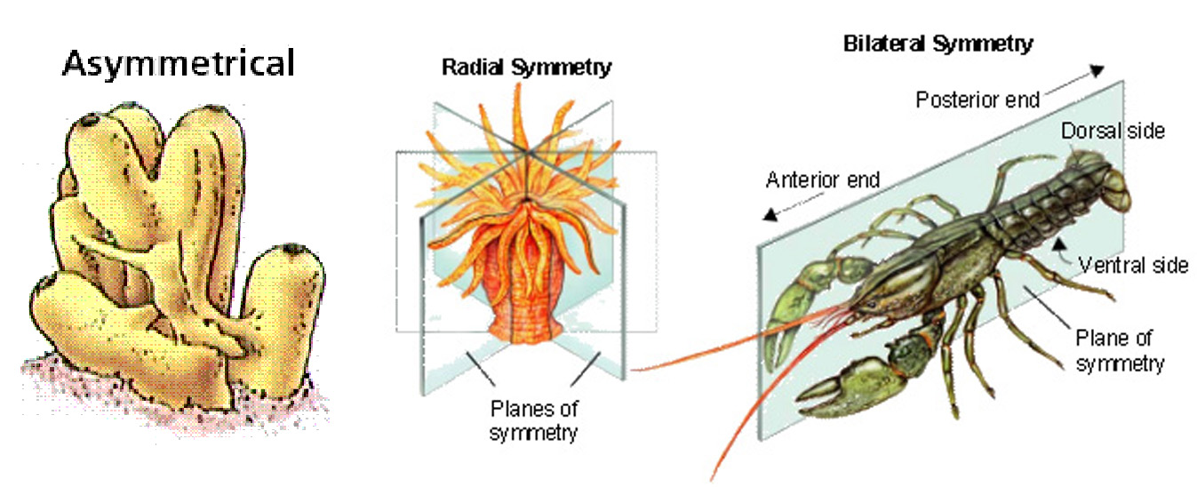
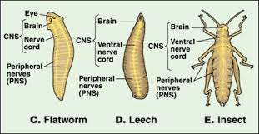

Slide 9
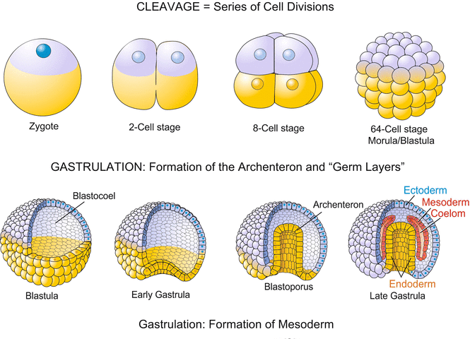
Human embryo development video

Slide 11
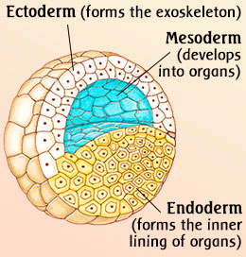
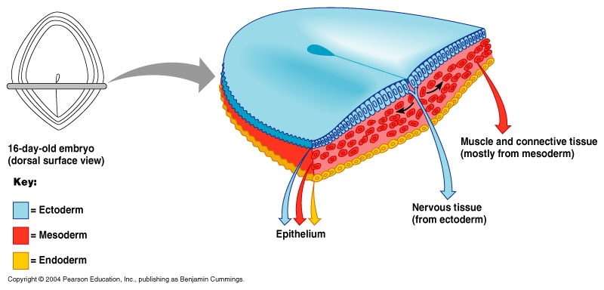
Classification Criteria
2. Germ layers
Early in animal development, cells will choose, or differentiate into three layers called germ layers.
The word germ means grow - the germ layers in animals grow to form the various tissues and organs
Three types: No germ layers, diploblastic, triploblastic

Slide 12
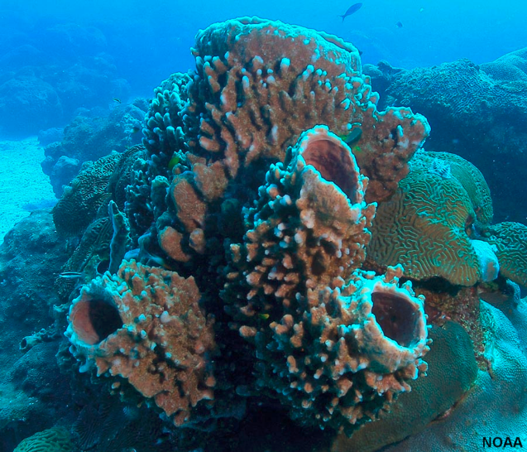
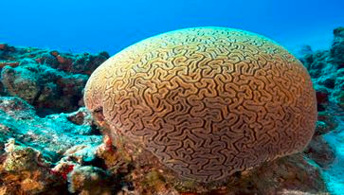
Classification Criteria
A. No Germ Layers
This is the most primitive as these animals develop no tissues or organs

Slide 13
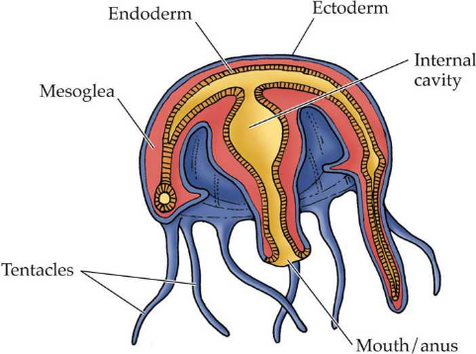
Classification Criteria
B. Diploblastic
Two germ layers: ectoderm and endoderm
Ectoderm: outer layer (forms skin and nervous system)
Endoderm: inner layer (forms lining of digestive tract)

Slide 14
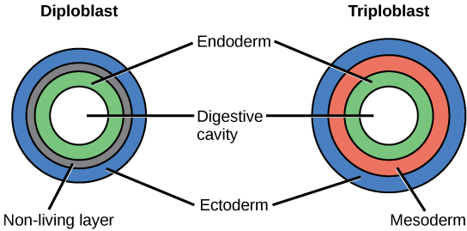
Classification Criteria
C. Triploblastic: three germ layers
Mesoderm grows between the ectoderm and endoderm.
Forms muscle and most of remaining internal organs
This is the highest level

Slide 15
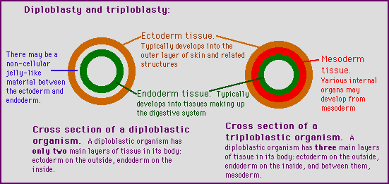

Slide 16
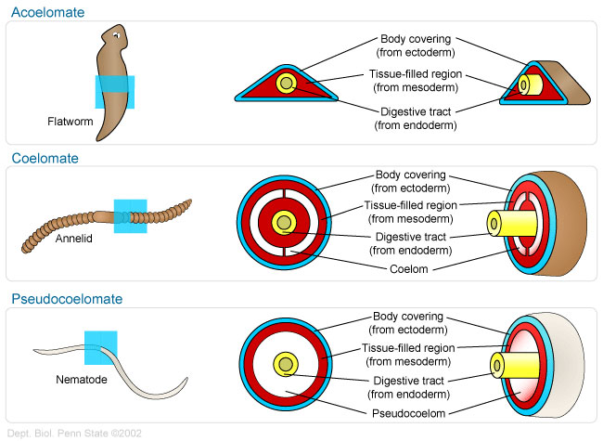
Classification Criteria
3. Body Plan: type of body cavity
The evolution of a body cavity, called a Coelom, provided a place for organs and organ systems to grow
Acoelomates: no coelom
- poorly developed organs

Slide 17
Classification Criteria
B. Pseudocoelomates: false coelom
Have a body cavity between endoderm and mesoderm layers
No muscle around gut so no co-ordination of food through dig. tract
Some organ systems develop in this space

Slide 18
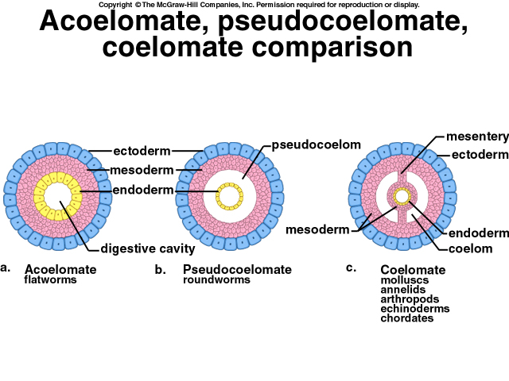
Classification Criteria
C. Coelomates: true coelom
Have a body cavity located between the mesoderm of the body wall and the new layer of mesoderm around the gut
Allows for co-ordinated digestion
Major organs start to develop
Highest level of development

Slide 19
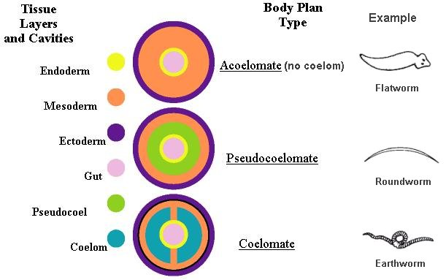

Slide 20
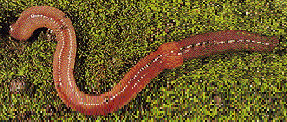
Classification Criteria
4. Segmentation
Segmentation leads to specialization and body regions
Non Segmented: no specialized sections
Segmented: identical repeating sections
Segmented with specialization
All segments of this worm are almost identical

Slide 21
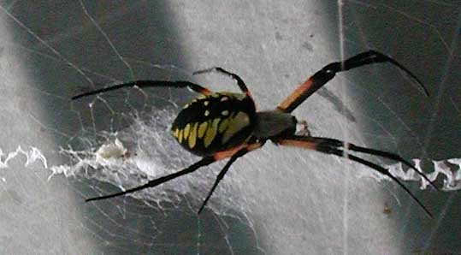
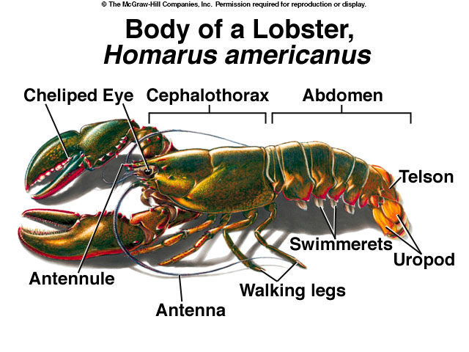
Classification Criteria
Segmented with specialization: Body segments fuse together to become body regions which focus on one set of tasks

Slide 22
Classification Criteria
5. Animal Evolution & Early Development Pattern
We typically study animals in three groups which reflect their evolutionary history and pattern of early development.
They are organized in the following order
Lower Invertebrates
Higher Invertebrates
Chordates

Slide 23
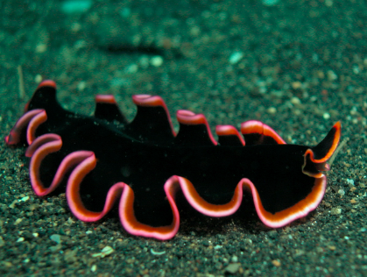
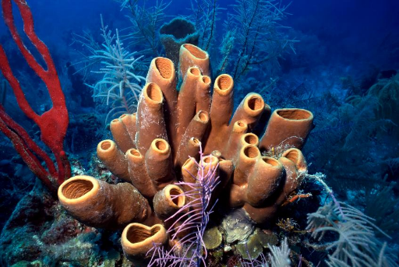
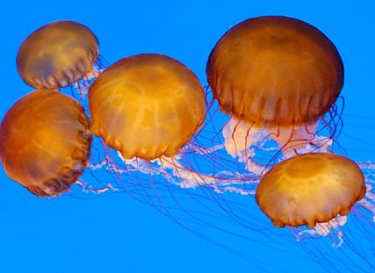
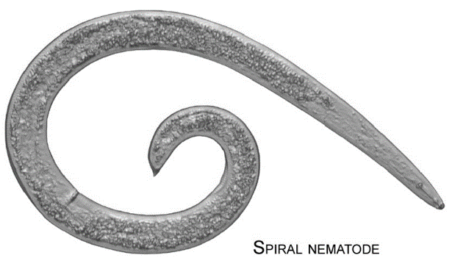
Classification Criteria
A. The Lower Invertebrates
These phyla demonstrate a fairly linear evolution (simple biology)
They include: Porifera, Cnidaria, Platyhelminthes and Nematodes

Slide 24
Classification Criteria
B. Higher Invertebrates:
i. The Protostomes
This is one of two main branches of animal evolution
Named this way due to embryo development (mouth develops first from blastopore)
They include the Annelids, Molluscs, and Arthropods
ii. The Deuterostomes
These are the animals on the other great branch of animal evolution
Include the Echinoderms and the Lower Chordates

Slide 25
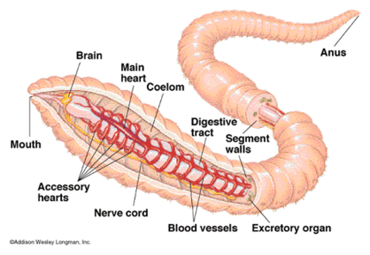
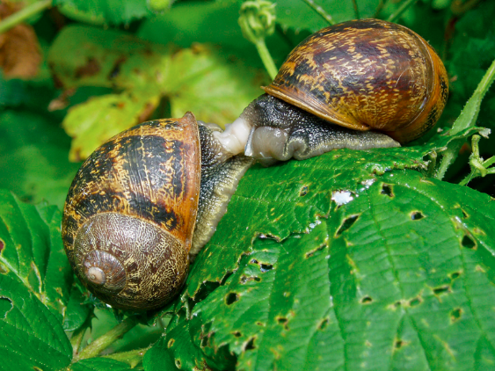
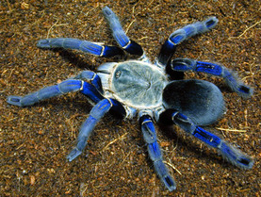
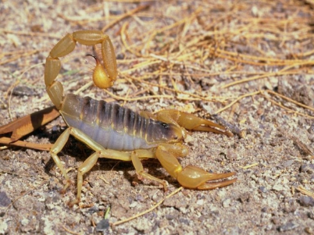
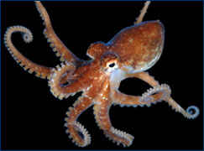
Annelid Mollusca
Cephalopod
Arthropoda

Slide 26
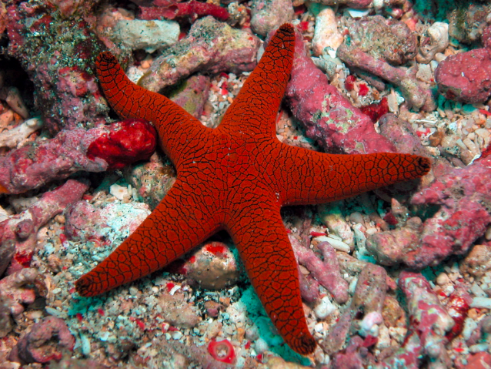
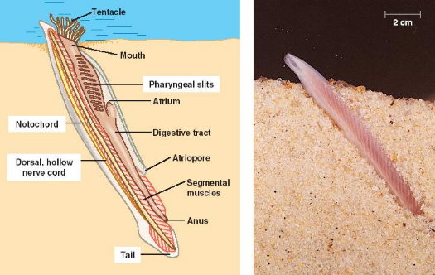
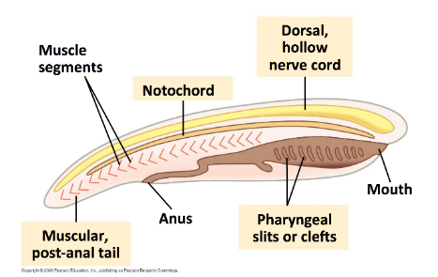
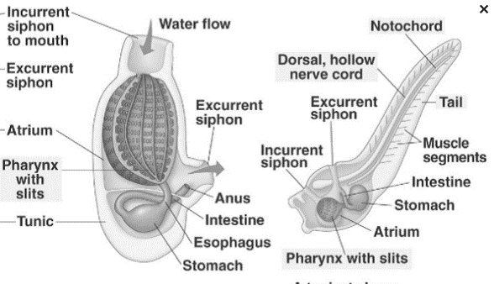
Echinoderm
Lower Chordates

Slide 27
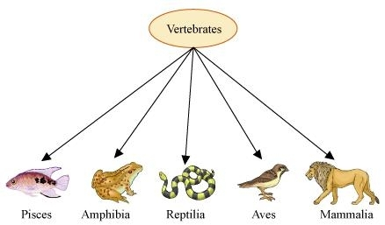
5. Animal Evolution
C. Vertebrates
Represent the most highly evolved animals (Us!!)

Slide 28
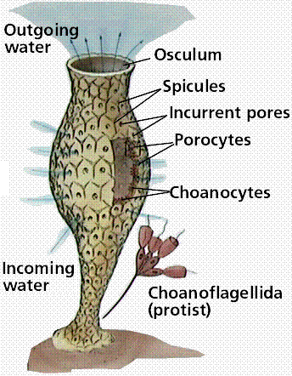
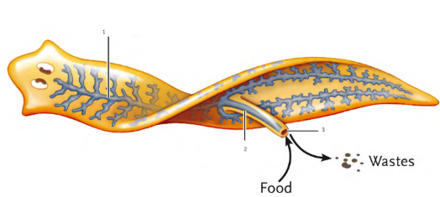
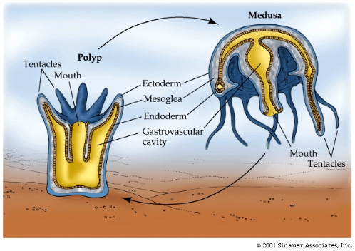
How you need to think
We will learn how different phylum and groups of animals do the following processes of life:
Feeding
Respiration
Circulation
Excretion
Response
Movement
Reproduction

Slide 29
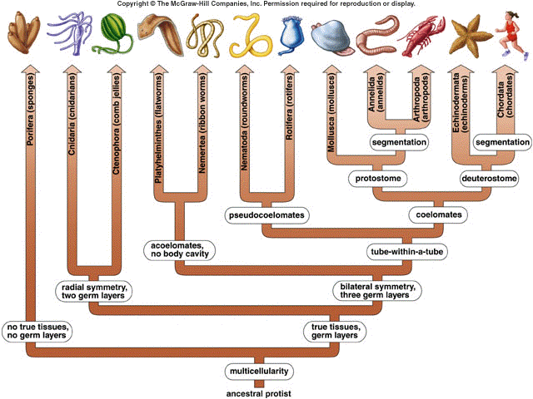

Slide 30
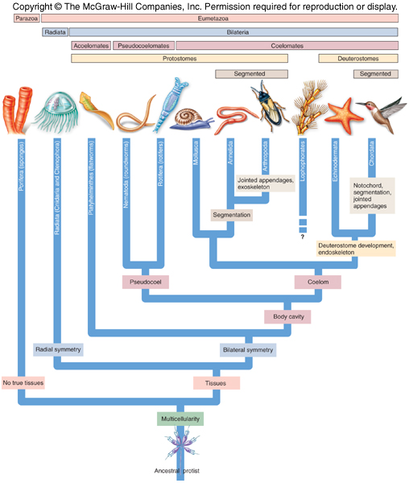

Slide 31
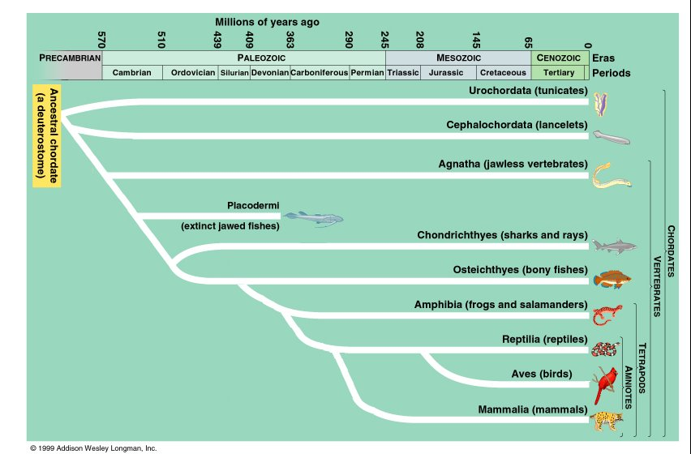

Slide 32
Can You …
… describe the 5 ways we classify animals?
Symmetry
Germ layers
Body plan
Segmentation
Animal Evolution & Early Development Pattern
… identify the most and least advanced forms within each classification?

