Slide 1
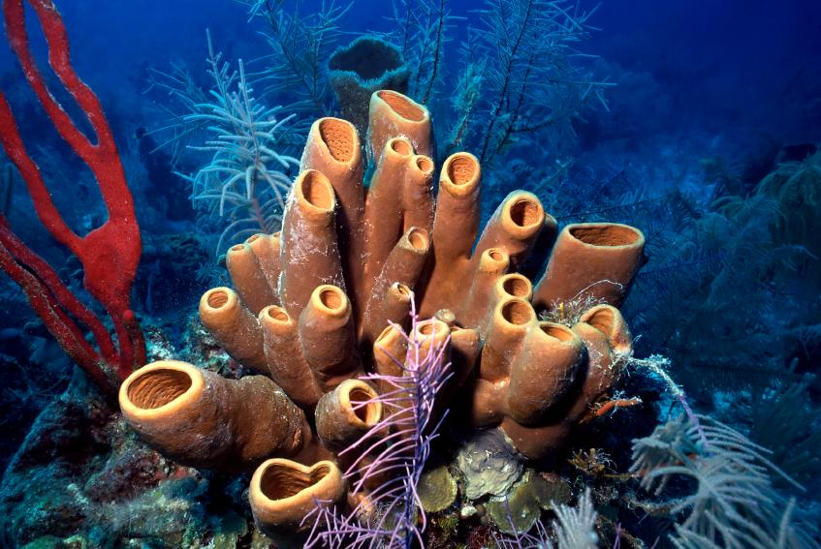
Life Sciences 11
Phylum Porifera:
The Sponges
Chapter 26-2: pg. 664

Slide 2
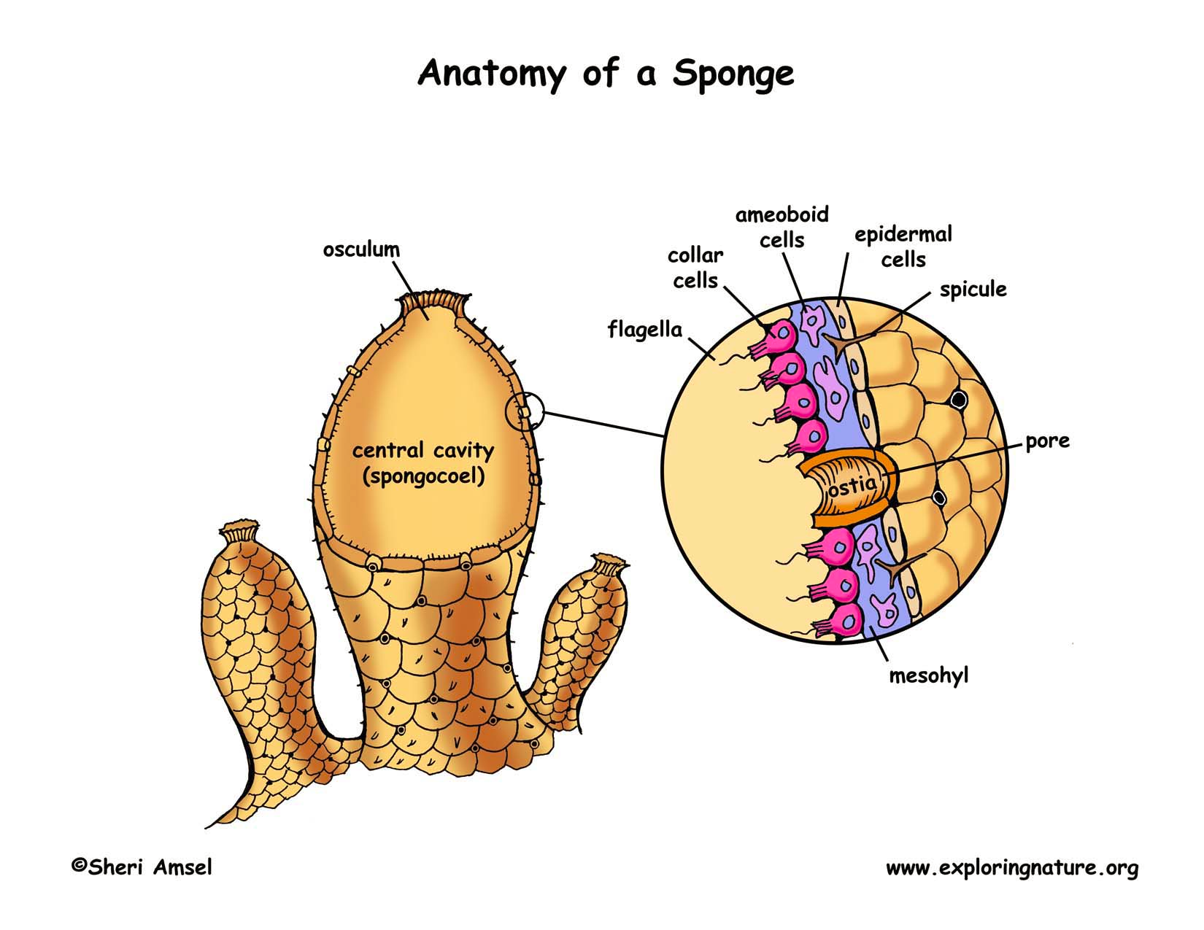
Objectives
Draw and describe the body plan of a typical sponge including each cell’s role within the sponge
Explain water’s role in sponge survival
Describe how a typical sponge reproduces and obtains nutrients

Slide 3
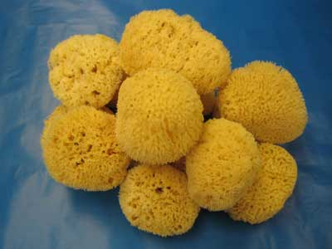
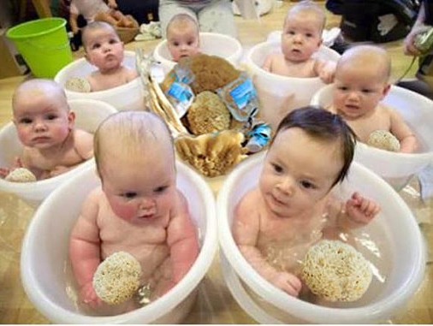
Phylum Porifera = Sponges
Porifera = ‘pore bearers’
One of the simplest and most unusual animals
Have been on earth for at least 540 million years
Most of them live a sessile life in the ocean
Most commonly used by humans for natural sponges for bathing

Slide 4
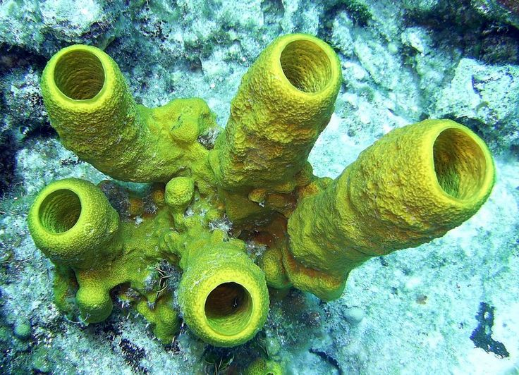
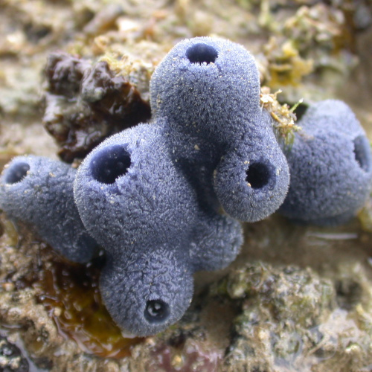
Phylum Porifera
They are considered animals because they are multicellular, eukaryotic, heterotrophic, and their cells lack cell walls
This phylum represents the first experiment in multi-cellularity for animals
There are specialized cells, but they do no work cooperatively together - not tissues
Simplest and most primitive animals
Have changed little since they evolved

Slide 5
Body Plan
Sponges are mostly asymmetrical, have no front or back ends, and no left or right sides
Think of a large, hollow, cylindrical water pump
Choanocytes (collar cells) are specialized cells that use flagella to move water through pores into the sponge
Water exits the sponge through the osculum, a large hole at the top
This movement of water is for feeding, respiration, circulation, and excretion

Slide 6
Body Plan
Amoebocytes (archaeocytes) are motile cells which have a variety of functions including delivering nutrients to other cells and creating eggs for sexual reproduction
Epithelial (epidermal) cells are flat cells which cover the outside of the sponge

Slide 7
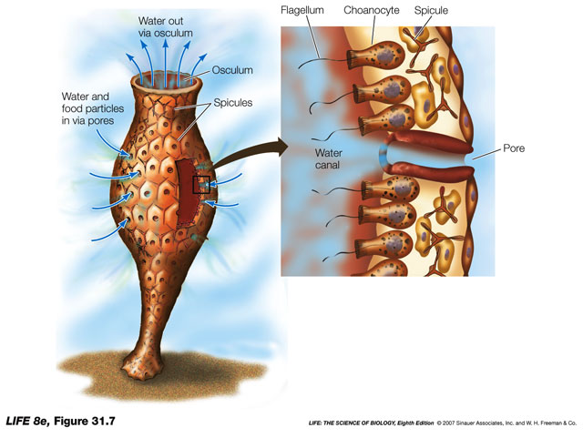
Body Plan

Slide 8
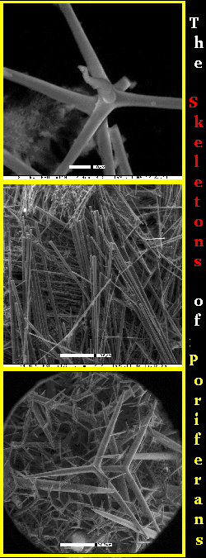
Body Plan
Sponges have a simple skeleton
In harder sponges, the skeleton is make up of spiny spicules
A spicule is a spike-shaped structure made up of chalklike calcium carbonate or glass-like silica
Softer sponges have an internal skeleton made up of spongin, a network of flexible protein fibres
Glass-like sponge spicules

Slide 10
Anatomy
amoebocyte

Slide 11
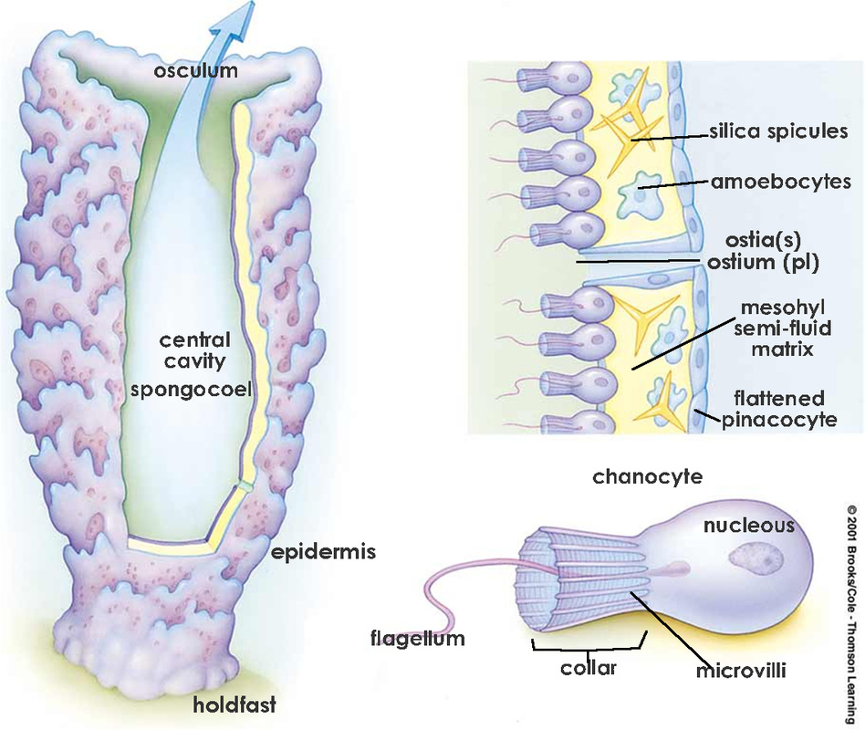
Feeding, Respiration, Circulation, and Excretion
The movement of water through their bodies is to carry out body functions
Sponges are filter feeders which means they filter food particles from the water using their choanocytes.
Oxygen from the water diffuses into cells and waste products like carbon dioxide and ammonia diffuse out of cells into the central cavity and out the osculum

Slide 12
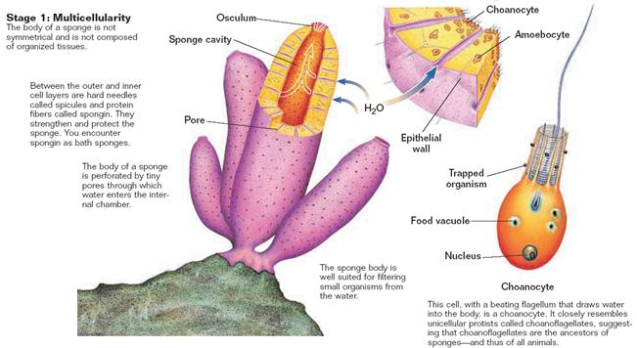

Slide 13
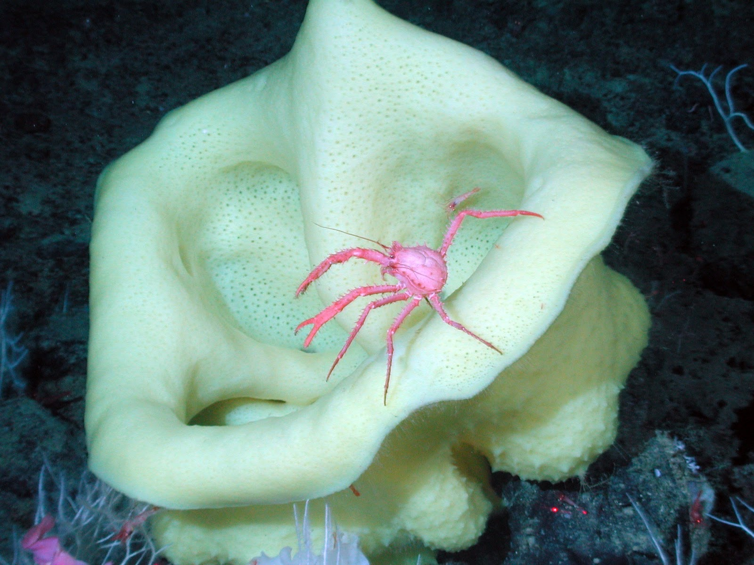
Response
Sponges do not have a central nervous system that would allow them to respond to their environment however, some sponges create toxins that are unpalatable or poisonous to potential predators.

Slide 14
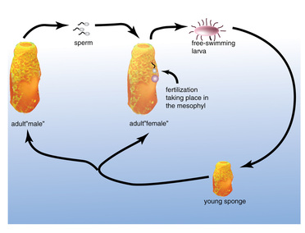
Reproduction
Sponges can reproduce either sexually or asexually
Sexual - Internal fertilization (sperm + egg = zygote → larva)
Larvae are motile and move to a different location

Slide 15
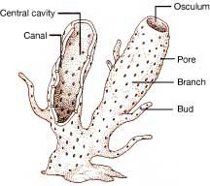
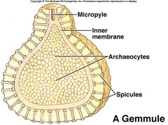
Reproduction
Asexual – budding: a new sponge clone forms on the side and eventually forms a clone
- gemmules: in unfavourable conditions, the sponge can surround ameobocytes (archaeocytes) in spicules forming a gemmule which can survive the harsh conditions then regrow the sponge

Slide 16
Water Flow Animation!
Go to website: Water Flow
http://www.biology.ualberta.ca/courses.hp/zool250/animations/Porifera.swf

Slide 17
Can You …
… draw and describe the body plan of a typical sponge including each cell’s role within the sponge?
… explain water’s role in sponge survival?
… describe how a typical sponge reproduces and obtains nutrients?

