Slide 1
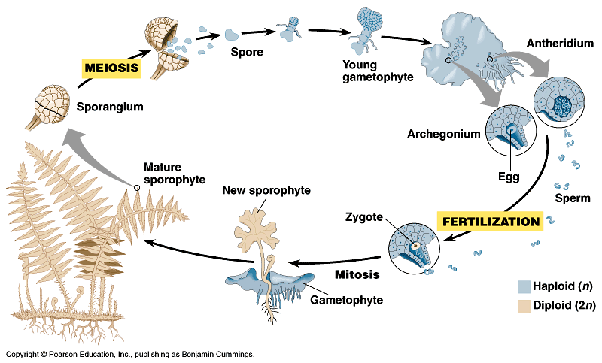
Life Sciences 11
Kingdom Plantae
The Pteridophytes

Slide 2
Objectives
By the end of the lesson you should be able to:
Compare and contrast bryophytes and pteridophytes and state the evolutionary advancements of the pteridophytes
Describe the life cycle of a pteridophyte
Give some examples of pteridophytes

Slide 3
Introduction
As the earth’s climate became dryer, nature selected for appropriate adaptations
This led to the evolution of the Vascular plants (containing conducting tissues)
In order to develop effective conducting and support tissues, plants selected for having a dominant sporophyte instead of the gametophyte…why?
The first vascular plants were better suited to land than the bryophytes but were still not fully adapted

Slide 4
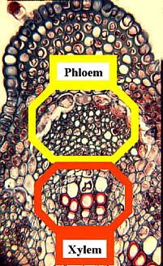
What is Vascular Tissue??
They are the “transport tubes” of plants:
Xylem: to conduct water from roots to shoots
Phloem: to conduct the products of photosynthesis from shoots to roots

Slide 5
Benefits of Vascular Tissue
Structural support to plant tissue
Movement of water and nutrients
Plants can be larger
This is the giant Sequoia tree

Slide 6
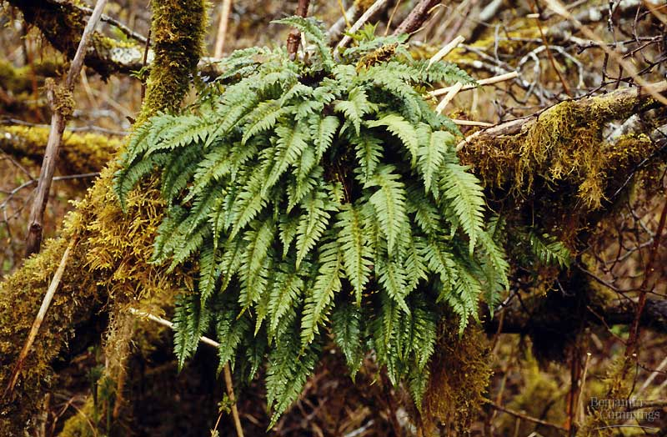
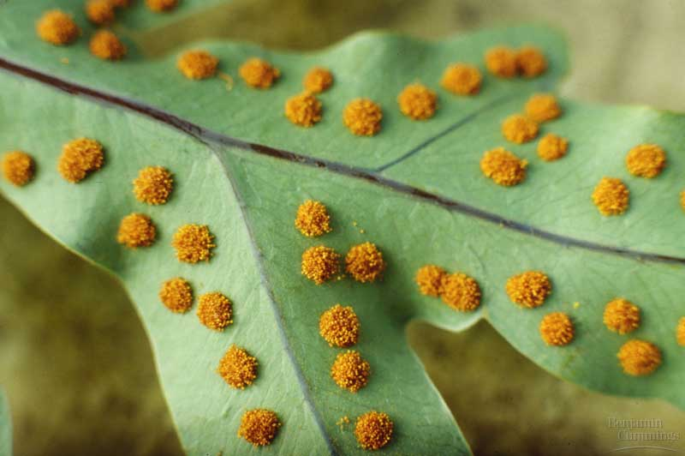
First vascular plants
diploid
Pteridophytes: the ferns
  vascular
    water transport system
    xylem, phloem, roots, leaves
  swimming sperm
    flagellated sperm
  life cycle dominated by
  sporophyte stage
    leafy fern plant you are familiar which is diploid
    fragile gametophyte
  spores for reproduction
    haploid cells which sprout
    to form gametophyte
haploid
Where must
ferns live?

Slide 7
Pteridophytes Basics
They utilize the Alternation of Generations life cycle
They do not produce seeds (thus they are called the “seedless vascular plants”)
The sperm must swim from the antheridium to the archegonium
They have roots, which absorb water and nutrients then conduct them up the stem to the fronds, which are photosynthetic.
They produce spores to reproduce.

Slide 8
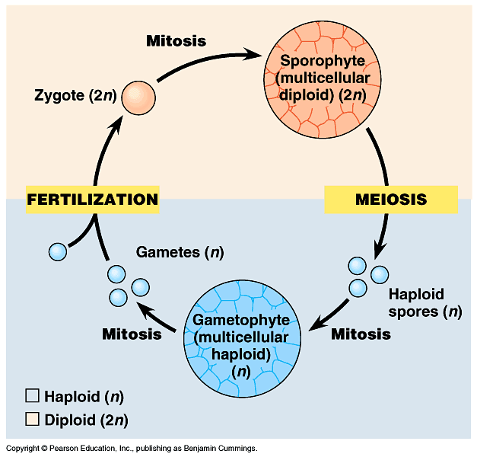
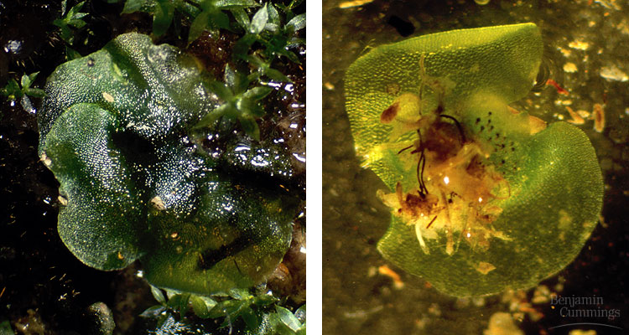
Alternation of generations
diploid
produces male
& female gametes
haploid

Slide 9
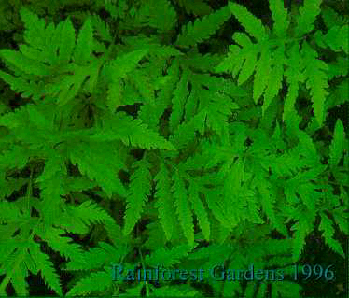
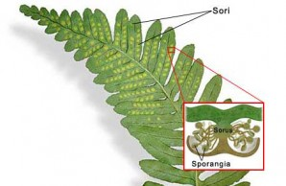
The Sporophyte Generation
The diploid sporophyte (dominant stage) develops haploid spores by meioisis.
These spores are in containers called sporangia which group into clusters called sori.

Slide 10
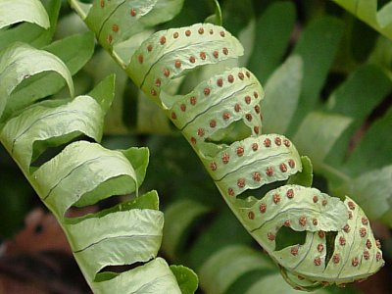
Fern Fronds (not called leaves!)
Fern sporophyte showing sori on underside

Slide 11
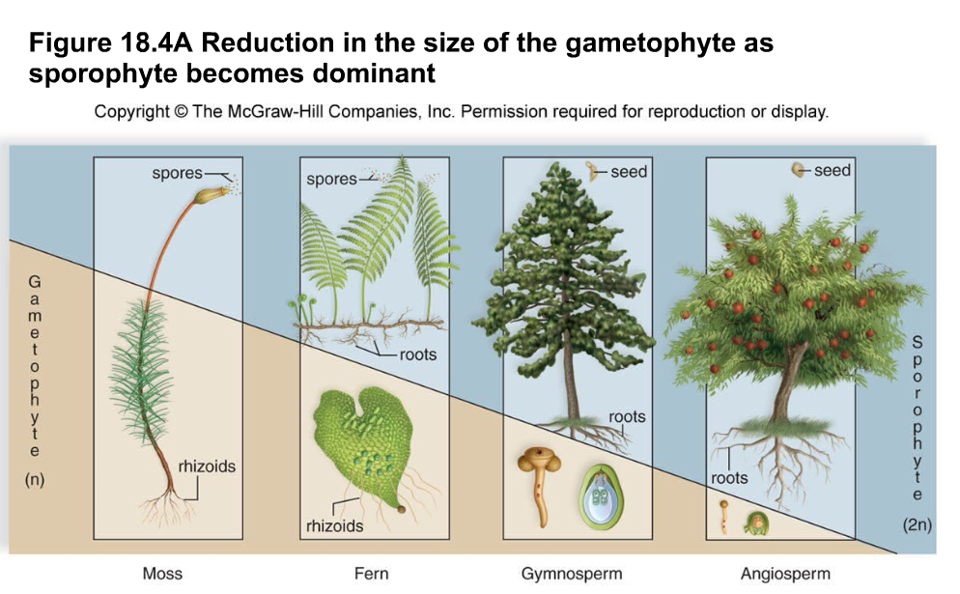

Slide 12
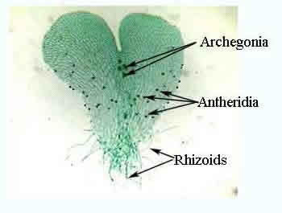
The Gametophyte Generation
Fern gametophyte (1n) is thin, heart shaped structure called a PROTHALLUS
The developing gametophyte first grows a set of root-like rhizoids then flattens into the heart shaped mature gametophyte
It’s very small and produces the gametes
Grows independently of the sporophyte

Slide 13
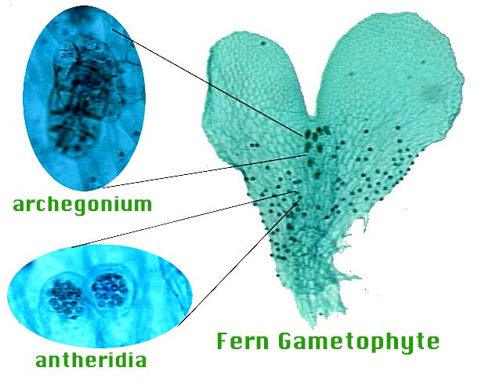

Slide 14
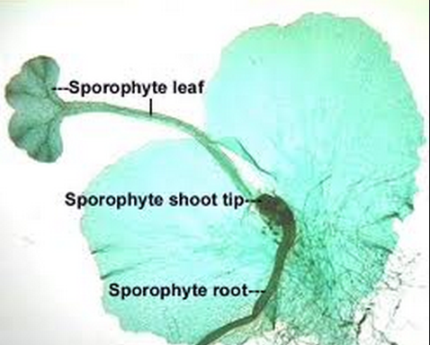
Sperm from the antheridia swims to the archegonium to fertilize an egg.
The diploid sporophyte embryo begins to grow.

Slide 15
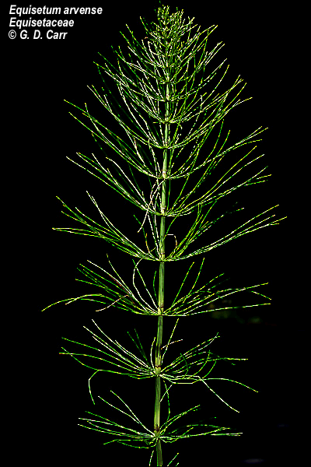
Examples:
Horsetail
The most common seedless vascular plant, besides the ferns, are the horsetails
Their biology and life cycles are similar to ferns and they live in the same types of environments
They are an obscure small group today but are an example of a “Living Fossil’

Slide 16
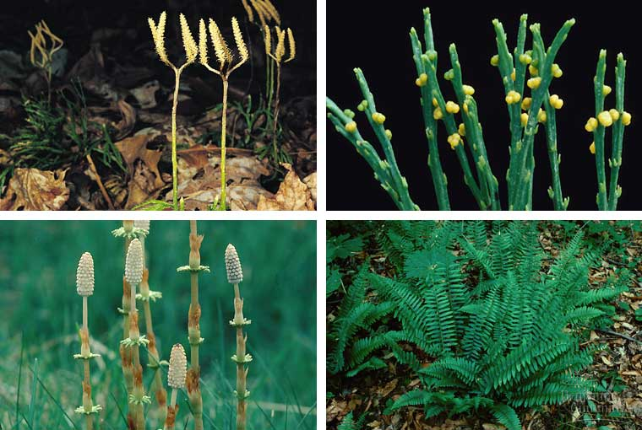
Examples:
Selaginella
Psilotum
Horsetails
Ferns

Slide 17
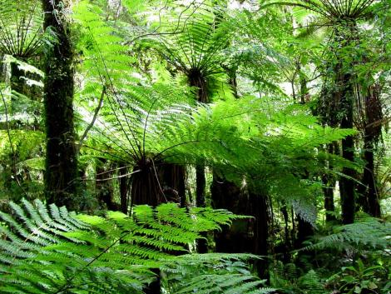
Fossil Fuel…..
Despite their shortcomings, the ferns quickly spread all over the world forming vast forests of tree ferns much like those seen in Vancouver Island today

Slide 18
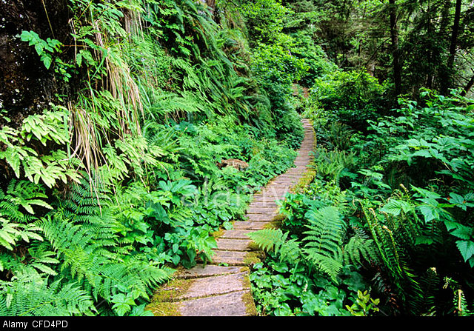
West Coast Trail, boardwalk path in fern forest, Vancouver Island.

Slide 19
Fossil Fuel…..
Despite their shortcomings, the ferns quickly spread all over the world forming vast forests of tree ferns much like those seen in Vancouver Island today
These fed the mighty dinosaurs who were also dominant on land at this time

Slide 20
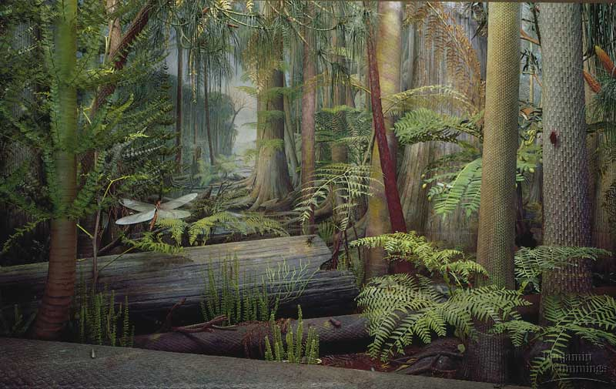
Early Pteridophytes: The Tree Ferns
Fossil fuels…
I get it!
Carboniferous forest – 290-350 mya
Forests of seedless plants decayed into deposits of coal & oil

Slide 21
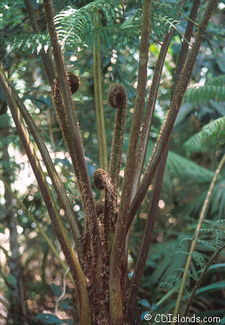
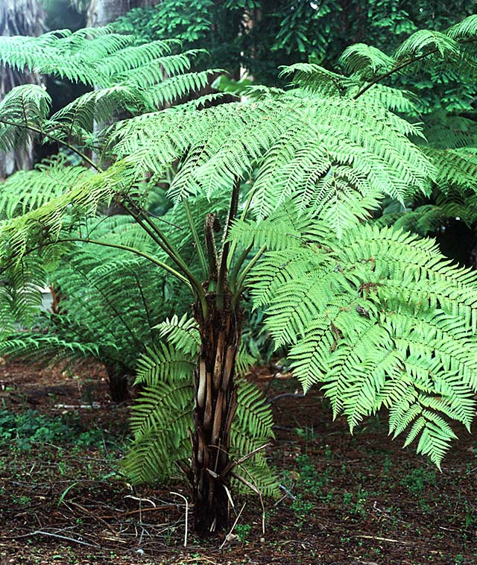
Tree ferns
With fronds
like these who
needs enemies!

Slide 22
Can You …
… compare and contrast bryophytes and pteridophytes and state the evolutionary advancements of the pteridophytes?
… describe the life cycle of a pteridophyte?
… give some examples of pteridophytes?

