Slide 1
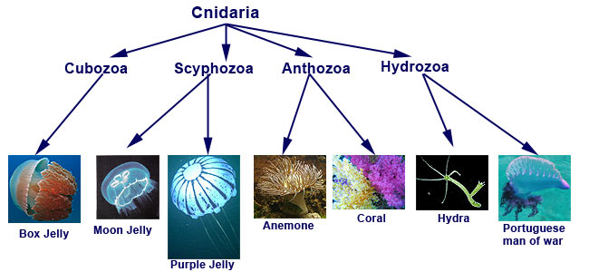
Life Sciences 11
Kingdom Animalia
Cnidaria
The Stingers

Slide 2
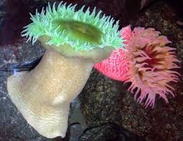
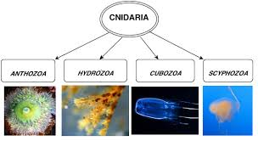
Cnidaria Objectives
Advances over sponges
General body plan of medusa and polyp
General life cycle
Dominant stages in 3 classes

Slide 3
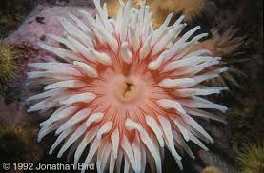
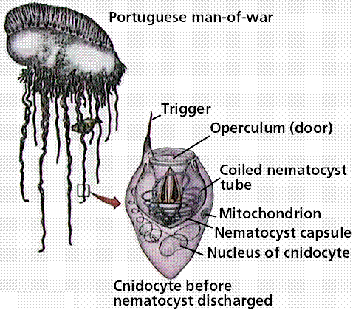
Cnidarians - Overview
Cnidarians are soft-bodied, carnivorous animals
Diploblastic – True tissues
Defining characteristic is that they have a stinging tentacles around their mouths
The stinging cell is called a cnidocyte, which is where the name cnidarian comes from
They have body symmetry and start to show specialized tissues.

Slide 4
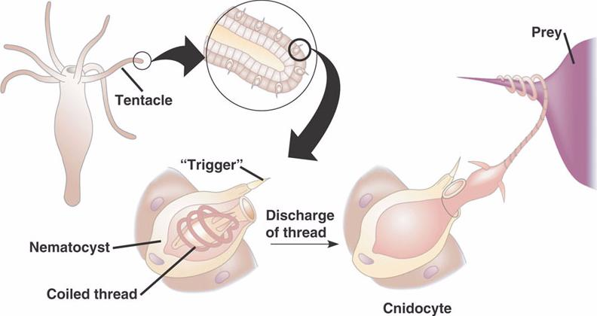
Cnidocytes!
Cnidocytes, or stinging cells, are located around their tentacles and are used for defense and to capture prey
Inside of these cnidocytes, there is a nematocyst which is a poison-filled stinging structure that contains a tightly coiled dart!
When a prey item brushes by the cnidarian, thousands of nematocysts explode into the animal, paralyzing or killing them.
Think of the cnidocyte as the ‘harpoon gun’ and the nematocyst as the ‘harpoon’.

Slide 5
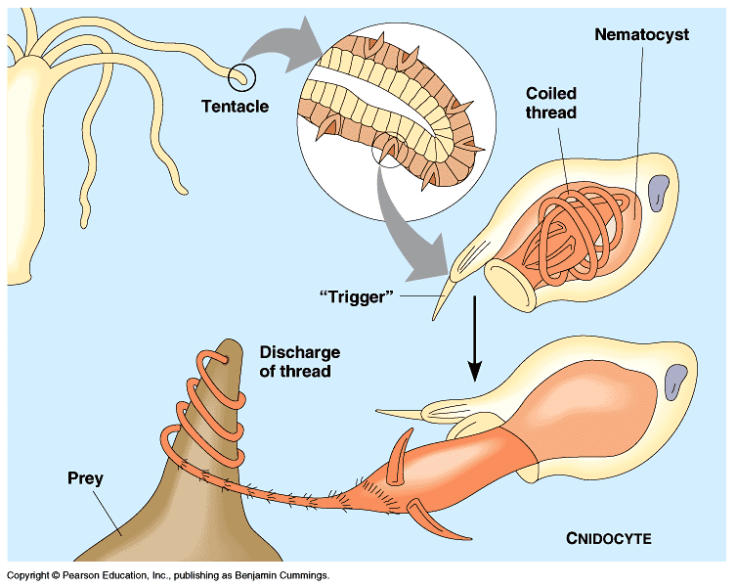
Cnidocyte = nettle cell or stinging cell
Nematocyst = thread sac

Slide 6
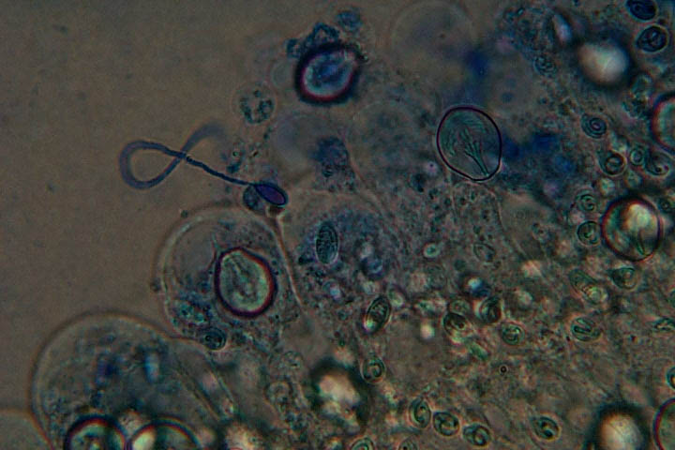
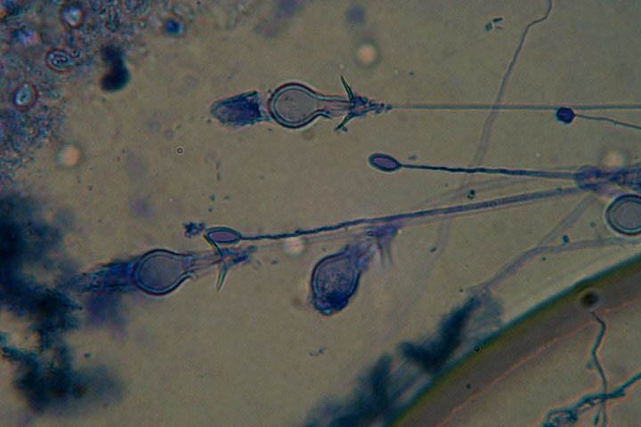

Slide 7
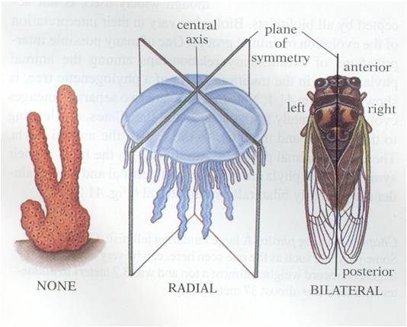
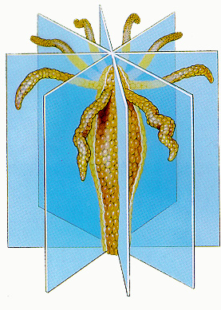
Body Plan
Radially symmetrical, diploblastic
Cnidarians have two main body plans, medusa and polyp.

Slide 8
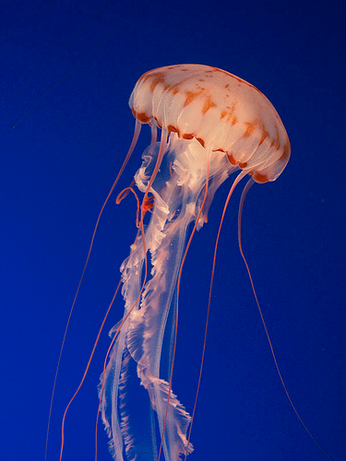
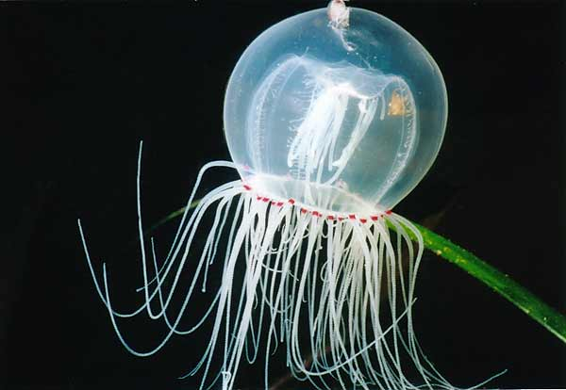
Medusa
Is motile, bell shaped body with the mouth at the bottom
Typically reproduce sexually

Slide 9
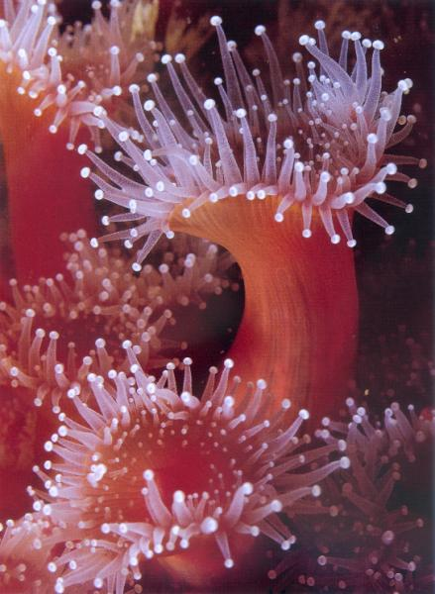
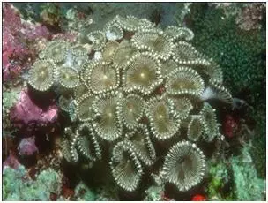
Polyp
Polyps are usually sessile
Cylindrical body with arm like tentacles
The mouth points upwards
Typically reproduce asexually

Slide 10
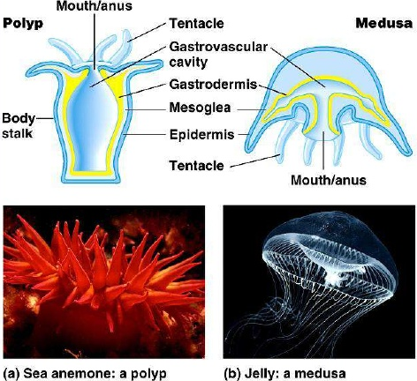

Slide 11
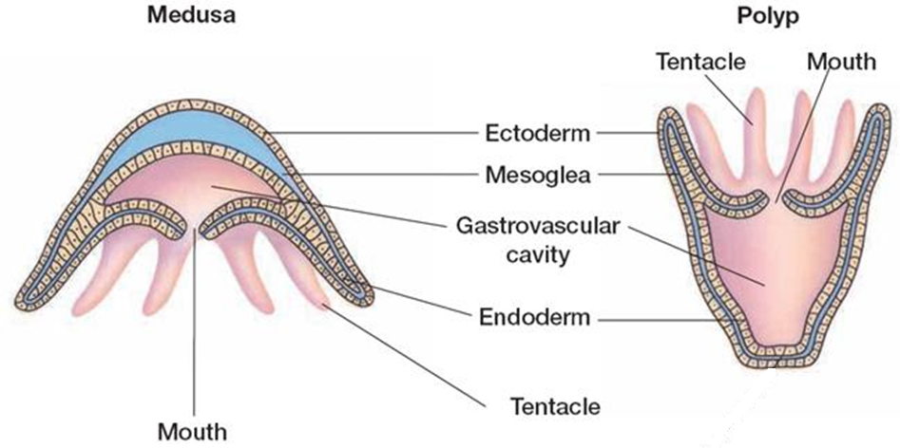

Slide 12
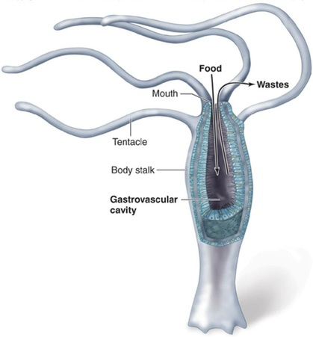
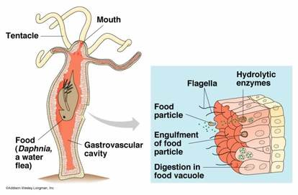
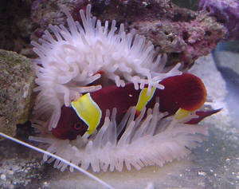
Feeding
After paralyzing the prey, cnidarians pull the prey into its mouth and into its gastrovascular cavity
Food is digested extracellularly (outside cells) and then absorbed and fully digested in gastroderm.
Any undigested materials leave through this same opening.
Incomplete digestive system

Slide 13
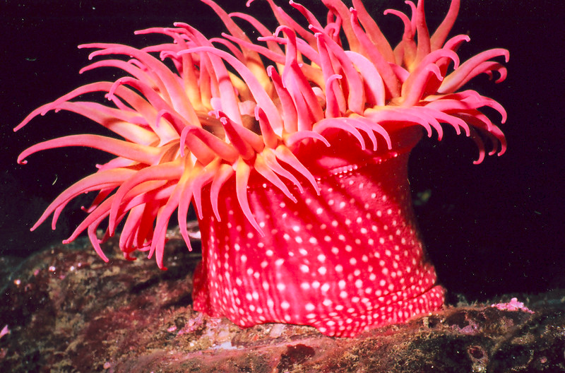
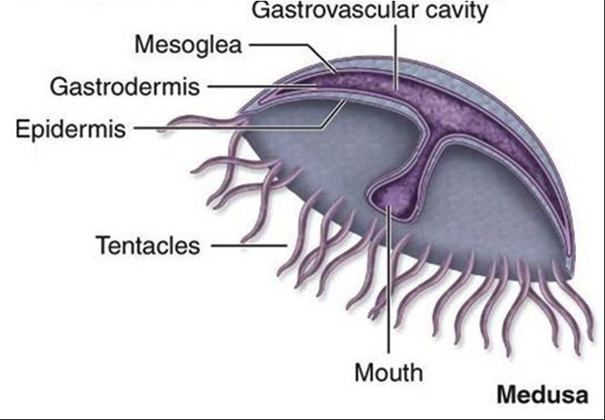
Respiration, Circulation, Excretion
Diffusion, diffusion, diffusion!
Diffusion of nutrients, oxygen and wastes occurs through their body walls

Slide 14
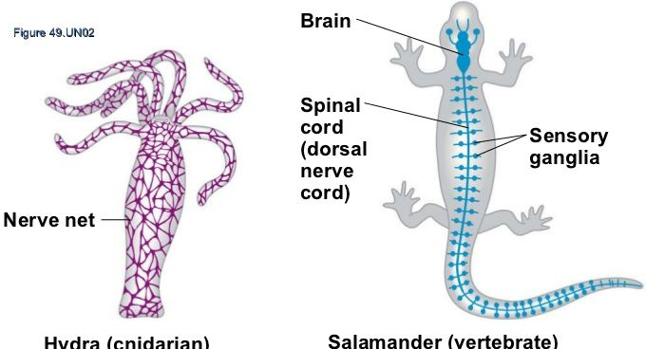
Response
They have a nerve net system
Nerve net is a loosely organized network of nerves that work together to detect stimuli
Distributed uniformly throughout the body
Statocysts are a group of sensory cells specifically to detect the direction of gravity
Ocelli are eyespots made up of nerve cells that detect light are found rarely in some species

Slide 15
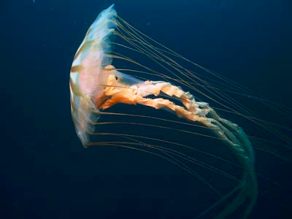
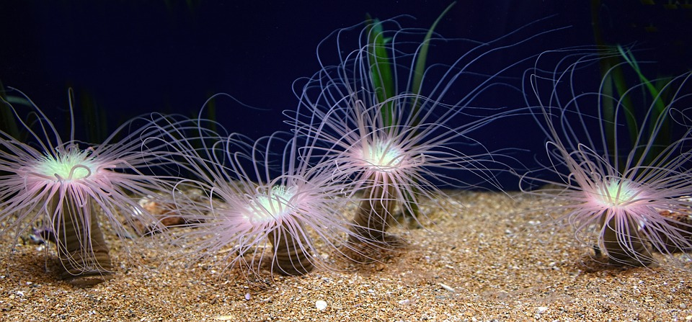
Movement
Because there are so many different types of Cnidarians, they have different forms of movement.
One important component is the hydrostatic skeleton, which is a circular layer of longitudinal muscles that, together with the water in the gastrovascular cavity, enable the cnidarian to move.
This allows the polyps to get taller and medusas to create a jet propulsion.

Slide 16
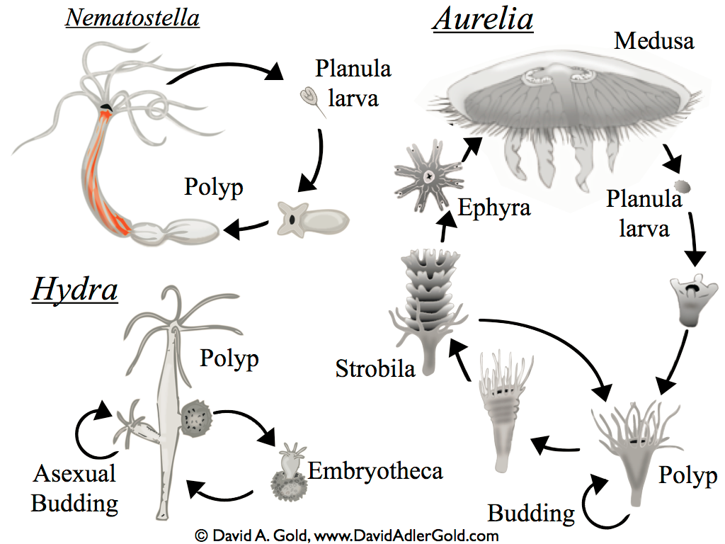
Reproduction & Life Cycle
Show “Alternation of Generations” with a polyp and medusa stage
Most cnidarians reproduce sexually and asexually
Polyps can reproduce asexually by budding which may produce a medusa or new genetically identical polyp

Slide 17
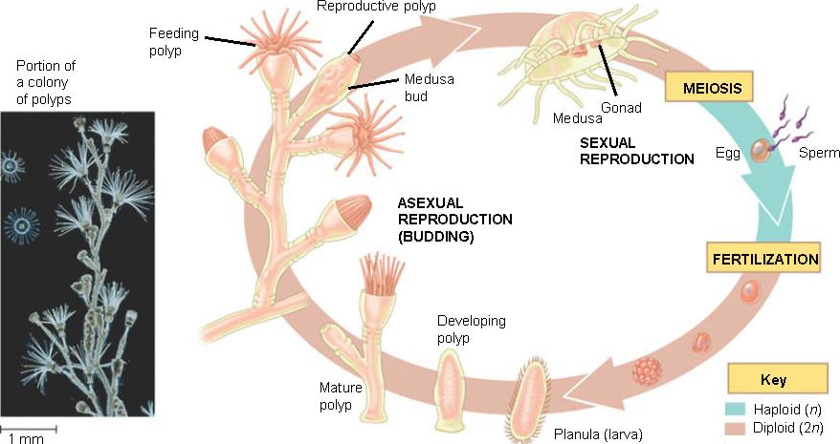
Reproduction & Life Cycle
Sexes are different and sexual reproduction occurs as external fertilization in the water.
The male and female release their gametes into the water and fertilization occurs creating a genetically different offspring
After fertilization, a larva develops called a planula larva which looks different from adult forms

Slide 18
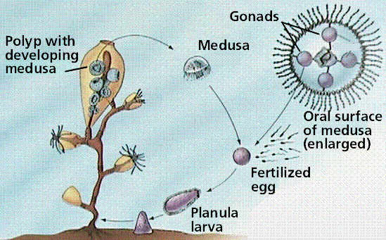
General Cnidarian Life Cycle

Slide 19
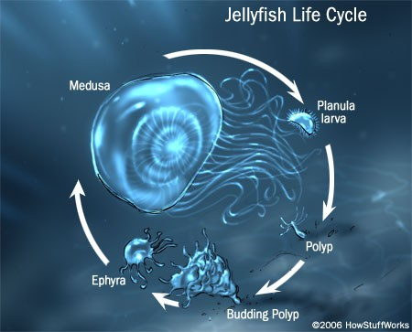

Slide 20
Groups of Cnidarias
Are all predators
Found in both fresh and salt water
Groups of Cnidarians include
  Jellyfish
  Hydras and their relatives
  Sea anemones
  Corals

Slide 21
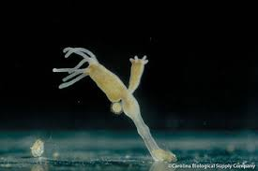
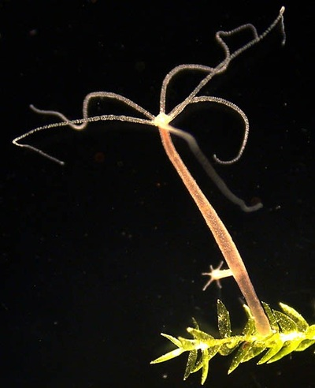
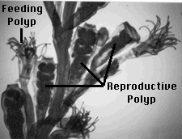
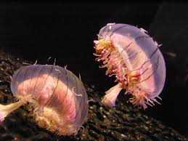
Phylum Cnidaria
Class Hydrozoa
Polyp stage is dominant
Medusa is used for species dispersal
Examples: Hydra sp. and Obelia sp.

Slide 22
Obelia Life Cycle

Slide 23
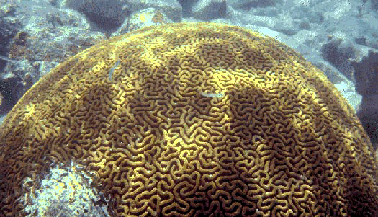
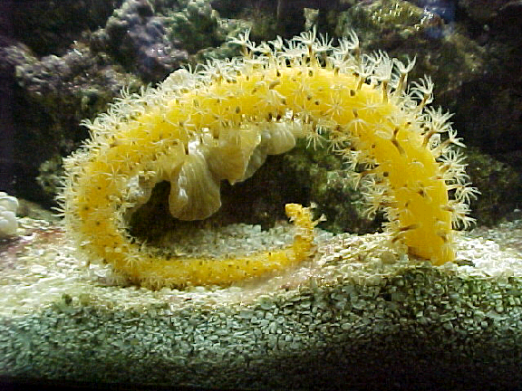
Phylum Cnidaria
Class Anthozoa
Generally have polyp stage only
Include: anemones, corals and sea pens
Brain coral
Sea Pen
Sea Anemone

Slide 24
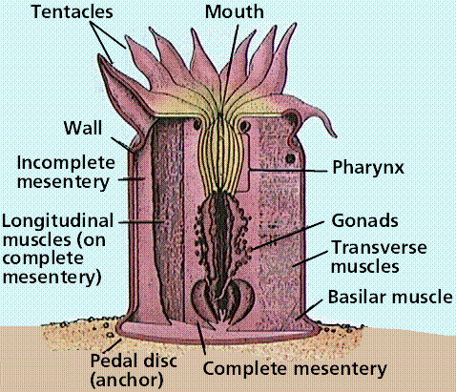
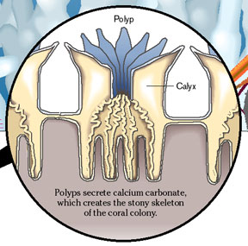
Coral Body Plan:

Slide 25
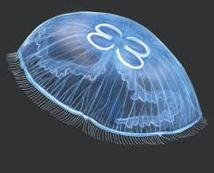
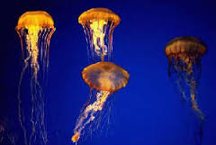
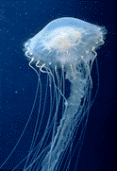
Phylum Cnidaria
Class Scyphozoa
Scyphozoa (sy-fuh-ZOH-uh) – cup animals
Medusa stage is dominant
Includes the jellies

Slide 26
Can YOU …
… explain the advancements over sponges?
… describe the general body plan of a medusa and a polyp?
… describe the general life cycle of a cnidarian?
… explain the differences in the 3 classes?

Slide 27
Hank Video
Video Link

