Slide 1
Life Sciences 11
Unit 2: Evolution
Lesson 3: HOW Evolution (Macro-Evolution)

Slide 2
Objectives
By the end of the lesson you should be able to:
Describe how macro-evolution (speciation) is different from micro-evolution
Describe 3 patterns of speciation
Compare and contrast Gradualism with Punctuated Equilibrium

Slide 3
Macro-Evolution
Macro-evolution: AKA Speciation
Speciation: the making of new species
Recall:
Species: population of organisms that are able to breed and produce viable, fertile offspring
Introduction to Speciation

Slide 4
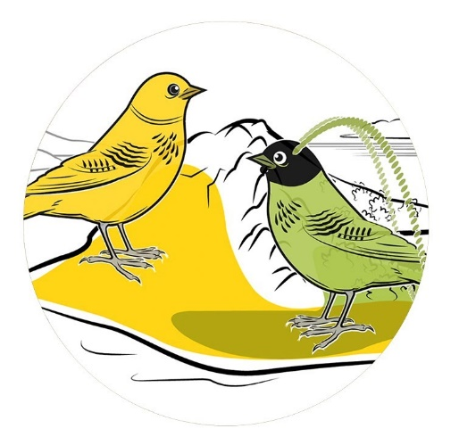
Speciation
When a population is separated (by a geographic barrier for example), speciation can occur over a long period of time as all of the small changes in the gene pool due to micro-evolution add up over time.
Eventually the differences in the two populations are so great that the two populations can no longer interbreed to make viable, fertile offspring. We now have two different species. Speciation is said to have occurred.

Slide 5
Patterns of Speciation
1. Divergent Evolution AKA Adaptive Radiation
Occurs when small fragments of a population inhabit new areas and become isolated …they adapt (evolve) to their new habitats
Recent common ancestor so DNA is similar
EX. Galapagos Finches

Slide 6
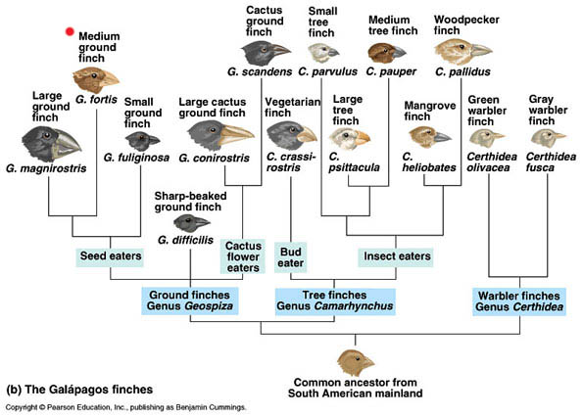

Slide 8
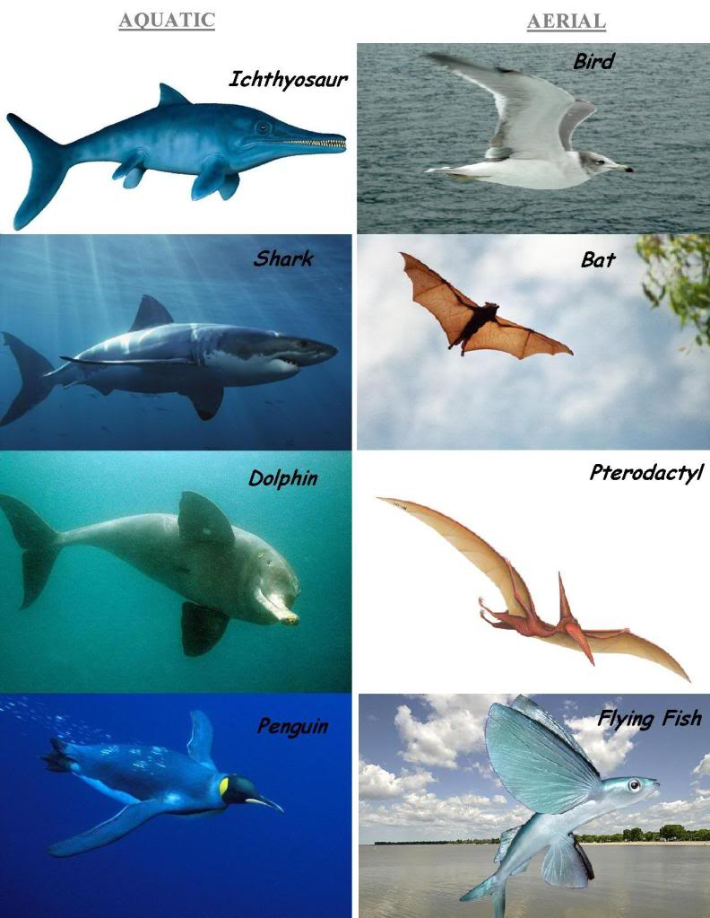
Another pattern of
evolution ….
What observations
can you make?

Slide 9
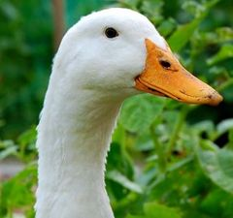
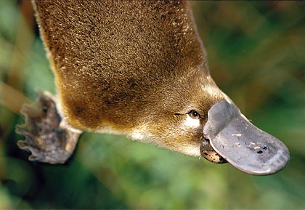
Patterns of Speciation
2. Convergent Evolution
Occurs when two unrelated species begin to inhabit the same environment and adapt (evolve) so will display similar characteristics
No recent common ancestor so DNA is not closely related
EX. Duck and platypus bills

Slide 10
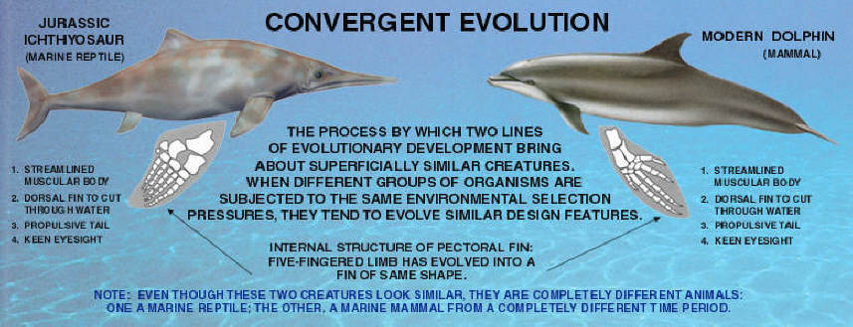

Slide 11
Another pattern of
evolution ….
What observations
can you make?

Slide 12
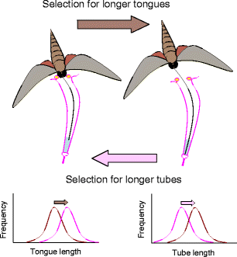
Patterns of Speciation
3. Coevolution
Occurs when organisms are closely connected to one another by biological interactions (symbiosis) and evolve together. A change in one organism may be followed by a corresponding change in the other organism.
EX. Plants and pollinators

Slide 13
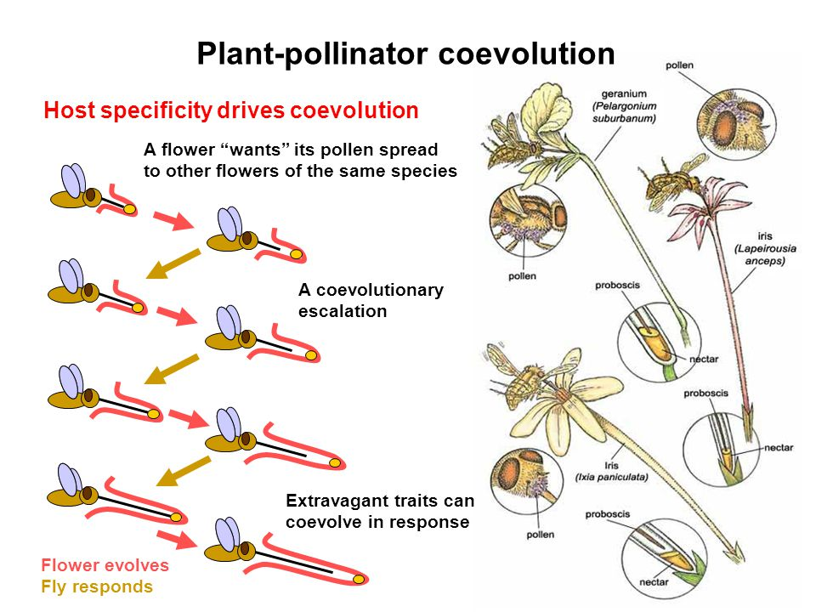
Convergent, Divergent and Coevolution Video

Slide 14
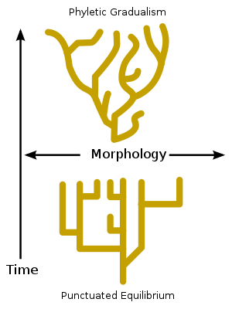
Rate of Evolution
There is no defined speed that evolution happens in, but there are two trends that can be clearly observed in the fossil record: Gradualism and Punctuated Equilibrium

Slide 15
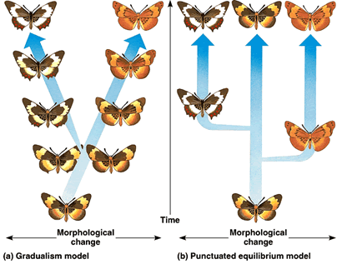

Slide 16
Rate of Evolution
Gradualism – Modern theory based on the principles of Charles Darwin
Slow and steady evolution of a species over time
Small changes (micro evolution) continually build up over time
Fossils are direct evidence that show speciation over time
The fossil record demonstrates clear examples of slow and steady changes over millions of years preserved in progressively younger layers of rock

Slide 17
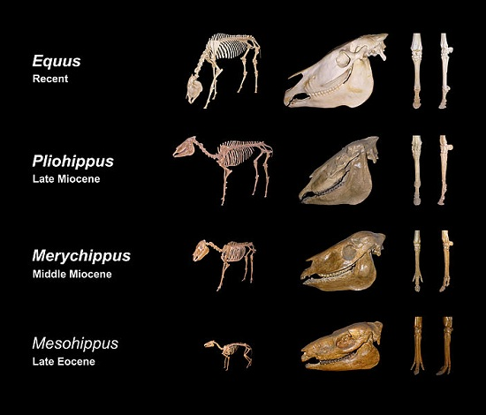

Slide 18
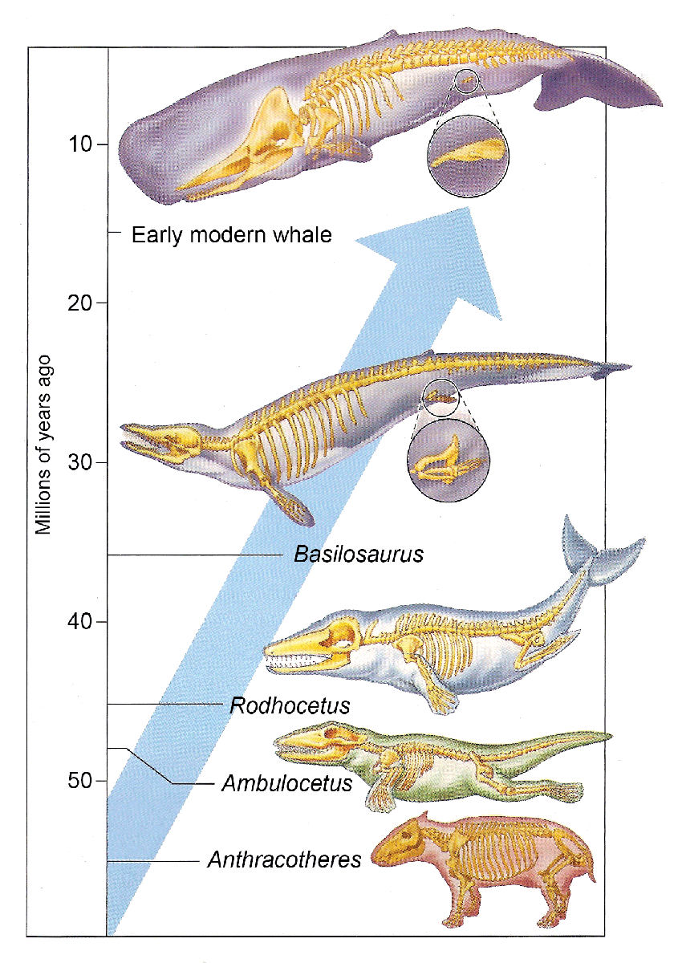

Slide 21
Rate of Evolution
Punctuated Equilibrium - Eldredge and Gould in 1972
Long periods of stasis (equilibrium) with short, rapid periods of change (punctuated)
Associated with sudden environmental change
The fossil record also demonstrates clear examples of periods of little change followed by rapid changes

Slide 22
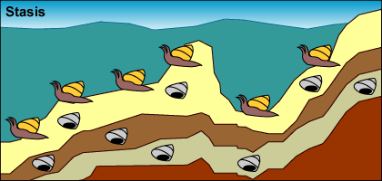
Punctuated equilibrium predicts that a lot of evolutionary change takes place in short periods of time tied to speciation events. Here's an example of how the model works:
Stasis: A population of mollusks is experiencing stasis, living, dying, and getting fossilized every few hundred thousand years. Little observable evolution seems to be occurring judging from these fossils

Slide 23
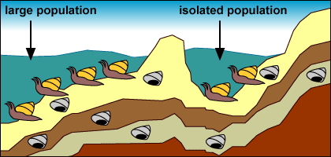
Isolation: A drop in sea level forms a lake and isolates a small number of mollusks from the rest of the population.

Slide 24
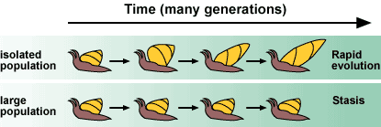
Strong selection and rapid change: The small, isolated population experiences strong selection and rapid change because of the novel environment and small population size: The environment in the newly formed lake exerts new selection pressures on the isolated mollusks. Also, their small population size means that genetic drift influences their evolution. The isolated population undergoes rapid evolutionary change.

Slide 25
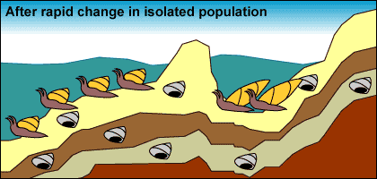
No preservation: Few fossils representing transitional forms are preserved because of their relatively small population size, the rapid pace of change, and their isolated location.

Slide 26
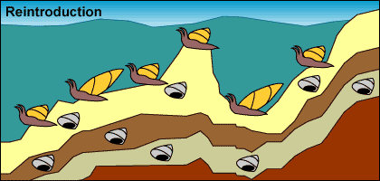
Reintroduction: Sea levels rise, reuniting the isolated mollusks with their sister lineage.

Slide 27
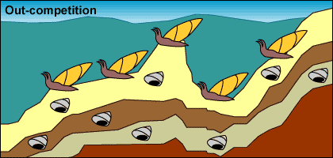
Expansion and stasis: The isolated population expands into its past range. Larger population size and a stable environment make evolutionary change less likely. The formerly isolated branch of the mollusk lineage may out-compete their ancestral population, causing it to go extinct.

Slide 28
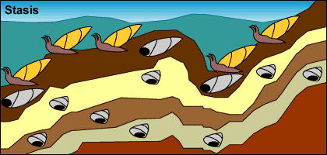
Preservation: Larger population size and a larger range move us back to step 1: stasis with occasional fossil preservation.

Slide 29
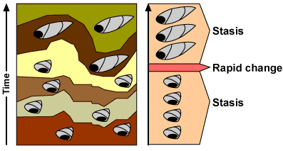
This process would produce the following pattern in the fossil record:

Slide 30
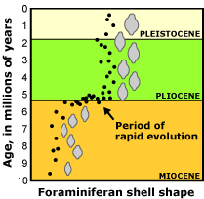
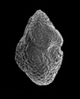
We observe similar patterns in the fossil records of many organisms. For example, the fossil records of certain foraminiferans (single-celled protists with shells) are consistent with a punctuated pattern.

Slide 31
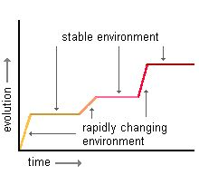

Slide 33
EX: Mollusk Evolution By Punctuated Equilibrium

Slide 34
Punctuated Equilibrium Video

Slide 35
In the fossil record we can observe examples of gradual, non-punctuated, evolution in some species and long periods of stasis followed by rapid change in other species. There is fossil evidence for both theories!
The question that needs answering is not which one is correct, but what are the relative frequencies of punctuated and gradual change?

Slide 36
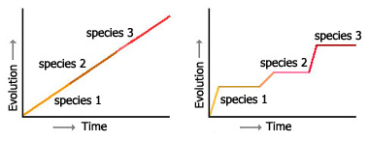
Which graph is showing Gradualism? Punctuated Equilibrium?
Gradualism Punctuated Equilibrium

Slide 37
Which diagram shows Gradualism and which shows Punctuated Equilibrium? Why?
Gradualism Punctuated Equilibrium

Slide 39
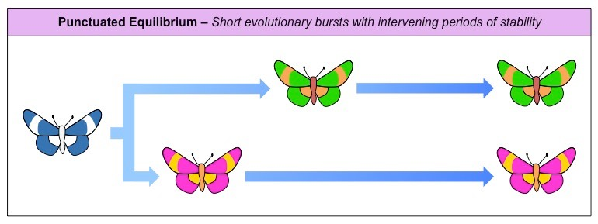
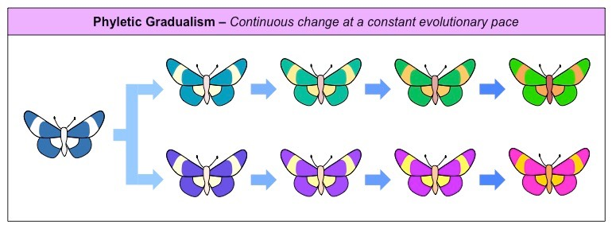

Slide 40
Comparison
← Eldredge and Gould
Darwin
→
Gradualism Punctuated Equilibrium

Slide 41
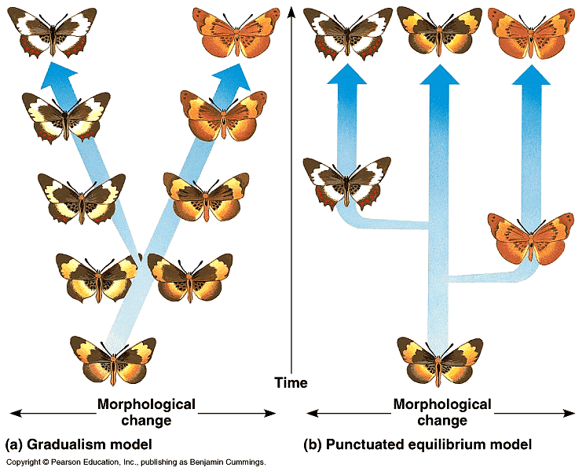

Slide 42
Can you …
… describe how macro-evolution (speciation) is different from micro-evolution?
… explain 3 patterns of speciation?
… compare and contrast Gradualism with Punctuated Equilibrium?

