Slide 1
Phylum: Nematoda
The Roundworms
27-2 pg. 689

Slide 2
Objectives
Describe the defining features of roundworms
Explain the advances over Platyhelminthes (the flatworms)
Describe the body plans and body systems
Describe 2 broad types and their example animals
Describe parasitic worms: which roundworms are important in human disease

Slide 3
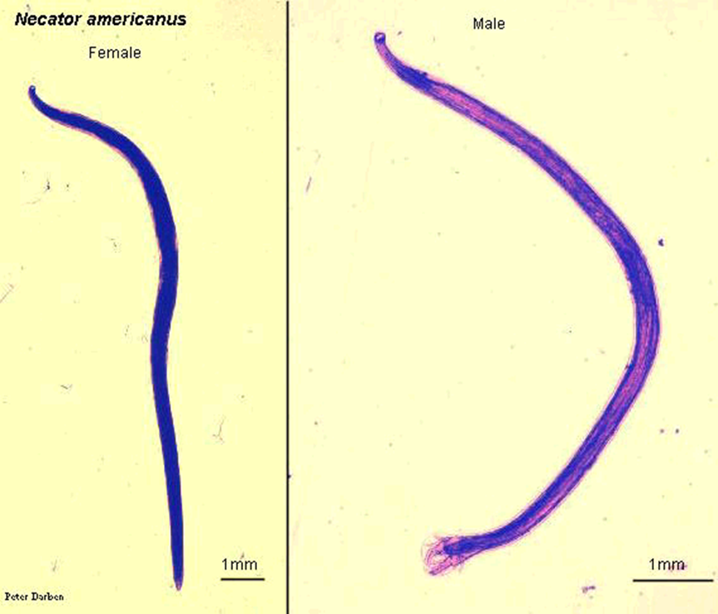
What is a roundworm?
Are slender, round, unsegmented worms with tapering ends
Their habits range as far north in polar regions to the tropics
There are two groups: free-living and parasitic
Most species are free-living, inhabiting soil, salt flats, aquatic sediments, and water
Many others are parasitic and live in the hosts that include almost every kind of plant or animal
A single rotting apple can contain up to 90,000. Your garden at home contains millions!

Slide 4
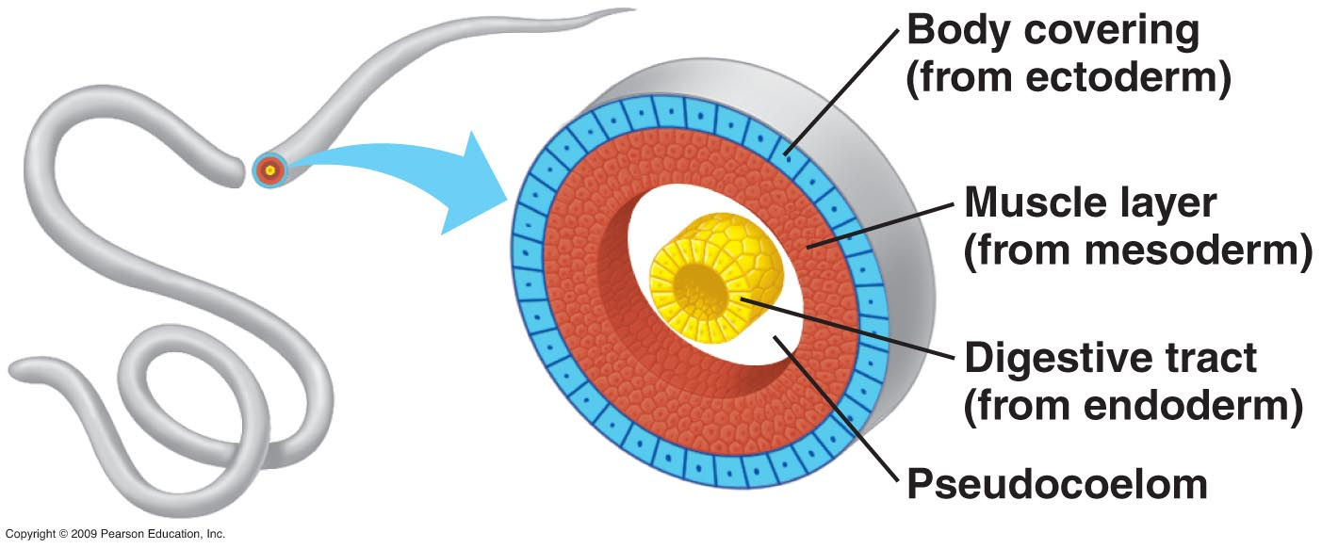
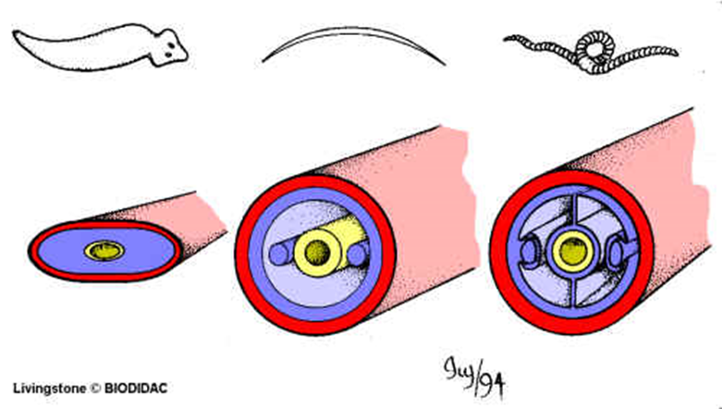
Body Plan
Like flatworms, nematodes develop from three germ layers - triploblastic
Roundworms have a body cavity that is located between the endoderm and mesoderm, therefore it is not fully surrounded in mesoderm tissue (such as muscle) and is known as a pseudocoelom.
A pseudocoelomate is an organism with a “false body cavity”

Slide 5
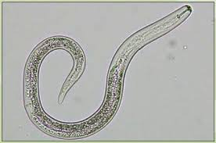
Body Plan
Unlike flatworms, the roundworms have a complete digestive tract with two separate openings, a mouth and an anus.
This body plan is referred to as a tube-within-a-tube structure, with the inner tube being the digestive tract and the outer tube being the body wall.
The development of an anus allows digestive wastes to exit through a different opening.
Free-living nematodes are more complex than parasitic nematodes

Slide 6
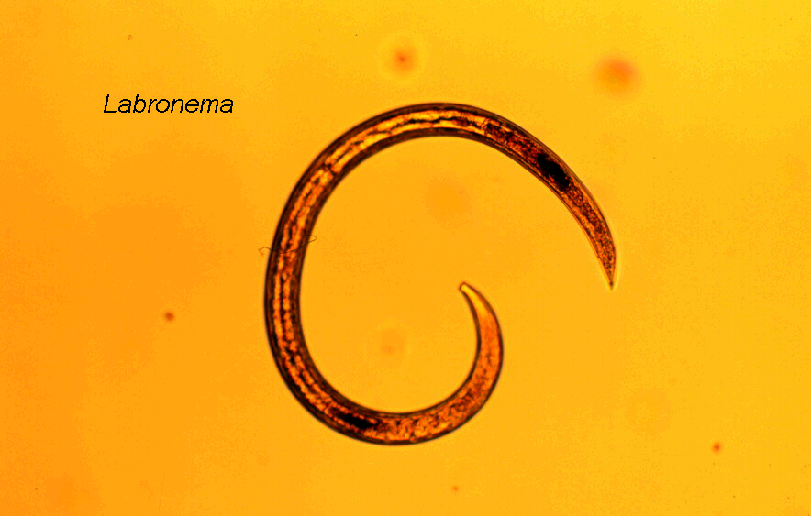
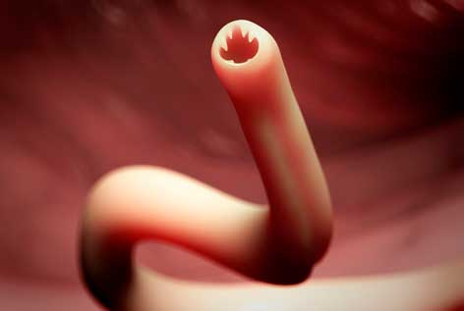
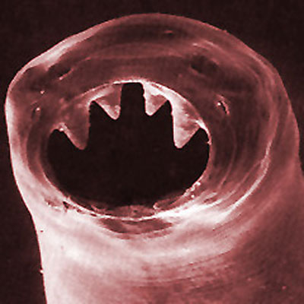
Feeding - Digestion
A Soil Nematode
Typically have a complete digestive system with a mouth, intestine and anus
Free-living nematodes often play an important role in ecology – they are decomposers
Parasitic roundworms feed on blood, tissues or pre-digested food from their host
Hookworm - a Parasitic Nematode

Slide 7
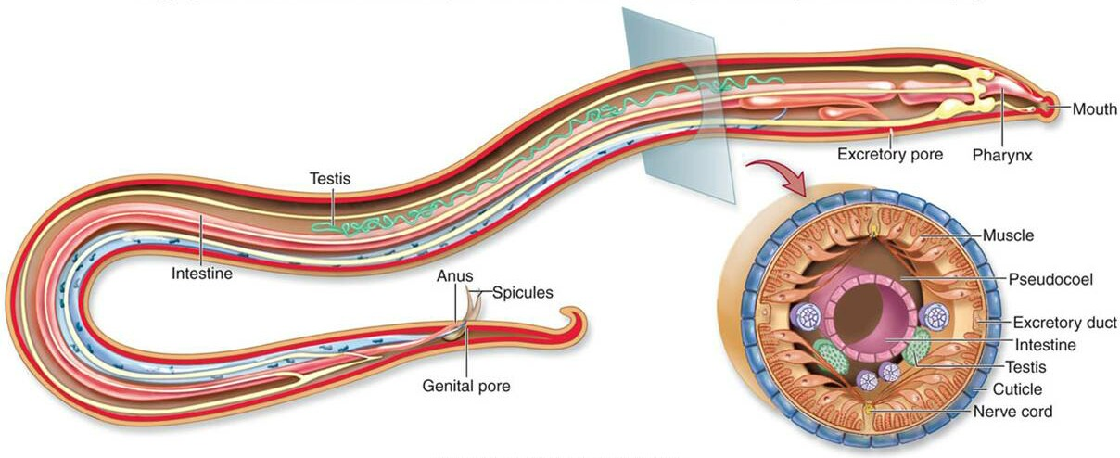
Respiration, Circulation & Excretion
Similar to flatworms, roundworms exchange gases and excrete metabolic waste through their body walls
They have no internal transport system therefore rely on diffusion on the movement of nutrients and wastes.

Slide 8
Response
Simple nervous systems with several ganglion
Several nerves extend from the ganglion in the head and run the length of the body
These nerves transmit several types of sense organs and movement
Sense organs can vary between nematodes but some have specialized structures that can detect chemicals given off by prey and hosts.

Slide 9
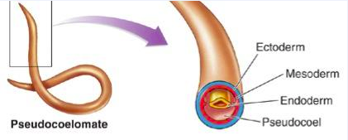
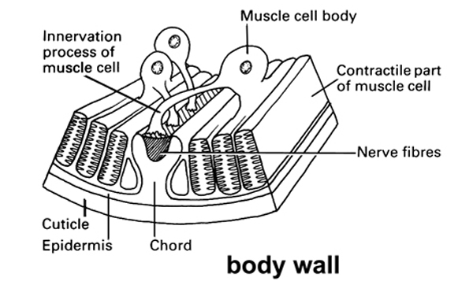
MOvement
Roundworms have muscles that extend the length of their bodies
Together with the fluid in their psuedocoelom, these muscles function as a hydrostatic skeleton
Aquatic roundworms contract these muscles to move like a snake through water
Soil-dwellers push their way through the soil by thrashing around

Slide 10
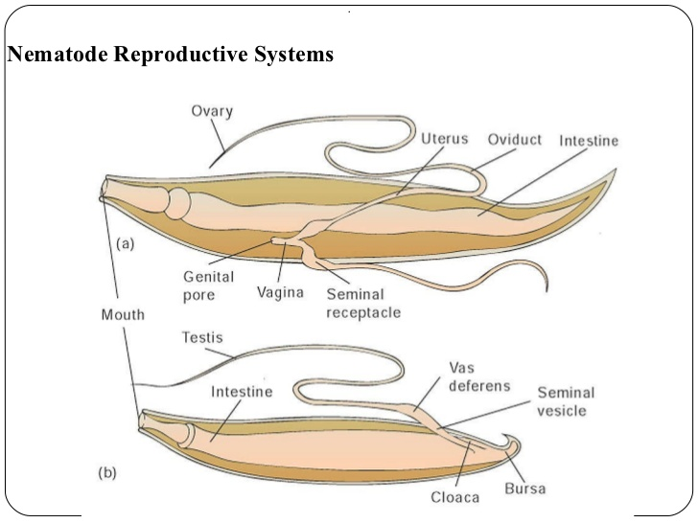
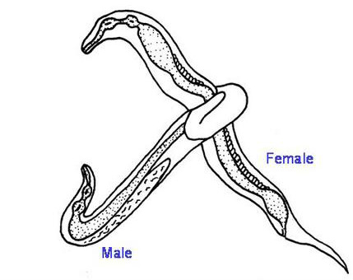
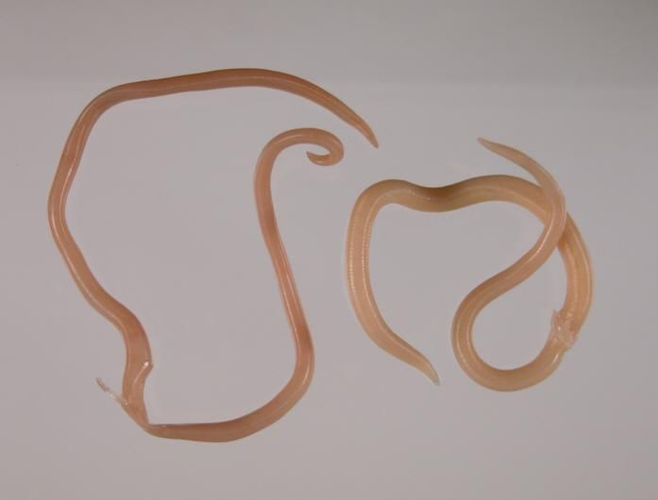
Reproduction
Reproduce sexually and typically have different sexes
Internal fertilization – the male deposits sperm inside the females reproductive tract.
Males typically have a ‘hooked’ end to grasp the females
Parasitic worms have complex lifecycles which often involve one or two hosts

Slide 11
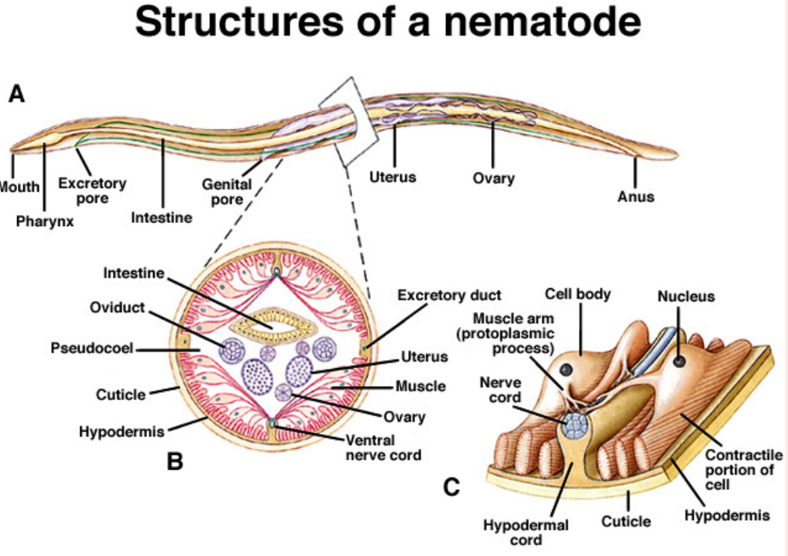

Slide 12
Parasitic Roundworms
Some of the worst worm parasites are members of phylum Nematoda. Some examples of very harmful nematodes include:
Intestinal roundworms such as Ascaris lumbricoides
Hookworms that enter between your toes and hook into your intestines to suck your blood
Pinworms that crawl out your anus at night
Trichinella which causes painful cysts in your muscles
Filarial worms which cause elephantiasis
And the Guinea stick worm (AKA Dracunculus) which causes … well, you will see! (if you don’t close your eyes)

Slide 13
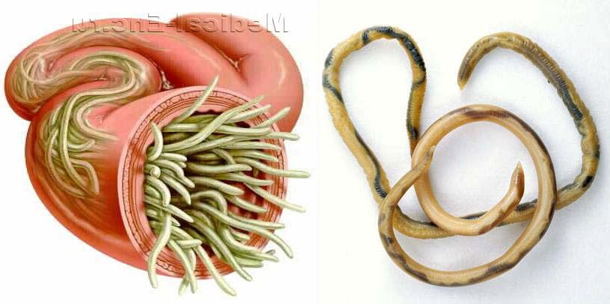
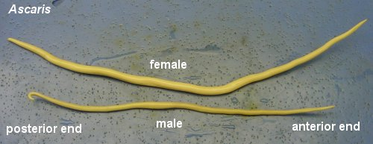
Parasitic Roundworms
1. Ascaris sp. the Intestinal Roundworm
Most common worldwide worm parasite - over 1 billion people have it
Lives in small intestine but travels through the body to lungs as a juvenile
Cause malnutrition as they absorb digested food from the host’s small intestine, nausea, vomiting, abdominal pain or coughing and gagging during the part of the lifecycle where they are in the lungs
Commonly spread by eating unwashed vegetables
Video – EXTREME WARNING!!
Surgery of bolus (ball) of ascaris being removed from intestines

Slide 14
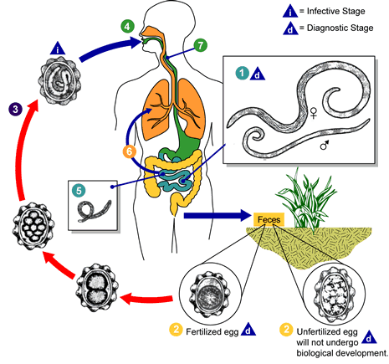

Slide 15
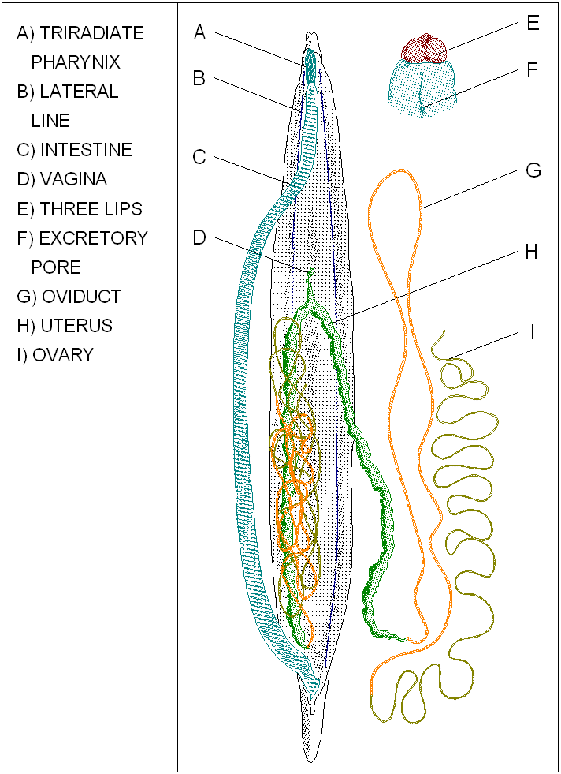

Slide 16
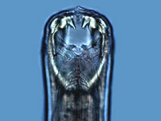
Parasitic Roundworms
2. Hookworm
Human hookworm (Necator sp.) feeds on blood from inside of intestine
A single worm can drain 20 ml of blood per day
Most serious in children as can lead to physical and mental retardation
Enters as “Itch worm” between toes
Video – strange, but effective
Video
Video – monsters inside me

Slide 17
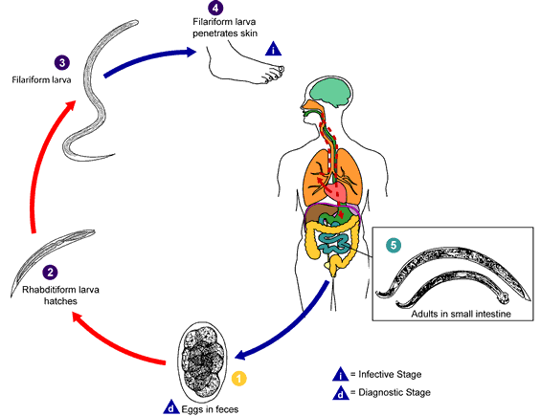

Slide 18
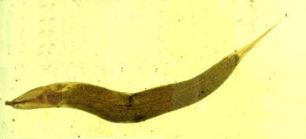
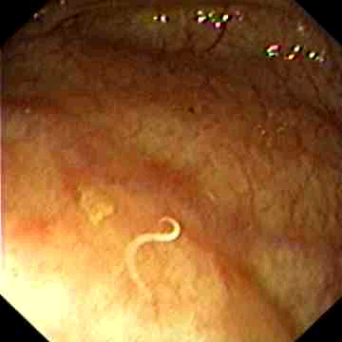
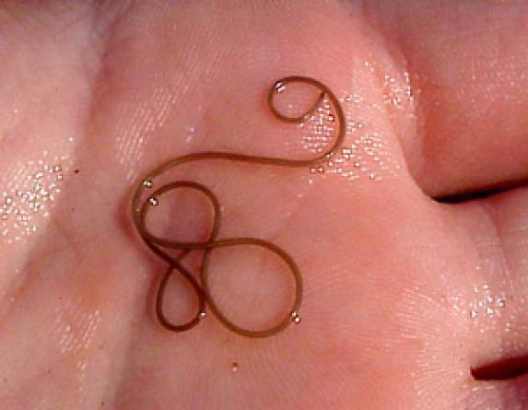
Parasitic Roundworms
3. Pinworm (Enterobius sp.)
Lives in lower bowel
Female migrates out anus each night to lay eggs
Secretes irritating toxin to get person to scratch
Re-infection is oral
Awkward video

Slide 19
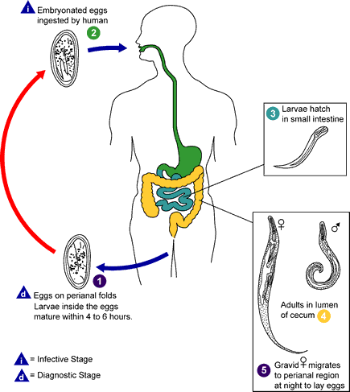

Slide 20
Parasitic Roundworms
4. Trichinella
From eating undercooked pork
Causes Trichinosis by invading muscles and organs forming painful cysts

Slide 21
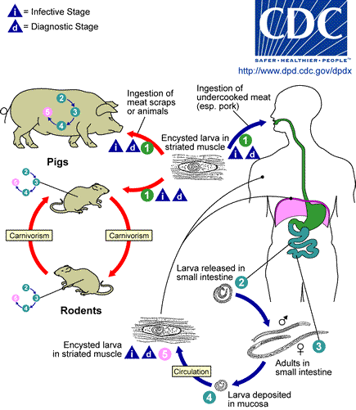

Slide 22
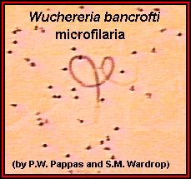
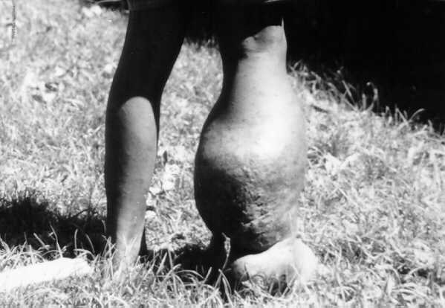
Parasitic Roundworms
5. Filarial Worm
Small nematode that lives in human lymph ducts and blocks them
As a result, fluids can’t drain so accumulate resulting in severe, grotesque swelling below where the worm is
Causes Elephantiasis

Slide 23
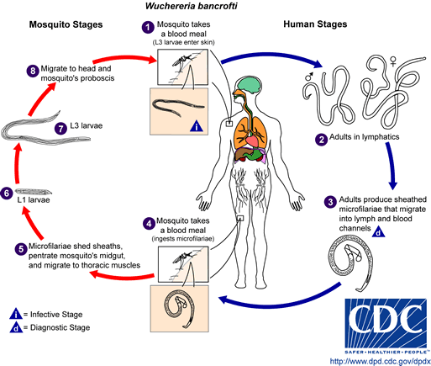

Slide 24
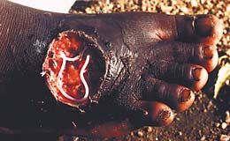
Parasitic Roundworms
6. The Guinea Stick Worm (Dracunculus sp.)
In Africa only
Enters while a person is in contaminated water and burrows through skin and grows into a painful open wound
No cure - is removed by wrapping around a stick - one turn per day
Contains deadly toxin if broken it can kill its victim
Video

Slide 25
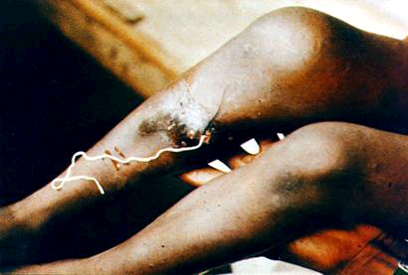

Slide 26
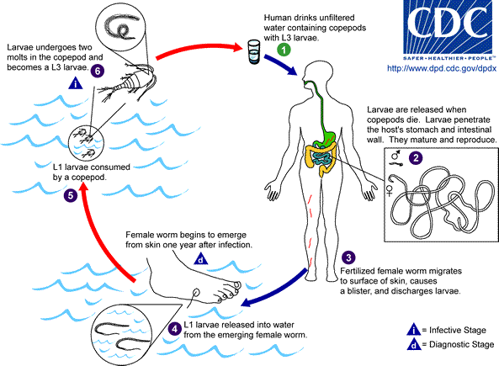

Slide 28
Nematoda Video
Video 1

Slide 29
Can You …
… describe the defining features of roundworms?
… explain the advances over Platyhelminthes (the flatworms)?
… describe the body plans and body systems?
… describe 2 broad types and their example animals?
… describe parasitic worms: which roundworms are important in human disease?

