Slide 1
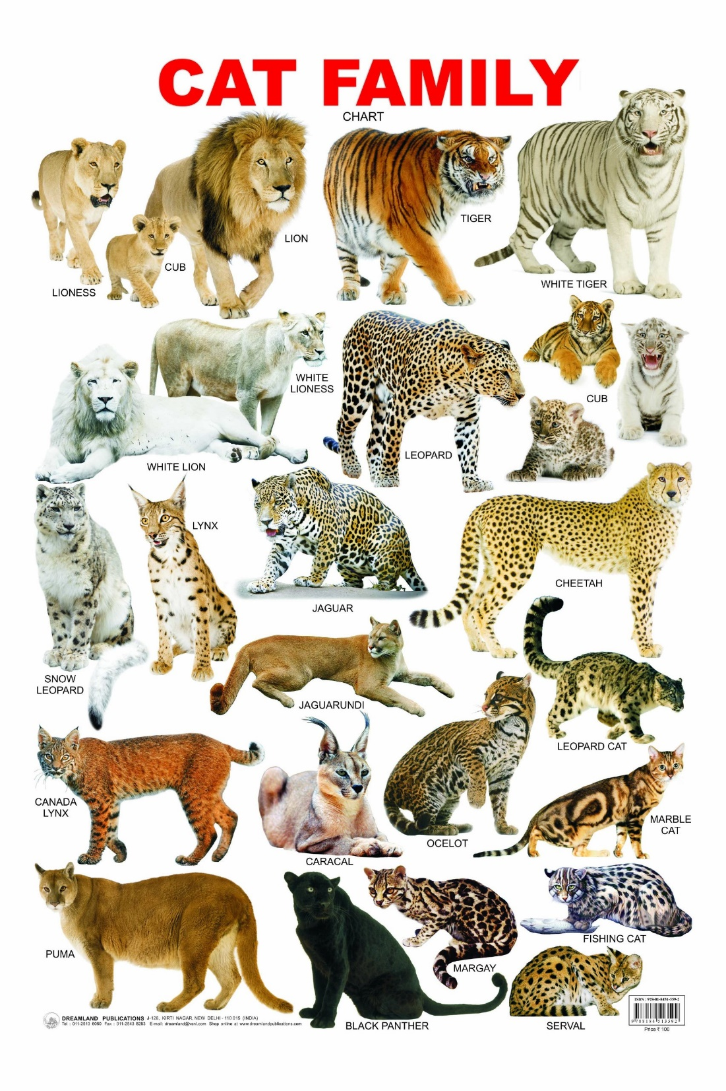
Life Sciences 11 Taxonomy

Slide 2
Life Sciences 11 Taxonomy

Slide 3
Objectives
By the end of the lesson you should be able to:
State the levels of classification and the man who created the classification system
Describe the 3 domains and the 4 kingdoms
Discuss the relatedness of organisms based on their classification

Slide 4
Introduction
Recall:
1) Life is both similar and diverse
2) Evolution helps us understand who is related to who
BUT….How do we organize and make sense of all these different life forms?

Slide 5
Taxonomy
The solution to this problem is taxonomy – the study of naming and classifying organisms
Based upon Carl Linneaus’ system of Binomial Nomenclature.
(name in 2 parts, based on Latin words)

Slide 6
Classifications
The first question in taxonomy is: What are the main divisions?
There used to be only 2 kingdoms: plants and animals.
Now, the latest classification system employs a “super category” called Domains.

Slide 7
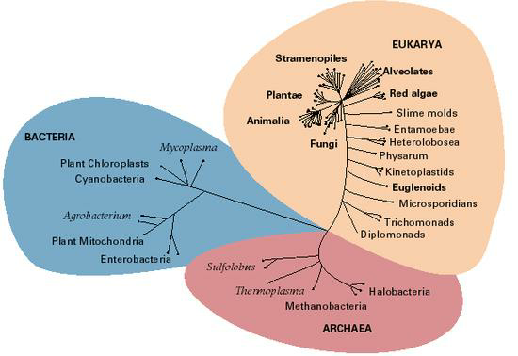
Domains

Slide 8
Intro to Classification

Slide 9
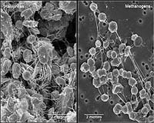
Domain Archaea
This includes one Kingdom: Archaebacteria.
They include forms of bacteria today that live in the most extreme conditions such as hot springs and sulfur pools.
Examples include:
Methanogens
Halophiles

Slide 10
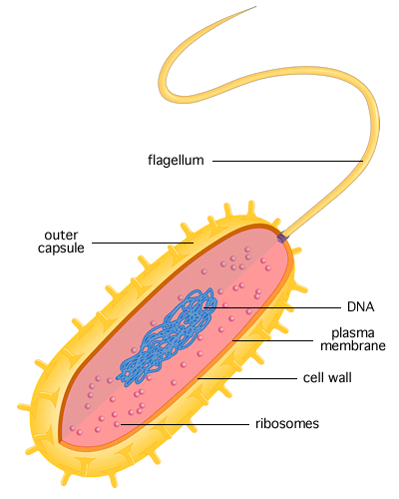
Domain Archaea
Characteristics:
Type of cells: prokaryotic
Number of cells: unicellular (microscopic)
Mode of nutrition: some autotrophic, some heterotrophic
Cell structures: have a cell wall but lacking peptidoglycan
Oxygen use: obligate anaerobes
DNA unique to Archaea
Live in extreme environments

Slide 11
Domain Bacteria
Includes one Kingdom: Eubacteria.
They include most of the bacteria that we are familiar with such as E. coli (gut bacteria).
Staphylococcus aureus

Slide 12
Domain Bacteria
Characteristics:
Type of cells: prokaryotes
Number of cells: unicellular (microscopic)
Mode of nutrition: some autotrophic, some heterotrophic
Cell structures: Cell walls contain peptidoglycan
Oxygen use: aerobes
DNA unique to Eubacteria
Live in moderate environments (almost everywhere!)

Slide 13
Domain Eukarya
This is a huge domain that includes all the eukaryotic organisms.
In this domain, we will see and use the more conventional 7 levels of classification.
We divide domain Eukarya into four kingdoms:
Kingdom
Phylum
Class
Order
Family
Genus
Species

Slide 14
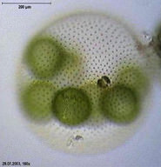
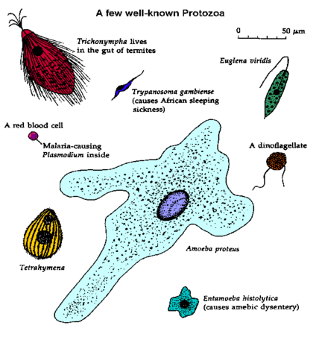
Kingdom 1: Protista
Type of cells: eukaryotic
Number of cells: mostly unicellular, some colonial,
some multicellular
Mode of nutrition: autotrophic a or heterotrophic
Cell structures: may have cell walls of cellulose or may have chloroplasts
Motile
“Catch-all” or “Junk drawer” of the Kingdoms – So much variety!
<--A protozoan
<--An algae

Slide 15
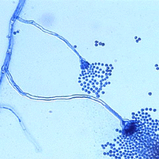
Kingdom 2: Fungi
Cell type: eukaryotic
Number of cells: Mostly multicellular, some unicellular (yeast)
Mode of nutrition: Heterotrophic
Cell structures: cell walls made of chitin
Non motile
Decomposers
Produce spores
Aspergillius, a bread mold

Slide 16
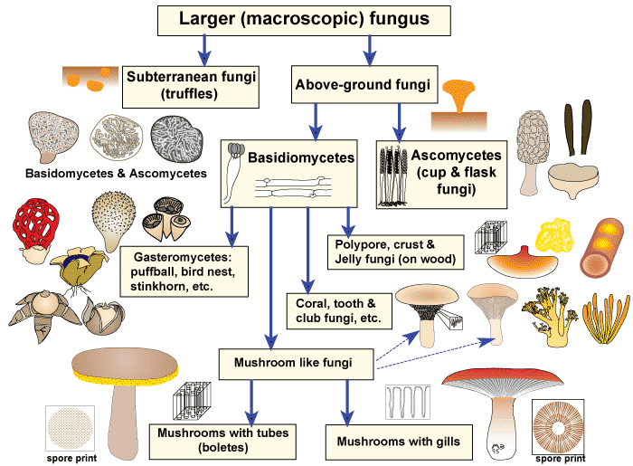

Slide 17
Kingdom 3: Plantae
Type of cells: eukaryotic
Number of cells: multicellular
Mode of nutrition: autotrophic
Cell structures: have chloroplasts and cell walls made of cellulose
Non motile
Asexual and sexual reproduction

Slide 18
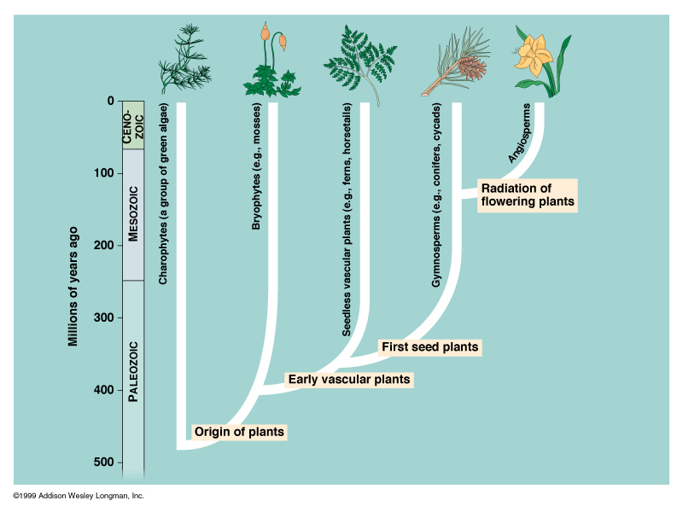

Slide 19
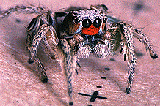
Kingdom 4: Animalia
Type of cells: eukaryotic
Number of cells: multicellular
Mode of nutrition: heterotrophic
Cell structures: no cell walls or chloroplasts
Motile
Sexual and asexual reproduction
Largest group is the Arthropods = 70% of all animals
A jumping spider

Slide 20
Conclusion
Taxonomy shows us where a species diverged from its relatives.
Let’s use humans, chimpanzees, house cats, and maple trees as examples to illustrate this:

Slide 21
Examples of Taxonomic Classification
Humans Chimpanzees House Cats Maple Trees
Domain Eukarya Eukarya Eukarya Eukarya
Kingdom Animalia Animalia Animalia Plantae
Phylum Chordata Chordata Chordata Tracheophyta
Class Mammalia Mammalia Mammalia Angiospermidea
Order Primata Primata Carnivora Sapindales
Family Hominidia Hominidia Felidia Aceridea
Genus Homo Pan Felis Acer
Species sapiens trogolodytes catus rubrum
We use the genus and species name to identify organisms.
Ex. Homo sapiens, Felis catus

Slide 22
Examples of Taxonomic Classification
Humans Chimpanzees House Cats Maple Trees
Domain Eukarya Eukarya Eukarya Eukarya
Kingdom Animalia Animalia Animalia Plantae
Phylum Chordata Chordata Chordata Tracheophyta
Class Mammalia Mammalia Mammalia Angiospermidea
Order Primata Primata Carnivora Sapindales
Family Hominidia Hominidia Felidia Aceridea
Genus Homo Pan Felis Acer
Species sapiens trogolodytes catus rubrum
Notice that the Genus is capitalized, and the species is not. The name should be in italics if typed or underlined if printed.
We use the genus and species name to identify organisms.
Ex. Homo sapiens, Felis catus

Slide 23
Examples of Taxonomic Classification
House Cat Lion
Domain Eukarya Eukarya
Kingdom Animalia Animalia
Phylum Chordata Chordata
Class Mammalia Mammalia
Order Carnivora Carnivora
Family Felidae Pantherinae
Genus Felis Panthera
Species catus leo
How do we identify lions?
Panthera leo

Slide 24
Can You …
…state the levels of classification and the man who created the classification system?
… describe the 3 domains and the 4 kingdoms?
… discuss the relatedness of organisms based on their classification?

