Slide 1
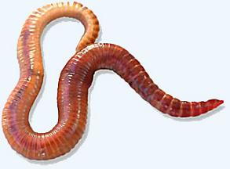
Life Sciences 11
Kingdom Animalia:
Phylum Annelida:
The Segmented Worms

Slide 2
Phylum Annelida Objectives
By the end of the lesson you should be able to:
State the advances over Nematodes
Describe all the body systems and structures (specifically on the Earthworm)
Describe the 3 classes and their example animals (and adaptations)

Slide 3
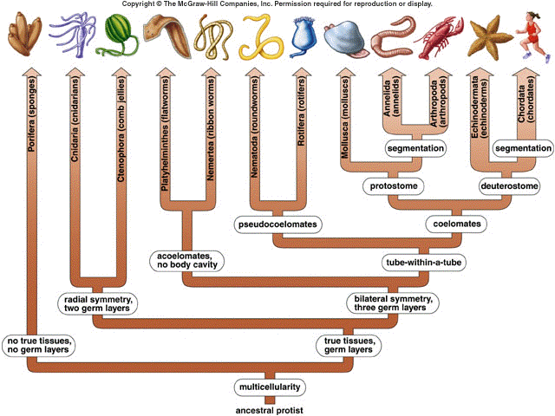

Slide 4
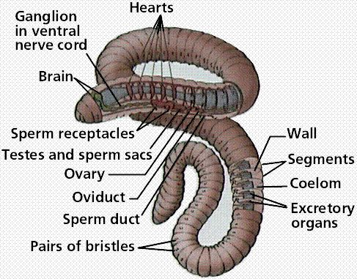
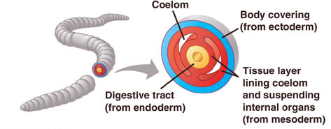
What is an Annelid?
Annelids are worms with segmented bodies
Their name comes from the Latin annellus which means ‘little ring’
Annelida is the first phylum with a true coelom – a body cavity surrounded in mesoderm

Slide 5
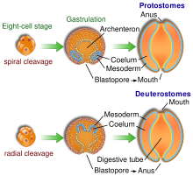
What is an Annelid?
Along with Arthropoda and Mollusca, Annelida are considered Protostomes, which means they develop mouth first in early development
While considered less advanced than the Deuterostomes, these phyla are the dominant animals on Earth today

Slide 6
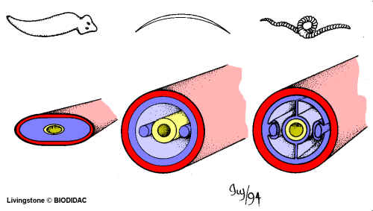
Body Plan
Like flatworms and roundworms, annelids develop from three germ layers – triploblastic
At this point in animal evolution, a true coelom developed. So there is mesoderm - and therefore muscle - around the skin and the gut
Tube-within-a-tube digestive tract surrounded in muscle – coordinated digestion and specialization of the food tube begins

Slide 7
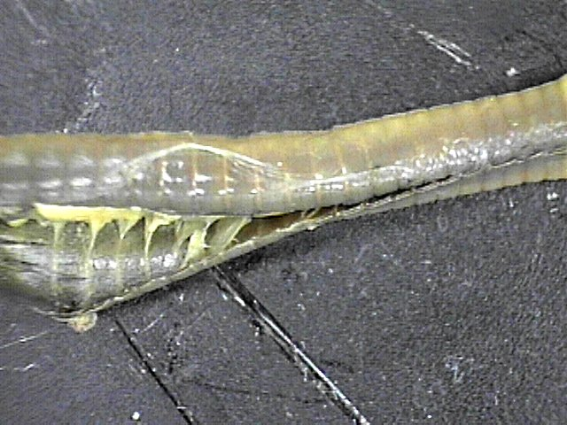
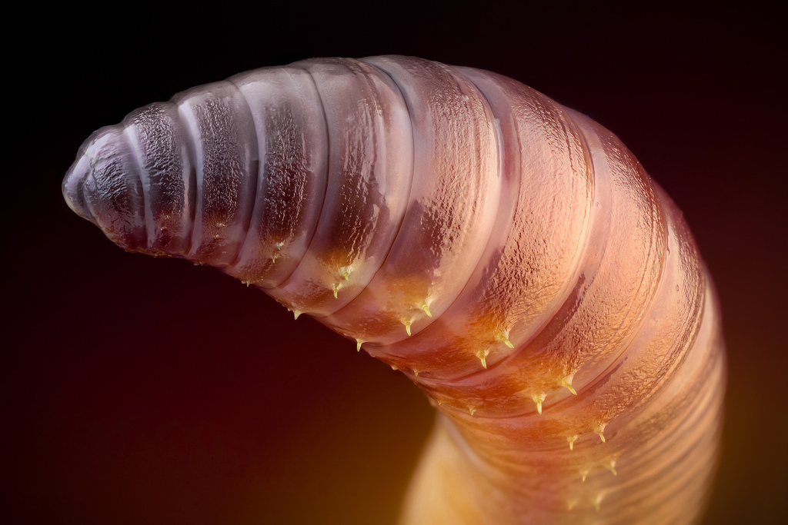
Body Plan
Segmented bodies separated by septa (internal walls) which may be modified to perform special functions ie. segments for eyes, antennae, excretion etc
Setae or bristles may line the ventral side of the worm to aid in movement

Slide 8
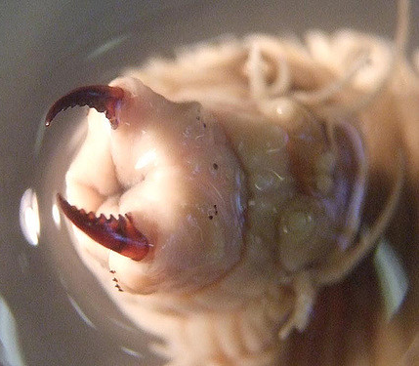
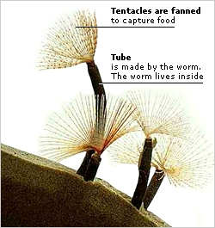
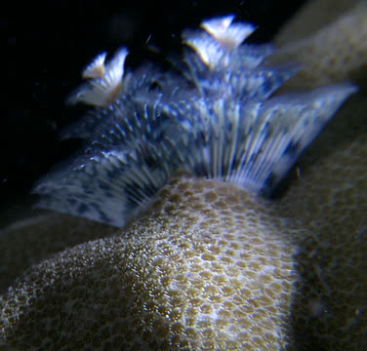
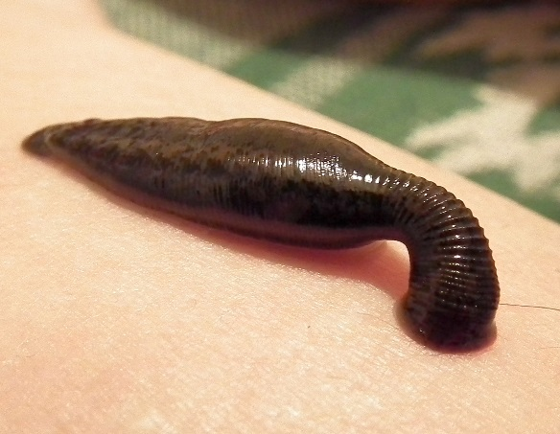
Feeding and Digestion
Diverse feeding methods from filter feeders to predators
Carnivorous worms such as Nereis which includes the sandworm have sharp jaws
Decomposers may use a sticky mucous covered pharynx to feed on decaying vegetation while others filter out food particles in water in a mucous bag
Ectoparasites such as leeches feed on the blood of the host

Slide 9
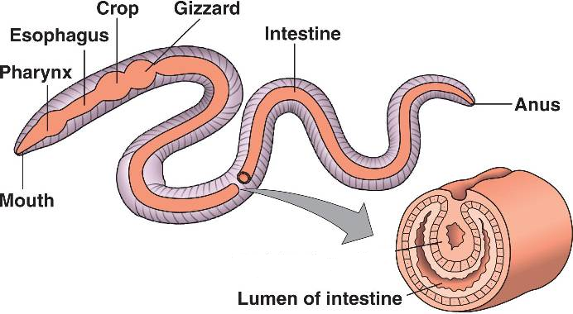
Feeding and Digestion
Earthworms have a pharynx to move food and soil into the esophagus
Food moves to the crop to be stored then muscular gizzard where it is ground into smaller pieces before being absorbed in the intestine

Slide 10
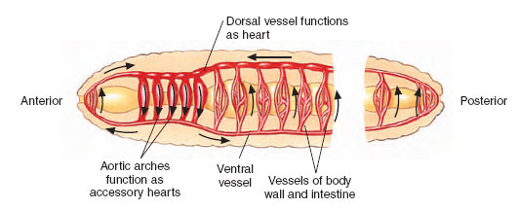
Circulation
First phylum to have a circulatory system - frees them from diffusion of materials - can grow larger.
Closed circulatory system where blood is contained within a network of blood vessels
Also have “hearts” or sets of aortic arches that pump blood through dorsal and ventral blood vessels that run the length of the body

Slide 11
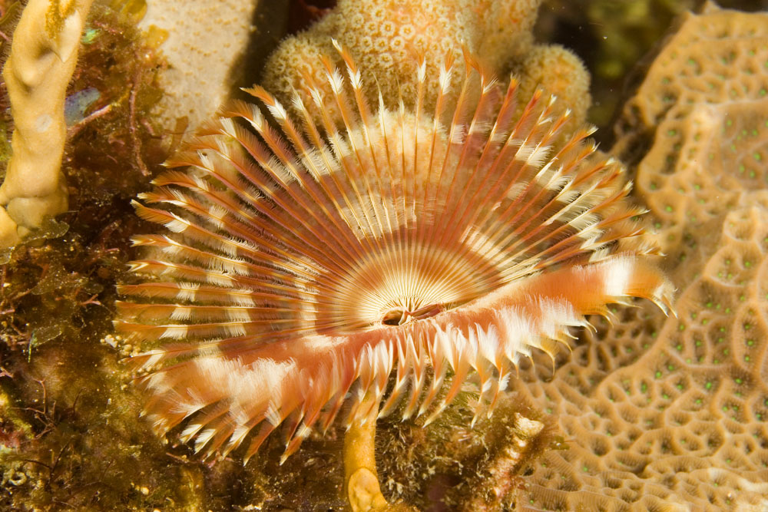
Respiration
Aquatic annelids often breathe through gills which exchange gases underwater
Terrestrial annelids must stay moist as they still rely on diffusion through their skin for gas exchange

Slide 12
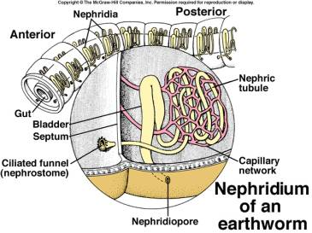
Excretion
Have specialized excretory units called nephridia in pairs in each segment
Used as a ‘kidney’ to get rid of metabolic wastes and excess water

Slide 13
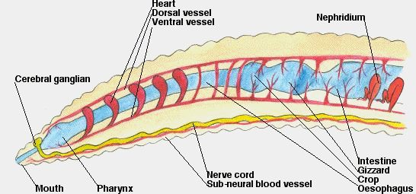
Response
Nervous system has a single ventral nerve cord with an anterior brain
There are many adaptations for detecting stimuli including sensory tentacles, chemical receptors, statocysts for balance and ocelli for detecting light

Slide 14
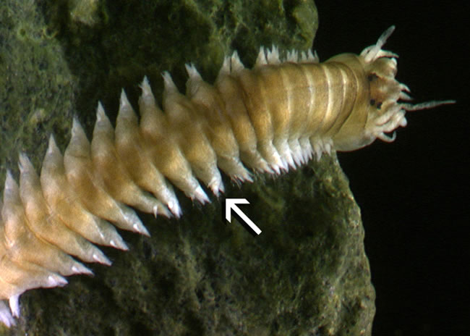
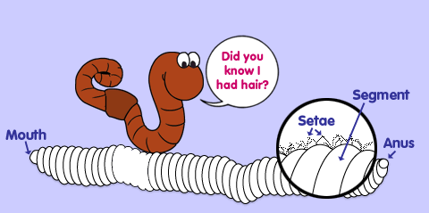
Movement
Hydrostatic skeleton with two groups of body muscles which contract to make the worm shorter and fatter or longer and thinner
By alternately contracting these muscles, and using setae to prevent slipping, burrowing annelids can move through the ground
Marine annelids have paddle-like appendages called parapodia (“foot-like”)

Slide 15
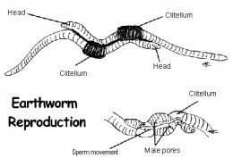
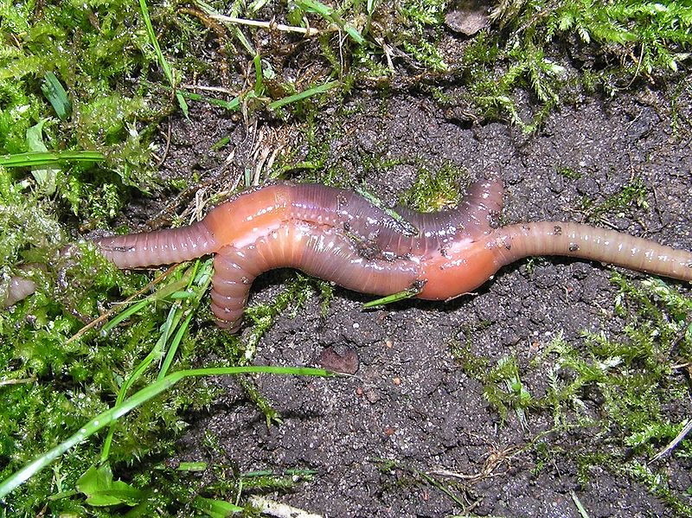
Reproduction
Usually sexual reproduction with separate sexes and external fertilization
Specialized region called the clitellum secretes a mucous ring where fertilization takes place then forms a protective cocoon

Slide 16
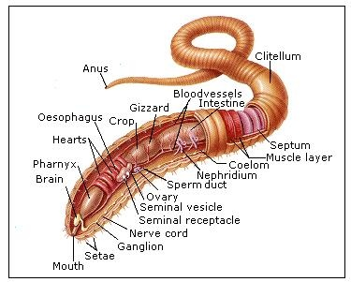
Annelid Classes
There are three major classes of Annelids:
Class Oligochaeta: ex. the earthworm
Class Polychaeta: ex. the sandworm
Class Hirudinea: ex. the leech

Slide 17
Class Oligochaeta
“few hairs”
Contains the earthworm
Move using setae (bristles)
Fairly well adapted to land but must stay in moist environment
Head is reduced as are obvious sense organs

Slide 18
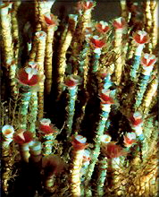
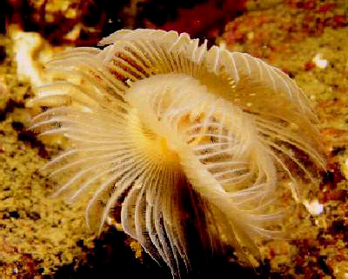
Class Polychaeta
Tube Worms
Contains “parapodia” that are modified setae
Used as paddles (thus this class is marine) to move about - beginning of appendage development
Also used as crude gills - beginning of respiratory system
Include sandworms and tubeworms
close up of mouth
Cluster

Slide 19
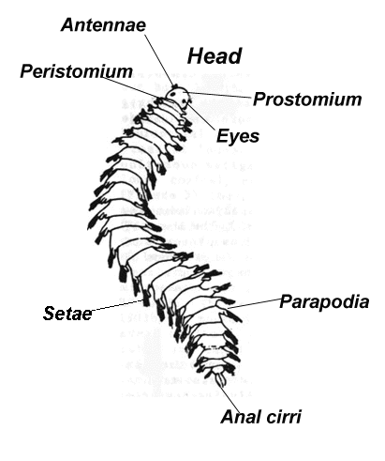
Class Polychaeta
The sandworm shows the parapodia development

Slide 20
Class Hirudinea
Leeches
These are ectoparasites that feed upon the blood of vertebrates including us.
Most common in fish
Can be used for medical purposes
A leech in a persons eye

Slide 21
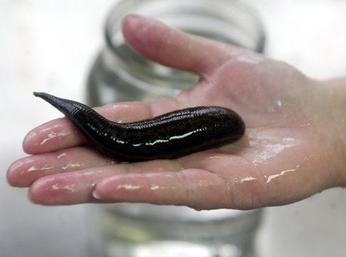

Slide 22
Annelids Video
Hank Video

