Slide 1
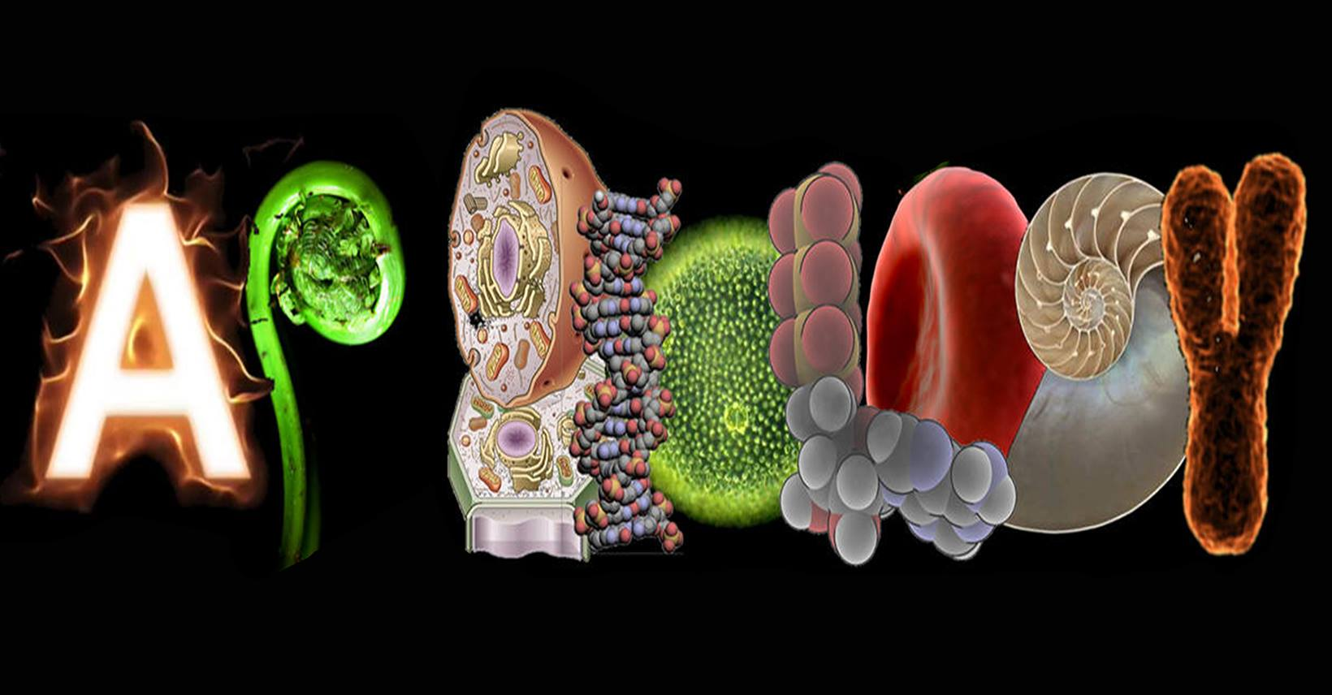
AP Biology

Slide 2
What is AP Biology?
AP Biology stands for Advanced Placement Biology
AP Biology is designed to be the equivalent of a university introductory Biology course
AP courses are designed by the College Board (the group in charge of the SATs)
Students worldwide take AP courses
Credit for first year university can be obtained by succeeding on the AP exam in May
At OKM, AP Biology is a full year course that gives you 4 credits for Biology 12 and 4 credits for AP Biology for a total of 8 credits

Slide 3
Why Take AP Biology?
To gain university credit
For the academic challenge
For advance preparation of what to expect in a university course
For university admission reasons (it looks great on a high school transcript when trying to get into competitive schools!)
Because you are really interested in Biology and have a future career in a related field such as medicine, veterinary or dental in mind

Slide 4
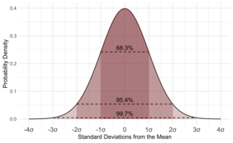
What Do You Do in AP Biology?
Develop questions and hypotheses, and then design experiments that provide evidence and explanations
Experimentation and data collection – at least 25% of the course is lab work
Statistical Tests and Data Analysis
Representing and Describing Data
Argumentation

Slide 5
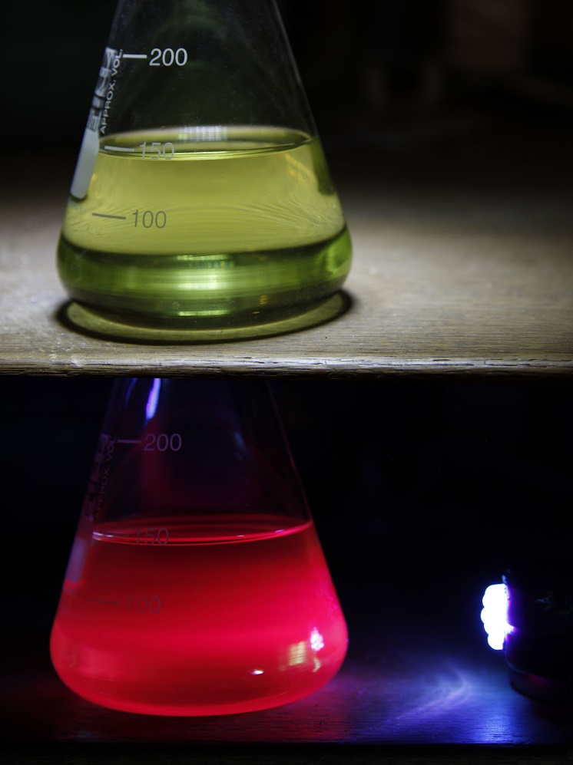
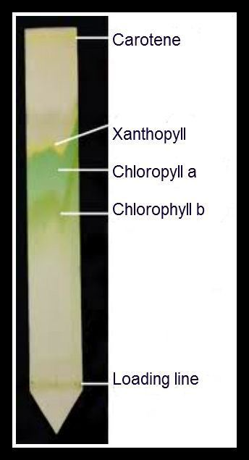
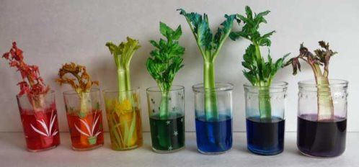
What Do You Do in AP Biology?
Plant pigment chromatography
Plant transpiration
Chlorophyll fluorescence

Slide 6
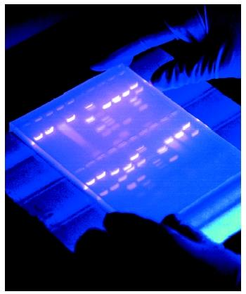
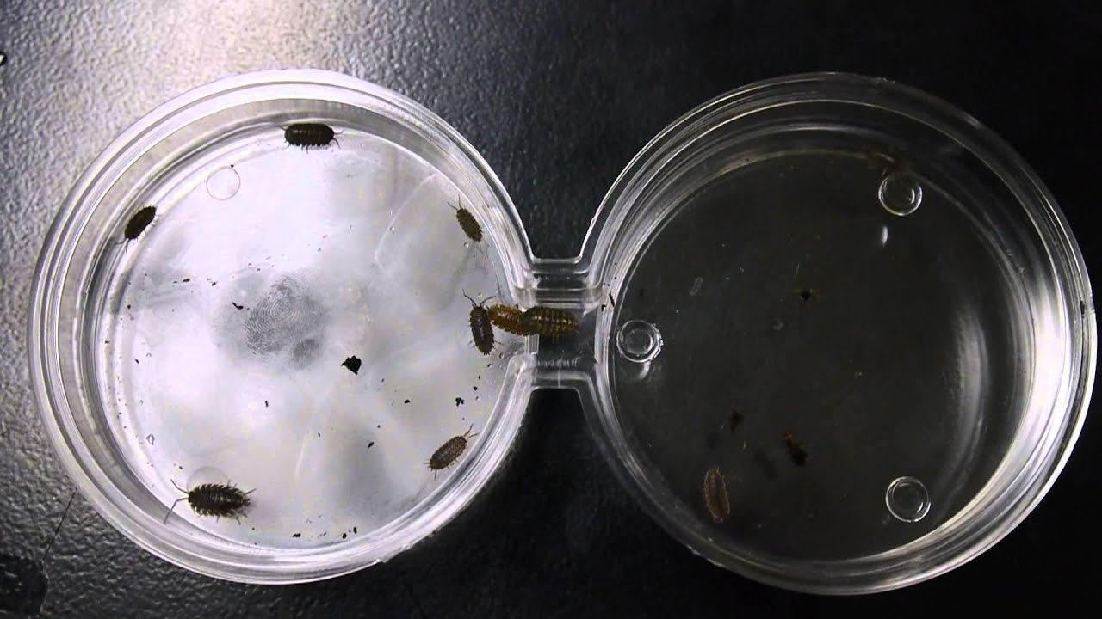
What Do You Do in AP Biology?
Forensic DNA Fingerprinting
Animal Choice Chamber
Dissections

Slide 7
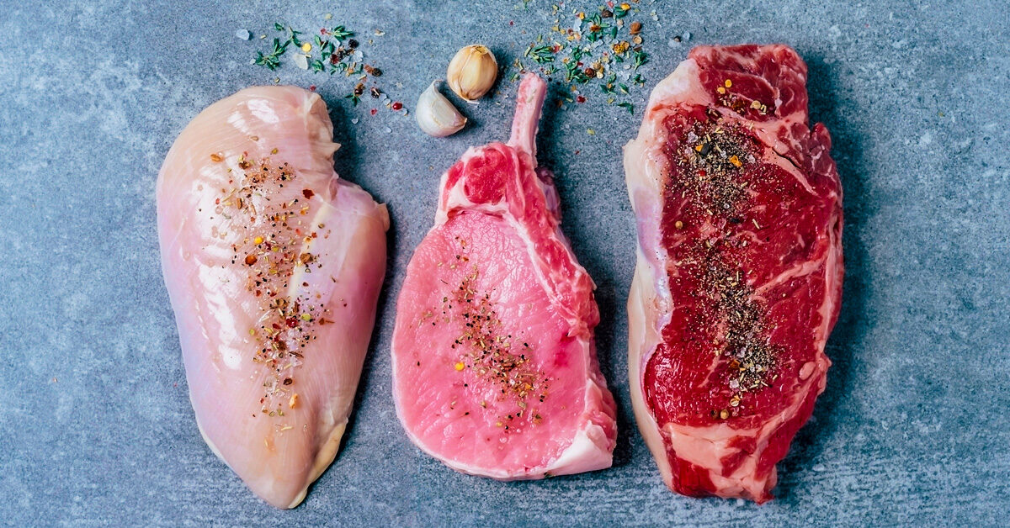
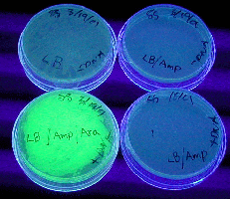
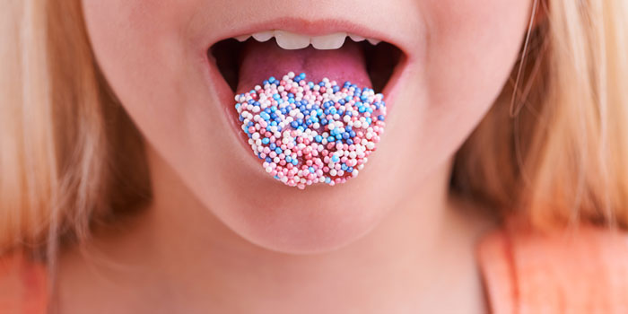
What Do You Do in AP Biology?
Transform bacteria using jellyfish DNA
Compare fat content in meat
Disrupt cell signaling between taste receptors

Slide 8
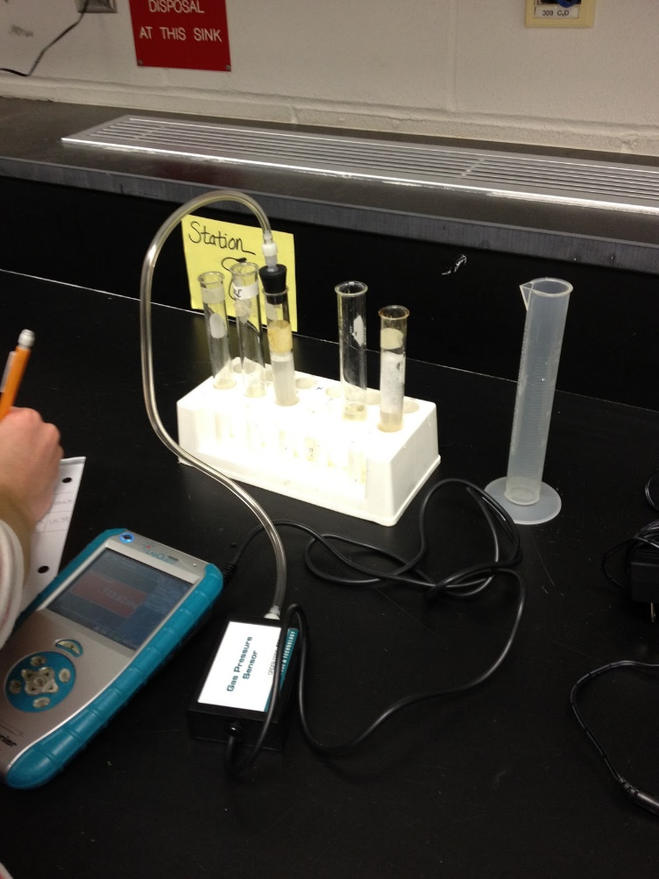
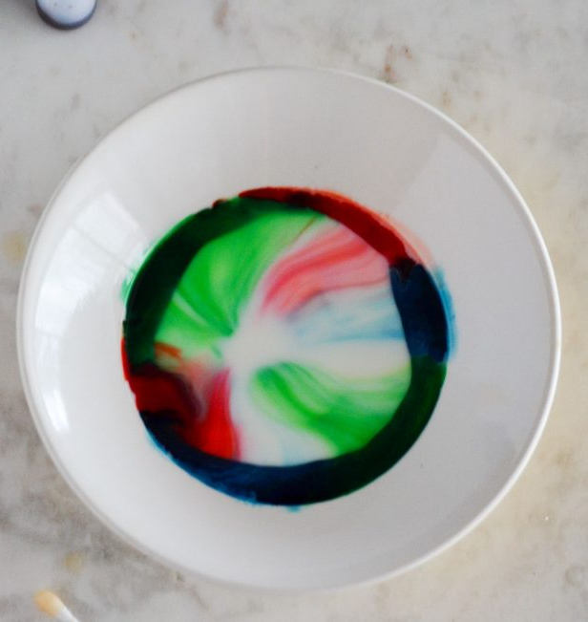
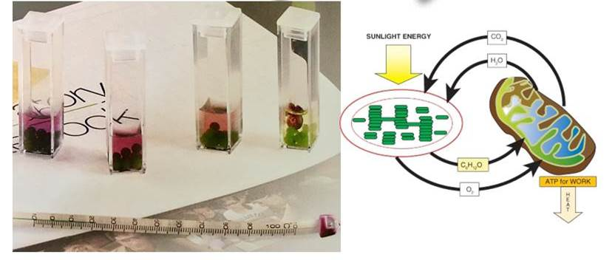
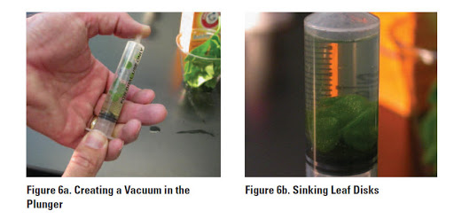
What Do You Do in AP Biology?
Measure rates of photosynthesis and cellular respiration in algae
Floating disk assay
Enzyme catalysis
And lots more

Slide 9
Suggested Pre-Requisites
Life Sciences 11
Chemistry 11
Good communication skills
Self-motivated
Willingness to spend time for success

Slide 10
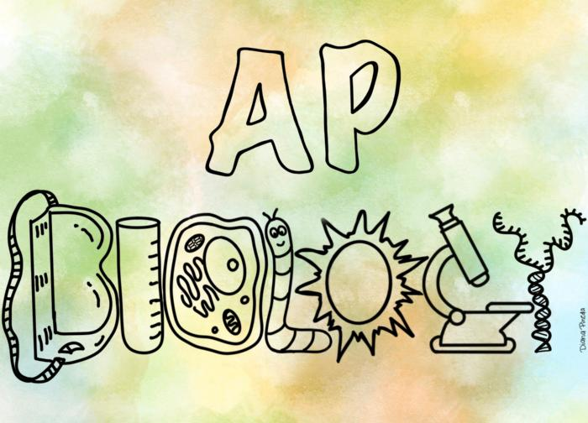
Curious?
Scan the QR code or follow the link below to add your name to the list of potential AP students for next year
https://tinyurl.com/y6lhqgv3

