Slide 1
Life sciences 11
Kingdom Animalia:
Phylum Arthropoda:
Jointed Legs

Slide 2
Phylum Arthropoda Objectives
State the advances over the Annelids
Know the 5 Classes and example animals
Explain the differences/similarities between grasshoppers and crayfish
Explain why insects are so well adapted to life on land

Slide 3
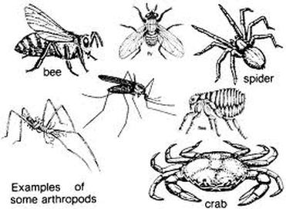
What is an Arthropod?
Most dominant animal phylum on Earth making up 75% of all animals
Name comes from Latin ‘jointed foot’
Segmented bodies with a high degree of specialization
Tough exoskeleton and jointed appendages
Protostomes – develop mouth first in early development
Examples include spiders, crabs, ants and centipedes

Slide 4
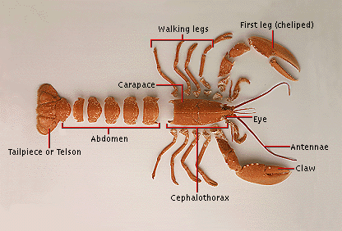
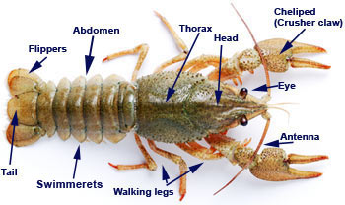
Body Plan
Triploblastic coelomates
Tube-within-a-tube
Exoskeleton: made of hard non-living chitin; provides strength and protection; must be shed for growth
- Requires many joints to allow for movement
Appendage Formation: can be used for many purposes and adapted and modified

Slide 5
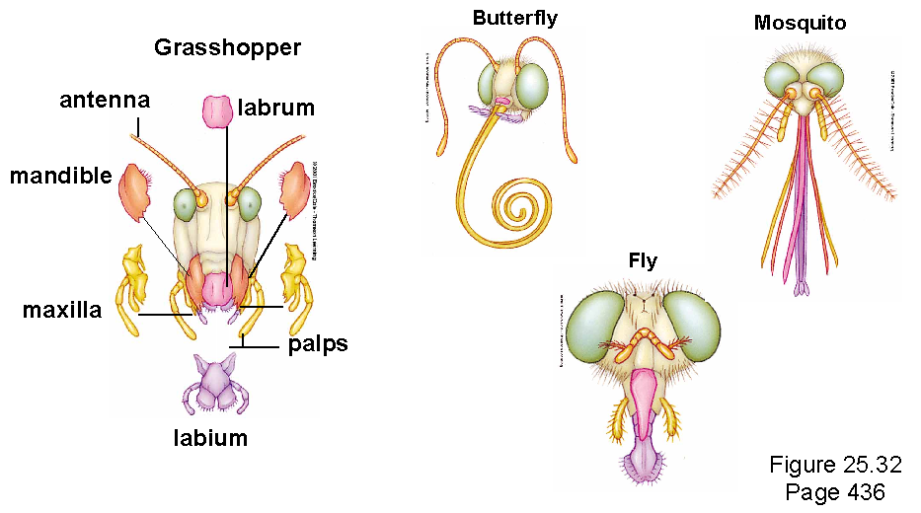
Feeding
Hugely diverse phylum which includes herbivores to carnivores and filter feeders to parasites
Arthropods have evolved complex mouth parts such as jaws, pincers and boring drill like structures that allow them to eat almost any type of food you can imagine

Slide 6
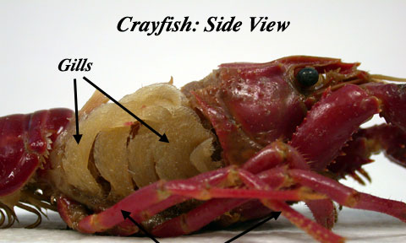
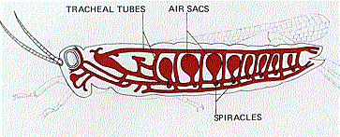
Respiration
Most aquatic arthropods such as crabs or lobsters use featherlike gills to breathe
Terrestrial arthropods such as grasshoppers use a network of branching tracheal tubes that extend throughout the body.
Air enters the tracheal tubes through small openings on the side of the body called spiracles.

Slide 7
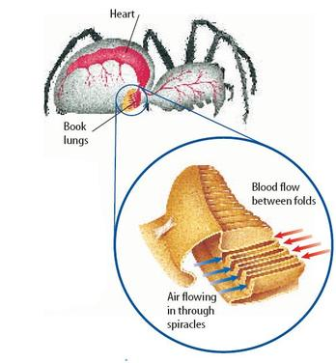
Respiration
Terrestrial arthropods such as spiders use book lungs for respiration.
Book lungs are organs that have layers of respiratory tissue stacked like pages of a book

Slide 8
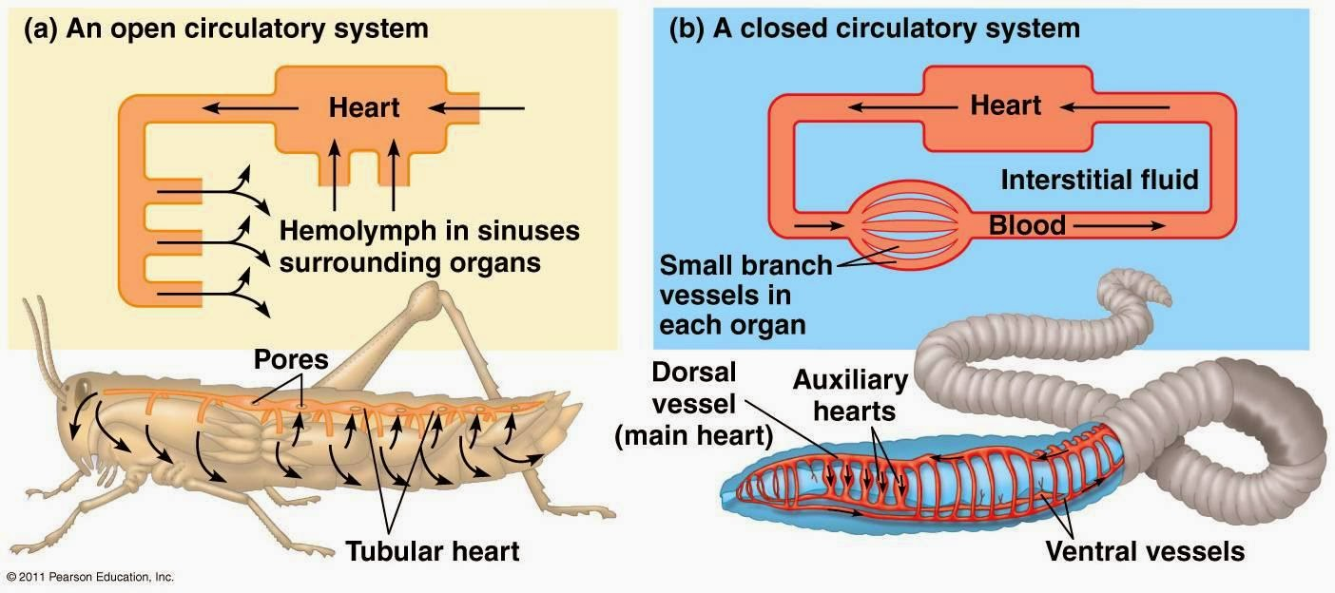
Circulation
Open circulatory system with a well developed heart
Blood leaves blood vessels into sinuses or cavities then collects in a large sinus surrounding the heart where it is pumped through the body

Slide 9
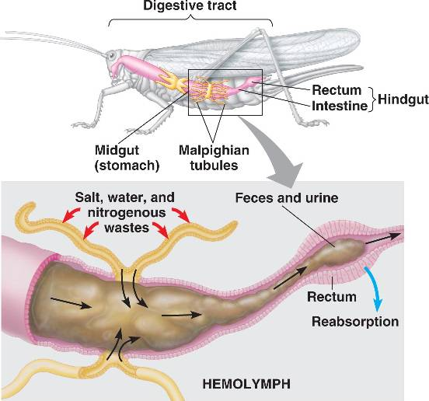
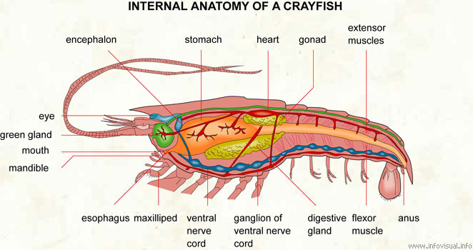
Excretion
In terrestrial arthropods, excretion of cellular wastes such as ammonia by malpighian tubes – sacs which extract waste from the blood and add it to digestive wastes
In aquatic arthropods, excretion of cellular waste may be by diffusion or may be by kidney-like organs called green glands in organisms such as crayfish

Slide 10
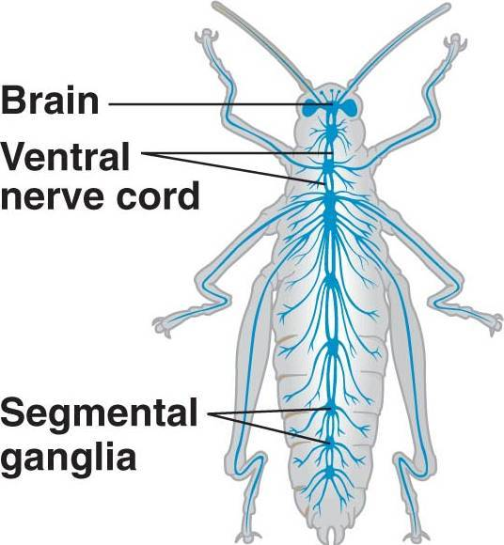
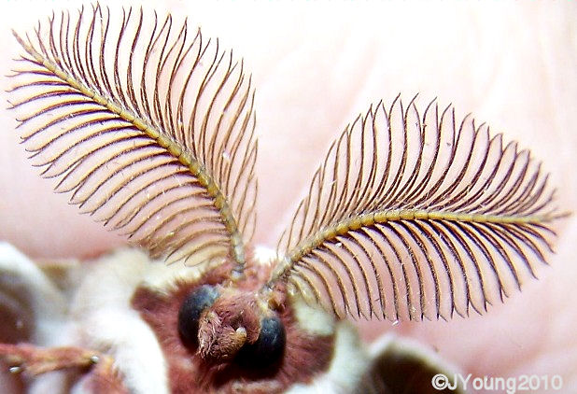
Response
Well developed nervous systems with brain and single ventral nerve cord
Several ganglia along the ventral nerve cord coordinate the movements of individual legs and wings
Sophisticated sense organs such as compound eyes that detect colour and motion to antennae which detect chemicals

Slide 11
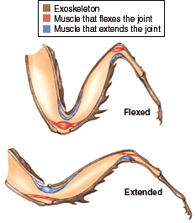
Movement
Well-developed groups of muscles contract or relax when stimulated by the nervous system
Different muscles pull against the exoskeleton to move appendages

Slide 12
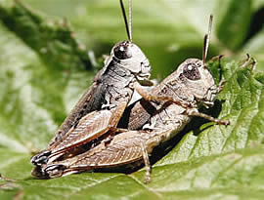
Reproduction
Separate sexes and all reproduction is sexual
Fertilization is typically internal for terrestrial arthropods and aquatic arthropods may be internal or external

Slide 13
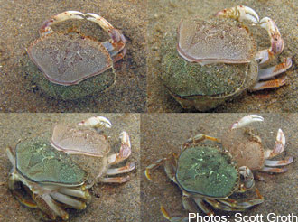
Growth and Development
Exoskeletons do not grow as the animal grows, so arthropods undergo molting
Moulting is when the arthropod sheds its exoskeleton and builds a larger one to take its place

Slide 14
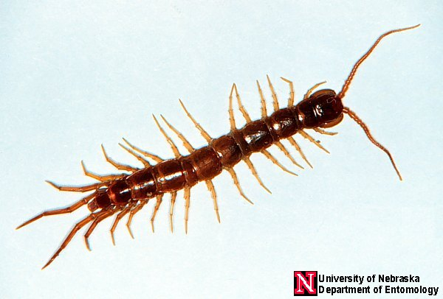
Class Chilopoda
The Centipedes
Very annelid-like with repeating segments
Setae are modified to crude appendages - only specialized in the mouthparts
Body segments have 1 pair of legs

Slide 15
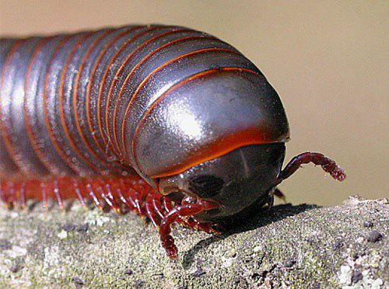
Class Diplopoda
The Millipedes
Very annelid like but have an exoskeleton
Unspecialized appendages
Body segments have 2 pairs of legs

Slide 16
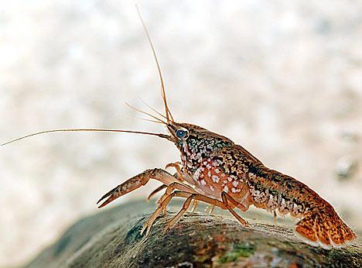
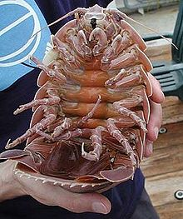
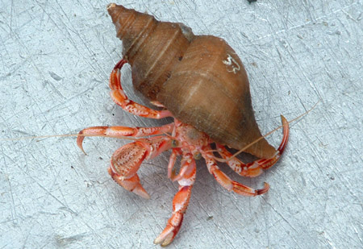
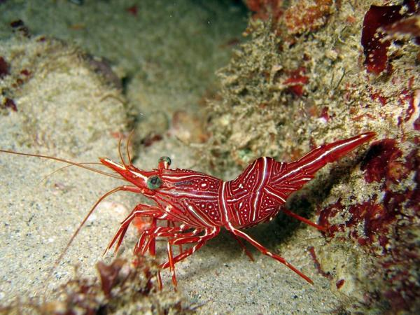
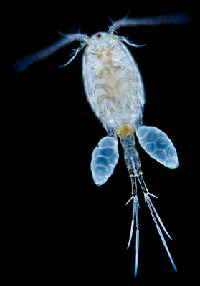
Class Crustacea
Crayfish
Development of body regions: head, thorax and abdomen
Have fused head and thorax called a “Cephalothorax”
Show major increase in segment specialization and many specialized appendages
Excellent sense organs and behavior begins
Decapod
Isopod
Shrimp
Copepod

Slide 17
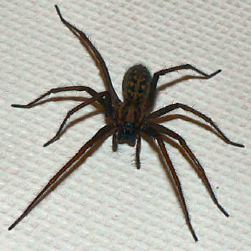
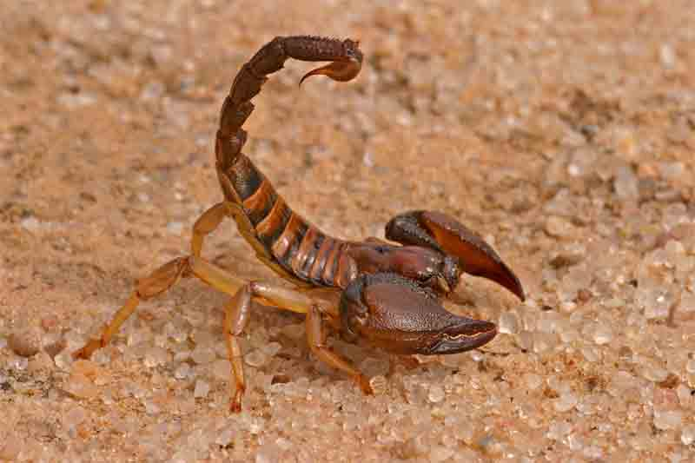
Class Arachnida
Spiders, scorpions, ticks and mites
Also have a fused cephalothorax but have 4 pairs of legs (an additional pair as mouth parts)
Use book lungs for breathing
Are all predators or parasites
Spider
Scorpion

Slide 18
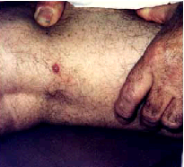
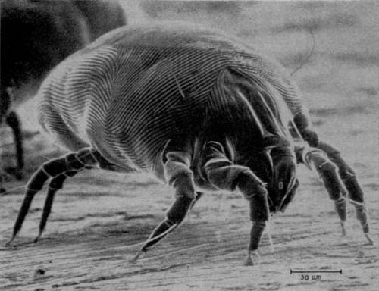
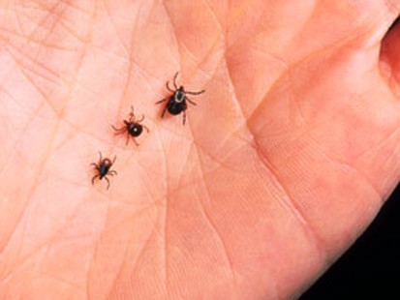
Class Arachnidia
Mites
Ticks

Slide 19
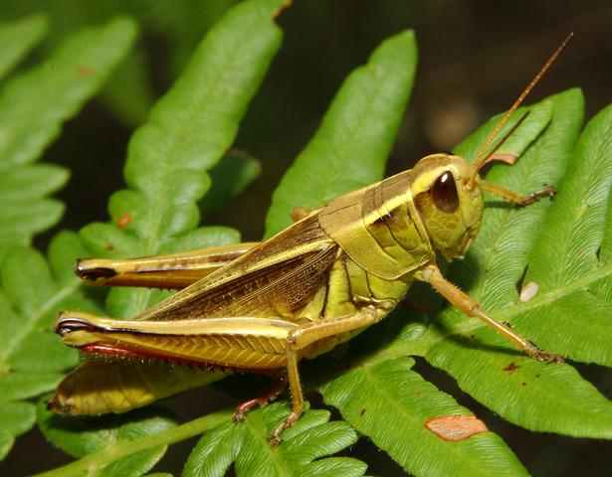
Class Insecta
Compose about 65% - 70% of the animal kingdom
Have three separate body regions and three pairs of legs
Only invertebrate capable of flight
Respiration with tracheal tubes, excretion by Malpighian Tubules

Slide 20
Why are the insects so successful??
1. Size: tiny to minute - don’t eat much, can hide
2. Exoskeleton: hard, yet great strength
3. Short life span - don’t eat much
4. Reproduction: all sexual - variation
5. Flight: many advantages
6. Specialized appendages: eat many things
7. Adaption of exoskeleton: camouflage etc
8. Well developed sensory ability
9. Evolved social behavior
10. Very specific niches: minimizes competition

