Slide 1
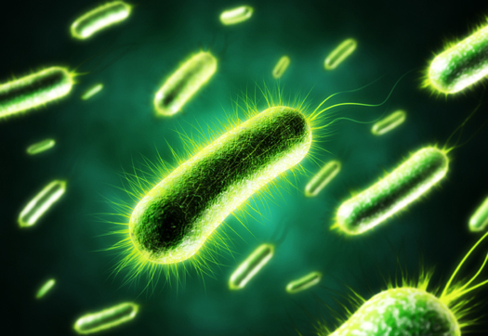
Life Sciences 11
Microbiology: Bacteria Basics

Slide 2
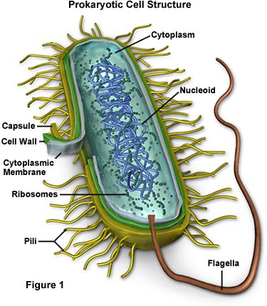
Objectives:
By the end of the lesson you should be able to:
State the classification of bacteria and why
Describe the structures of bacteria
Describe the form and arrangement of bacteria

Slide 3
Introduction
The prokaryotes are found almost everywhere on Earth - they live anywhere that life can physically survive
They are essential to life - their importance cannot be overestimated
They also cause some of our major diseases

Slide 4
Taxonomy
Recall that there are 3 domains:
Bacteria: prokaryotic cell; “regular” bacteria
Archaea: prokaryotic cell; ancient bacteria, live in extreme conditions
Eukarya: eukaryotic cells

Slide 5
Domain Bacteria Kingdom Eubacteria
Bacteria are very small cells; just visible with a light microscope
Clostridium tetani: causes tetanus!
One of the most potent biological toxins that affects humans

Slide 6
Kingdom Eubacteria
General structures:
A cell wall (not like a plant! It’s made out of peptidoglycan not cellulose!)
A plasma membrane (protective layer, decides what goes in/out)
Cytoplasm (“jelly”)
A free floating chromosome of DNA
Ribosomes (make proteins)

Slide 7
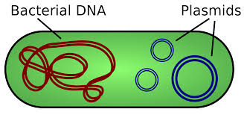
Other Structures: Plasmid
A small circular piece of DNA separate from the chromosomal DNA which can replicate independently and be transferred between bacterial cells.

Slide 8
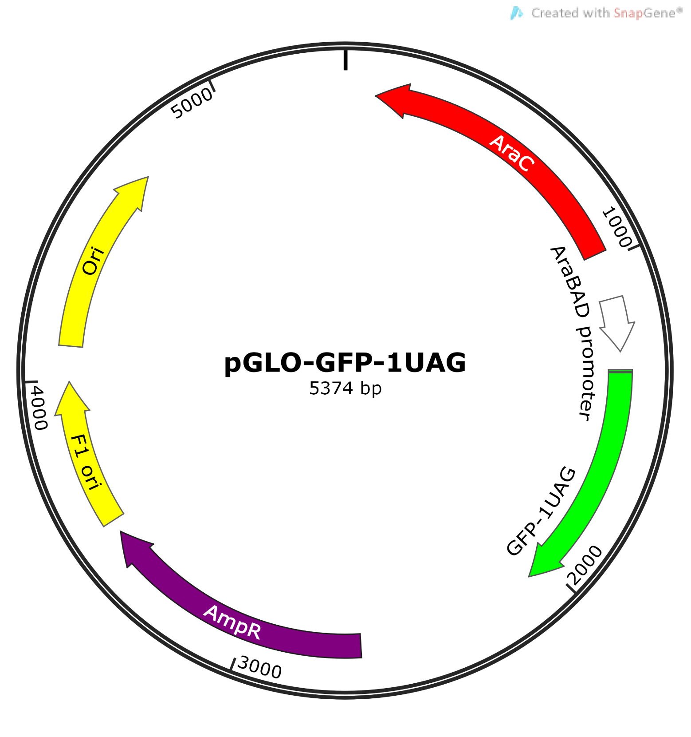

Slide 9
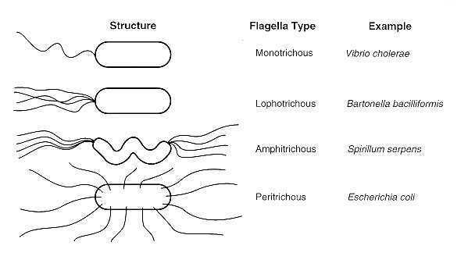
Other Structures: Flagella
Used for movement
Causes cholera
Causes a feverlike illness
Causes infections
Type of food poisoning

Slide 10
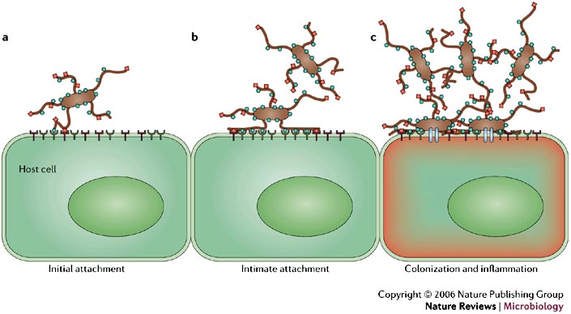
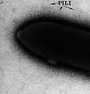
Other Structures: Pili
Used for attachment to solid surfaces, in transfer of DNA from one cell to another, small movements and cell-cell adhesion

Slide 11
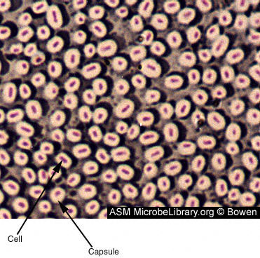
Other Structures: Capsule
These are non-protein thick protective coats outside of a bacteria cell

Slide 12
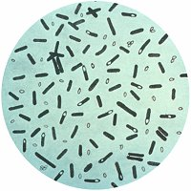
Other Structures: Endospores
Endospores are tough coated structures that contain a complete bacteria chromosome
Endospores can remain dormant waiting for more favourable growth conditions
Clostridium botulinum bacteria. The bacterium produces a nerve toxin that causes botulism.

Slide 13
They can tolerate extreme dryness.
Some cannot be killed even at subzero
temperatures and high heat.
Some can spread poisonous chemicals
Bacterial endospores are extremely resistant. Endospores of tetanus and anthrax, for example, can survive in the soil for many years. (1300 year old anthrax endospores can cause disease)
The wall breaks when favourable conditions return

Slide 14
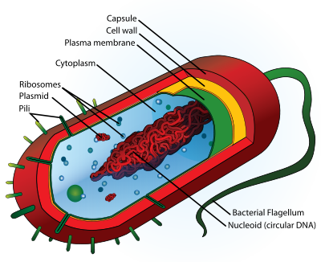
Typical Prokaryotic Cell

Slide 15
Form and Arrangement
Form: the shape of the bacteria
Arrangement: how the bacteria are arranged spatially

Slide 16
Forms and Arrangement
ARRANGEMENTS:
FORMS:
1. Coccus
Cell form (shape) is a sphere

Slide 17
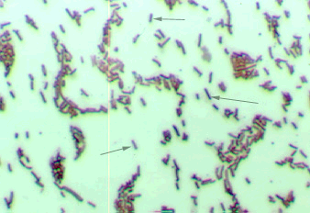
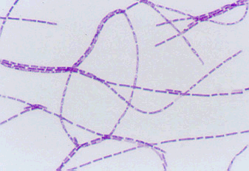
Forms
Rods
True Bacillus
2. Bacillus
Cells are longer than wide (rods); typically solo, in pairs or chains

Slide 18
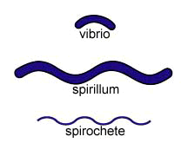
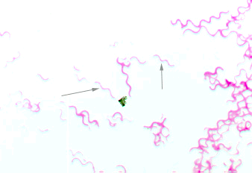
Forms
3. Spirillum
Longer than wide and curved
Most are pathogens and in a single arrangement

Slide 19
Bacteria Video

Slide 20
Can you …
… state the classification of bacteria and why?
… describe the structures of bacteria?
… describe the form and arrangement of bacteria?

