Slide 1
Life Sciences 11
Microbiology
Bacteria: The Details

Slide 2
Objectives
By the end of the lesson you should be able to:
Describe the difference between Gram positive and Gram negative bacteria
Describe how bacteria reproduce
Describe how bacteria eat
Describe the pros and cons of bacterial existence
Explain why and how bacterial resistance occurs

Slide 3
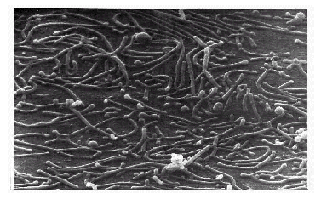
Types Of Bacteria
A) Gram Positive Bacteria
Have thin cell walls with lots of peptidoglycan
Susceptible to antibiotics; especially to Penicillin
Appear purple in Gram stains
Corynebacterium diptheria
Mycoplasma pneumonia

Slide 5
Types of Bacteria
B) Gram Negative Bacteria
Have thick walls with less peptidoglycan so are more resistant to antibiotics especially Penicillin.
Appear red or pink in Gram stain.
Penicillin, and other antibiotics, inhibit linkages between peptidoglycan molecules
Klebsiella pneumonia

Slide 8
Reproduction
Bacteria reproduce asexually via binary fission
However, bacteria can create new combination of genes through:
Transduction: genes introduced from viruses to bacteria
Conjugation: direct transfer of genes between bacteria
Transformation: genes taken up from environment

Slide 9
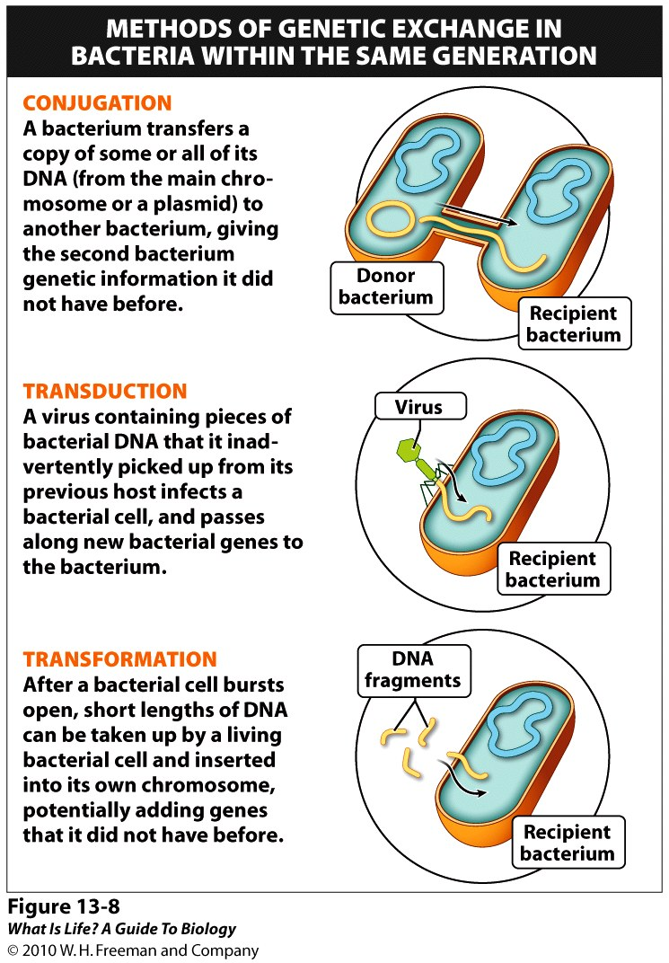

Slide 10
Modes of Nutrition
Prokaryotes need a carbon source and energy to survive.
Carbon source: - autotrophic (requires fixation of inorganic C source: CO₂)
- heterotrophic (requires organic C source: glucose)
Energy source: - phototrophic (from light)
- chemotrophic (from chemicals)

Slide 11
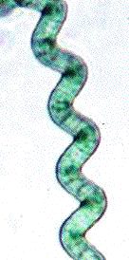
Modes of Nutrition
1. Autotrophic: Organisms that make their own food (require fixation of inorganic CO₂)
A) Photoautotrophs
photo = light, auto = self, troph = nourishment
Use light energy with CO2 to make organic
compounds (ex. Carbohydrates - glucose)
Ex. Cyanobacteria (blue-green algae)

Slide 12
Modes of Nutrition
B. Chemoautotrophs
Chemo = chemical, auto = self, troph = nourishment)
Use CO₂ as a carbon source and energy from inorganic molecules (instead of light) to make organic compounds (ex. Carbohydrates - glucose)
Examples include:
Using H₂S, sulfur fixing bacteria
Using NH₃, nitrogen fixing bacteria
Using CH₄, methane fixers
Using Fe⁺³, iron fixers.

Slide 13
Modes of Nutrition
2. Heterotrophic: organisms that don’t make their own food (require an organic carbon source - glucose)
Photoheterotrophs: require light energy to make ATP (cell usable energy) and an organic food source; very few prokaryotes do this!
photo = light, hetero = (an)other, troph = nourishment
Chemoheterotrophs: usually consume organic C (glucose) sources for energy and C; most widely used method by bacteria!
chemo = chemical, hetero = (an)other, troph = nourishment

Slide 14
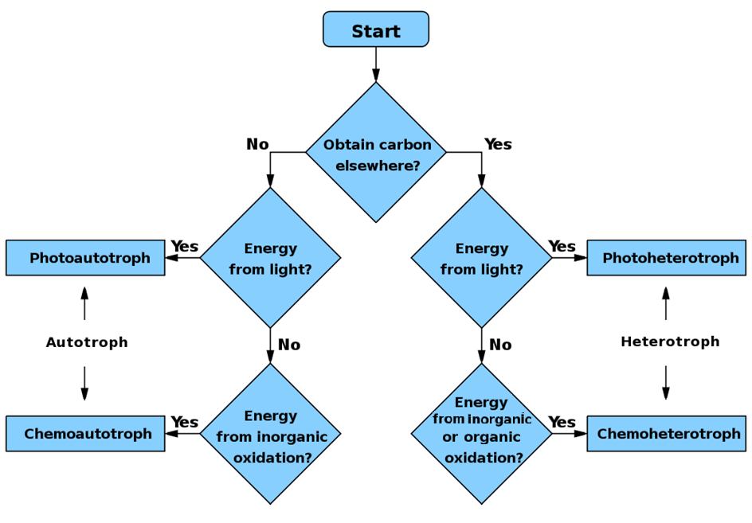
ie. Something besides CO₂ !

Slide 15
Complete the Chart!
Mode of Nutrition | Energy Source | Carbon Source | Types of Prokaryotes
Photoautotrophs | Light | CO2 | Cyanobacteria
Chemoautotrophs | Inorganic compounds | CO2 | Nitrogen fixing bacteria
Photoheterotrophs | Light | Organic compounds (such as glucose) | Few bacteria
Chemoheterotrophs | Organic or inorganic compounds | Organic compounds (such as glucose) | Most bacteria

Slide 16
Chemoheterotrophs and Oxygen
Believe it or not, but not all bacteria require O₂ to live!
Obligate Aerobes: require O₂ to grow and for cellular respiration
Facultative Anaerobes: will use O₂ if it’s present but can grow by fermentation (without O₂)
Obligate Anaerobes: poisoned by O₂! Grow by fermentation

Slide 17
Importance of Bacteria
Importance of bacteria can be divided into two categories from a human prospective: Pros and Cons
1. Beneficial Aspects (Pros)
Decomposition
Recycle Inorganic Nutrients
Industrial Uses
Part of animals first line of defense
Genetic research
2. Harmful Aspects (Cons)
Destruction of Food
Rotting Structures
Disease

Slide 18
Importance of Bacteria: Pros
A) Decomposition:
Breaking down dead organisms so the nutrients can be reabsorbed by other living organisms
B) Recycle Inorganic Nutrients
N₂ fixers are bacteria that convert atmospheric N₂ into nitrates which plants absorb and use to make proteins and nucleic acids
These bacteria often live in a symbiotic relationship with a plant in structures called root nodules.

Slide 19
Importance of Bacteria: Pros
C) Industrial Uses
a) Dairy Industry
b) Leather Production
c) Tobacco Curing
d) Antibiotics
D) Part of the first line of defense
Bacteria live in our skin, mouth, ears, etc
Bacteria also live in our gut

Slide 20
Importance of Bacteria: Pros
E) Genetic research
Bacteria are plentiful, cheap and reproduce very quickly - ideal for genetic studies
Used to figure out many biochemical pathways and basic patterns of gene control

Slide 21
Importance of Bacteria: Cons
A. Destruction of Food
Bacteria destroy up to 1/3 of all our food (one of our two main competitors)
We have learned to use technology to reduce bacteria food spoilage
B) Rotting Structures
Bacteria destroy many things we want preserved

Slide 22
Importance of Bacteria: Cons
C) Diseases: Bacteria can cause diseases in almost all life forms
Ex. Botulism
1 g of botulism toxin could kill one million people!
Other examples:
chills, fever, diarrhea, damage to circulatory system and sometimes fatal allergic reactions (salmonella, E.coli)

Slide 23
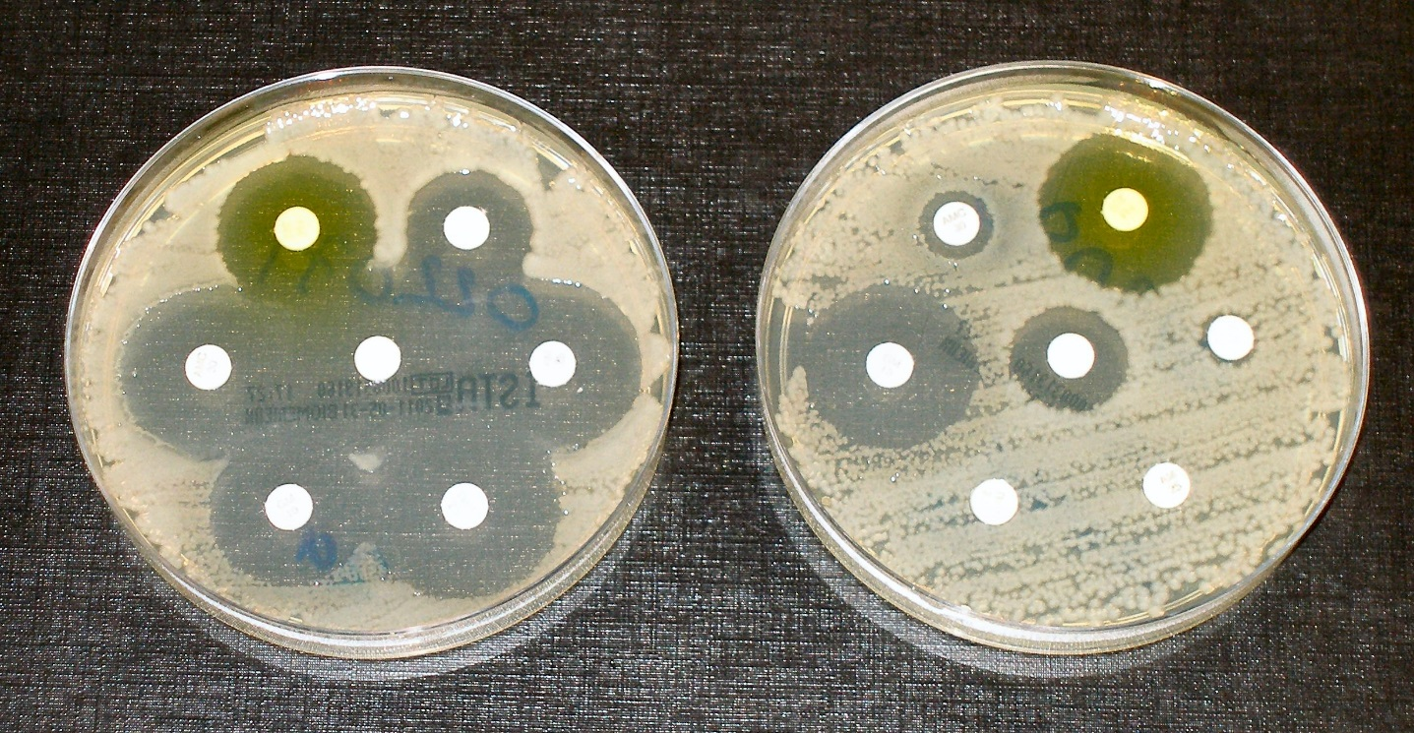
Bacterial Resistance
A classic example of evolution is unfolding today as we wage war against bacteria
Due to indiscriminant and excessive use of antibiotics, bacteria have developed an increasing resistance to antibiotics (HOW?)

