Slide 1
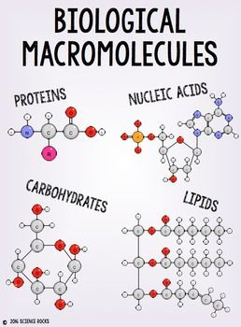
Biological Macromolecules
Cell Biology

Slide 2
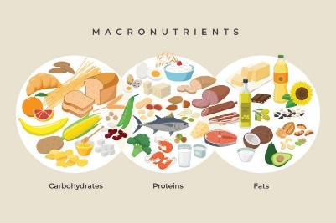
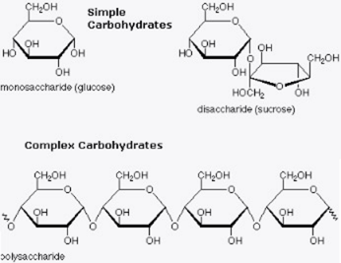
objectives
By the end of the lesson you should be able to:
Recognize the structure of the 4 molecules of life
State the function and give examples of the 4 molecules of life

Slide 3
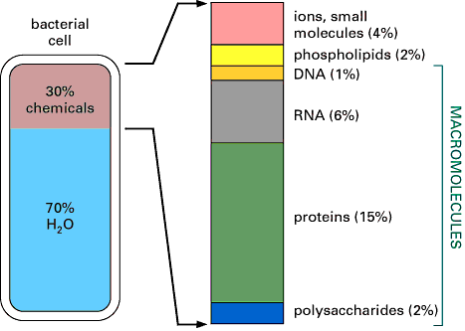
4 Molecules of Life
Besides water, a cell is mainly made up of 4 types of molecules
1. Carbohydrates
2. Lipids
3. Proteins
4. Nucleic Acids
These molecules are composed mostly of four elements: C, H, O, & N
Video – Biomolecules - You are what you eat!

Slide 4
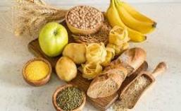
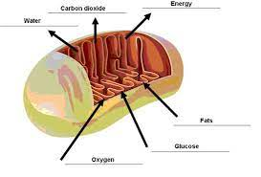
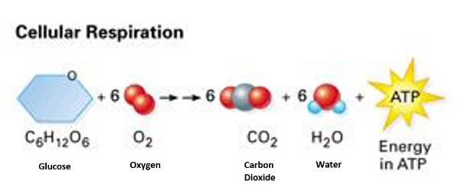
Carbohydrates
Carbohydrates are sugar molecules and are your main source of energy. You eat your carbs in the form of breads, cereals, rice, and pasta.
The mitochondria in your cells use the sugar for cellular respiration to make ATP. ATP is the cellular energy that all cells use.

Slide 5
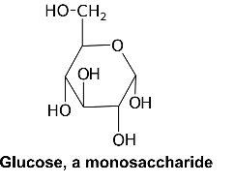
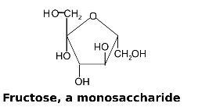
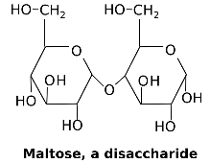
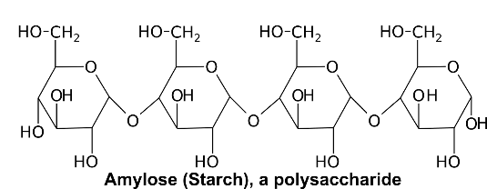
Carbohydrates are composed of the elements carbon (C), hydrogen (H), and oxygen (O).
They typically form 5 or 6 sided carbon rings.
There are 3 types of carbohydrates:
1. Monosaccharides
2. Disaccharides
3. Polysaccharides

Slide 6
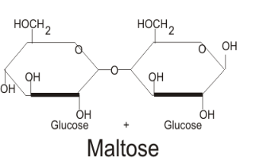
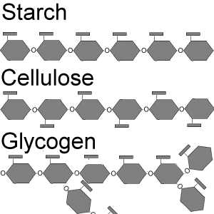
Monosaccharides are a single unit of sugar.
If two monosaccharides are combined together, the result is called a disaccharide
If there are many monosaccharides combined, the resulting molecule is a polysaccharide

Slide 7
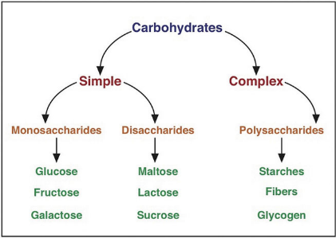
Examples of Carbohydrates
Monosaccharides: glucose, fructose, galactose
Disaccharides: sucrose, lactose, maltose
Polysaccharides: starch, chitin, glycogen, cellulose

Slide 8
Functions of carbohydrates
Simple monosaccharide sugars (such as glucose) and disaccharides (such as lactose) are used in cellular respiration to quickly make energy for cell in the form of ATP.
Polysaccharides are more complex sugars and have two main functions:
short term energy storage
structure

Slide 9
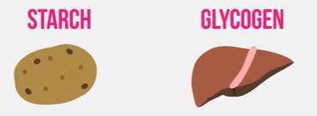
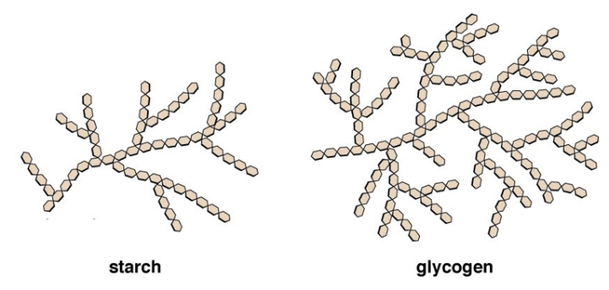
Starch and glycogen are examples of short-term energy storage polysaccharides.
They are made of long branching chains of glucose molecules which can be stored and saved for use in cellular respiration later.

Slide 10
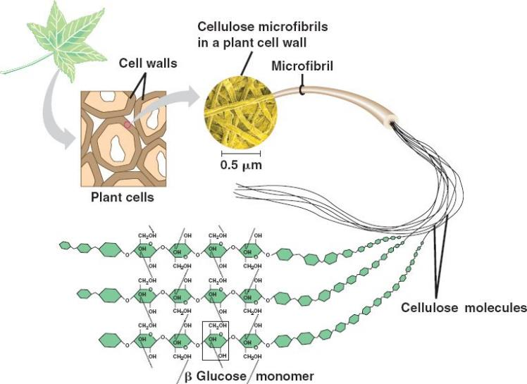
Cellulose is an example of a structural polysaccharide as it forms plant cell walls

Slide 11
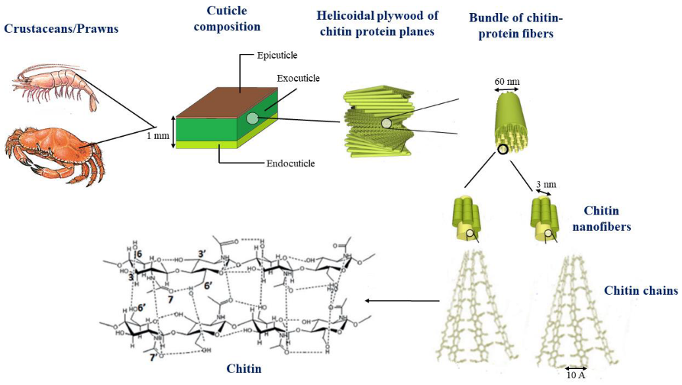
Chitin is an example of a structural polysaccharide as it forms fungus cell walls and arthropod exoskeletons

Slide 12
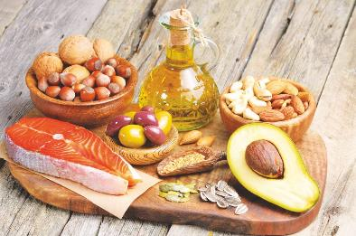
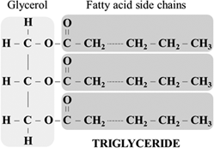
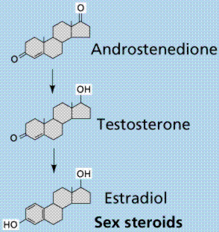
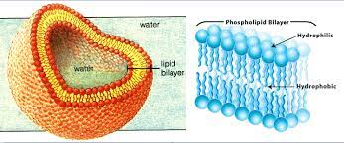
Lipids (Fats & Oils)
Lipids are fatty, waxy, or oily compounds that are insoluble in water. You eat your lipids in the form of butter, oils, cheese, meat fats, avocados, etc.
Lipids are used for long term energy storage, insulation, cell membranes, and sending signals through the body.

Slide 13
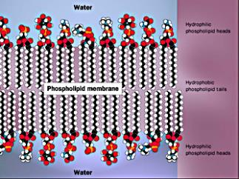
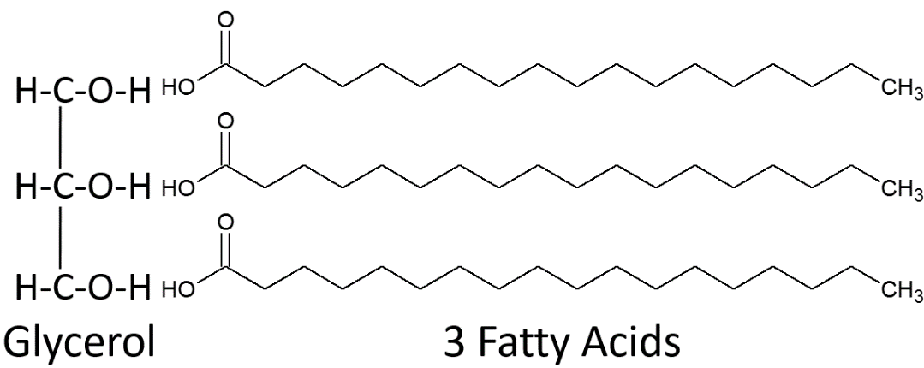
Lipids are composed of the elements C, H, and O.
There are 3 main types of lipids:
1. Triglycerides: long term energy storage, insulation (blubber) → fat!
2. Phospholipids: used to make cell membranes
3. Steroids: hormones (signaling molecules)

Slide 15
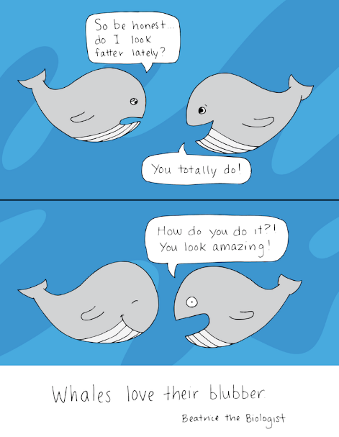
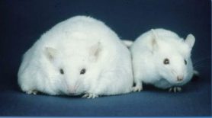

Slide 16
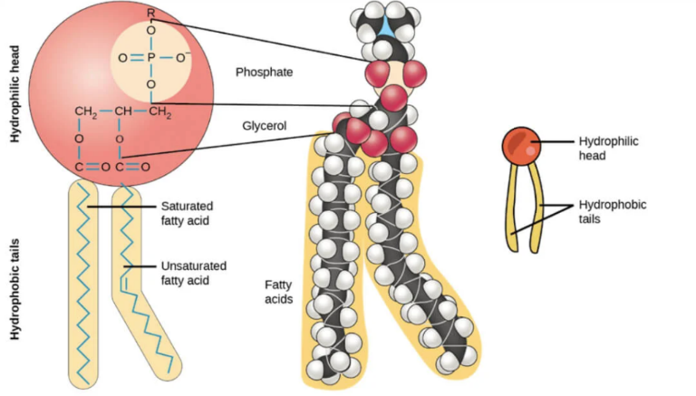
Phospholipids have a glycerol structure attached to two fatty acid tails and the one phosphate head

Slide 17
One end of the phospholipid is attracted to water (hydrophilic) and the other end is repelled by water (hydrophobic). This causes phospholipids to automatically form a spherical bilayer when placed in water.

Slide 18
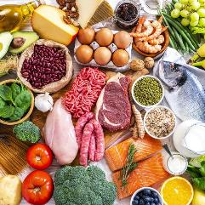
Proteins
Proteins are building blocks for muscle, skin, hair, bones, cell structures, enzymes, immune system (antibodies), and are responsible for the majority of functions of cells in the body. You eat your proteins in the form of meats, eggs, nuts, beans, etc.
Proteins are primarily made up of the elements C, H, O, and nitrogen (N).
Proteins are made up of smaller units called amino acids.
Amino acids are located in the cytoplasm (jelly) of the cell.
*** important for later ****

Slide 19
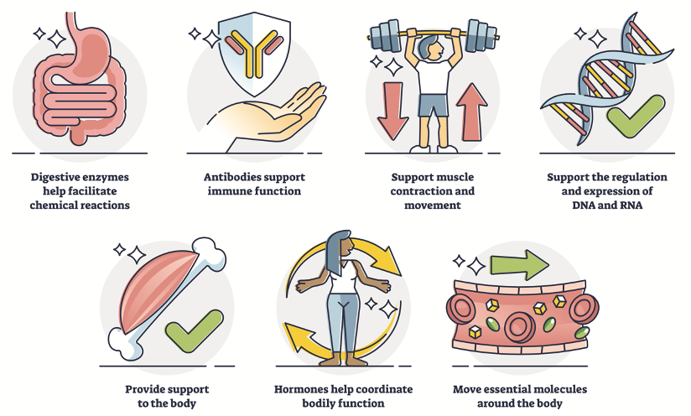

Slide 20
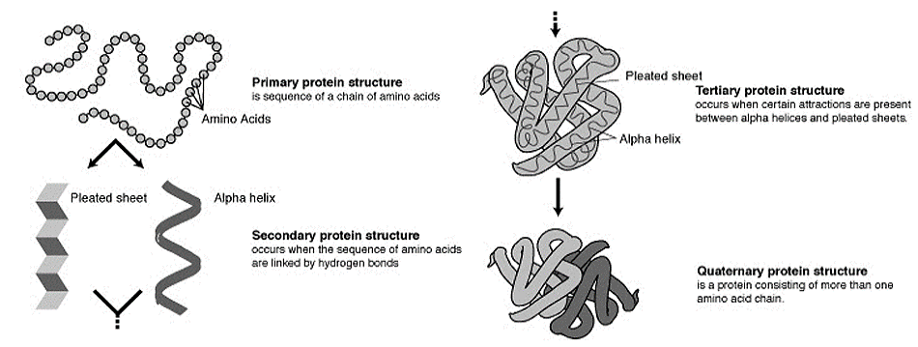
The amino acids link together to form a chain
These long chains of amino acids fold up in a very specific way
The difference between proteins is the sequence of the amino acids and how they are folded up

Slide 21
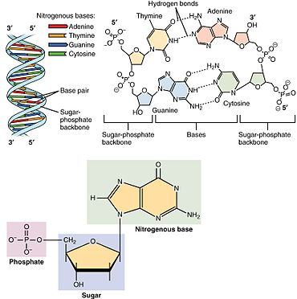
Nucleic Acids
Nucleic acids contain genetic information. Nucleic acids are found in all living things so fruit, vegetables, meats, etc. are good sources of nucleic acids.
Nucleic acids are made of C, H, O, N, and phosphorus (P).
There are two types of nucleic acids used for heredity: DNA and RNA

Slide 22
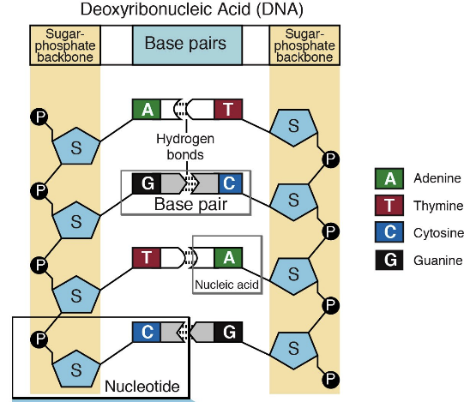
A nucleic acid is made up of small molecules called nucleotides which include a base (ACTG&U), a sugar and phosphate group
Nucleotides are found inside the nucleus of a cell in the nucleoplasm

Slide 23
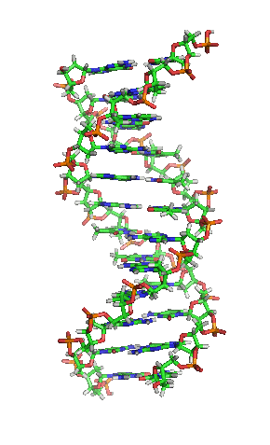
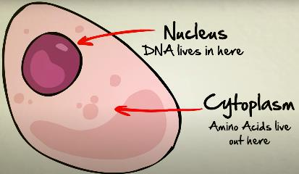
Deoxyribonucleic Acid (DNA) is the largest molecule on earth!
DNA contains all the genetic information (a recipe) to build a living organism
DNA is found in the nucleus (*** remember for later ***) and is twisted into a double helix

Slide 24
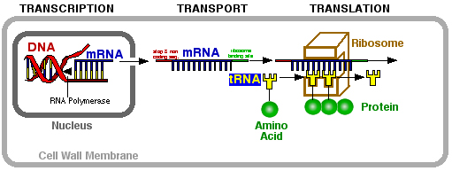
Ribonucleic Acid (RNA): there are 3 main types
1. Messenger RNA (mRNA) a copy of one gene from the DNA that exits the nucleus
2. Transfer RNA (tRNA) (grade 12)
3. Ribosomal RNA (rRNA) (grade 12 - makes ribosomes)
All are single stranded and help DNA make proteins
Has a U base instead of the T base
Video – DNA Stated Clearly

Slide 25
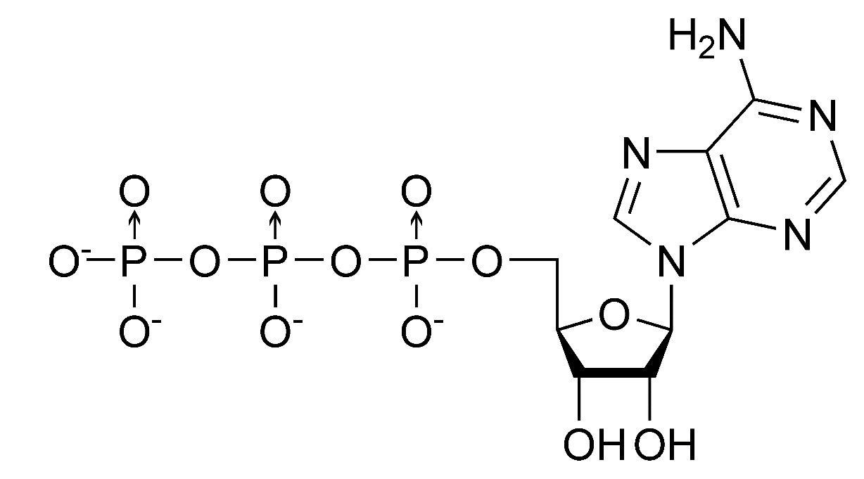
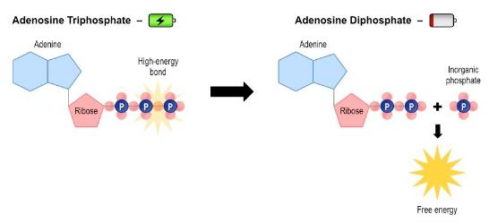
Adenosine Triphosphate (ATP) video
This is the energy molecule of life and acts like a rechargeable battery that cells can use.
There are 3 phosphate molecules bonded together
The last two have a lot of energy stored in their bonds

Slide 26
DNA Technology
Is DNA the Future of Data Storage? Ted Ed
We Could Back Up The Entire Internet On A Gram Of DNA
Is DNA the Future of Data Storage? Pretty Sweet
Genetic Engineering Will Change Everything Forever – CRISPR

Slide 27
Can You …
… recognize the structure of the 4 molecules of life?
… state the function and give examples of the 4 biological macromolecules?

