Slide 1
Biomolecules

Slide 2
Either play against your shoulder partner one vs one, or play against a group in front/behind you two vs two
Each question is worth either 1 or 2 points. If you write the correct answer, add the points. If you do not write the correct answer, you receive zero points.
Keep track of your own score. Be honest, and good luck!

Slide 3
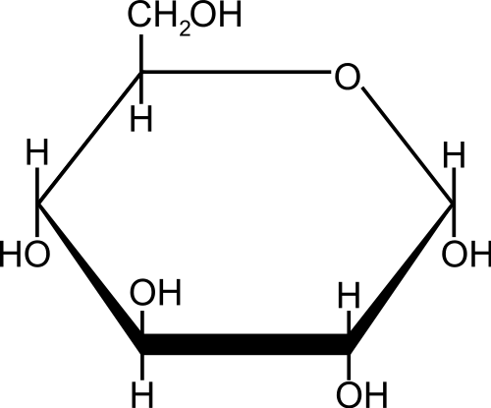
Carbohydrate
Monosaccharide
Glucose
1 point

Slide 4
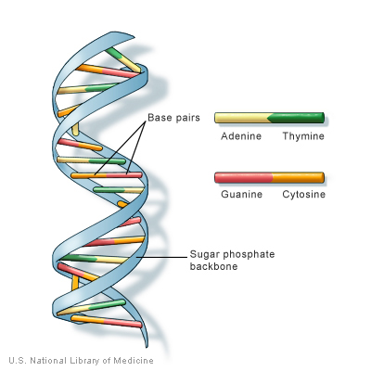
Nucleic Acid
DNA
1 point

Slide 5
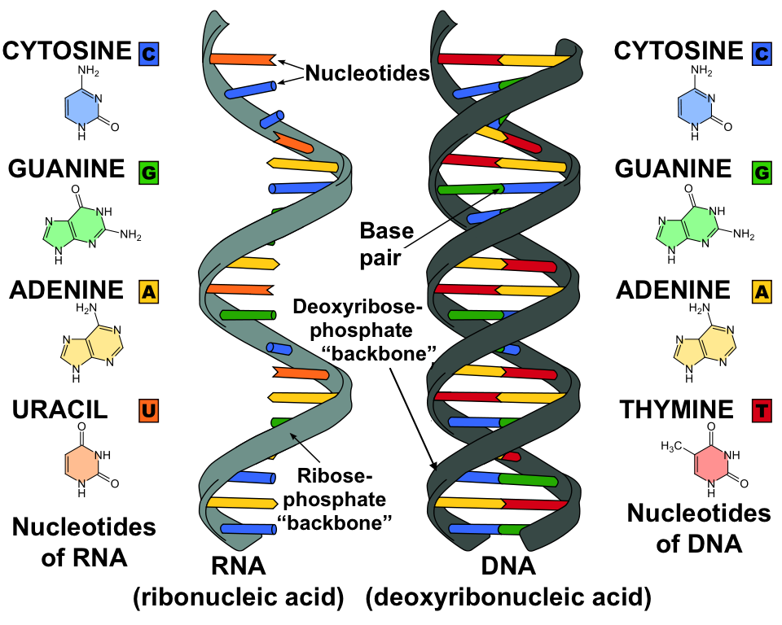
Nucleic Acids
Left – RNA
Right – DNA
1 point

Slide 6
Nucleic acid
Nucleotide monomer
1 point

Slide 7
Nucleic Acid
DNA
1 point

Slide 8
C, H, O, N
Protein
1 point

Slide 9
C, H, O, N, P
Nucleic Acid
1 point

Slide 10
Nucleic Acid
1 point

Slide 11
Carbohydrate
Disaccharide
1 point

Slide 12
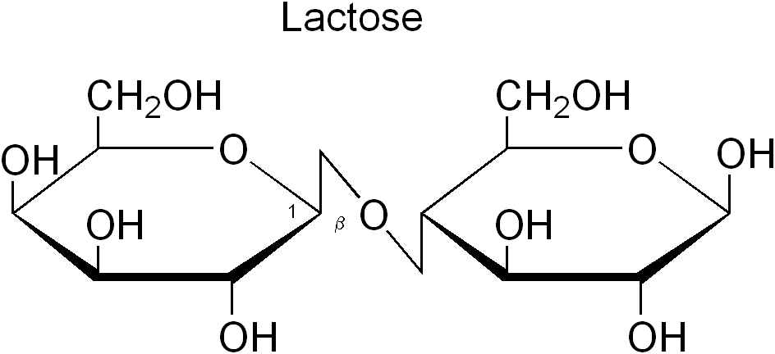
Carbohydrate
Disaccharide
1 point

Slide 13
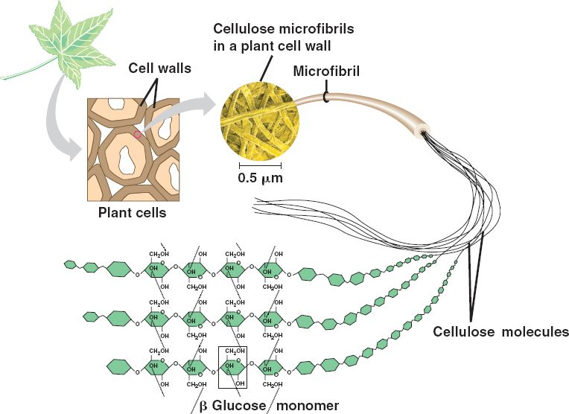
Carbohydrate
polysaccharide
cellulose
1 point

Slide 14
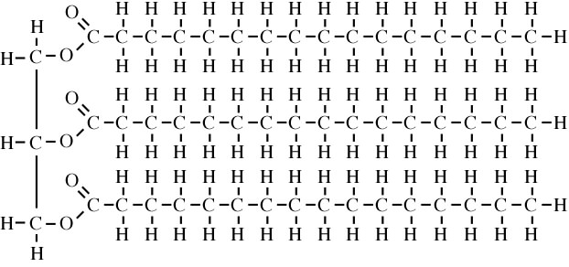
Lipid
Triglyceride
1 point

Slide 15
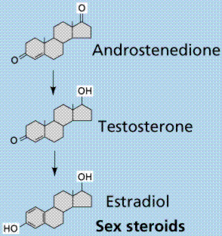
Lipid
Steroids
1 point

Slide 16
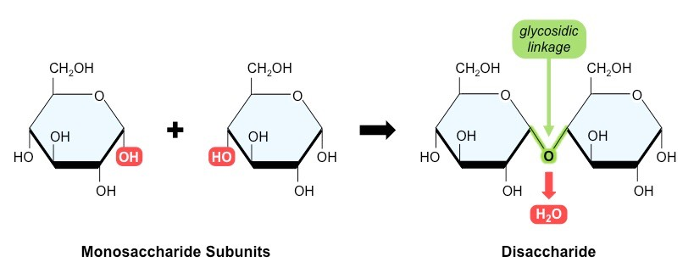
Carbohydrate
Monosaccharides
combining to make
a disaccharide
1 point

Slide 17
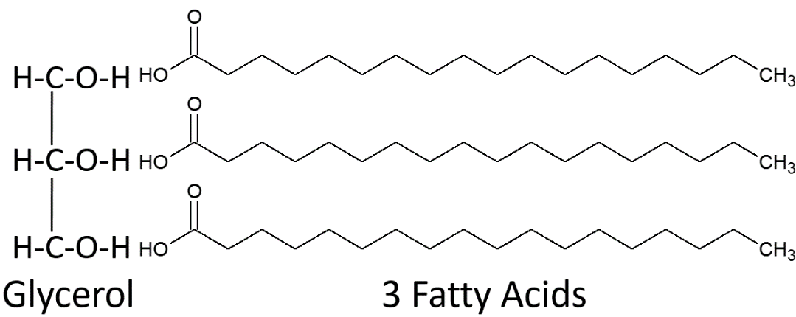
Lipid
Triglyceride
1 point

Slide 18
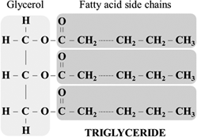
Lipid
Triglyceride
1 point

Slide 19
Lipid
Steroids
1 point

Slide 20
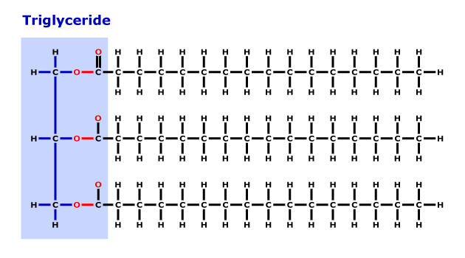
Lipid
Triglyceride
1 point

Slide 21
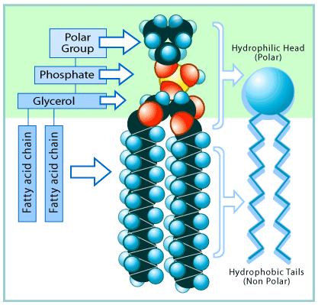
Lipid
Phospholipid
1 point

Slide 22
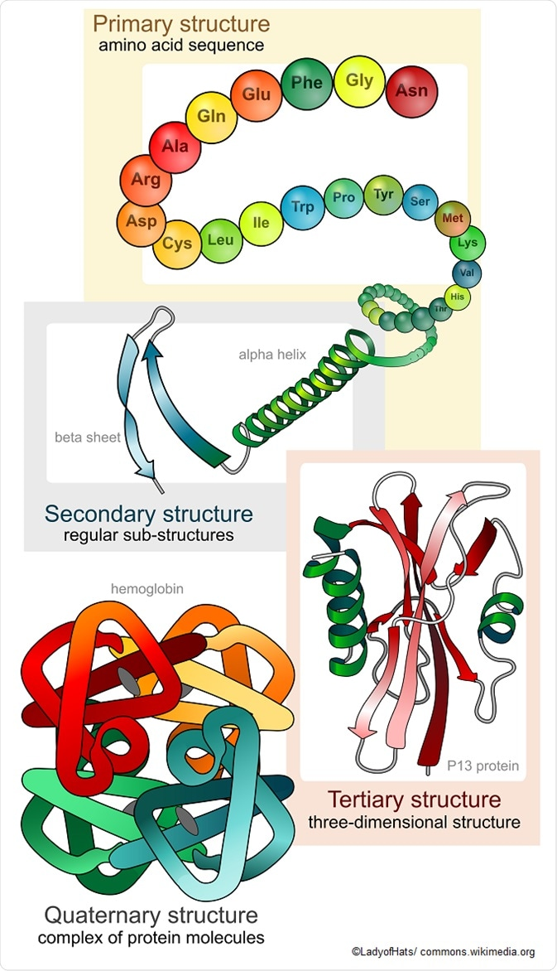
Protein
Amino acid
monomers
1 point

Slide 23
Protein
Amino acid
monomers
1 point

Slide 24
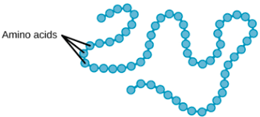
Protein
Amino acid
Monomers
Primary Structure
1 point

Slide 25
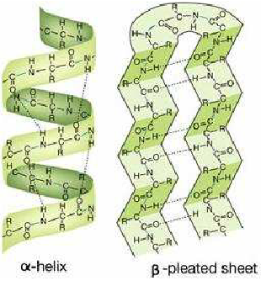
Protein
Amino acid
Monomers
Secondary Structure
1 point

Slide 26
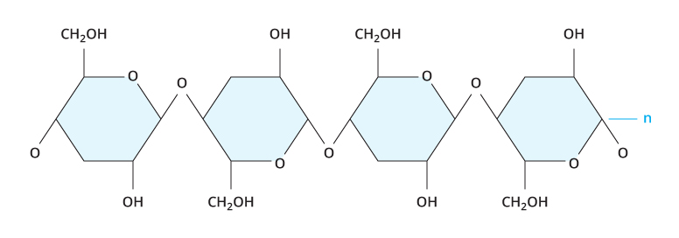
Carbohydrate
Polysaccharide
1 point

Slide 27
Used for short term energy
Carbohydrate
1 point

Slide 28
Used in the mitochondria to produce ATP during cellular respiration
Carbohydrate
(glucose)
1 point

Slide 29
Used to make cell walls of plants
Carbohydrate
Polysaccharide
Cellulose
1 point

Slide 30
Building blocks (monomers) of nucleic acids
Nucleotides
1 point

Slide 31
Building blocks (monomers) of carbohydrates
monosaccharides
1 point

Slide 32
Used for insulation such as blubber
Lipids
1 point

Slide 33
Building blocks (monomers) of proteins
Amino acids
1 point

Slide 34
Used in the immune system such as antibodies
Proteins
1 point

Slide 35
Used to make cell membranes
Lipids – Specifically
phospholipids
1 point

