Slide 1
Biology 11
Cell Processes

Slide 2
Objectives
By the end of the lesson you should be able to:
Describe Protein Synthesis
Compare and contrast the processes of mitosis and meiosis
Compare and contrast diffusion and osmosis

Slide 3
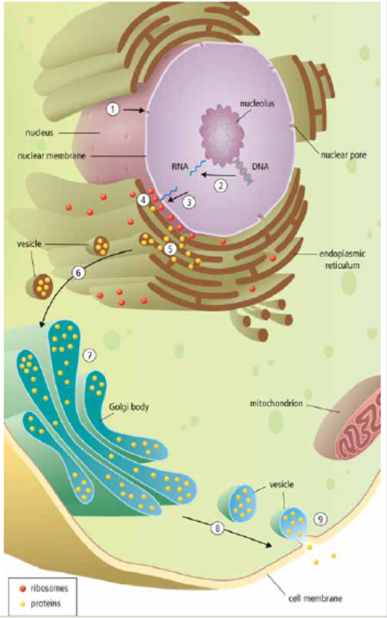
Protein Synthesis
The nucleus receives a chemical signal to make a specific protein
The DNA message for a specific protein is copied into a small molecule called ribonucleic acid or RNA
RNA leaves through a nuclear pore
The RNA message is delivered to the ribosome, where the protein is made

Slide 4
Protein Synthesis cont’d
The manufactured protein enters the ER
A vesicle forms off the end of the ER and carries the vesicle to Golgi body
Golgi repackages the protein for transport
A vesicle forms off the end of Golgi and moves to cell membrane
The vesicle attached to cell membrane and is released out of the cell.

Slide 5
Cell Reproduction
MITOSIS
MEIOSIS
Body cells
Growth and repair
Creates 2 identical cells
Daughter cells are identical to parent
Sex cells
Makes gametes
Creates 4 genetically different cells
Daughter cells are genetically different to parent

Slide 6
Cell Reproduction
MITOSIS
A 2N diploid cell (contains two copies of each chromosome – one from each parent) will divide to form two identical diploid (2N) cells.
MEIOSIS
A 2N diploid cell (contains two copies of each chromosome – one from each parent) will divide to form four different N haploid cells (half as many of the original number of chromosomes)

Slide 7
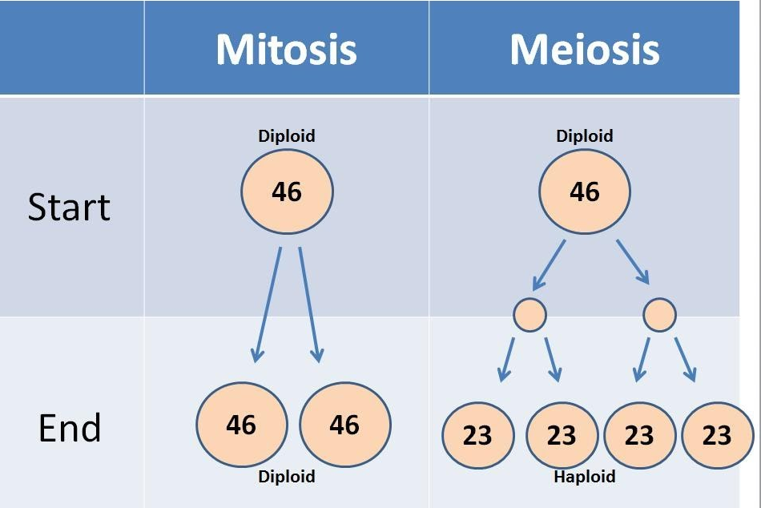

Slide 8
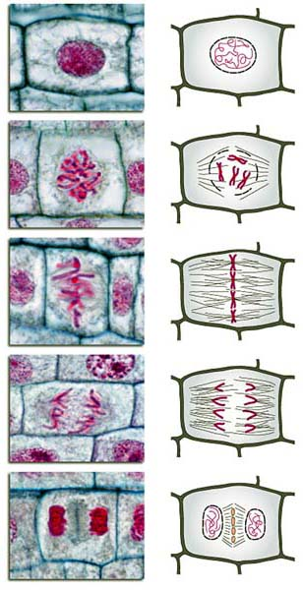
Mitosis Steps
Interphase
Prophase
Metaphase
Anaphase
Telophase
Cytokinesis
I Picked Many Apples Today Check it out.
Mitosis Crash Course!

Slide 9
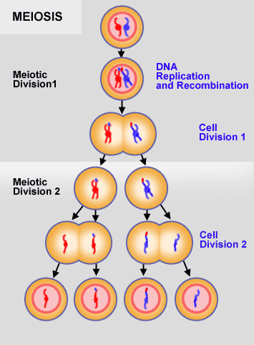
Meiosis
I
PI
MI
AI
TI
IK
PII
MII
AII
TII
C

Slide 10
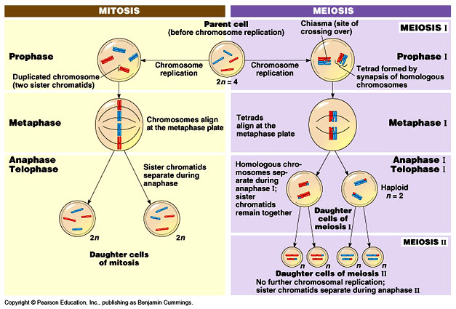
Mitosis Vs Meiosis

Slide 11
Meiosis
Crash Course Video

Slide 12
Diffusion and Osmosis
Diffusion
Movement of PARTICLES from an area of high concentration to an area of low concentration
Osmosis
Movement of WATER from an area of high concentration to an area of low concentration

Slide 13
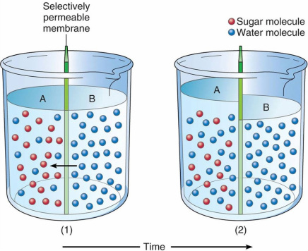
Selectively Permeable Membrane
Cell membranes are selectively permeable – they select what is able to cross them
Water is able to cross membranes while many solutes (particles dissolved in solution such as sugar) do not cross freely
This leads to osmosis, the
diffusion of water

Slide 14
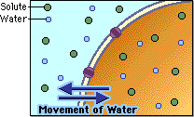
Osmosis Details
Isotonic: equal concentration of water inside and outside the cell
the concentration of the solute is equal on both sides of the cell membrane
No net gain of water into or out of the cell

Slide 15
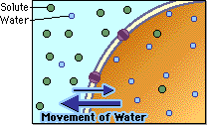
Osmosis Details
Hypertonic: higher concentration of water inside the cell
the concentration of the solute is higher outside of the cell (solution)
Water moves out of the cell; the cell shrinks

Slide 16
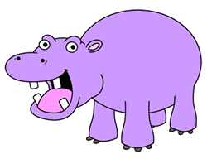
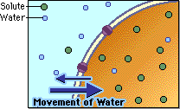
Osmosis Details
Hypotonic: lower concentration of water inside the cell
the concentration of the solute is lower on the outside of the cell (solution)
so water moves into the cell; the cell swells (if too much it can burst! → LYSIS!)

Slide 17
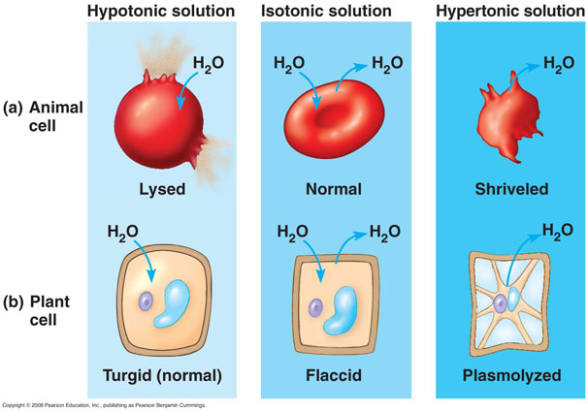

Slide 18
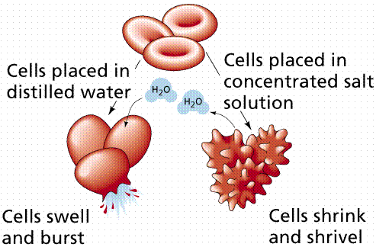

Slide 19
Diffusion and Osmosis
Crash Course Video

