Slide 1
Life Sciences 11
Cell Processes

Slide 2
Objectives
By the end of the lesson you should be able to:
Describe Protein Synthesis
Compare and contrast diffusion and osmosis
Compare and contrast the processes of mitosis and meiosis

Slide 3
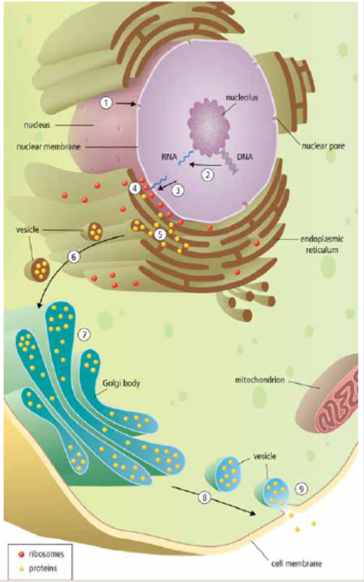
Protein Synthesis
The nucleus receives a chemical signal to make a specific protein
The DNA message for a specific protein is copied (TRANSCRIPTION) into a small molecule called ribonucleic acid or RNA
RNA leaves through a nuclear pore
The RNA message is delivered to the ribosome, where the protein is made (TRANSLATION)

Slide 4
Protein Synthesis cont’d
The manufactured protein enters the ER
A vesicle forms off the end of the ER and carries the vesicle to Golgi body
Golgi repackages the protein for transport
A vesicle forms off the end of Golgi and moves to cell membrane
The vesicle attached to cell membrane and is released out of the cell.

Slide 5
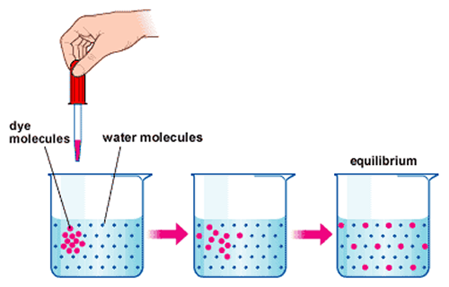
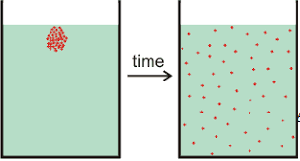
Diffusion and Osmosis
Diffusion
Movement of PARTICLES from an area of high concentration to an area of low concentration

Slide 6
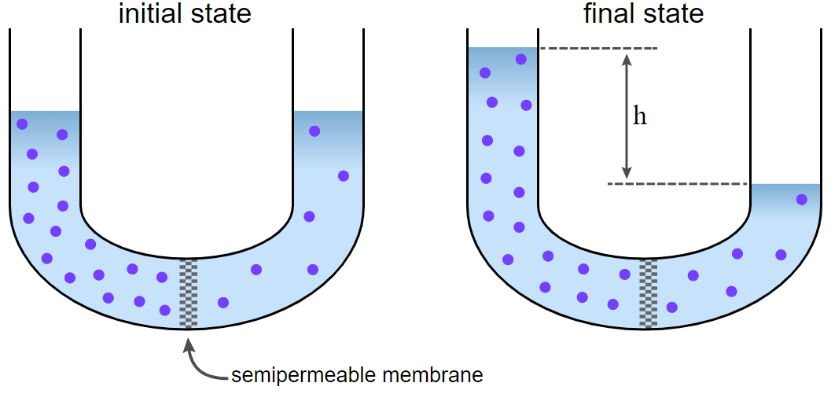
Diffusion and Osmosis
Osmosis
Movement of WATER from an area of high concentration to an area of low concentration

Slide 7
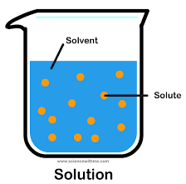
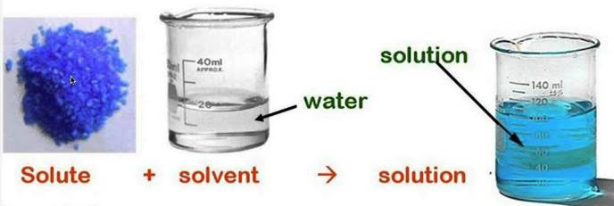
Useful Terms
Solution: mixture of one or more substances evenly distributed in another substance
Solute: substance dissolved in a solution
Solvent: substance in which the solute is dissolved

Slide 8
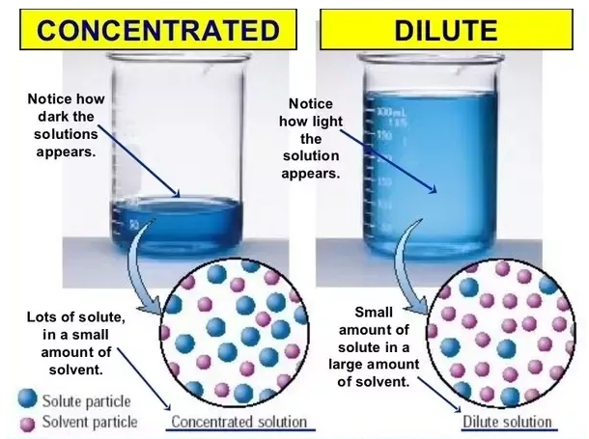
Useful Terms
Concentration: the amount of solute dissolved in the solution

Slide 9
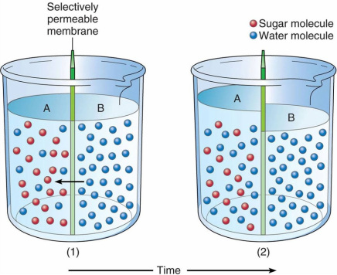
Selectively Permeable Membrane
Cell membranes are selectively permeable – they select what is able to cross them
Water is able to cross membranes while many solutes, such as sugar or salt, do not cross freely
This leads to osmosis, the diffusion of water

Slide 10
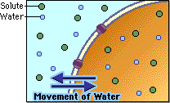
Osmosis Details
Isotonic Solution: equal concentration of solute in the solution compared to the cell
the concentration of water is equal on both sides of the cell membrane
No net gain of water into or out of the cell

Slide 11
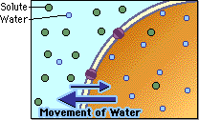
Osmosis Details
Hypertonic Solution: higher concentration of solute in the solution compared to the cell
the concentration of water inside the cell is greater than outside (solution) of the cell
Water moves out of the cell; the cell shrinks

Slide 12
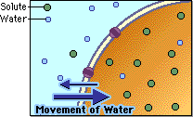
Osmosis Details
Hypotonic Solution: lower concentration of solute in the solution compared to the cell
the concentration of water outside (solution) the cell is greater than inside the cell
so water moves into the cell; the cell swells (if too much it can burst! → LYSIS!)

Slide 13
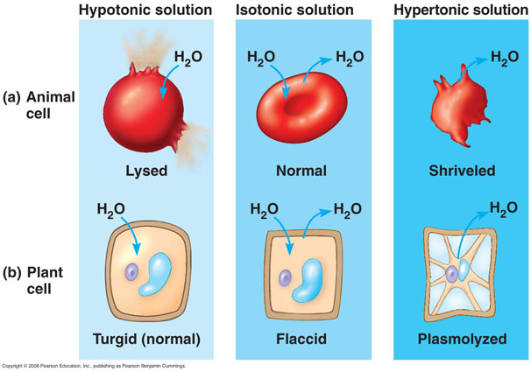

Slide 14
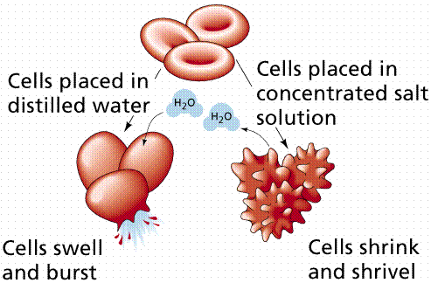

Slide 15
Diffusion and Osmosis
Crash Course Video

Slide 16
Cell Reproduction
MITOSIS
MEIOSIS
Body cells
Growth and repair
Creates 2 identical cells
Daughter cells are identical to parent
Sex cells
Makes gametes
Creates 4 genetically different cells
Daughter cells are genetically different to parent

Slide 17
Cell Reproduction
MITOSIS
A 2N diploid cell (contains two copies of each chromosome – one from each parent) will divide to form two identical diploid (2N) cells.
MEIOSIS
A 2N diploid cell (contains two copies of each chromosome – one from each parent) will divide to form four different N haploid cells (half as many of the original number of chromosomes)

Slide 18
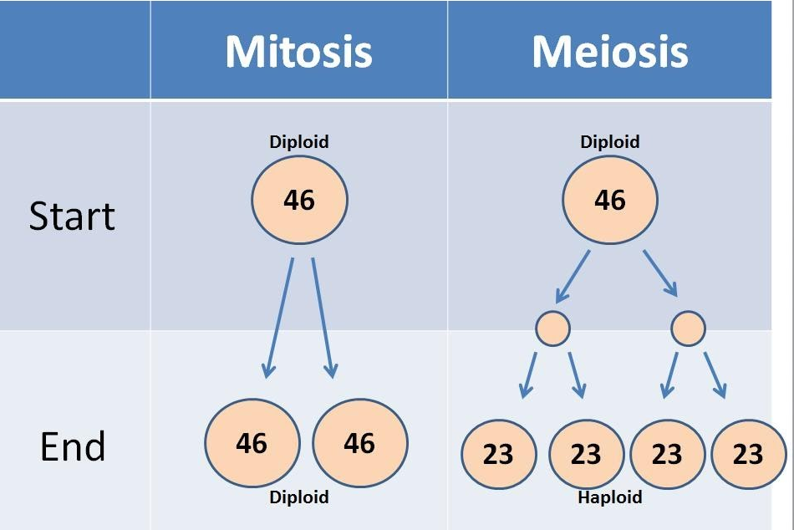

Slide 19
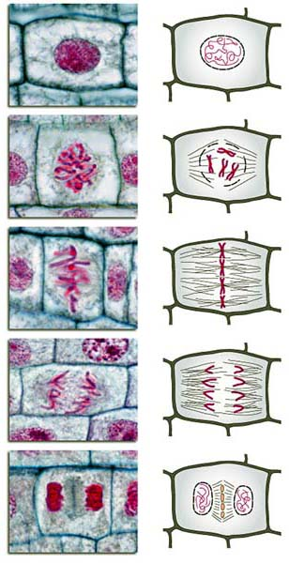
Mitosis Steps
Interphase
Prophase
Metaphase
Anaphase
Telophase
Cytokinesis
I Picked Many Apples Today Check it out.
Mitosis Crash Course!

Slide 20
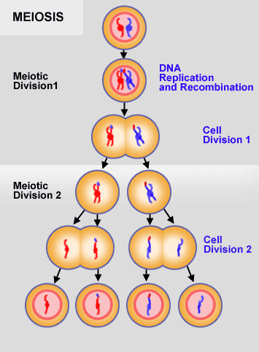
Meiosis
I
PI
MI
AI
TI
IK
PII
MII
AII
TII
C

Slide 21
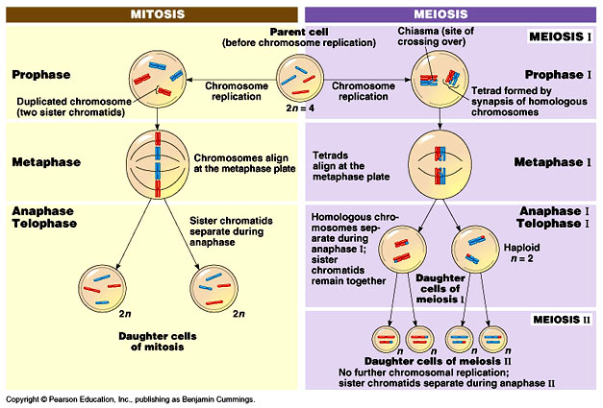
Mitosis Vs Meiosis video

Slide 22
Meiosis
Crash Course Video

Slide 23
Can You …
… describe protein synthesis?
… compare and contrast diffusion and osmosis?
… compare and contrast the processes of mitosis and meiosis?

