Slide 1
Biology 11
Kingdom Animalia
Cnidaria
The Stingers

Slide 2
Cnidaria Objectives
Advances over sponges
General body plan of medusa and polyp
General life cycle
Dominant stages in 3 classes

Slide 3
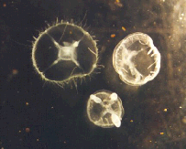
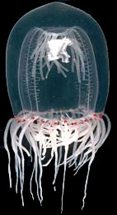
Phylum Cnidaria
Characteristics and Advances:
1. Have true tissues
→ Diploblastic!
2. Radial Symmetry
3. Have a nerve net nervous system (statocysts – balance receptor and ocelli – simple eye)
4. Incomplete digestive system

Slide 4
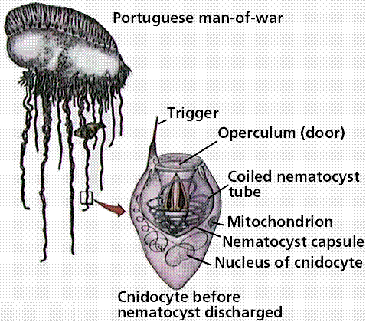
Phylum Cnidaria
5. Show “Alternation of Generations” with a polyp and medusa stage
6. Contain Cnidocytes (nematocysts)
7. Are all predators
8. Reproduce asexually by budding and sexually by motile gametes
9. Found in both fresh and salt water

Slide 5
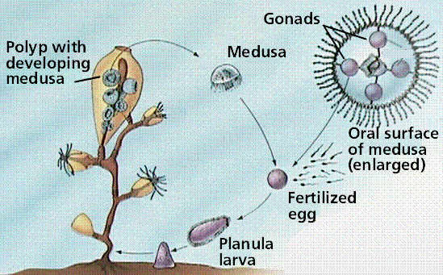
General Cnidarian Life Cycle

Slide 6
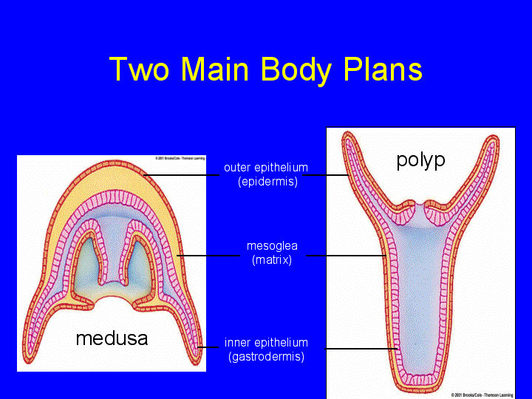

Slide 7
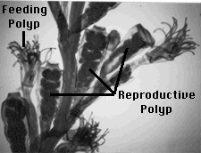
Phylum Cnidaria
Class Hydrozoa
Polyp stage is dominant
Medusa is used for species dispersal
Examples: Hydra sp. and Obelia sp.

Slide 8
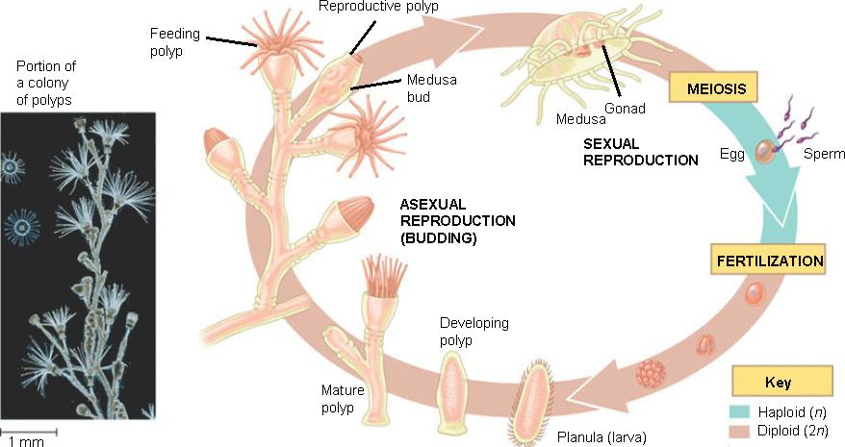
Obelia Life Cycle

Slide 9
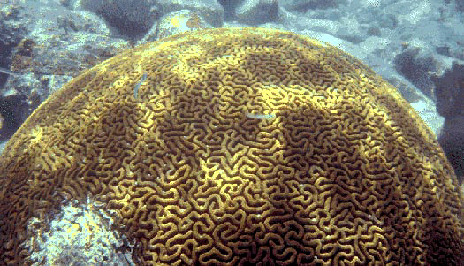
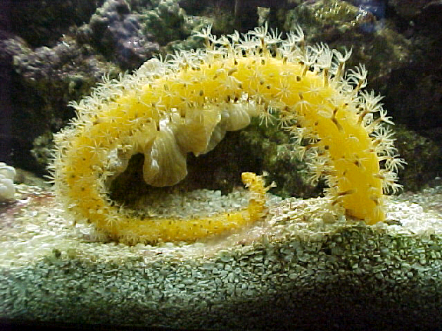
Phylum Cnidaria
Brain coral
Class Anthozoa
Generally have polyp stage only
Include: anemones, corals and sea pens
Sea Pen
Sea Anemone

Slide 10
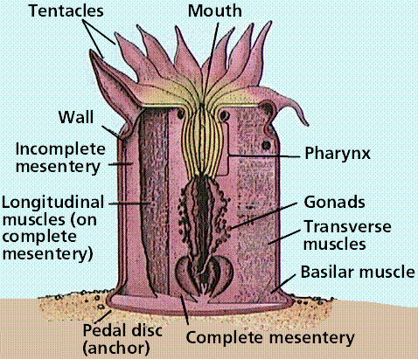
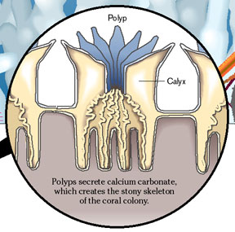
Coral Body Plan:

Slide 11
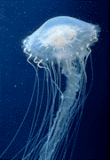
Phylum Cnidaria
Class Scyphozoa
Medusa stage is dominant
Includes the jellies

Slide 12
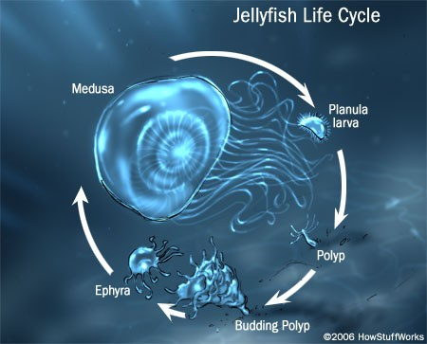

Slide 13
Hank Video
Video Link

