Slide 1
Biology 11
Kingdom Animalia
Phylum Echinodermata
The Spiny Skins

Slide 2
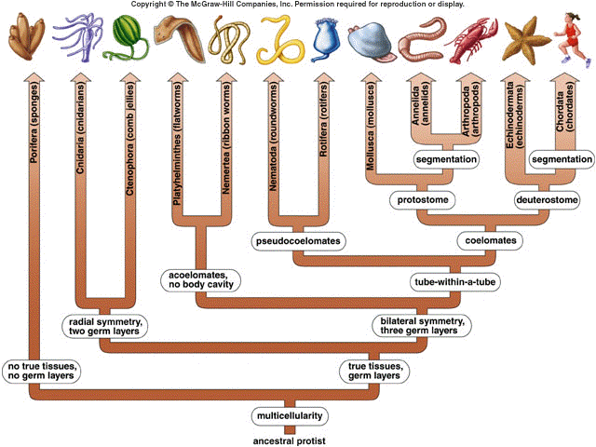

Slide 3
Objectives
How echinoderms are more advanced than arthropods
Defining characteristics of echinoderms
5 classes and example organisms
The body plan and systems of a seastar

Slide 4
Deuterostomes
We now move to the other great branch of animal evolution; the deuterostomes
This branch is dominated by the vertebrates which we will study next
The other phylum of deuterostomes seems a strange evolutionary mate for the vertebrates
They are the Echinoderms

Slide 6
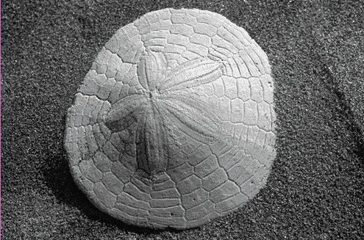
Phylum Echinodermata
“Spiny skinned animals”
Characteristics:
1. Exclusively marine
2. Semi flexible endoskeleton of calcarious plates
3. Show pentaradial symmetry where all structures are in 5’s (as seen in this sand dollar).
4. Reproduction mostly sexual but good powers of regeneration.

Slide 7
Phylum Echinodermata
5. Unique system called “water vascular” system, used for movement, feeding, and respiration
6. Externally shows as tube feet which are used to move, and in hunting
7. Contains 5 classes:
- Class Asteroidea
- Class Echinoidea
- Class Holothuroidea
- Class Ophiuroidea
- Class Crinoidea

Slide 8
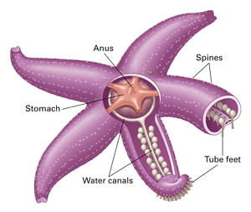
General External Anatomy

Slide 9
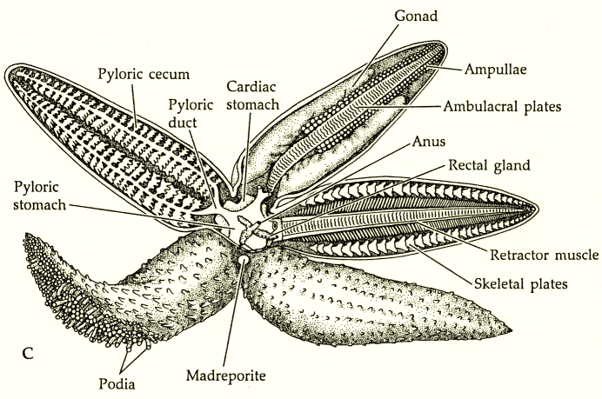
General Internal Anatomy

Slide 10
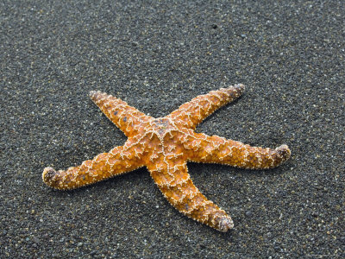
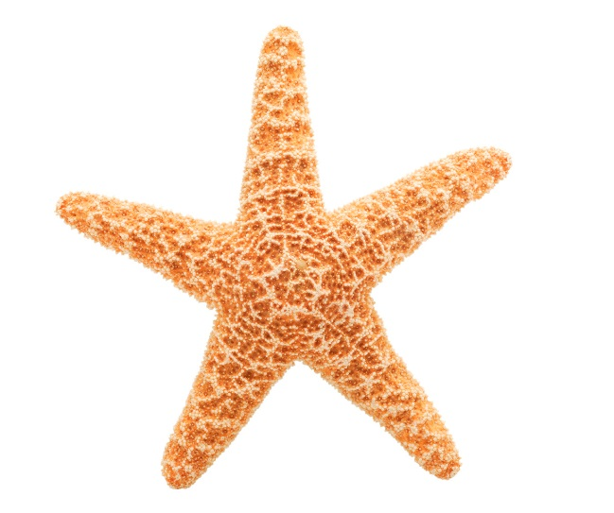
Class Asteroidea: Sea stars
Greek asteroeides, starlike
Flattened body with penta-radial symmetry
Mostly carnivorous
Good powers of regeneration

Slide 11
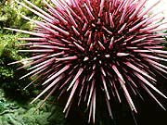
Class Echinoidea:
sea urchins
Greek ekhinos, spine (figuratively), sea urchin, hedgehog
Oval shaped body covered in sharp calcareous (calcium carbonate) material that make up the spines
Arms are absent
Mostly detritivores

Slide 12
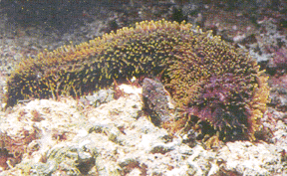
Class Holothuroidea: sea cucumbers
Greek, holothurum, a sedentary marine animal, possibly from Greek holos, whole; or (thureos, oblong shield (from thura, door))
Long and cylindrical
Arms absent
Detritus feeders

Slide 13
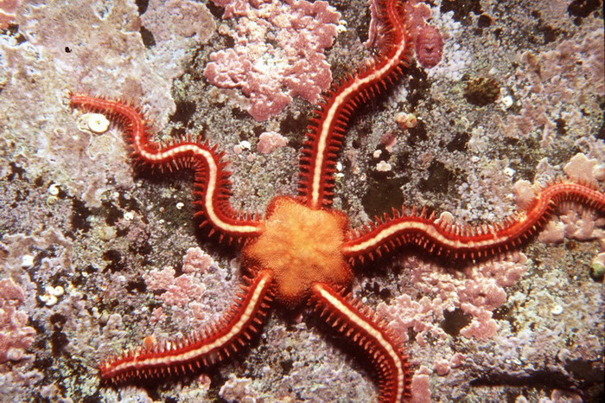
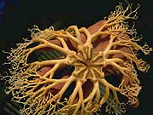
Class Ophiuroidea:
Greek ophis, snake + Greek oura, tail
Penta-radial symmetry with long, slender, flexible arms
Mostly detritivores or filter feeders
Feather Star
Basket Star
Brittle Star

Slide 14
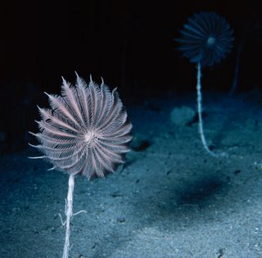
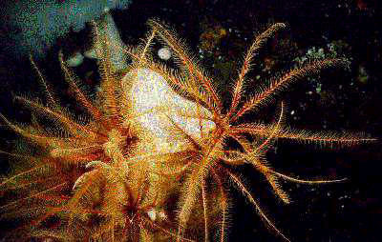
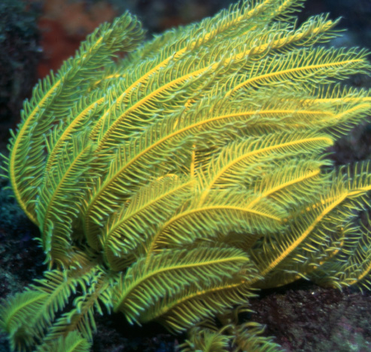
Class Crinoidea: Sea Lilies and Feather Stars
Greek krinon, lily
Long, feathery arms
Mostly filter feeders
Sea lilies
Feather Star

