Slide 1
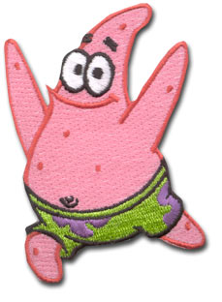
SEA STAR DISSECTION
http://www.emerchandise.com/images/p/SBS/pdPASBS0005.jpg

Slide 2
Kidspiration by Riedell

Slide 3
SEA STARS
LATIN meaning
KINGDOM _____________
PHYLUM _____________________________
CLASS _______________________________
ANIMALIA
ECHINODERMATA “spiny skin”
ASTEROIDEA “star-like”

Slide 4
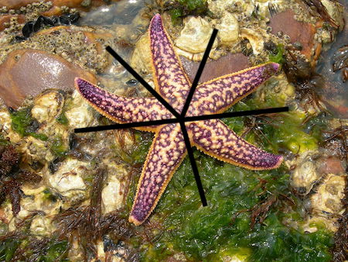
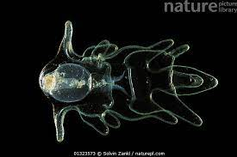
SYMMETRY
ADULTS- Pentaradial
LARVA- Bilateral

Slide 5
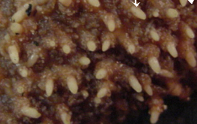
SPINY SKIN
http://wwwbio200.nsm.buffalo.edu/labs/tutor/Starfish
SPINES for protection connect to
ENDOSKELETON inside underneath skin

Slide 6
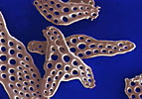
OSSICLES Calcium carbonate plates
form endoskeleton inside
http://ebiomedia.com/prod/BOechinoderms.html

Slide 7
SKIN GILLS Hollow skin tubes that project from skin for increased surface area connect to coelom inside
Image by Riedell

Slide 8
Skin gills between spines
http://wwwbio200.nsm.buffalo.edu/labs/tutor/Starfish
EXCHANGE GASES and
EXCRETE NITROGEN WASTE

Slide 9
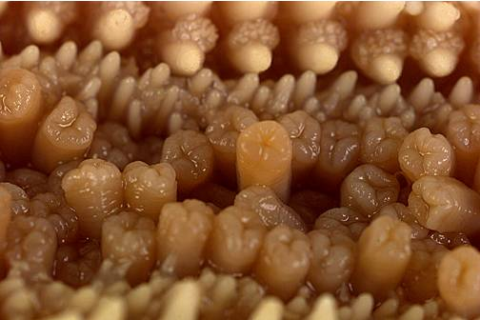
TUBE FEET surfaces
http://wwwbio200.nsm.buffalo.edu/labs/tutor/Starfish

Slide 10
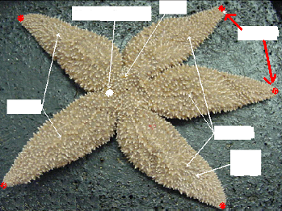
EYESPOTS
Sense light/dark

Slide 11
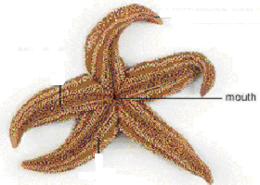
ORAL VIEW
http://wwwbio200.nsm.buffalo.edu/labs/tutor/Starfish

Slide 12
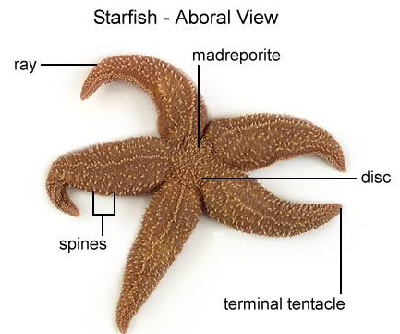
http://wwwbio200.nsm.buffalo.edu/labs/tutor/Starfish

Slide 13
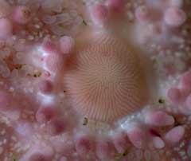
Madreporite
Opening to water vascular system
http://ebiomedia.com/gall/skin/skin1.html

Slide 14
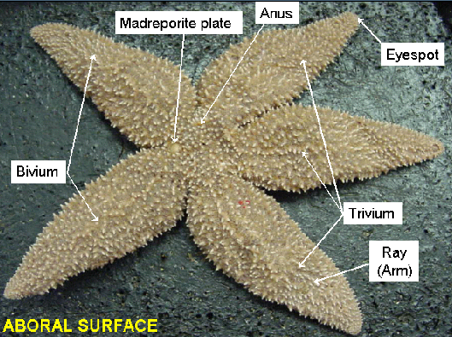

Slide 15
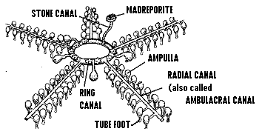
WATER VASCULAR SYSTEM
BIODIDAC

Slide 16
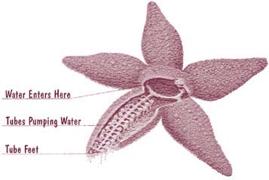
http://mbgnet.mobot.org/salt/animals/star.jpg

Slide 17
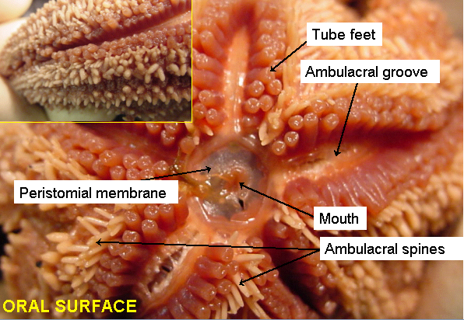

Slide 18
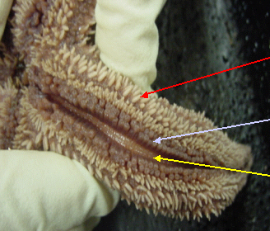
AMBULACRAL GROOVE
TUBE FEET sit in GROOVE

Slide 19
TUBE FEET
Used for feeding & locomotion

Slide 20
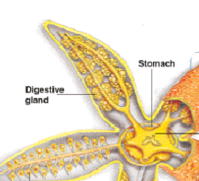
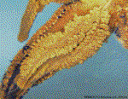
DIGESTIVE GLAND
Makes BILE
ABSORBS NUTRIENTS

Slide 21
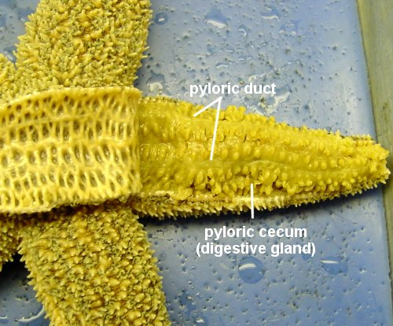
http://www.k-state.edu/organismic/echinoderms_and_protochordates.htm

Slide 22
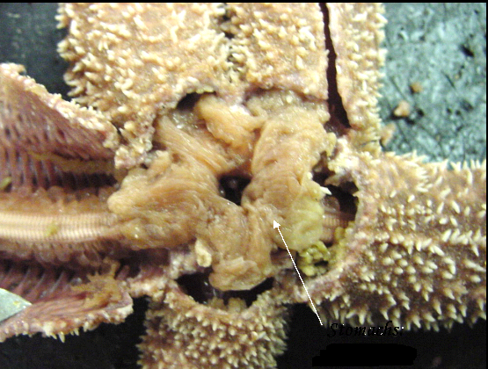
2 part STOMACH

Slide 23
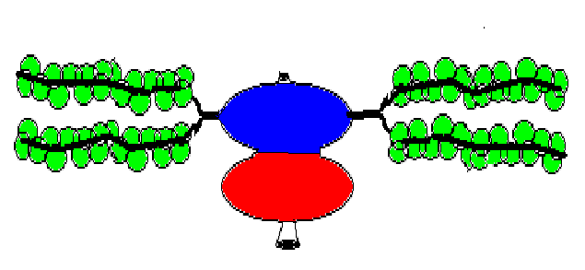
DIGESTIVE SYSTEM
ANUS
DIGESTIVE
GLANDS
DIGESTIVE
GLANDS
MOUTH

Slide 24
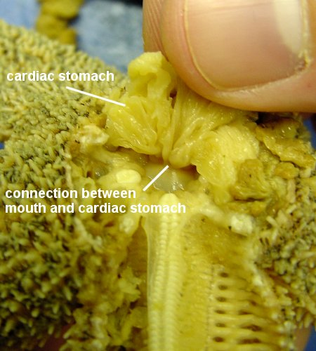
http://www.k-state.edu/organismic/echinoderms_and_protochordates.htm
CARDIAC stomach connects to mouth (extruded during feeding)
PYLORIC stomach connects to digestive glands and ANUS

Slide 25
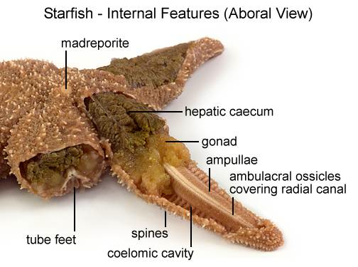
http://wwwbio200.nsm.buffalo.edu/labs/tutor/Starfish/

Slide 26
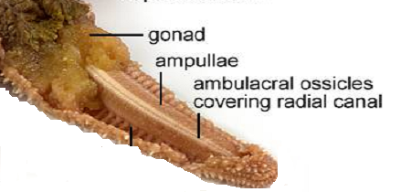
http://wwwbio200.nsm.buffalo.edu/labs/tutor/Starfish/
AMBULACRAL RIDGE covered by OSSICLES
contains RADIAL NERVE (nervous)
RADIAL CANAL (water vascular system)

Slide 27
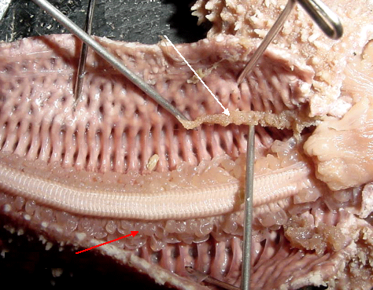
AMBULACRAL RIDGE
AMPULLAE (tops of tube feet)

Slide 28
OSSICLES Calcium carbonate plates
form endoskeleton inside
http://ebiomedia.com/prod/BOechinoderms.html

Slide 29
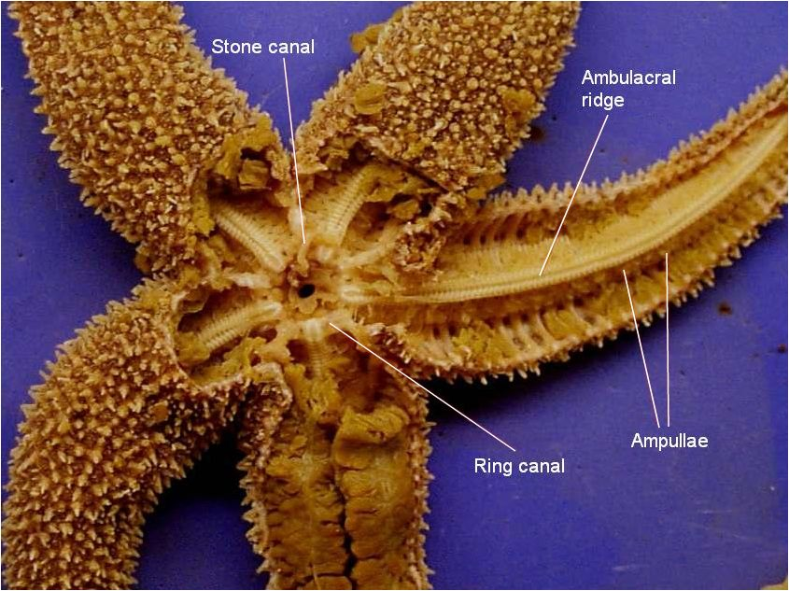
GONADS

Slide 30
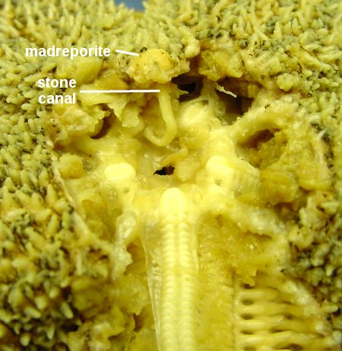
http://www.k-state.edu/organismic/echinoderms_and_protochordates.htm

Slide 31
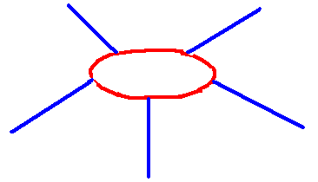
NERVOUS SYSTEM
NERVE RING encircles mouth
RADIAL NERVES run inside
AMBULACRAL RIDGE in each arm

Slide 32
SEPARATE SEXES
GONADS- reproductive organs
Sea star have both SEXUAL ASEXUAL (Regeneration)

Slide 33
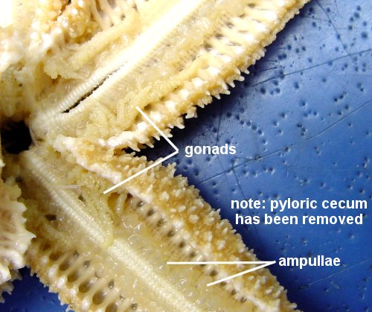
http://www.k-state.edu/organismic/echinoderms_and_protochordates.htm

Slide 34
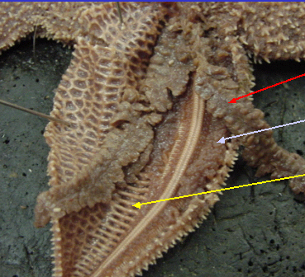
DIGESTIVE GLAND
GONAD
OSSICLES

Slide 35
SEXUAL REPRODUCTION
FERTILIZATION
EXTERNAL
DEVELOPMENT
INDIRECT
LARVA
BIPINNARIA
Has BILATERAL SYMMETRY and wings to swim

Slide 36
ASEXUAL REPRODUCTION
Ability to self amputate
AUTOTOMY
Ability to regrow lost parts
REGENERATION

