Slide 1
Endosymbiotic Theory Evidence

Slide 2
Mitochondria and chloroplasts have their OWN DNA (mtDNA & cpDNA) which is separate from the nuclear DNA. This DNA is inherited maternally (from the mother’s egg).

Slide 3
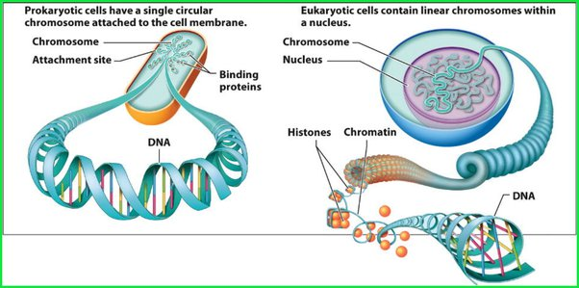
Eukarotic nuclei contain linear DNA. Prokaryotic cells have circular DNA. mtDNA and cpDNA is also circular!

Slide 4
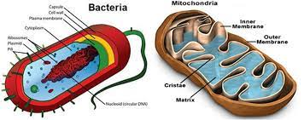
Mitochondria and chloroplasts are the same size as prokaryotic cells.

Slide 5
Mitochondria and chloroplasts reproduce by the process binary fission, which is how prokaryotes reproduce.

Slide 6
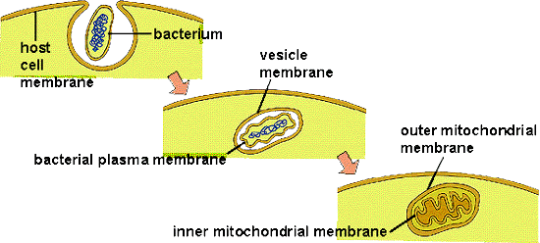
Mitochondria and chloroplasts have a double lipid bilayer. This can be explained by a prokaryote being enveloped by another organism and forming a vesicle within it.

