Slide 1
Biology 11
Unit 1: Evolution
Lesson 4: Evidence of Evolution

Slide 2
Objectives:
By the end of the lesson you should be able to:
State the 4 types of evidence AND explain why they are good pieces of evidence

Slide 3
Evidences of Evolution
The 4 approaches to studying evolution are:
1. Fossils
2. Comparative anatomy
3. Comparative embryology
4. Molecular evidence

Slide 4
1. Fossil Evidence
Fossils are preserved remains from the past.
Compare homologous (similar) structures in fossil to species alive today.

Slide 5
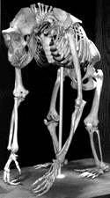
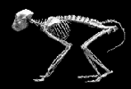
2. Comparative Anatomy
Comparing homologous structures of species alive today.
Can be any homologous organs, not just bones.
Baboon Human Gorilla

Slide 6
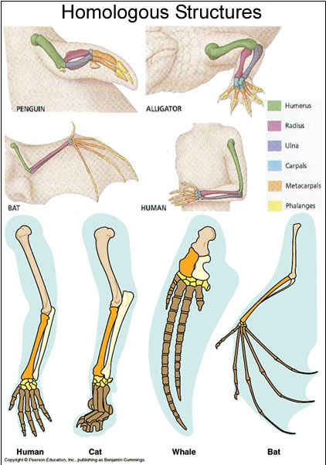
Homologous Structures
Many organisms have similar bone structure
Therefore they must have had a common ancestor

Slide 7
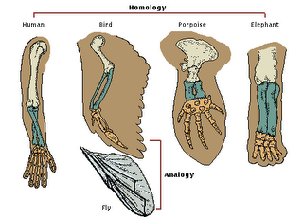
Analogous Structures
NOT a good piece of evidence!!!
Same job but NOT similar structure; therefore, NOT similar DNA

Slide 8
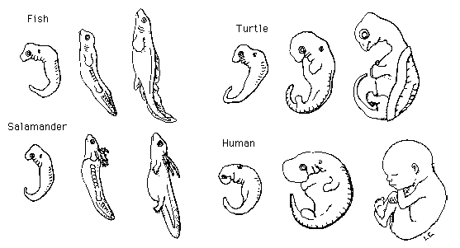
3. Comparative Embryology
A growing embryo, expresses the most basic and primitive genes first - easier to see relationships.

Slide 9
4. Molecular Evidence
This method examines the gene itself or its product, a protein!! (remember the protein synthesis story??!)
This new method is lab intensive but provides some of the most convincing evidence for evolutionary relationships.
We will examine two applications of this:

Slide 10
4. Molecular Evidence
1. Amino acid sequences
Inheritable mutations occur in any population at the same rate. The longer the two populations are isolated, the greater their difference will become.
Differences in amino acid sequences act as a “molecular clock” to approximate how long the gene pools have been separated.

Slide 11
4. Molecular Evidence
2. DNA Comparisons
Members of the same species have virtually identical DNA
Interbreeding species distribute any mutations that occur quickly through the gene pool.
Isolated species collect their own random mutations which become subject to different environmental pressures.

Slide 12
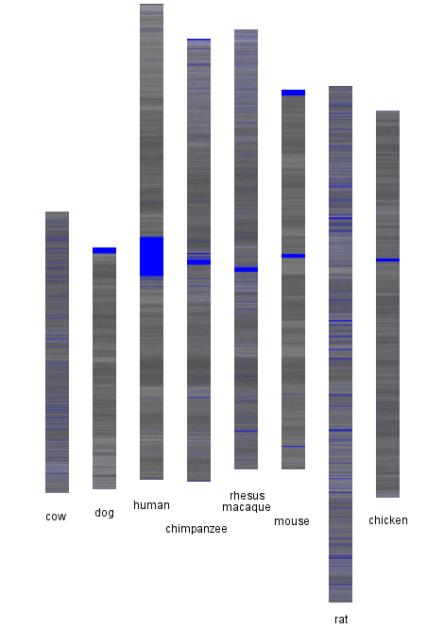
DNA Comparisons
A-T: Black bands
C-G: White bands
Unknown: Blue bands

Slide 13
Adaptations
There are 3 types of adaptations that can occur within species to change the way the behave within an ecosystem
Structural
Behavioural
Physiological

Slide 14
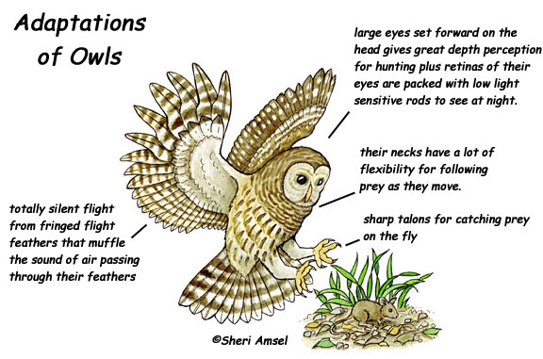
Structural Adaptations
As discussed when looking at different bones/parts of an organism.
It is a physical feature that changes over time

Slide 15
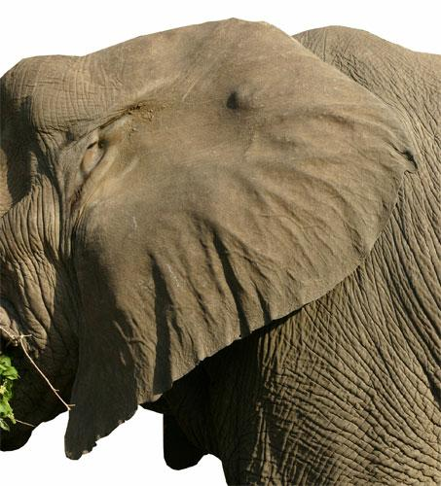
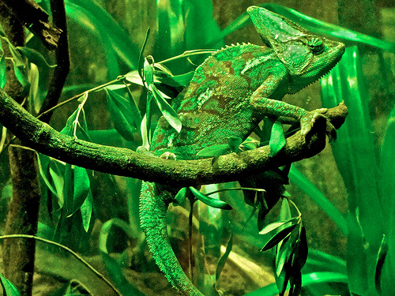
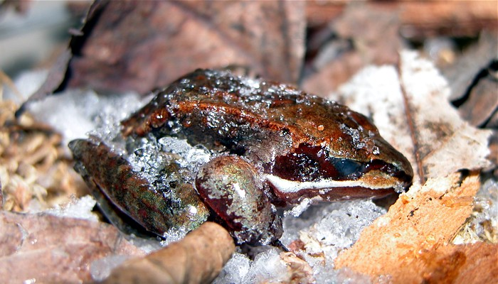
Physiological Adaptations
Chemical or cellular processes that occur inside an organism’s body that help it survive its environment and reproduce
Eg. Color changes in chameleons or maintaining a certain body temperature or cacti and water use.

Slide 16
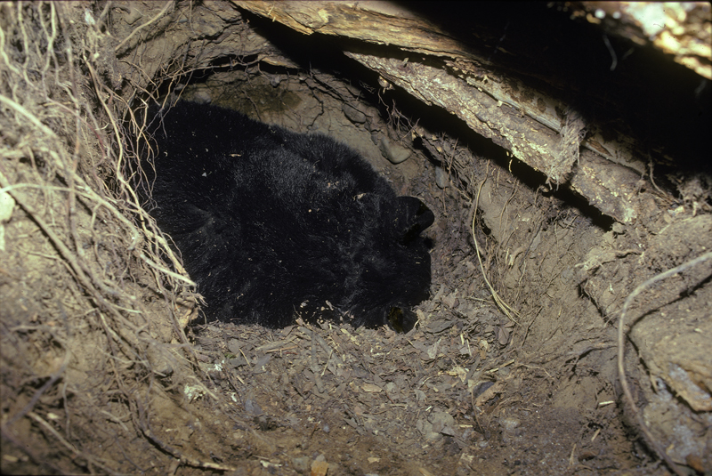
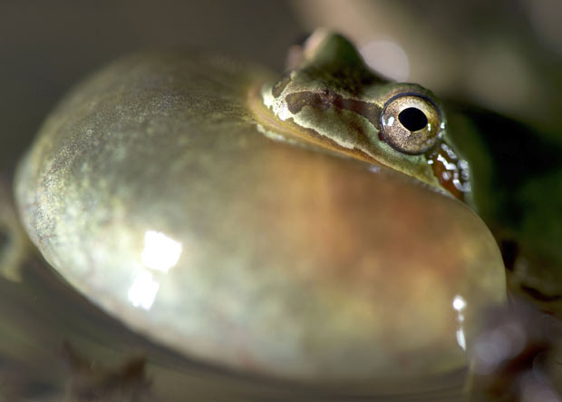
Behavioral Adaptation
Behaviors or what they do to help them survive in their environment and reproduce.
Eg. Mating calls, flying south, hibernation, hunting in packs

Slide 17
Summary
By putting data from all methods together, we can determine the evolutionary history of a group of organisms.
This is also used to determine the correct classification of living organisms.
We will be doing classification next! ☺

