Slide 1
Life Sciences 11
Unit 2: Evolution
Lesson 4: Evidence of Evolution

Slide 2
Objectives:
By the end of the lesson you should be able to:
State 4 types of evidence AND explain why they are good pieces of evidence

Slide 3
Evidences of Evolution
The 4 main approaches to studying evolution are:
1. Fossils
2. Comparative anatomy
3. Comparative embryology
4. Molecular evidence

Slide 4
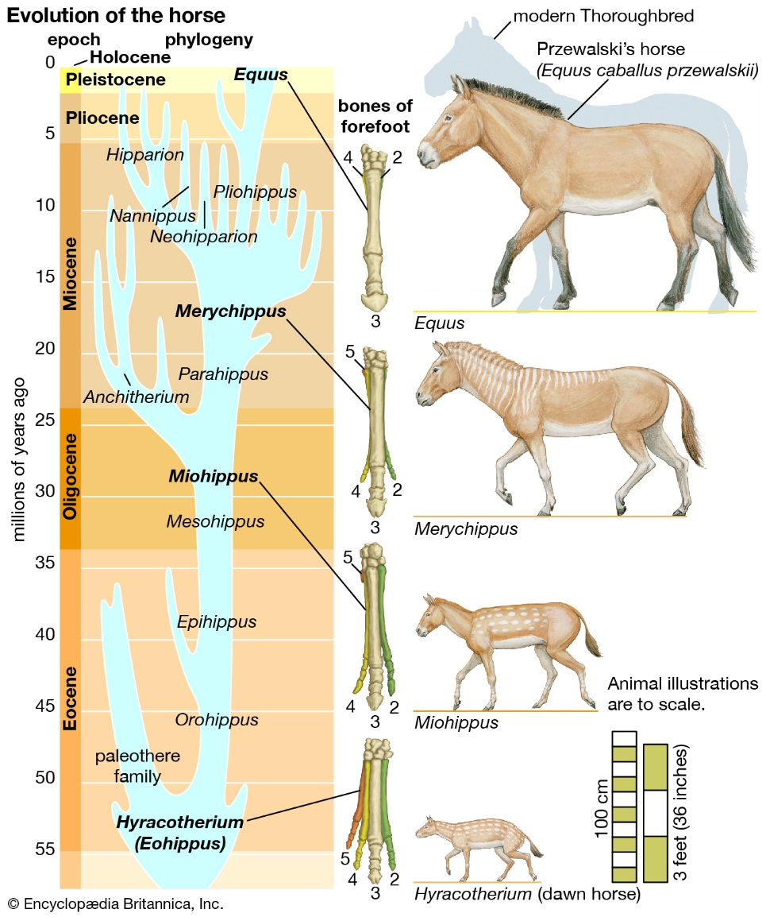
1. Fossil Evidence
Fossils are preserved remains from the past.
Fossils allow us to see into the past and follow evolution through history.
Fossils are direct evidence and the closest we have to a time machine

Slide 5
1. Fossil Evidence
They allow us to compare homologous (similar) structures in fossil to species alive today.

Slide 6
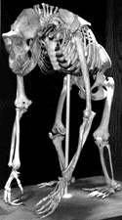
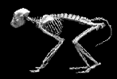
2. Comparative Anatomy
Comparing homologous structures of species alive today.
Can be any homologous organs, not just bones.
Baboon Human Gorilla

Slide 7
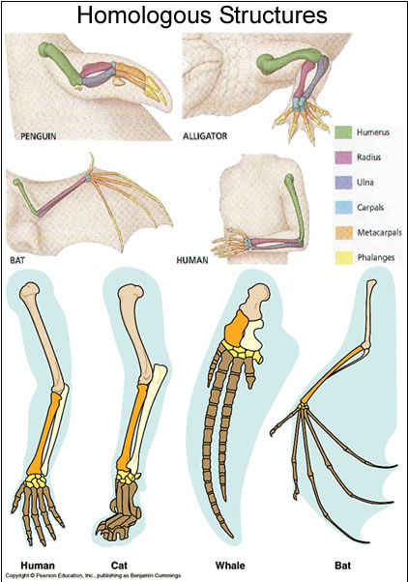
Homologous Structures
Many organisms have similar bone structure
Therefore they must have had a common ancestor
Similar structure, different function

Slide 8
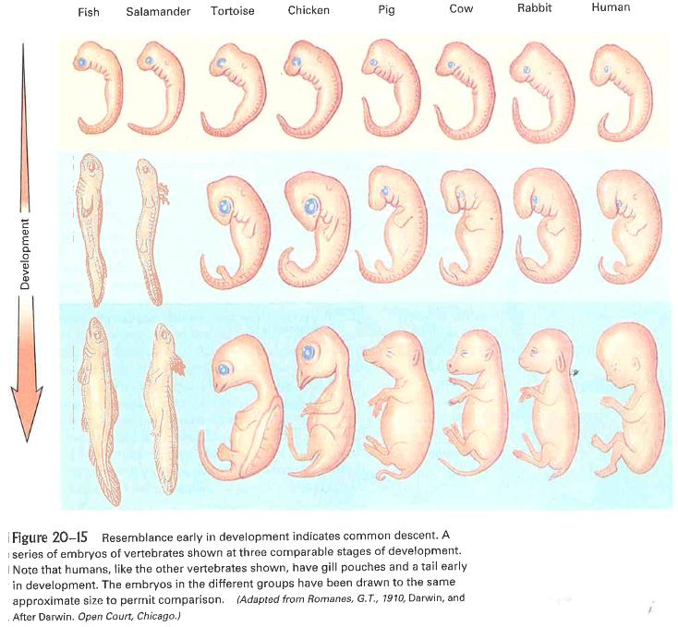

Slide 9
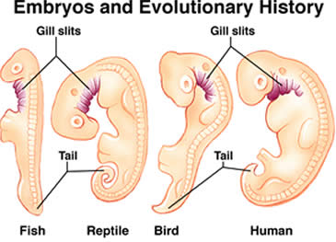

Slide 10
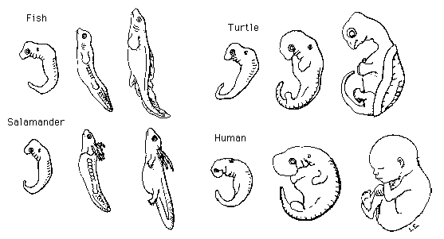
3. Comparative Embryology
A growing embryo expresses the most basic and primitive genes first – the basic structures of a common ancestor.

Slide 11
4. Molecular Evidence
This method examines the gene itself or its product, a protein!! (remember the protein synthesis story??!)
This new method is lab intensive but provides some of the most convincing evidence for evolutionary relationships.
We will examine two applications of this:
DNA comparisons and Molecular Clocks

Slide 12
4. Molecular Evidence
1. DNA Comparisons
The same DNA code is shared among all living organisms, and genes from one organism can be transferred in a lab from organisms to another and still function

Slide 13
4. Molecular Evidence
1. DNA Comparisons
The same DNA code is shared among all living organisms, and genes from one organism can be transferred in a lab from organisms to another and still function

Slide 14
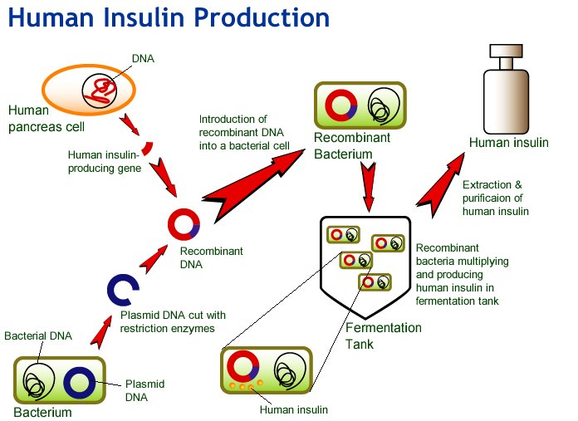
4. Molecular Evidence
Glow in the dark transgenic animals
1. DNA Comparisons
The same DNA code is shared among all living organisms, and genes from one organism can be transferred in a lab from organisms to another and still function

Slide 15
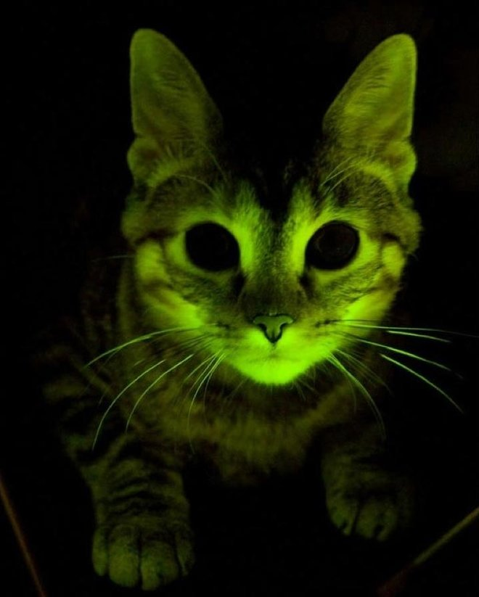
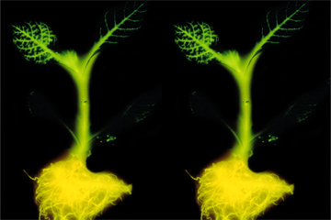
4. Molecular Evidence
Glow in the dark transgenic organisms

Slide 16
4. Molecular Evidence
1. DNA Comparisons
Members of the same species have virtually identical DNA
Interbreeding species distribute any mutations that occur quickly through the gene pool.
Isolated species collect their own random mutations which become subject to different environmental pressures, leading to the creation of a new species.
This new species will have different, but very similar DNA to the previous

Slide 18
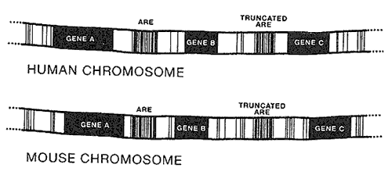

Slide 19
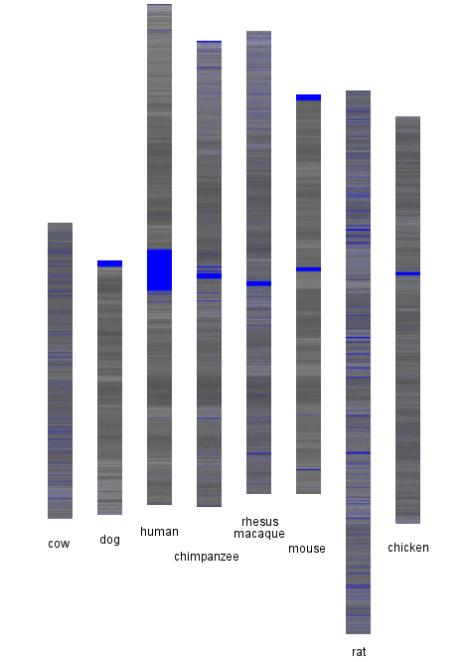
DNA Comparisons
A-T: Black bands
C-G: White bands
Unknown: Blue bands

Slide 20
4. Molecular Evidence
2. Molecular Clocks
Inheritable mutations occur in any population at the same rate. The longer the two populations are isolated, the greater their difference will become.
Differences in DNA sequences act as a “molecular clock” to approximate how long the gene pools have been separated.

Slide 21
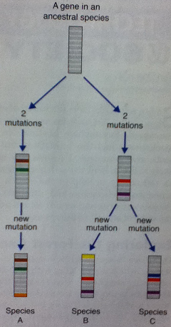

Slide 22
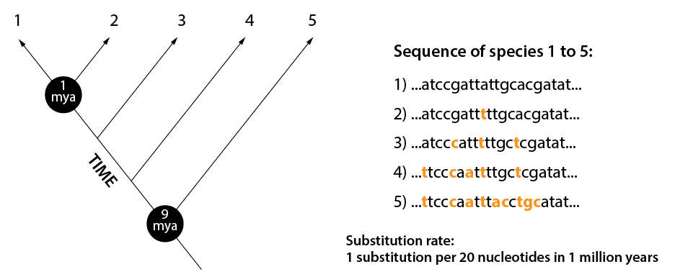
Image shows basic principle of a molecular clock. Species 1 and species 2 diverged 1 million years ago, because they only have one base pair difference per 20 nucleotides in their sequence. Given a substitution rate of 1/20 per 1 million years, this equals in a 1 million year old split
Molecular Clocks Video

Slide 23
Bonus! Vestigial Structures
Structures that serve no function but useful structures in earlier ancestors
Examples: Ear muscles
Human tailbone
Appendix
Whale hip bones

Slide 24
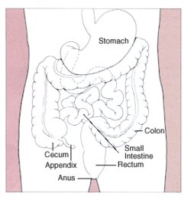
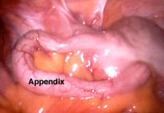

Slide 26
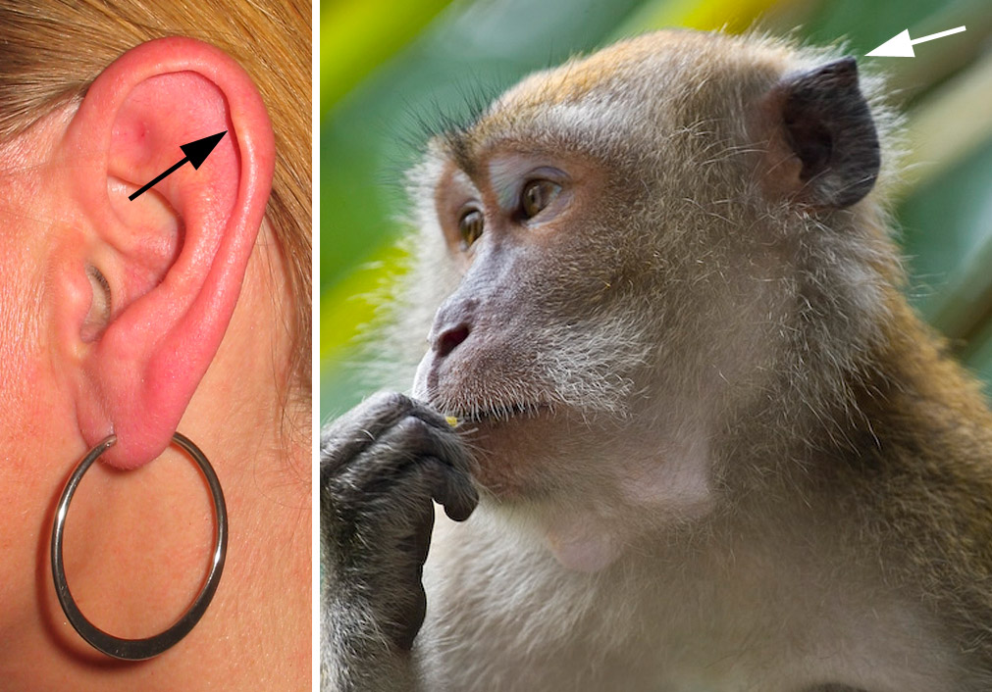

Slide 27
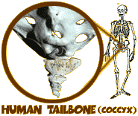
Vestigial Organs

Slide 28
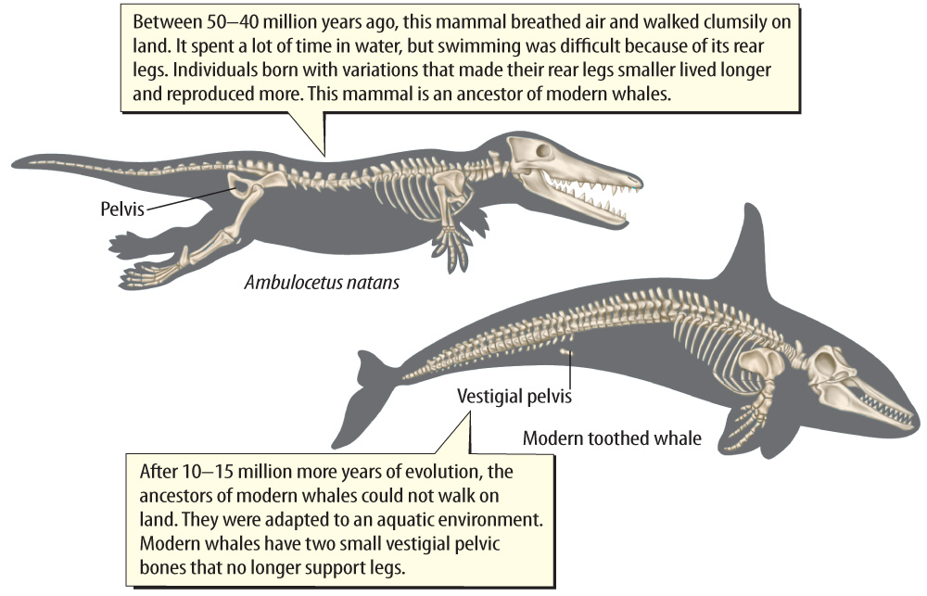
Vestigial structures are body parts that have lost their original function through evolution.

Slide 29
Summary
By putting data from all methods together, we can determine the evolutionary history of a group of organisms.
This is also used to determine the correct classification of living organisms.
We will be doing classification next! ☺

