Slide 1
Life Sciences 11
Kingdom Plantae
The Gymnosperms

Slide 2
Objectives
By the end of the lesson you should be able to:
Compare and contrast bryophytes, pteridophytes and gymnosperms
Describe the lifecycle of a gymnosperm
Give examples of gymnosperms

Slide 3
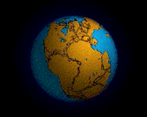
Evolution of Seeded Vascular Plants
When the Mesozoic era got under way, it ushered in a time of geological and climatic instability
Continental drift formed the “super continent” called Pangaea
Cooler and dryer conditions put survival pressure on the water dependent non-seeded vascular plants
The key to survival was surviving without water

Slide 4
Evolution of Seeded Vascular Plants
In plants, this resulted in three significant advances:
1. Gametophyte reduced even more and becomes protected and completely dependent upon sporophyte
2. Asexual spores evolved into sexual pollen for air distribution of the gametes
3. Development of an embryo protecting mechanism (seeds) that also could more effectively distribute their species

Slide 5
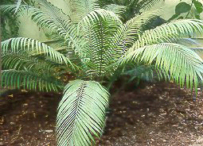
Gymnosperms: seeded vascular plants
First evolved in Paleozoic
Changes in the Mesozoic made this their era
Dominant during this time were the ginkgo and cycads
A cycad

Slide 6
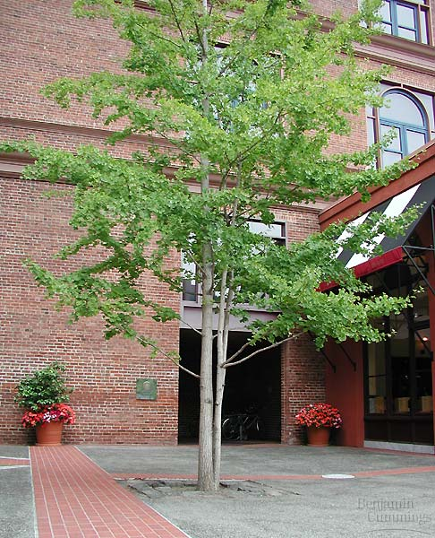
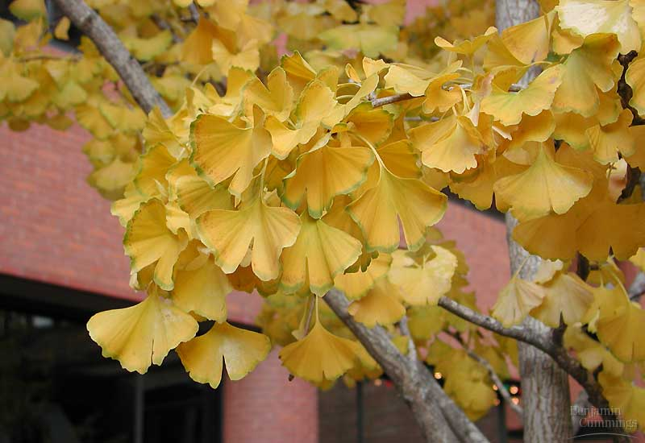
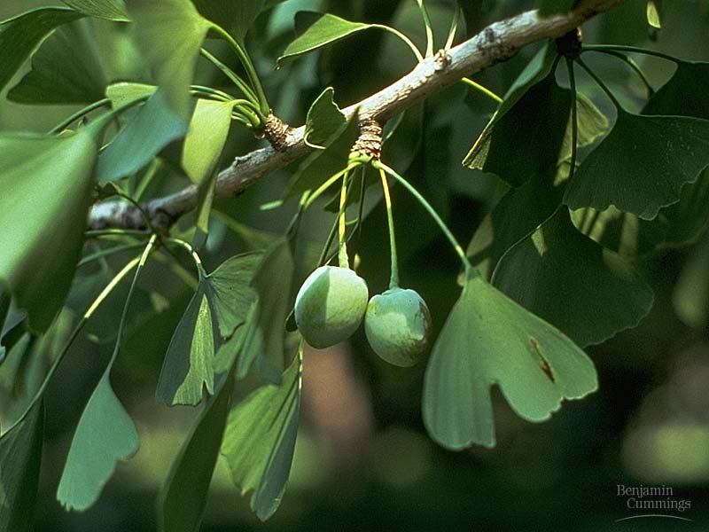
Early Gymnosperm: Ginkgo

Slide 7
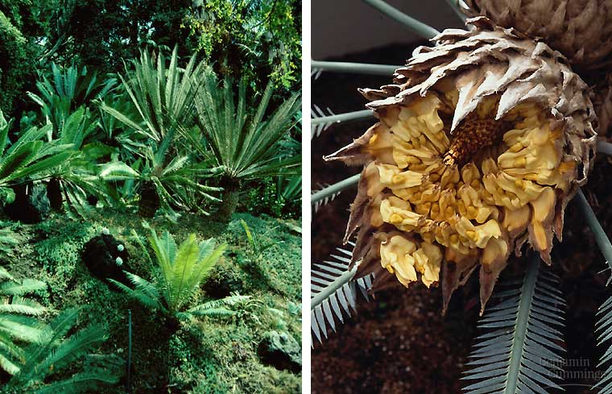
Early Gymnosperm: cycads

Slide 8
Gymnosperms
The Conifers
These are our familiar evergreen trees and shrubs
They lived in the dry continental interiors
When the climate changed at the end of the Mesozoic, the conifers were pre-adapted and flourished

Slide 9
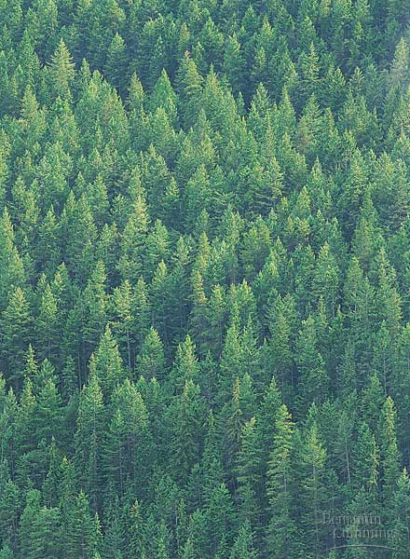
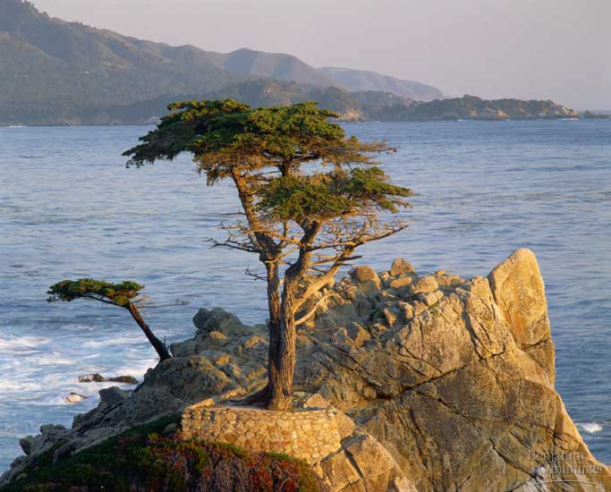
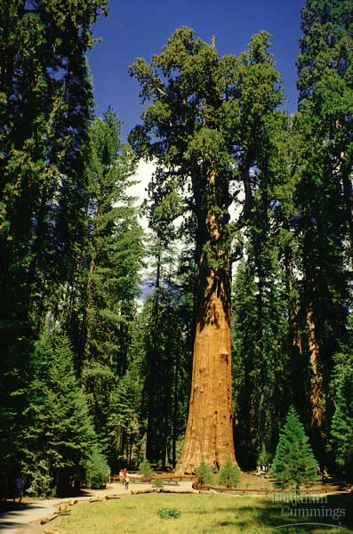
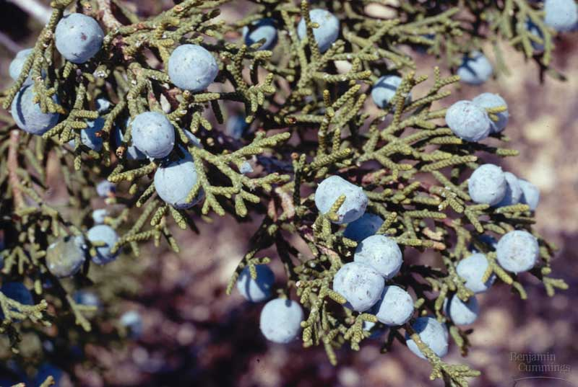
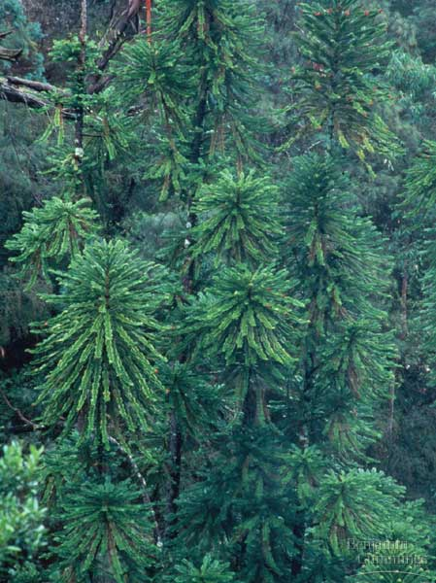
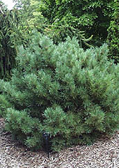
Common Gymnosperm:
Conifers

Slide 10

Gymnosperms
They are still the dominant plant in the north temperate zones
They are the dominant biome in Canada called Boreal or Taiga coniferous forests

Slide 11
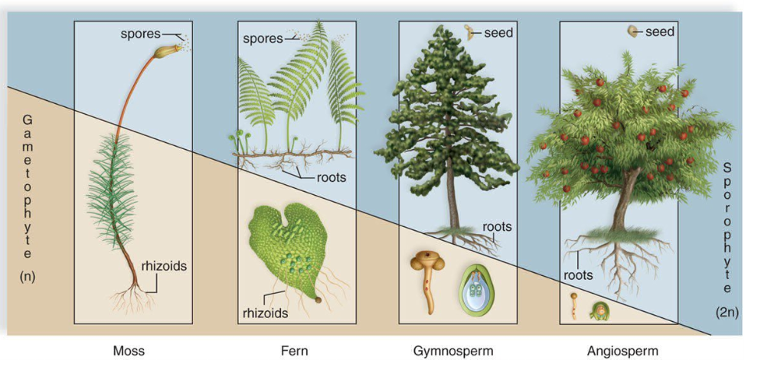
Gymnosperms – “Naked Seed”
The sporophyte has become very dominant
It is utilizing all of the advantages so far evolved

Slide 12
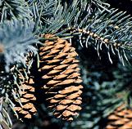
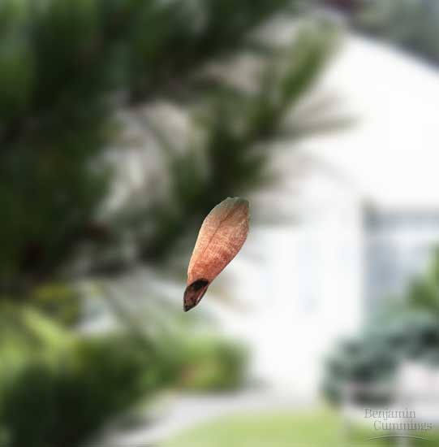
Seeded Vascular Plants
Gymnosperm: conifers
  vascular
  heterospory
    male vs. female gametophytes
  seeds
    naked seeds (no fruit)
  pollen
    contain male gametophyte
  life cycle dominated by sporophyte stage
    coniferous trees you are familiar with are diploid
    reduced (microscopic) gametophyte
    reduction of gametophyte protects delicate egg & embryo in protective sporophyte
      protected from drought & UV radiation

Slide 13
Gymnosperms
Advances:
Deep roots are seen for the first time which allows the gymnosperms to live in drier conditions
They no longer need water for reproduction
Leaves are modified into needles (decrease water loss)
The resins inside the needles act as a natural antifreeze
As a result, they became (and are) the dominant tree of the north temperate zones

Slide 14
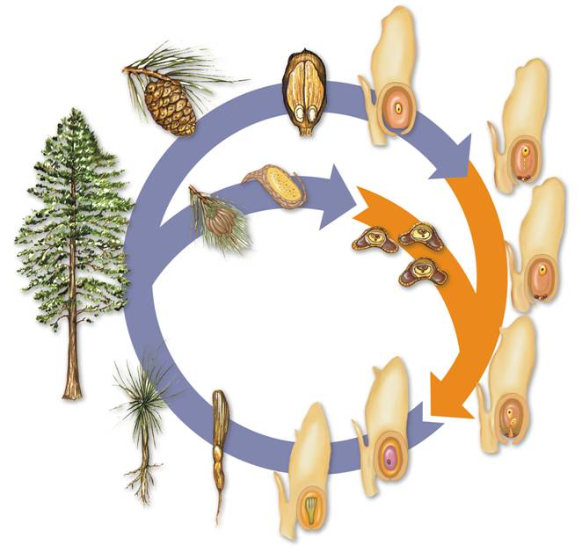
Seed Cone
Cone Scale
Diploid cell (2N)
Ovule
Four haploid cells (N)
Ovules
Meiosis
Female Gametophyte (N)
Pollen Cone
Pollen grain (N)
(male gametophytes)
Mature Sporophyte
(2N)
Seed
Egg Cell
Fertilization
Sperm
Pollen Tube
Seedling
Zygote (2N)
(new sporophyte)
Gametophyte tissue (N)
Embryo (2N)
Seed coat (old sporophyte)
Germinated Seed

Slide 15
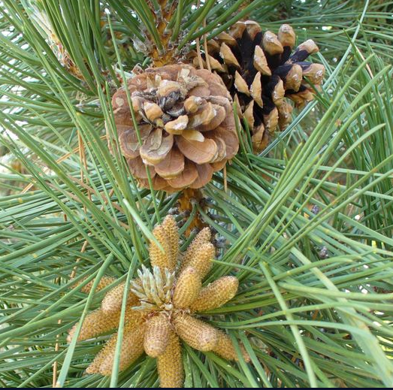
Male Cones
The male gametophyte is the pollen grain formed by meiosis inside the male cone
The male cone is small and short lived, dropping off the tree after a few weeks

Slide 16
Female Cones
The female gametophyte is the egg formed by meiosis inside the female cone
After fertilization the female cone houses the seeds until next spring
The female cone is large and long lived, dropping off the tree after 2 years!

Slide 17
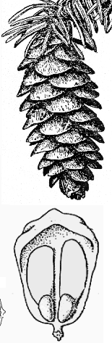
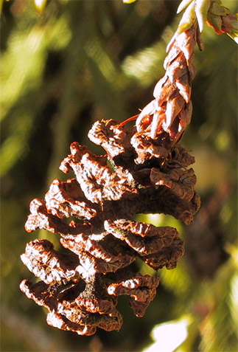
Cones & naked seeds

Slide 18
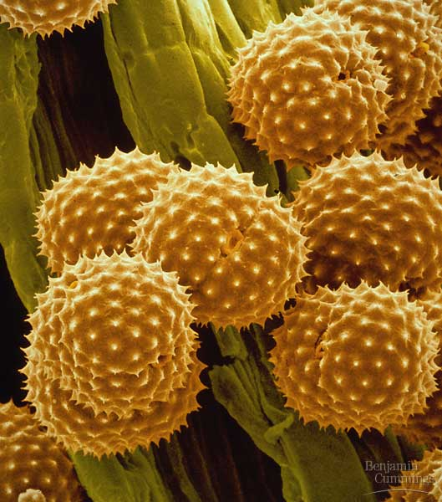
Pollen
Pollen eliminated the requirement for water for fertilization
  spread by wind & animals
Where can
conifers live?

Slide 19
Pollination
  Pollination
    The gymnosperm life cycle typically takes two years to complete.
    The cycle begins as male cones release pollen grains.
    Pollen grains are carried by the wind and reach female cones.

Slide 20
Meiosis
Fertilization
Notes:
This illustration shows the life cycle of a typical gymnosperm. A pine tree—the mature sporophyte—produces male and female cones. Male cones produce pollen, and female cones produce ovules located on cone scales. If an egg is fertilized by the sperm, it becomes a zygote that is nourished by the female cone. In time, the zygote develops into a new sporophyte plant.

Slide 21
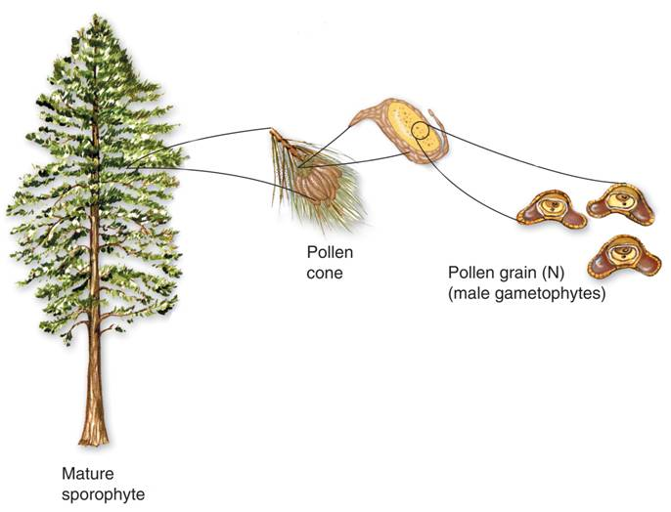
Male Cones
Pollen cone
Pollen grain (N) (male gametophytes)
Mature sporophyte
Notes:
A pine tree—the mature sporophyte—produces male and female cones. Male cones produce pollen, and female cones produce ovules located on cone scales.

Slide 22
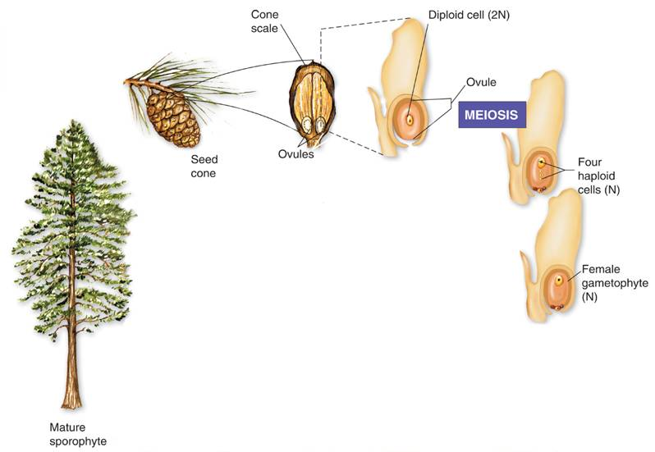
Cone scale
Diploid cell (2N)
Female Cones
Ovule
Seed cone
Ovules
Four haploid cells (N)
Female gametophyte (N)
Mature sporophyte
Notes:
A pine tree—the mature sporophyte—produces male and female cones. Male cones produce pollen, and female cones produce ovules located on cone scales. If an egg is fertilized by the sperm, it becomes a zygote that is nourished by the female cone.

Slide 23
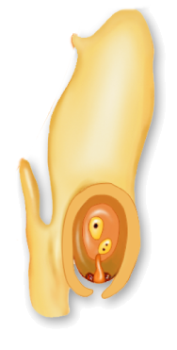
If pollen grains land on and enter an ovule, pollination occurs.
A pollen tube grows out of each pollen grain and releases sperm near an egg.
Egg cell
Discharged sperm nucleus
Pollen tube

Slide 24
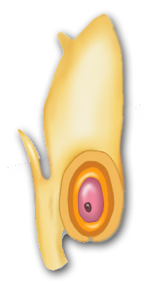
Life Cycle of Gymnosperms
Fertilization produces a diploid zygote which develops into a new sporophyte plant.
Zygote (2N)
(new sporophyte)

Slide 25
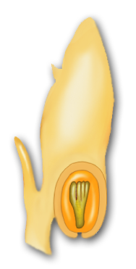
This zygote grows into an embryo and is encased within what will develop into a seed.
Seed
Gametophyte tissue
Embryo (2N)
Seed coat
(old sporophyte)

Slide 26
The seed is then dispersed by wind.
When conditions are favorable, the seed germinates and its embryo grows into a seedling.
Seedling
Germinated seed

Slide 27
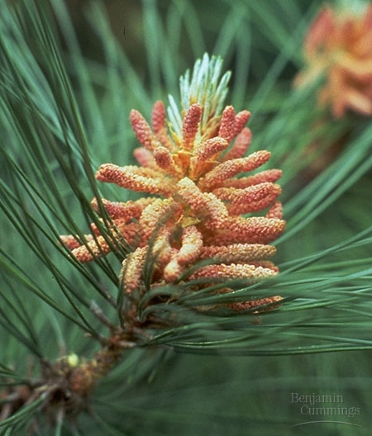
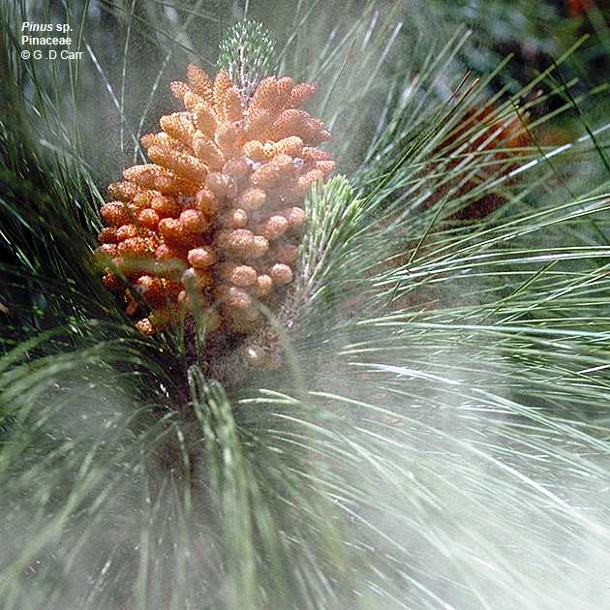
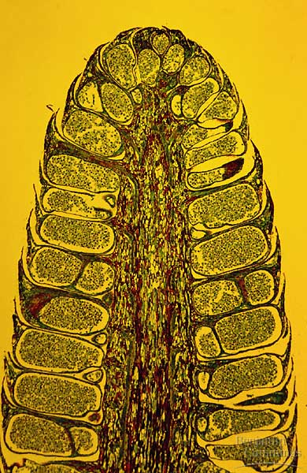
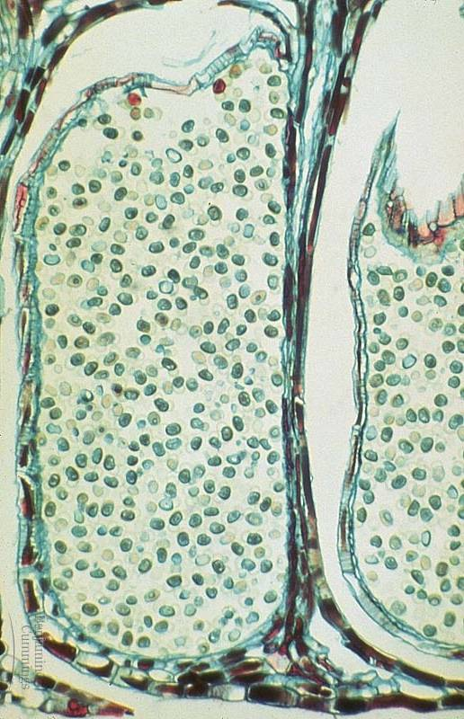
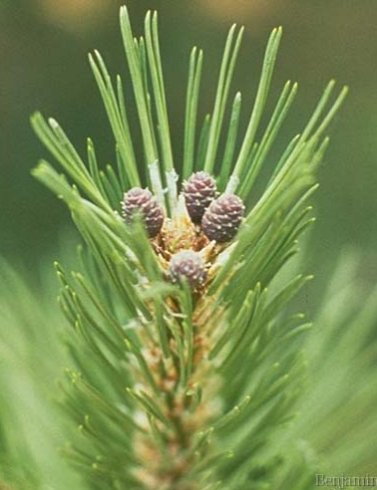
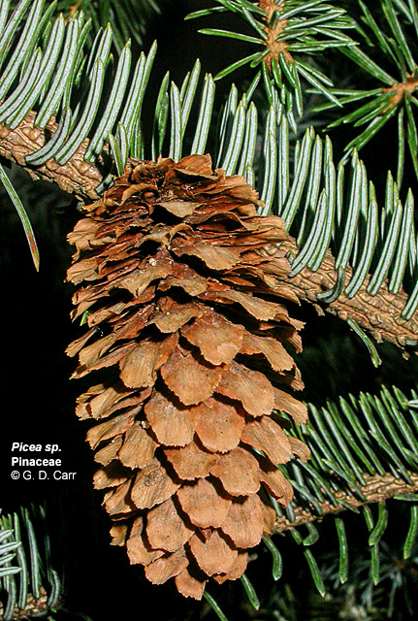
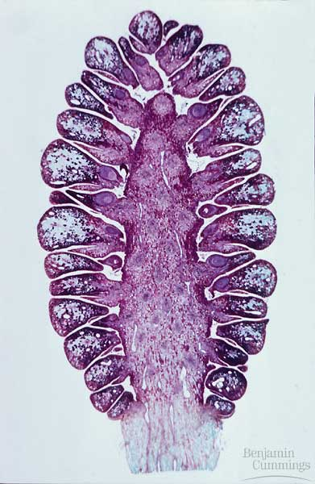
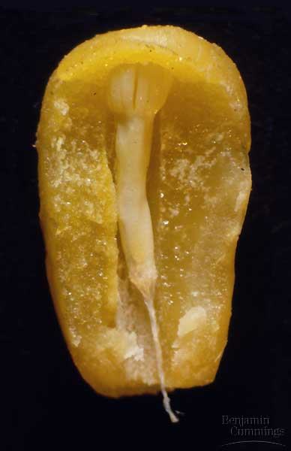
sporangium & pollen
male
male (pollen) cones
female
female cones
pine embryo

Slide 28
