Slide 1
Biology 11
Unit 1: Evolution
Lesson 3: HOW Evolution (Macro-Evolution)

Slide 2
Objectives
By the end of the lesson you should be able to:
Describe how macro-evolution is different from micro-evolution
Describe the 2 types of speciation
Explain the problem with speciation and the proposed solution

Slide 3
Macro-Evolution
Macro-evolution: AKA Speciation
Speciation: the making of new species
Recall:
Species: population of organisms that are able to breed and produce viable, fertile offspring

Slide 4
Mechanisms of Speciation
1. Divergent Evolution
Occurs when small fragments of a populations inhabit new areas and become isolated…..they adapt (evolve) to their new habitats
Common ancestor so DNA is similar
EX. Galapagos Finches

Slide 5
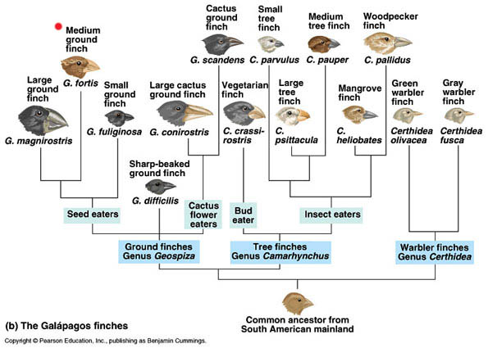

Slide 7
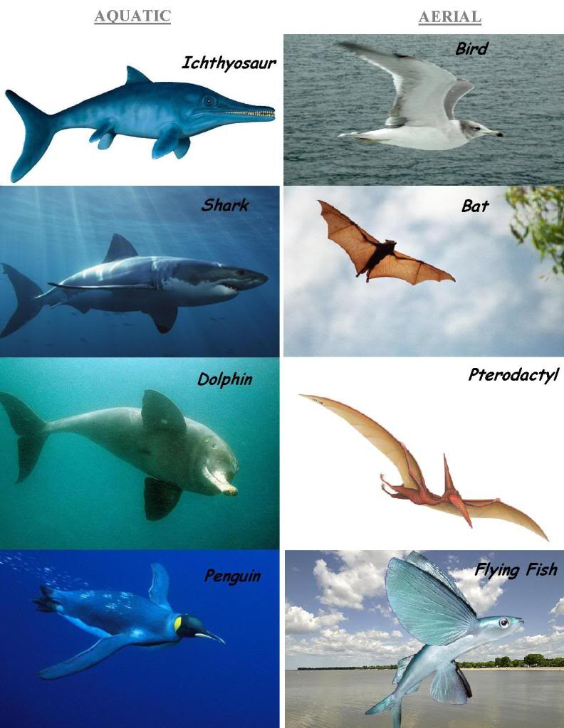
Another type of
evolution ….
What observations
can you make?

Slide 8
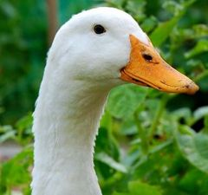
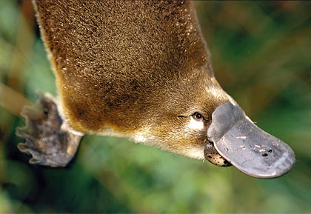
Mechanisms of Speciation
2. Convergent Evolution
Occurs when two unrelated species begin to inhabit the same environment and adapt (evolve) so will display similar characteristics
No common ancestor so DNA is not related
EX. Duck and platypus bills

Slide 9
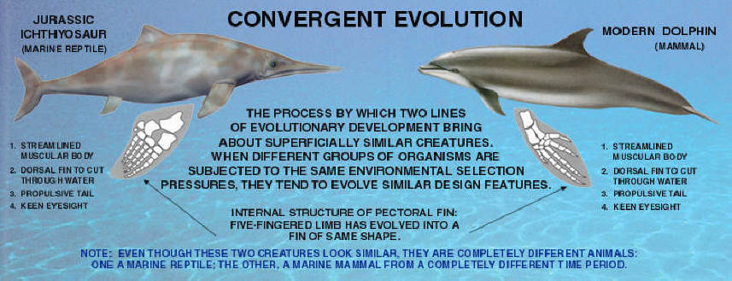

Slide 10
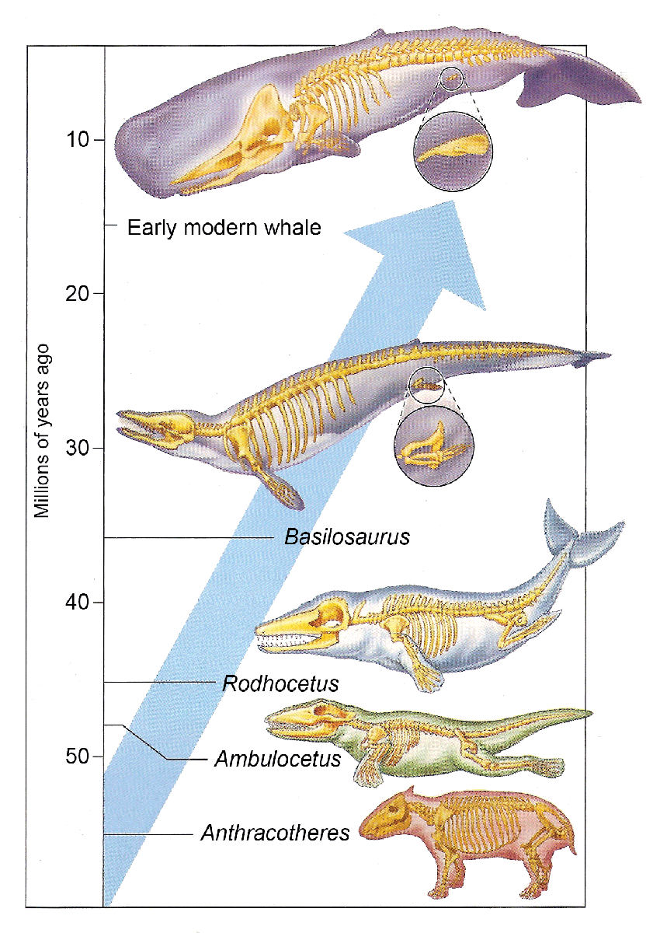
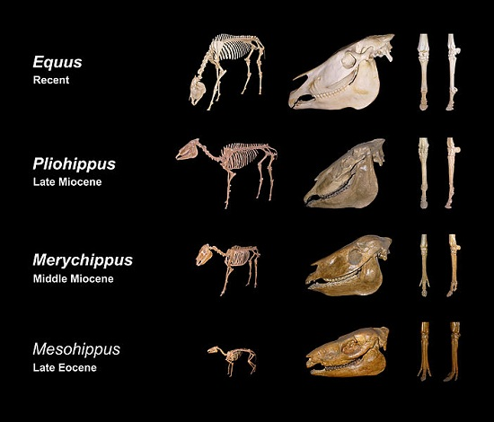
Fossils show speciation over time …

Slide 11
Houston We’ve Got a Problem!!
There is a lack of intermediate fossils.
How is it possible that can we jump from one species to another with no fossil record of it ever occurring?
Why is fossil evidence so important??

Slide 13
Proposed Solution – Punctuated Equilibrium
Eldredge and Gould in 1972
Proposed that “less fit but survivable” members of a population would be pushed to the periphery or to less desirable extremes of the species habitat.
The peripheral population would adapt (evolve) to the new harsh environment
Re-introduction could happen and the peripheral population would out-compete the original population
BUT WHY NO FOSSIL
RECORD!??!?

Slide 14
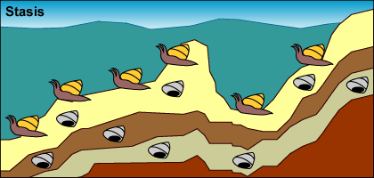
Punctuated equilibrium predicts that a lot of evolutionary change takes place in short periods of time tied to speciation events. Here's an example of how the model works:
Stasis: A population of mollusks is experiencing stasis, living, dying, and getting fossilized every few hundred thousand years. Little observable evolution seems to be occurring judging from these fossils

Slide 15
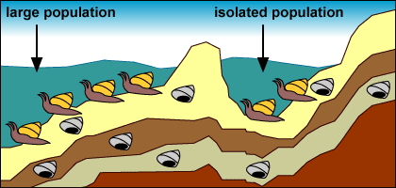
Isolation: A drop in sea level forms a lake and isolates a small number of mollusks from the rest of the population.

Slide 16
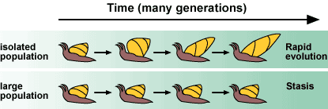
Strong selection and rapid change: The small, isolated population experiences strong selection and rapid change because of the novel environment and small population size: The environment in the newly formed lake exerts new selection pressures on the isolated mollusks. Also, their small population size means that genetic drift influences their evolution. The isolated population undergoes rapid evolutionary change.

Slide 17
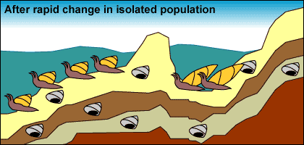
No preservation: Few fossils representing transitional forms are preserved because of their relatively small population size, the rapid pace of change, and their isolated location.

Slide 18
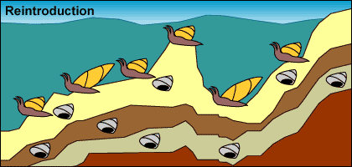
Reintroduction: Sea levels rise, reuniting the isolated mollusks with their sister lineage.

Slide 19
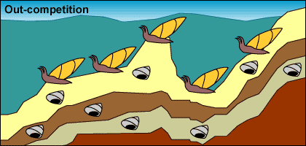
Expansion and stasis: The isolated population expands into its past range. Larger population size and a stable environment make evolutionary change less likely. The formerly isolated branch of the mollusk lineage may out-compete their ancestral population, causing it to go extinct.

Slide 20
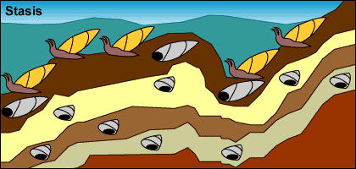
Preservation: Larger population size and a larger range move us back to step 1: stasis with occasional fossil preservation.

Slide 21
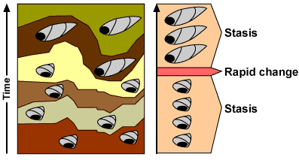
This process would produce the following pattern in the fossil record:

Slide 22
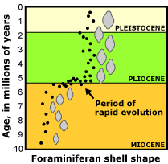
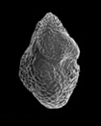
We observe similar patterns in the fossil records of many organisms. For example, the fossil records of certain foraminiferans (single-celled protists with shells) are consistent with a punctuated pattern.

Slide 23
EX: Mollusk Evolution By Punctuated Equilibrium

Slide 24
However, it is also important to note that we observe examples of gradual, non-punctuated, evolution in the fossil record too. The question that needs answering is: what are the relative frequencies of punctuated and gradual change?

Slide 26
Comparison
← Eldridge and Gould
Darwin
→
Gradualism Punctuated Equilibrium

Slide 27
