Slide 1
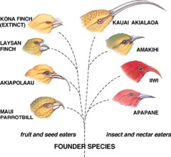
Life Sciences 11
Unit 2: Evolution
Lesson 2: HOW Evolution?? (Micro-evolution and Populations)

Slide 2
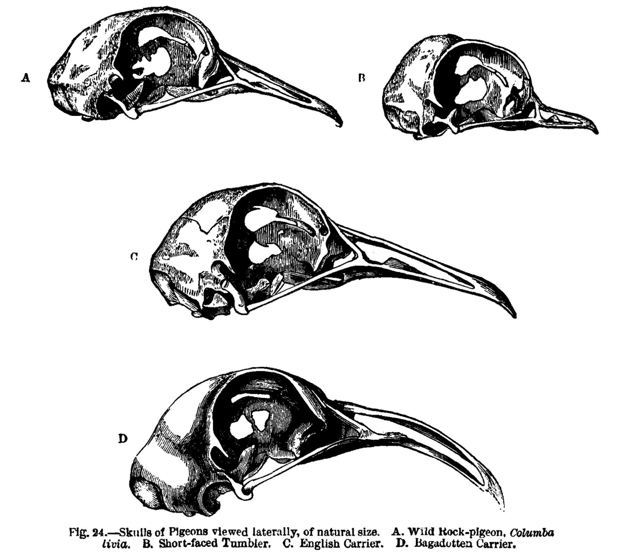
Objectives:
By the end of the lesson you should be able to:
Describe the 2 types of evolution
Describe the 5 ways to change a gene pool (micro-evolution)
Describe the 3 ways a population can change due to selection

Slide 3
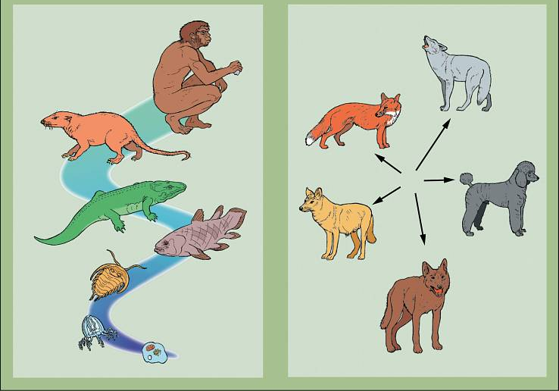
Evolution
Macro Micro
There are two basic types:
Micro-evolution: changes within one species
Macro-evolution: changing from one species to another
Species: population of organisms that are able to breed and produce viable, fertile offspring

Slide 4
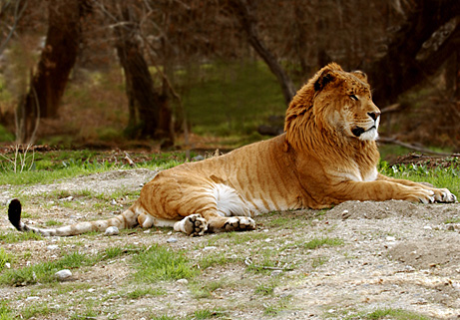
Liger
Product of a lion and tiger
Are lions and tigers the same species?!
No, because the liger offspring is NOT fertile
Mule
Product of a horse and a donkey
Are horses and donkeys the same species??
No, because the mule offspring is not fertile

Slide 5
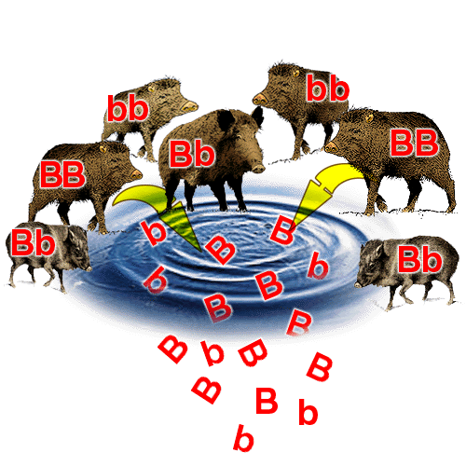
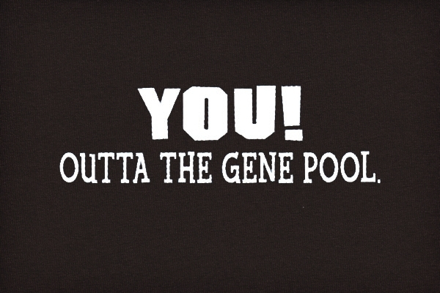
Gene Pools
What is a gene?
Gene Pool: all the possible genes available to the next generation
Contains all variations (versions) for all genes, called alleles
There are 5 mechanisms (ways) of changing the gene pool of a population…..THIS IS MICRO-EVOLUTION!

Slide 6
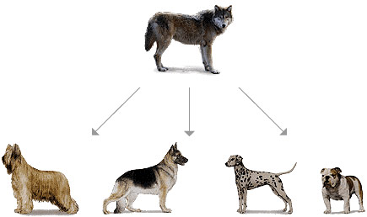
Mechanisms of Micro-Evolution
5 ways to change a gene pool:
Natural selection
Mutations
Genetic drift
Gene flow
Sexual selection (Non-random mating)
5 Fingers of Evolution video

Slide 7
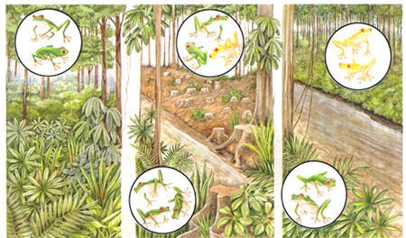
1. Natural Selection
Those best suited to the environment, survive, and pass on their genes to the next generation
BrainPop video, Natural Selection Stated Clearly

Slide 8
2. Mutations
Mutation: a change in the DNA of an organism
This change can be passed on to future generations and can change the gene pool
Effects of Mutations: good, bad or neutral
The effect of a mutation is highly variable
There is much repetitious DNA
There is also lots of “non-coding” DNA
A mutation in coding DNA is usually harmful but a rare few produce a favorable variation
Mutation here is less likely to be harmful

Slide 9
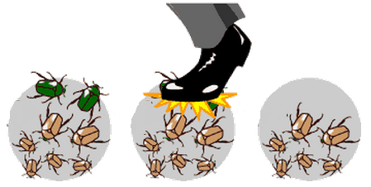
3. Genetic Drift
There is a change in the gene pool as a result of chance (random) events

Slide 10
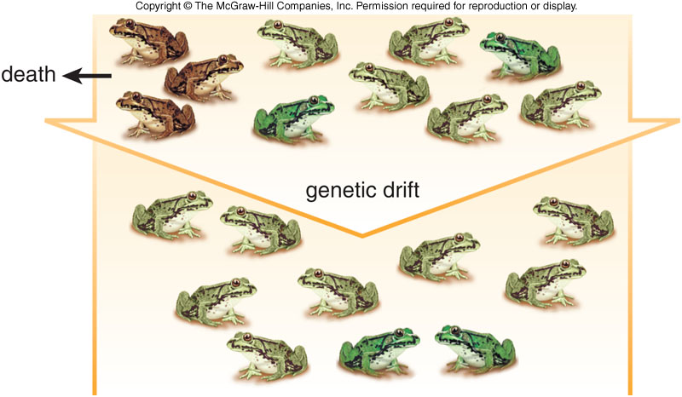

Slide 11
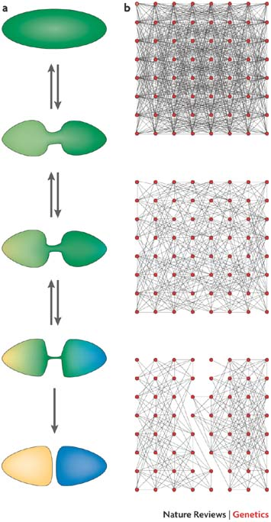
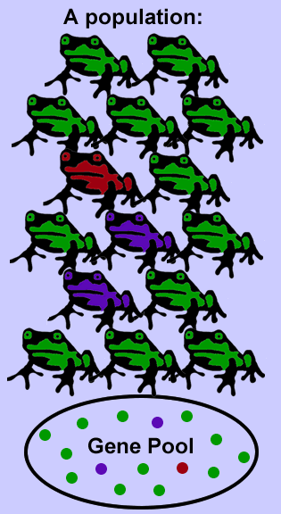
4. Gene Flow
The transfer of genes from one population to another
This can introduce new variations into a population (introduce a yellow frog)
or
If gene flow stops or is restricted, populations that were once joined, now change independently

Slide 12
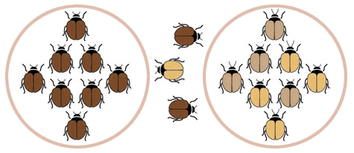
Gene Flow

Slide 13
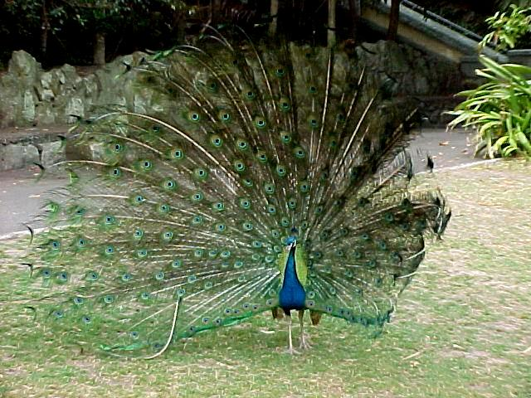
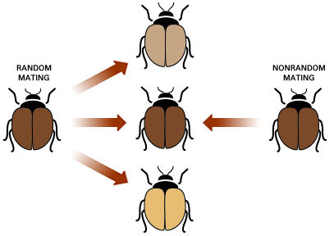
5. Sexual Selection (Non-Random Mating)
Sexual selection video
Sexual Selection: based on selection criteria (colour, displays, territory, song, size etc)
Organisms rarely mate randomly
Examples:
Harems: one male has many females
Assortative mating: choosing those like you

Slide 14
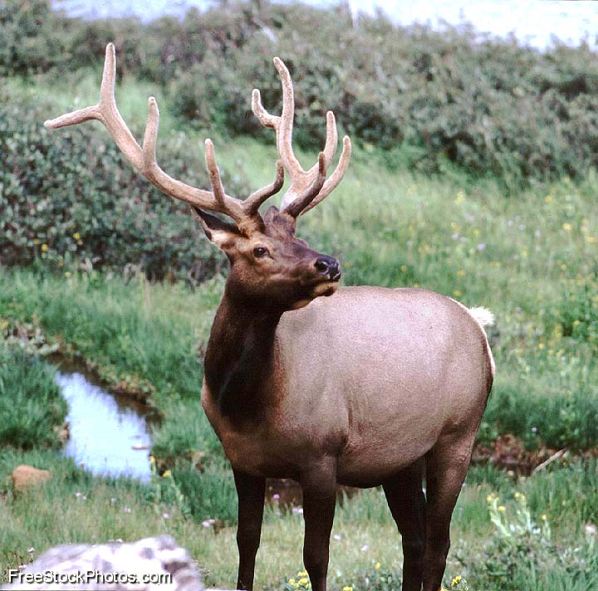
Who’s The Fittest?
Fittest in any population means the organism who contributes the most and best genes to the next generation (NOT who is in the best shape!)
In elk, one dominant male may mate with 80% of fertile females but if he happens to be sterile he’s not “fittest”
WHY?

Slide 15
Fitness and populations
Populations are made of many variations of genes
Those who contribute the most (the fittest!) have their genes represented the most in the next generation
So in each generation the genes that are the most represented depends on who was the fittest in the previous generation

Slide 16
Populations
If NO evolution is occurring in a population, then these frequency of each variation should remain the same from generation to generation.
But, if we see changes in the frequencies from generation to generation than we know that the population must be evolving!

Slide 17
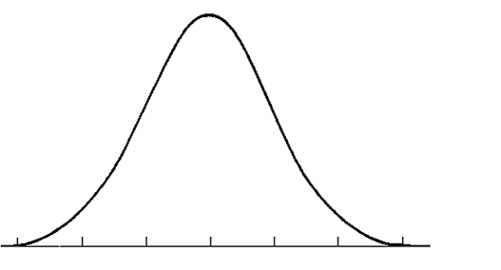
Populations
The most common genes can be represented in a graph
Natural selection will act on the population to produce a new shape of graph
% of Individuals
Possible Variations (usually a gradient)

Slide 18
Populations – Effects of Natural Selection
1. Stabilizing Selection
Acts against the extreme variations in a population, so makes the most common even more common
Genetic Diversity decreases

Slide 19
Populations
2. Directional Selection
Occurs when extreme variations at one end are favored over average.
One phenotype is favored over the other

Slide 20
Populations
3. Disruptive (or Diversifying) Selection
Occurs when extreme variations are favored over intermediate forms

Slide 21
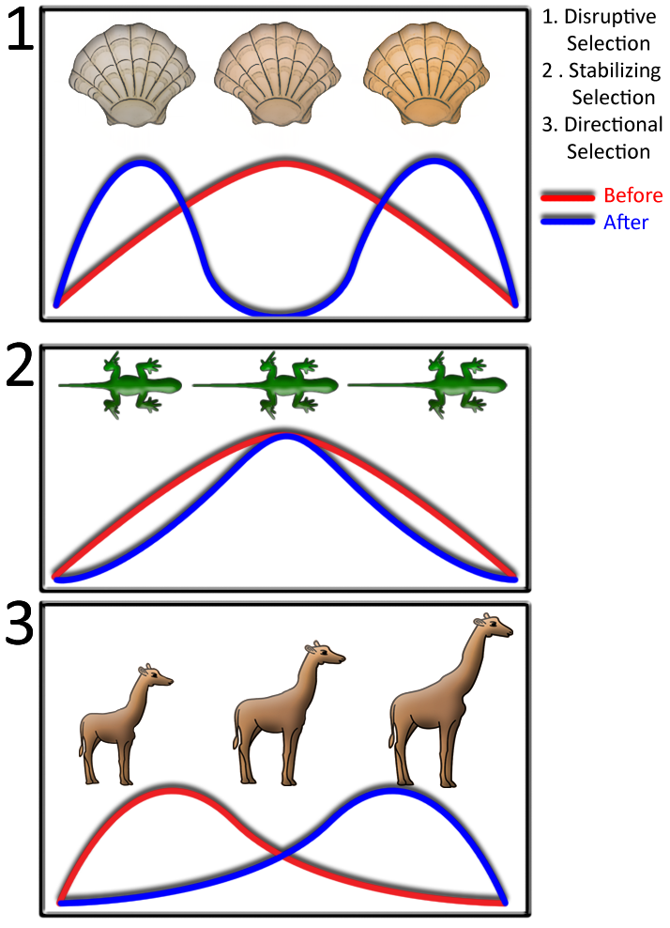

Slide 22
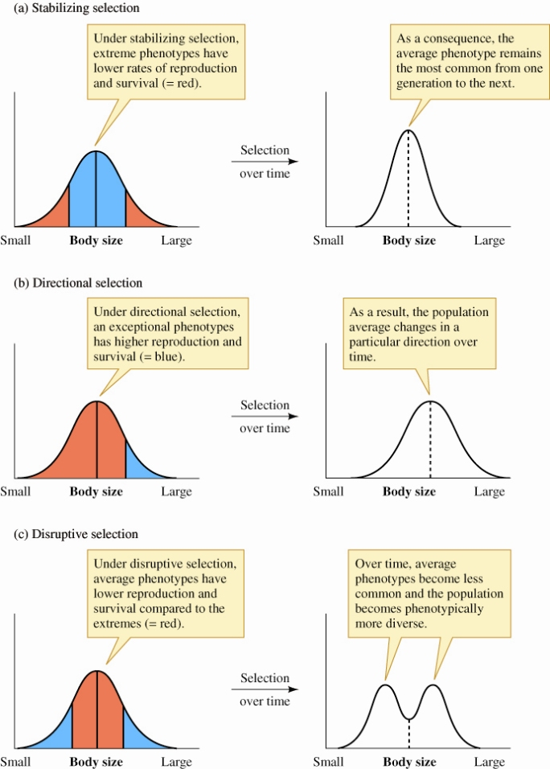

Slide 23
