Slide 1
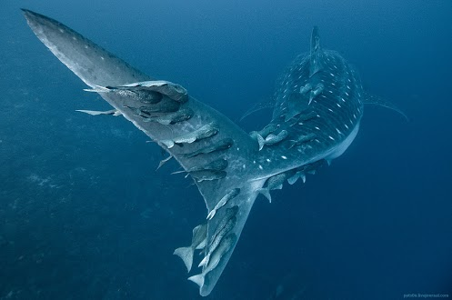
Introduction to Biology
The Study of Life

Slide 2
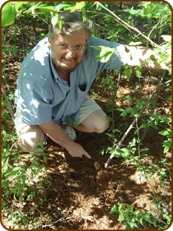
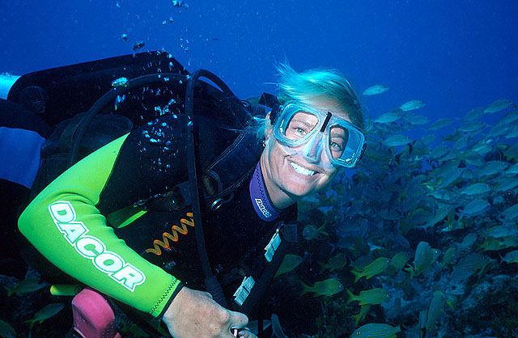
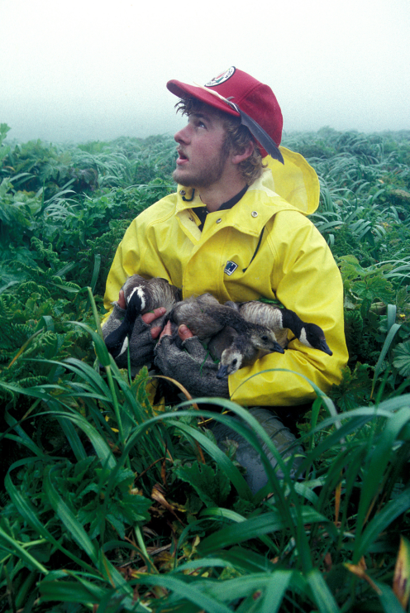
A Few Branches of Biology
      Zoologists
      Botanists
      Cell Biologists
      Geneticists
      Microbiologists
      Ecologists

Slide 3
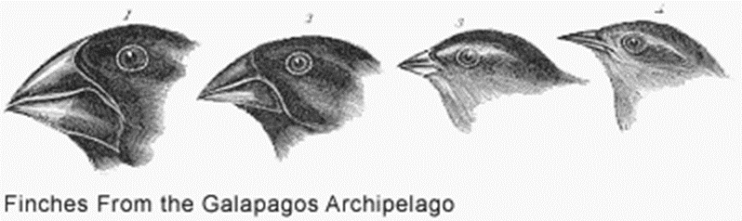
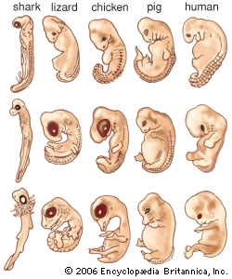
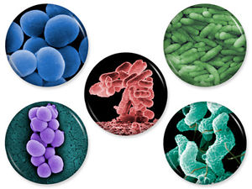
Topics of Life Sciences 11
Nature of Science
Cell Biology
Evolution
Taxonomy
Microbiology
Plants
Animals

Slide 4
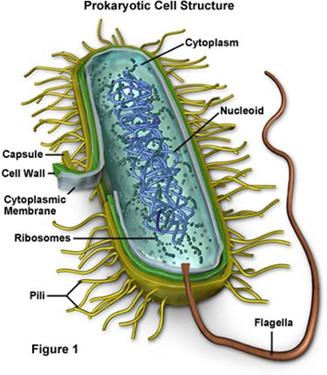
Objectives
By the end of the lesson you should be able to:
Describe the 8 characteristics of life
Describe how life is organized

Slide 5
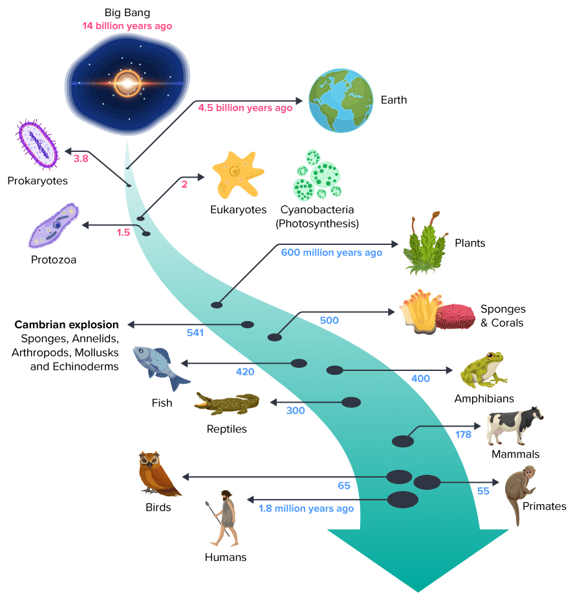
Life on Earth
Life arose more than 3.7 billion years ago
First organisms (living things) were single celled
Only life on Earth for millions of years
Organisms changed over time (evolved)
New organisms arose from older kinds
Today there are millions of species that inhabit almost every region of Earth today

Slide 6
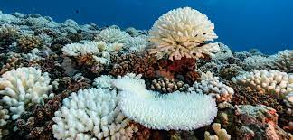
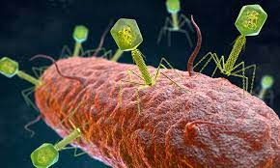
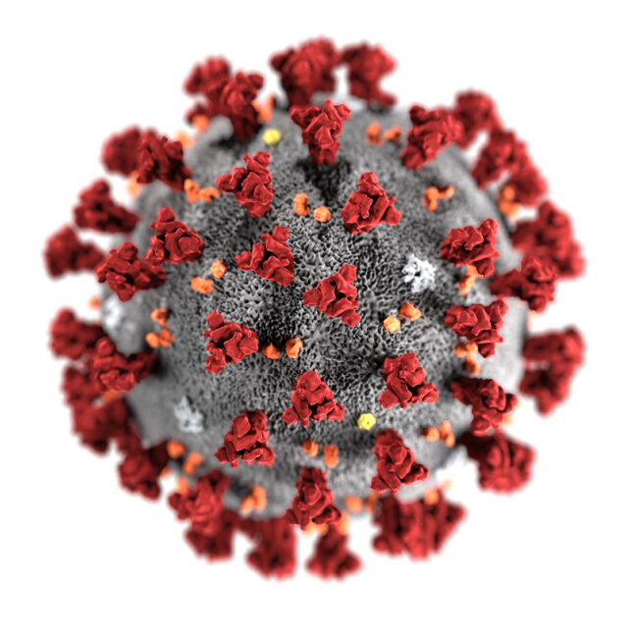
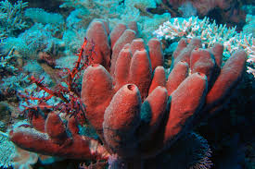
Characteristics of Life
Biology is the scientific study of life.
What defines life? Most biologists look for a set of general characteristics.

Slide 7
All life …
1) … is made up of at least one or more cells
2) … must obtain and use materials and energy
3) … grows and develops
4) … reproduces itself
5) … responds to its environment
6) … adapts over time - evolves - to survive in its environment
7) … maintains homeostasis (stable internal environments)
8) … is based on a universal genetic code

Slide 8
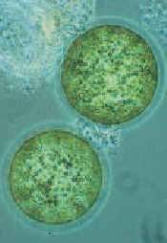
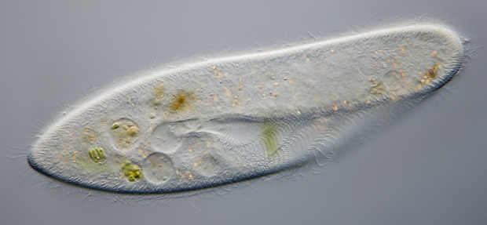
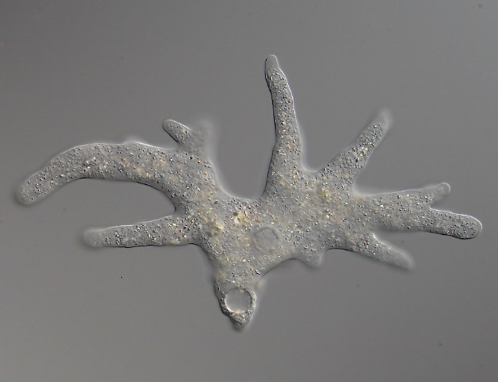
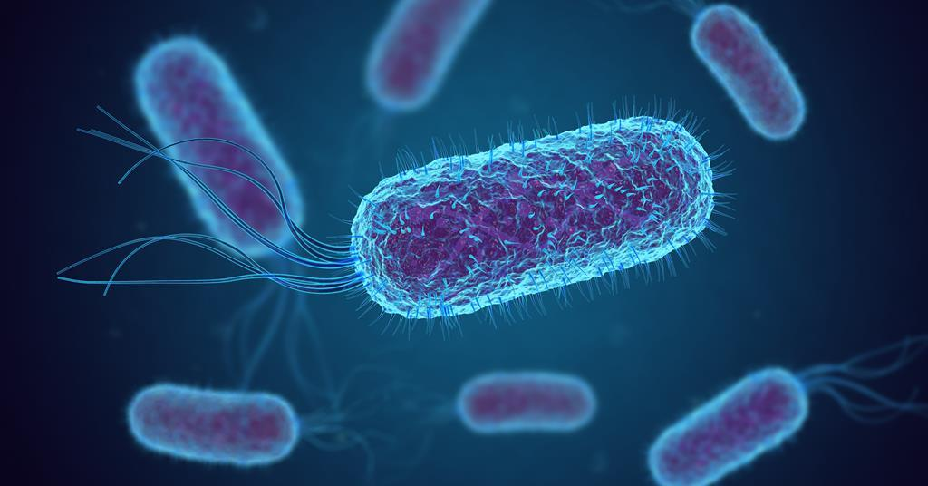
1) Life is Made Up of at Least One Cell
Cells are the basic unit of life
All organisms are made of and develop from cells
Some composed of only a single cell (unicellular) which is usually identical to parent (eg. bacteria, amoeba, algae, paramecium)

Slide 9
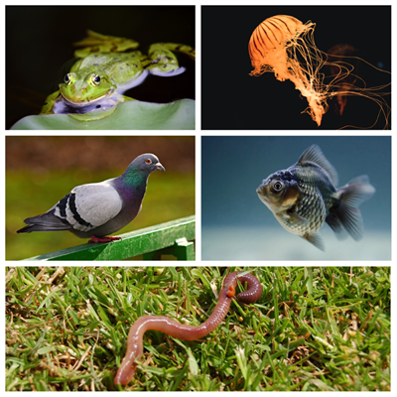
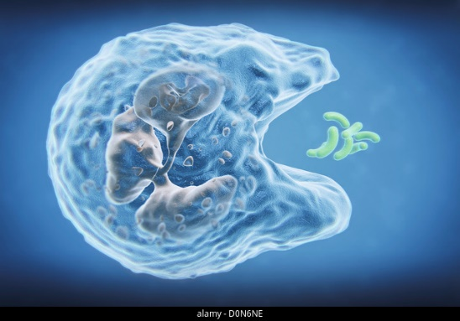
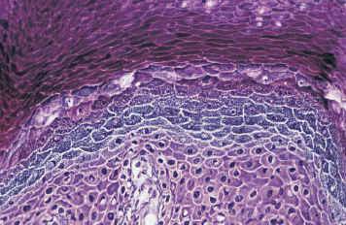
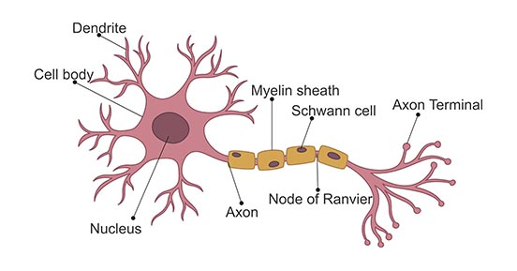
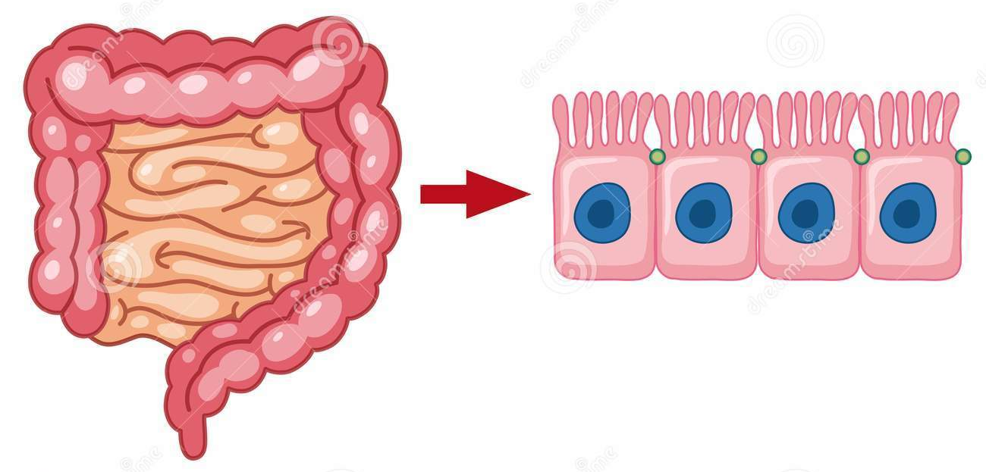
Most organisms are composed of many cells (multicellular)
  Cells are different (undergo differentiation)
Cells are small and highly organized
There is a close relationship between cell Structure and Function

Slide 10
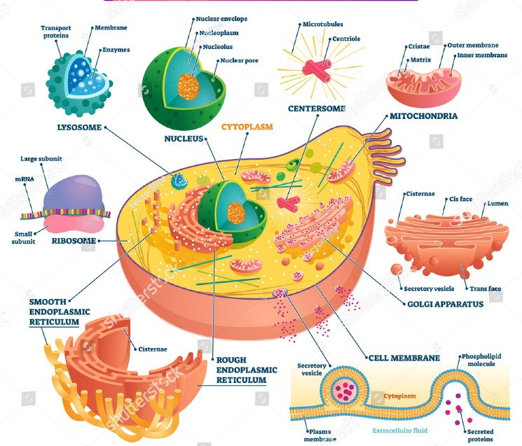
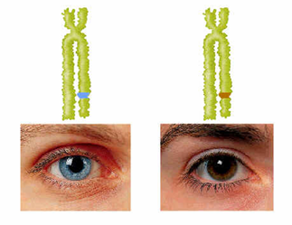
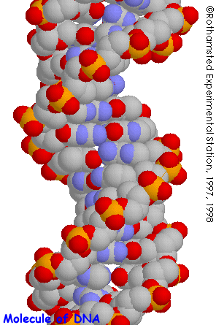
Cells contain specialized structures (organelles) that carry out the cell’s life processes
Many different kinds of cells exist
All cells surrounded by a plasma membrane
Contain a set of instructions called DNA (genetic information)

Slide 11
2) Life Must Obtain and Use Materials and Energy (Metabolism)
Living things need energy to power cellular processes and materials to build new cells, grow and reproduce
Set of chemical reactions that convert “food” into energy is called metabolism - Sum of all chemical processes

Slide 12
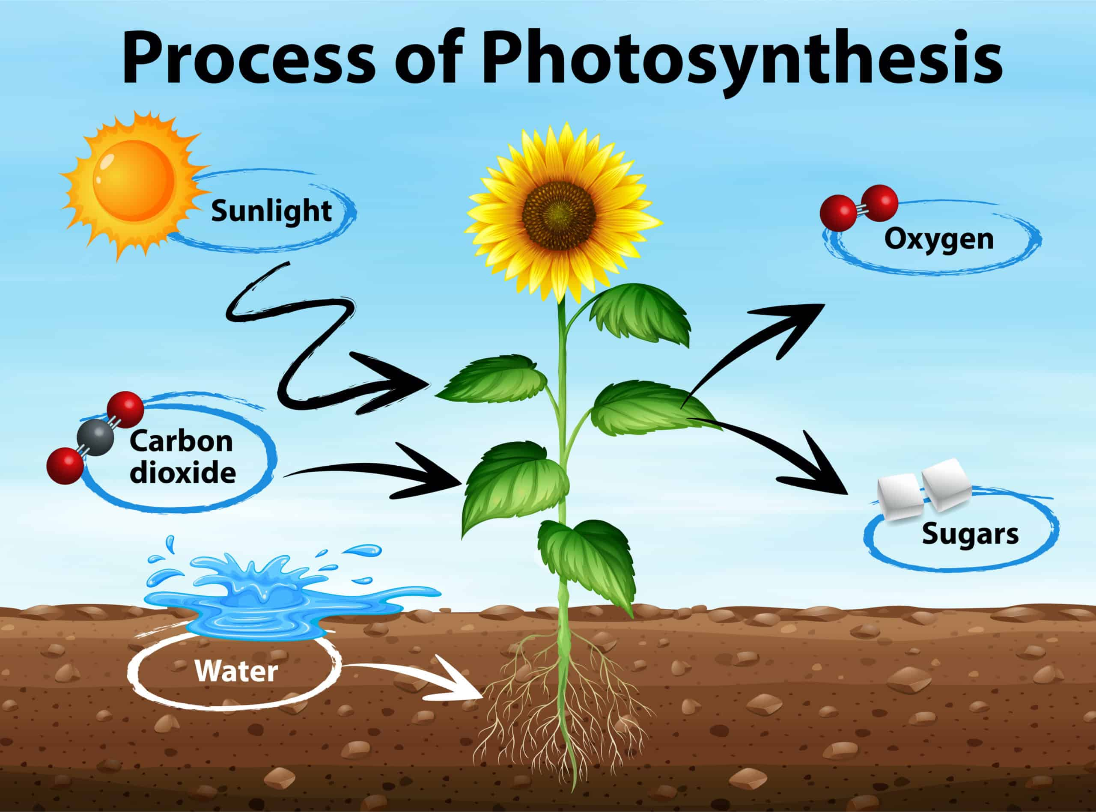
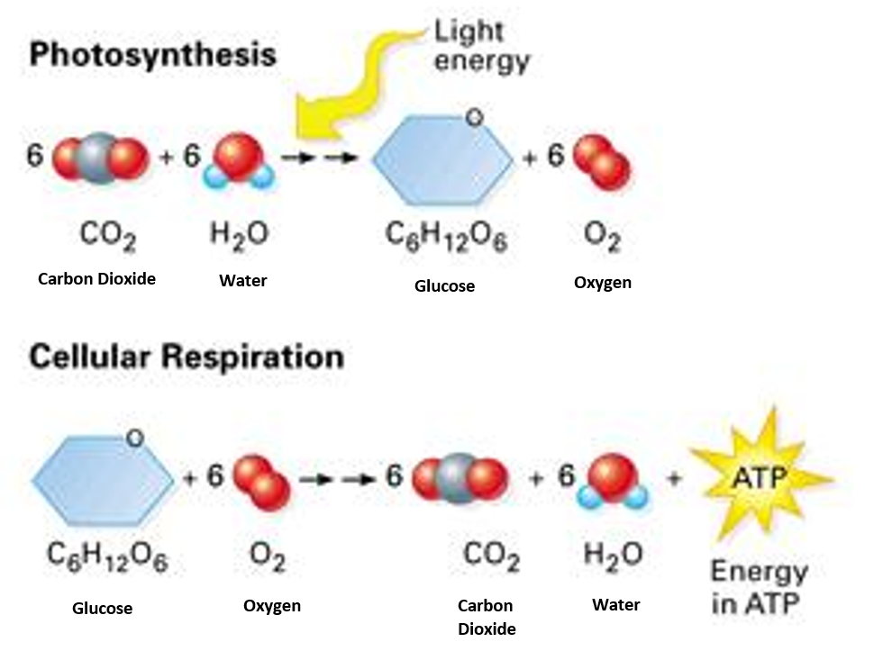
Almost all energy comes from the SUN (directly or indirectly)
Photosynthesis is the process by which some organisms capture the energy from the sun (solar energy) and transform it into chemical energy that can be used by living things

Slide 13
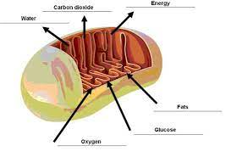
Cellular respiration is the process by which all organisms break down glucose (sugar) to produce the high energy molecule ATP (cellular energy) that can be used by the organism.

Slide 14
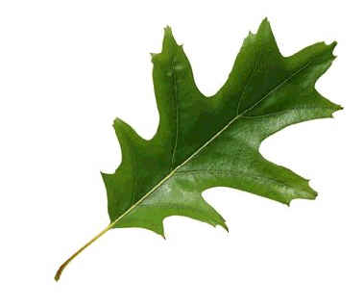
Autotrophs
Organisms that make their own food are called autotrophs
Phototrophs – use solar energy (photosynthesis) to get energy
Convert H₂O and CO₂ into sugar and O₂
Chemotrophs – use different chemical processes to get energy

Slide 15
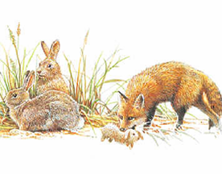
Heterotrophs
Organisms that must take in food to meet their energy needs are called heterotrophs
Consume autotrophs (herbivores), other heterotrophs (carnivores) or both (omnivores) for their energy needs
Complex chemicals are broken down and reassembled into chemicals and structures needed by organisms

Slide 16
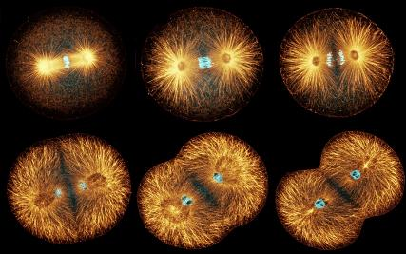
Growth
3) Life Grows and Develops
Growth is an increase in biomass that occurs as the result of cell division and cell enlargement
Cell division is the formation of two cells from a preexisting cell
New cells enlarge as they mature
When a cell grows to a size where its surface area isn’t big enough for its volume, the cell divides

Slide 17
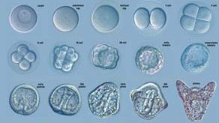
Development
The process by which an adult organism arise is called development
  Repeated cell divisions and cell differentiation

Slide 18
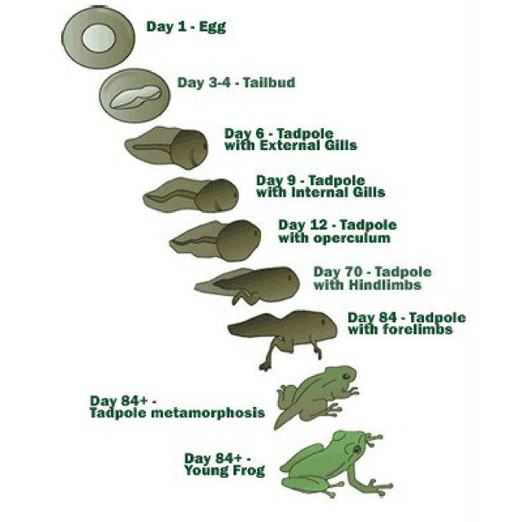
Organisms grow and develop along a specific sequence based on the instructions present in their genetic code (DNA).

Slide 19
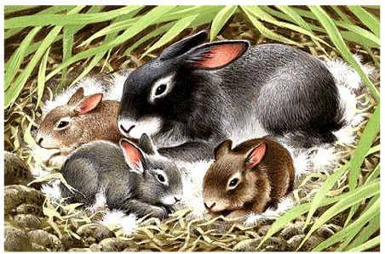
4) Life Reproduces Itself
All species have the ability to reproduce
  Not essential to survival of individual but is essential for continuation of a species

Slide 20
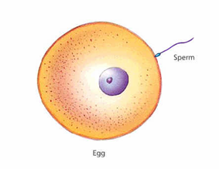
Sexual Reproduction
Hereditary information from two different organisms of the same species are combined
Egg and sperm → zygote (fertilized egg)
Zygote contains hereditary information from both parents

Slide 21
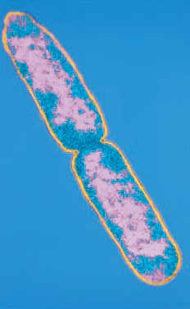
Asexual Reproduction
Hereditary information from one, usually unicellular, organism that divides
Resulting cells contain identical hereditary information
Genetic information from single parent

Slide 22
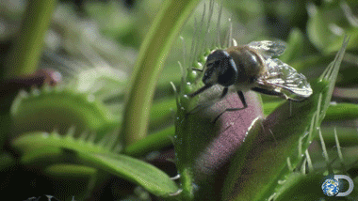
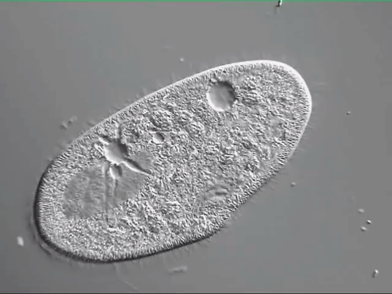
5) Life Responds to its Environment
Livings things have the ability to respond to changes in their environment called stimuli
Detect and respond to changes in light, heat, sound, chemicals and mechanical contact
Coordinates its responses

Slide 23
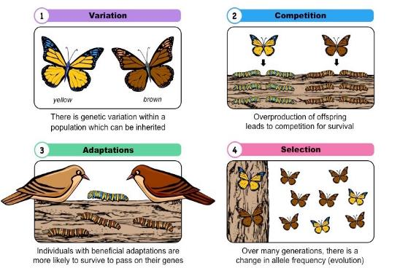
6) Life Adapts Over Time - Evolves - to Survive in its Environment
Populations of organisms adapt to their environment over time through the process of evolution
Favorable characteristics are selected for and passed on to offspring
Called adaptations
Driven by
Natural Selection
or “survival of the
fittest”

Slide 24
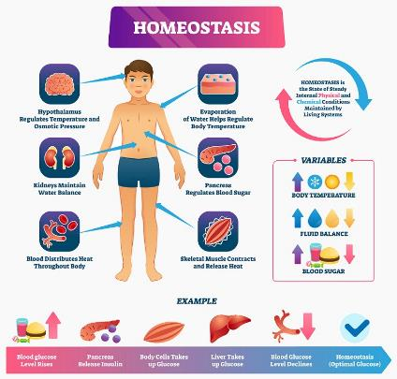
7) Life Maintains Homeostasis (Stable Internal Environments)
Living organisms must maintain a specific range of internal conditions in spite of the outside changes. This balance is called homeostasis
Homeo = same, steady
Stasis = state
Examples:
- Water balance inside and
outside of cell
- Human body temperature
*Cells function best when these are in balance

Slide 25
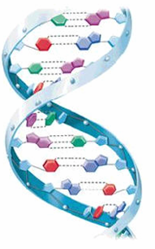
8) Life is Based on a Universal Genetic Code
DNA
Genetic Information in all cells
Deoxyribonucleic Acid
DNA contains instructions for traits GENES
Make the structures and complex chemicals necessary for life PROTEINS
DNA in every body cell (SOMATIC CELLS) is exactly alike

Slide 26
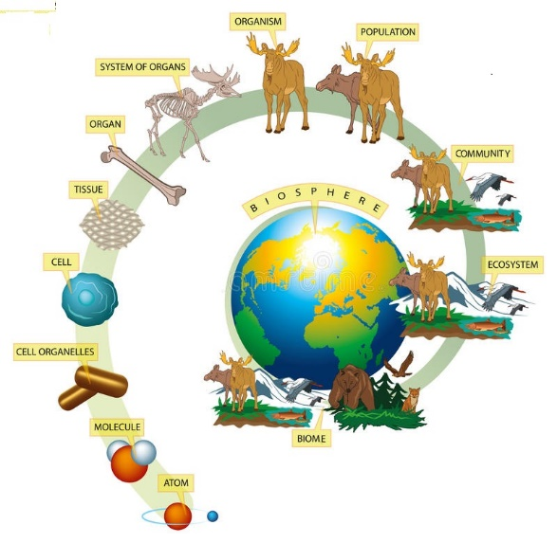
Organization of Life

Slide 27
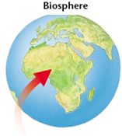
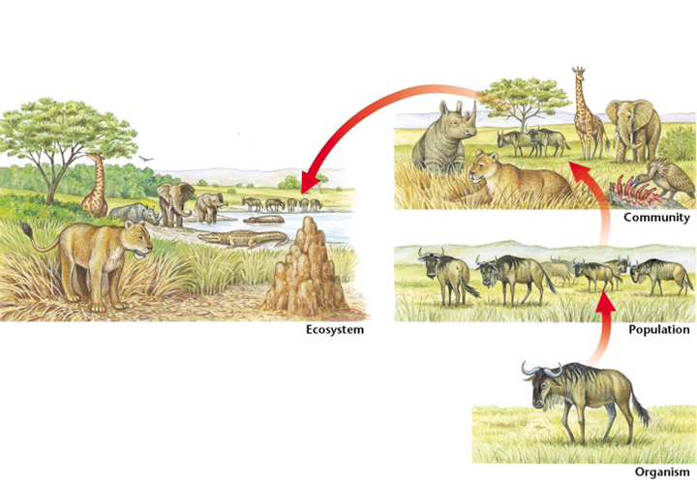
Organization of Life
The biosphere is the part of Earth that supports life.
An ecosystem is a specific area within the biosphere with a common set of physical characteristics.
  Climate, soil, landforms, etc.

Slide 28
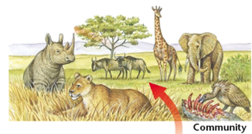
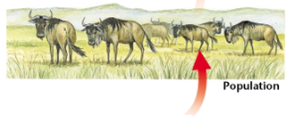
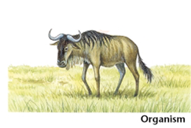
The biological community is made of all populations living and interacting in one ecosystem.
A population includes all members of a species that live in the same community.
An organism is an individual living thing.

Slide 29
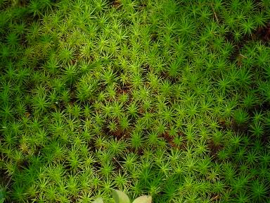
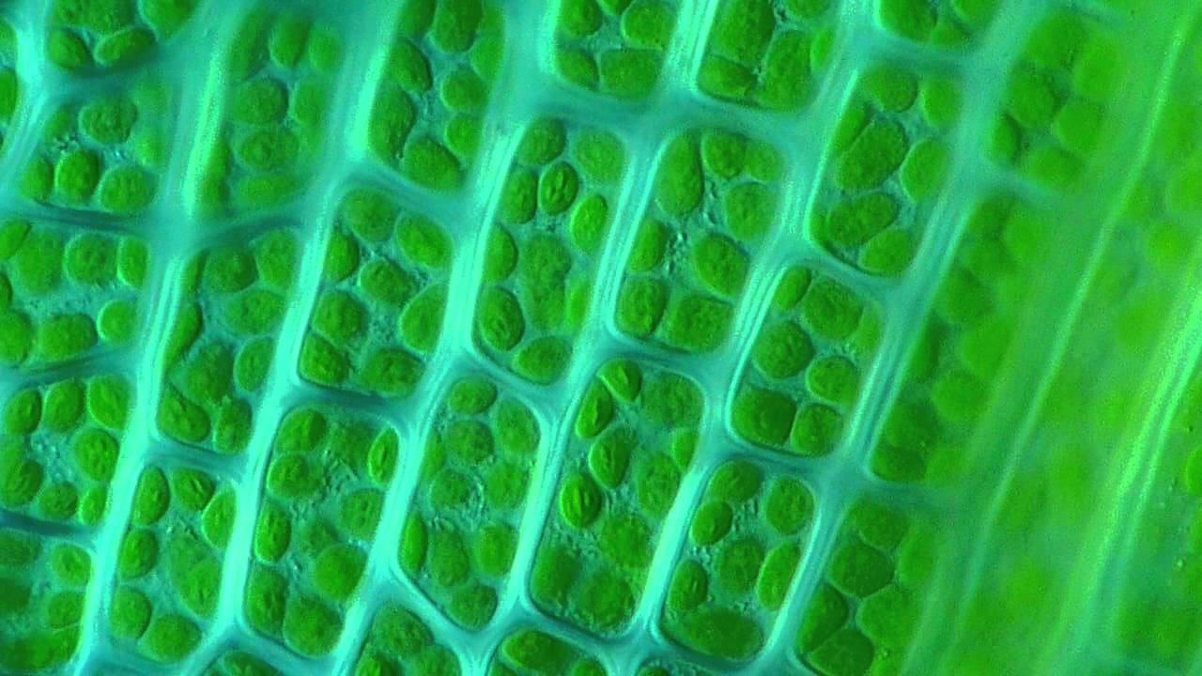
Organisms are made of organ systems and organs, structures with a specific vital function.
Each organ is made of a collection of tissues, which are groups of cells with similar structure and functions.
The cell is the smallest unit of an organism that still demonstrates all the basic characteristics of life.
Moss is an organism made of stems and leaves (organs). Each leaf is made of different tissues, which then contains many cells.

Slide 30
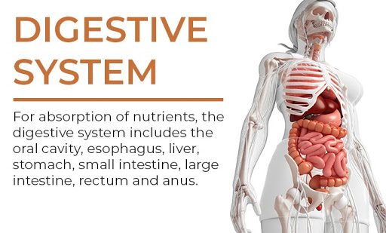

Slide 31

What is Life Made From?
You are what you eat! This will be our next topic!

Slide 32
Can You …
… describe the 8 characteristics of life?
… describe how life is organized?

