Slide 1
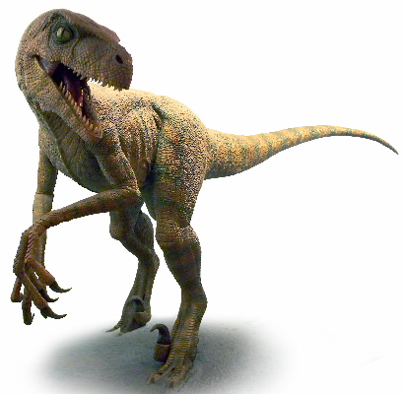
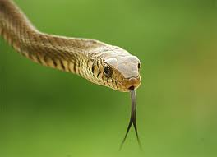
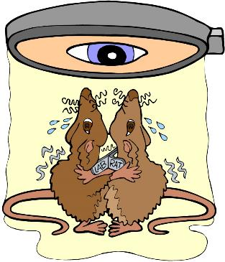

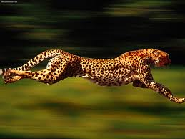
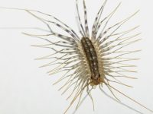

Introduction to Science
and the Scientific Method

Slide 2
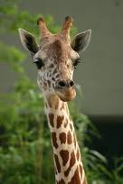
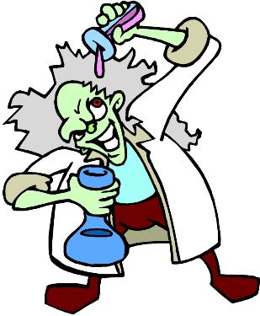
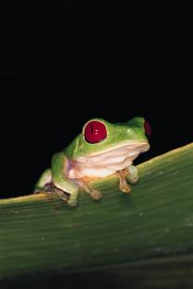
What is Science?
The goal of science is to investigate and understand the natural world, to explain events in the natural world, and to use those explanations to make useful predictions.
1. Science deals only with the natural world.
3. Scientists propose ___________ that can be ______ by examining evidence.
2. Scientists:
explanations
collect and organize information in a careful, orderly way, looking for patterns and connections between events.
tested
4. Science is an organized way of using evidence to learn about the natural world.

Slide 3


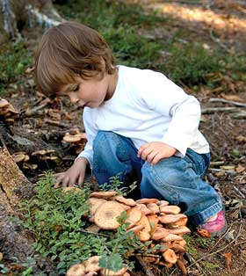
How is Science Done?
Science begins with an _____________.
This is the process of gathering information about events or processes in a careful, orderly way.
observation
Data is the information gathered from making observations.

Slide 4

There are two types of data:
Quantitative data are:
numbers and are obtained by counting or measuring.
Qualitative data are:
descriptions and involve characteristics that cannot be counted.

Slide 5
An inference is a scientific explanation for a set of observations.
A hypothesis is a testable prediction of what might happen.
Inference
Hypothesis

Slide 6
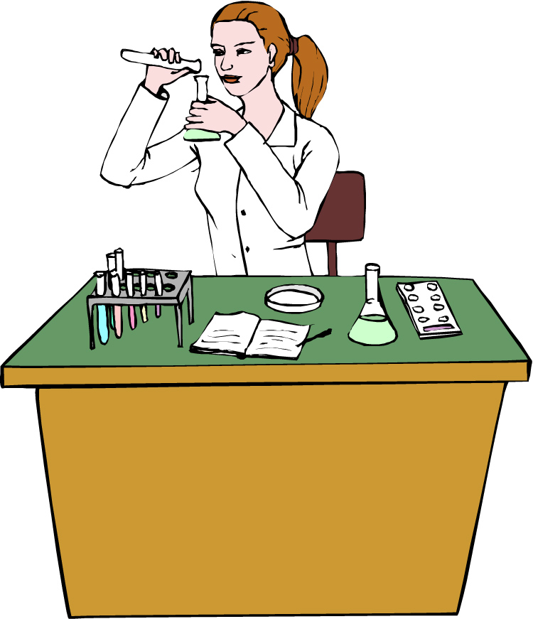
Scientific Method
The scientific method is:
A series of steps used by scientists to solve a problem or answer a question.
The Steps to the Scientific Method
Observation / Asking a Question
Form a Hypothesis
Design a Controlled Experiment and collect data
Record and Analyze Results
Draw Conclusions
Retest

Slide 7


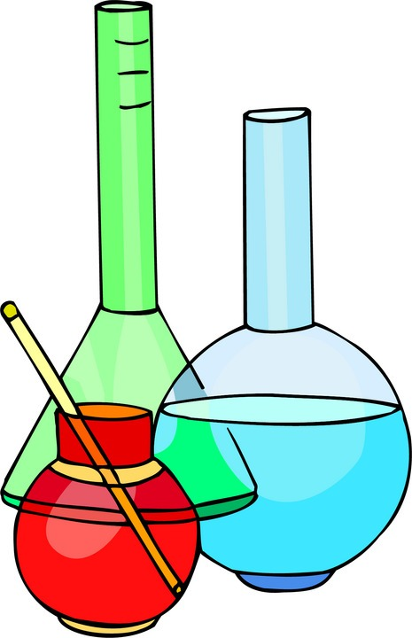
Step 1:
Observation / Asking a Question
Step 2: Form a Hypothesis
Hypothesis
A problem or a question must first be identified.
A testable prediction to the question or problem.
It is simply a prediction and has not yet been proven or disproven.
It must be stated in a way that is testable.
A statement is considered “testable” if evidence can be collected that either does or does not support it.
How much water can a root hair absorb?
Why does a plant stem bend toward the light?
What effect does temperature have on heart rate?

Slide 8
Step 3: Designing a Controlled Experiment
1. The factors in an experiment that can be changed are called variables. Some example of variables would be: changing the temperature, the amount of light present, time, concentration of solutions used.
2. A controlled experiment works with one variable at a time. If several variables were changed at the same time, the scientist would not know which variable was responsible for the observed results.
3. In a “controlled experiment” only one variable is changed at a time. All other variables should be unchanged or “controlled”.
4. An experiment is based on the comparison between a ____________ with an ________________.
control group
experimental group
a) These two groups are identical except for one factor.
b) The control group serves as the comparison. It is the same as the experiment group, except that the one variable that is being tested is removed.
c) The experimental group shows the effect of the variable that is being tested.

Slide 9
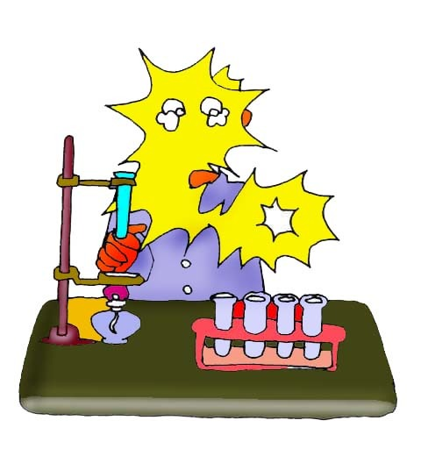
Example: In order to test the effectiveness of a new medicine, 50 volunteers are selected and divided into two groups. One group will be the control group and the other will be the experimental group. Both groups are given a pill to take that is identical in size, shape, color and texture.
Even though the volunteers are given identical looking pills, the control group will not actually receive the medicine.
Describe the control group.
Describe the experimental group.
What variables are kept constant?
What variable is being changed?
This group will receive the medicine.
The size, shape, color, and texture of the pill.
Whether or not the pill contains the medicine.

Slide 10
There are two variables in an experiment:
c) In the above example, what is the independent variable?
a) The independent variable is the variable that is deliberately changed by the scientist.
It is the addition of the medicine to the pills that were given to the volunteers.
b) The dependent variable is the one observed during the experiment. The dependent variable is the data we collect during the experiment. This data is collected as a result of changing the independent variable.
d) In the above example, what is the dependent variable?
The observed health of the people receiving the pills.

Slide 11
e) In order to make this experiment FAIR, what are some controls (also called constants) that must be kept the same?
Everyone will
start with the same illness
take the same number of pills
same time of day (eg. after a meal)
maintain similar exercise routines
maintain similar diets

Slide 12

Step 4: Recording and Analyzing Results
1. The data that has been collected must be organized and analyzed to determine whether the data are reliable.
2. Does the data support or not support the hypothesis?

Slide 13

Step 5: Drawing Conclusions
The evidence from the experiment is used to determine if the hypothesis is proven or disproven.

Slide 14
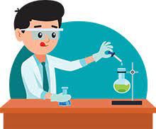
Step 6: Retest
Experiments must be repeated over and over. When repeated, the results should always be the same before a valid conclusion can be reached.

Slide 15
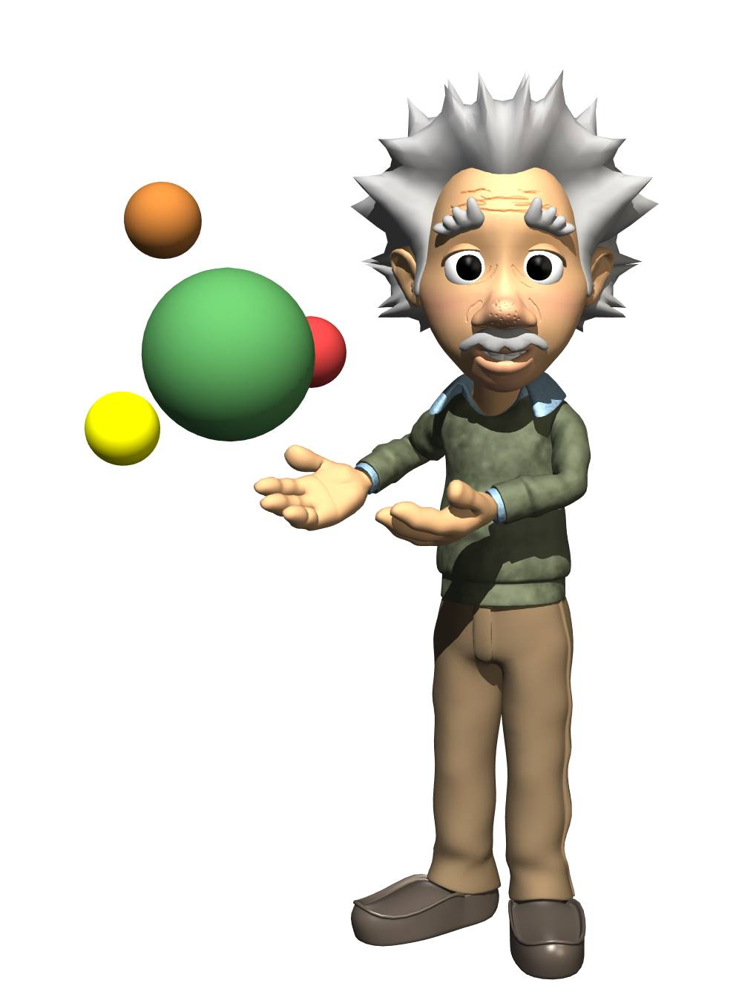
Forming a Theory
A theory may be formed after the hypothesis has been tested many times and is supported by considerable evidence.
Theory:
A broad and comprehensive explanation of some aspect of nature that is supported by a vast body of evidence.

Slide 17
Practice Problem:
You want to determine the effects of a certain fertilizer on the growth of orchids grown in a greenhouse. Materials that are available to you include: greenhouse, 100 orchid plants, water, fertilizer, and soil. You want to know if the orchids will grow best with a weak concentration of fertilizer, a medium concentration of fertilizer, or a high concentration of fertilizer. How will you design an experiment to test different concentrations of this fertilizer?
State your hypothesis:
Possible answer:
I predict that the orchids will grow best with a medium concentration of fertilizer.

Slide 18

How will you set up a controlled experiment?
Here is one possibility:
The 100 plants will be divided into 4 groups as follows:
Group 1: 25 plants will receive plain water.
Group 2: 25 plants will receive a weak concentration of fertilizer.
The plants will be watered daily.
Over a period of a month, the plants will be measured to see which ones grew the tallest.
Group 3: 25 plants will receive a medium concentration of fertilizer.
Group 4: 25 plants will receive a high concentration of fertilizer.

Slide 19

Control Group
Experimental Group
What is the control group in this experiment?
The control group consists of the 25 plants that are receiving plain water.
What is the experimental group in this experiment?
The experimental group consists of the 75 plants that are receiving various concentrations of fertilizer.

Slide 20
In a “controlled experiment”, all variables must be kept constant except the one variable that is being changed.
What variables must be kept constant in this experiment?
All plants must receive the same amount of fluid each day.
All plants are grown in pots of equal size.
All plants are grown at the same temperature.
All plants receive the same amount of sunlight.
What variable is being changed in this experiment?
The variable being changed is the amount of fertilizer received by each group of plants.

Slide 21
After one month of measuring the orchids, the following data is obtained:
Group 1 (Control Group): Grew to an average height of 15 cm.
Group 2 (Weak conc.): Grew to an average height of 35 cm.
Group 3 (Medium conc.): Grew to an average height of 28 cm.
Group 4 (High conc.): Grew to an average height of 10 cm.
Is your hypothesis supported or disproved by these results?
We hypothesized that the orchids would grow best with a medium concentration of fertilizer.
The results do not support this.
The results disprove our hypothesis.

Slide 22
After one month of measuring the orchids, the following data is obtained:
Group 1 (Control Group): Grew to an average height of 15 cm.
Group 2 (Weak conc.): Grew to an average height of 35 cm.
Group 3 (Medium conc.): Grew to an average height of 28 cm.
Group 4 (High conc.): Grew to an average height of 10 cm.
What is your conclusion based on these results?
Orchids grow best with a weak concentration of fertilizer.
At medium to high concentrations, plant growth is inhibited.

Slide 23
Analysis Questions
Why is it important to have a large sample size in any experiment?
It is important to test a large sample in order to get a true picture of the results of the experiment. If the sample size is too small, an inaccurate conclusion may be reached. Results obtained by testing a large number of individuals would be much more accurate than if only a few individuals had been tested.

Slide 24
Analysis Questions
Why is it important to repeat the experiment many times?
Experiments should be repeated to see if the same results are obtained each time. This gives validity to the test results.

Slide 25
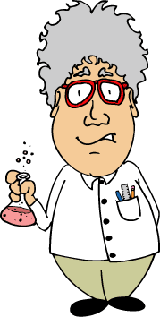
Analysis Questions
What is the importance of the control?
The control shows what will happen when the experimental factor is omitted. Without the control, there would be no basis for comparison and you would not know how the experimental factor affected the results.

Slide 26

Analysis Questions
How is a theory different than a hypothesis?
A hypothesis is an “educated guess” that is testable through observations and experimentation. A theory is a broad statement of what is believed to be true based on many experiments and considerable amounts of data.

Slide 27
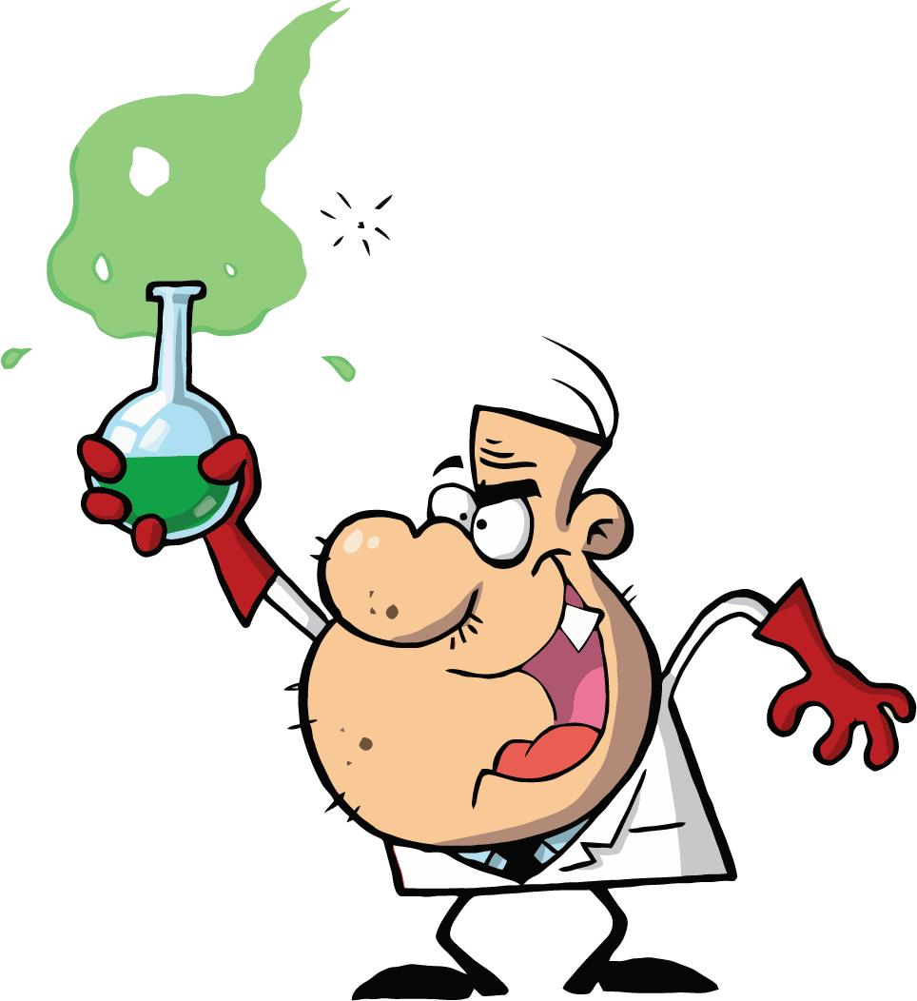
Analysis Questions
Why is it so important that a scientist accurately describes the procedure used in the experiment?
It allows other scientists to repeat the experiment and verify the results.

Slide 28

Analysis Questions
What is the difference between the independent and the dependent variables in an experiment?
The independent variable is the variable that is deliberately changed by the scientist. The dependent variable is the one observed during the experiment. The dependent variable is the data we collect during the experiment.

Slide 29
Analysis Questions
In a “controlled experiment”, why must all of the variables, except one, be kept constant throughout the experiment?
If several variables were changed at the same time, the scientist would not know which variable was responsible for the observed results.

Slide 30

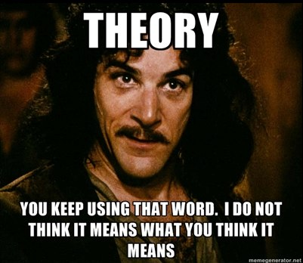
Analysis Questions
You have probably heard the expression “it’s just a theory” or “here’s my theory” in everyday language. Does the word ‘theory’ in science have the same meaning as in everyday conversation?

Slide 31
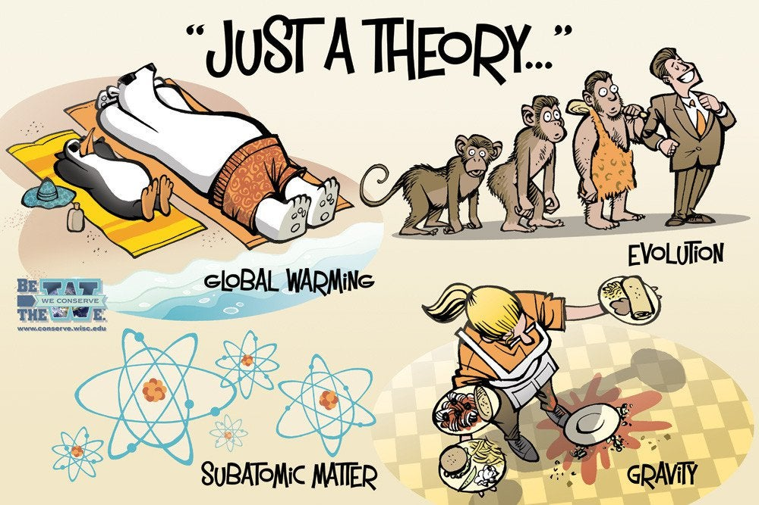
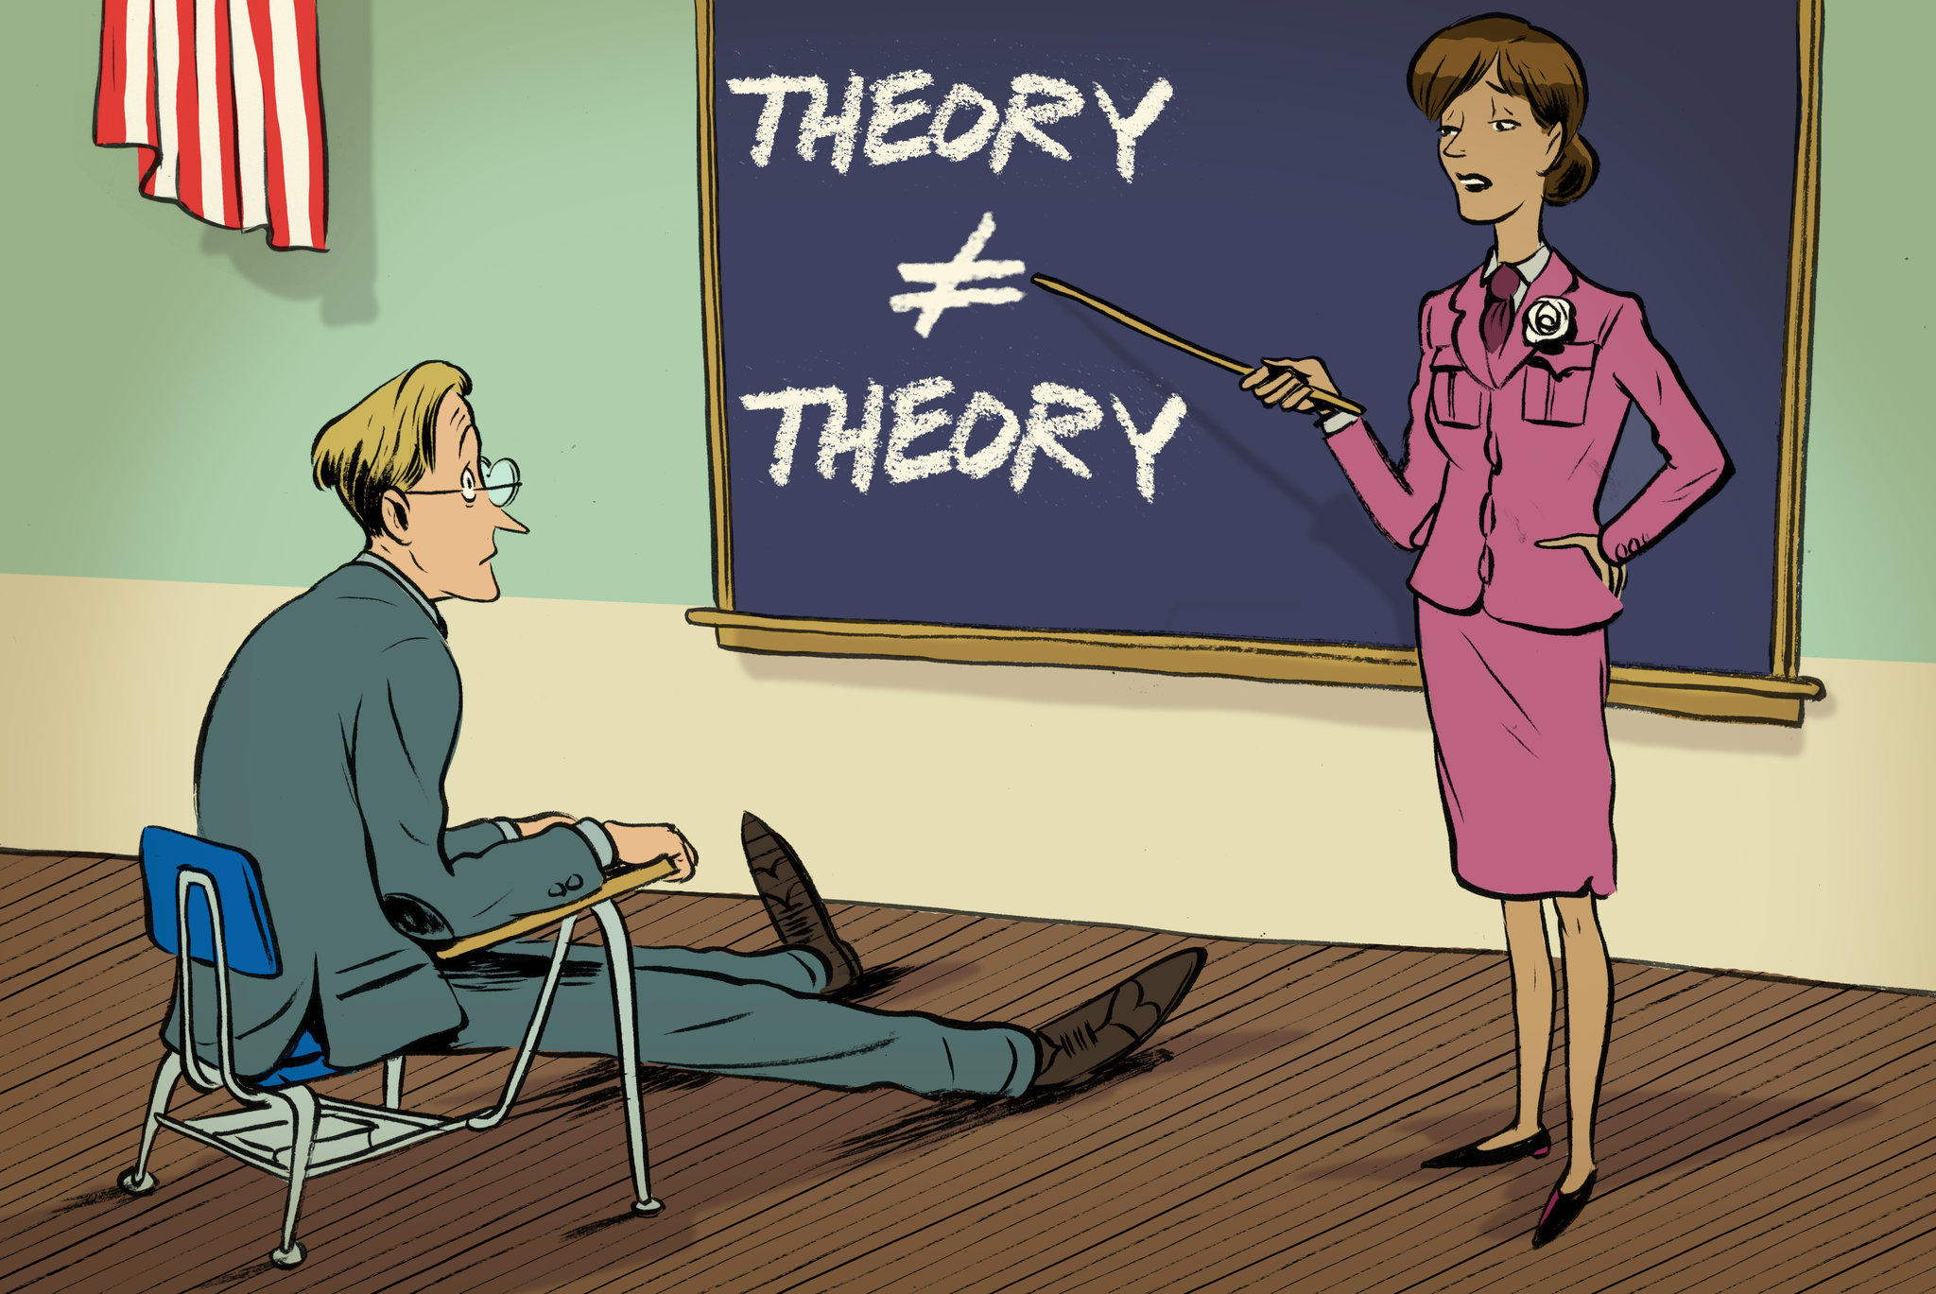
In everyday language, the word ‘theory’ actually means something more similar to ‘hypothesis’ or a simple idea.

