Slide 1
Jeopardy
Life Sciences 11:
Evolution

Slide 2
Historically Speaking | “I will survive..” | Prove It! | PE: but not in the gym! | It’s All Random!
100 | 100 | 100 | 100 | 100
200 | 200 | 200 | 200 | 200
400 | 400 | 400 | 400 | 400
600 | 600 | 600 | 600 | 600
800 | 800 | 800 | 800 | 800
1000 | 1000 | 1000 | 1000 | 1000

Slide 3
Historically Speaking 100
The definition is “change over time”
evolution
Board

Slide 4
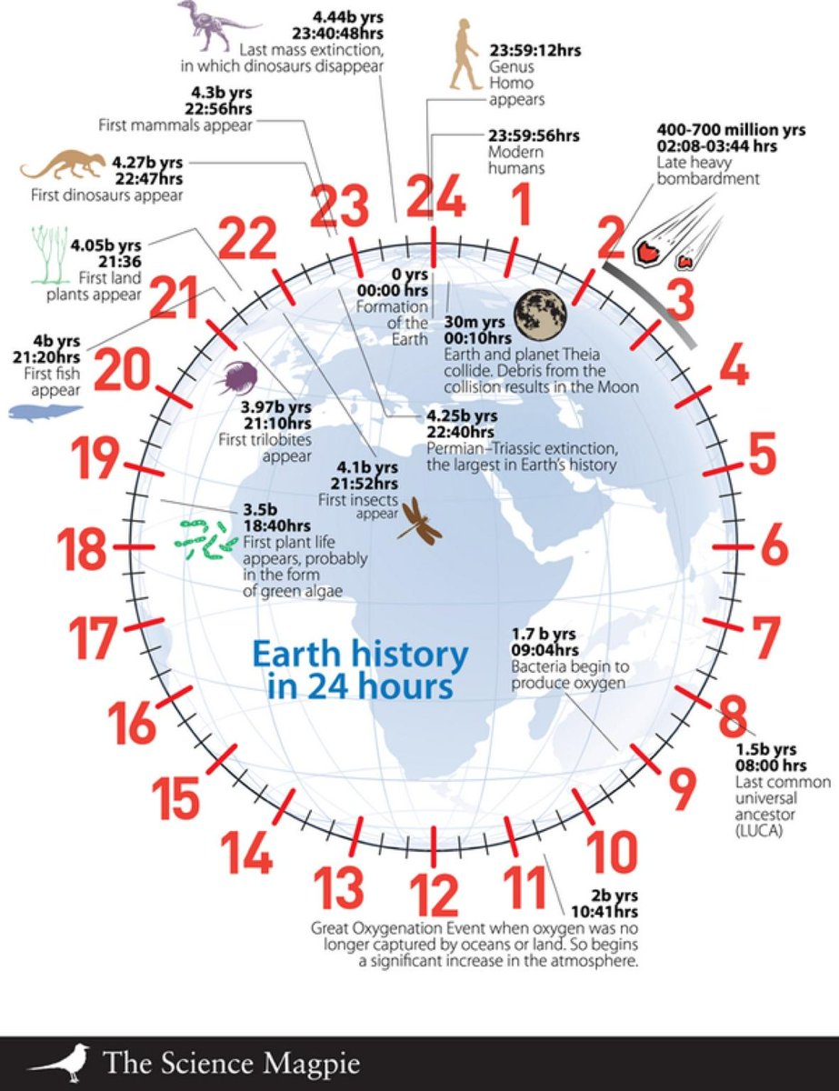
Historically Speaking 200
If Earth’s 4.6 billion years are represented as a 24 hour clock, how long have modern humans been around?
a) 4 hours b) 4 minutes c) 4 seconds
C) 4 seconds
Board

Slide 5
Historically Speaking 400
He believed in “inheritance of acquired characteristics”
Lamarck
Board

Slide 6
Historically Speaking 600
This man had that same ideas as Darwin but lost all his evidence when his boat sank :(
Alfred Russell Wallace
Board

Slide 7
Historically Speaking 800
Darwin was predisposed to his evolutionary theory from an early age due to this man’s influence
Erasmus Darwin
Board

Slide 8
Historically Speaking 1000
If only Darwin had read this man’s work on genetics…
Gregor Mendel
Board

Slide 9
Prove It! 100
Of the 4 types of evidence, these were the first used (a snapshot of history)
Fossils
Board

Slide 10
Prove It! 200
Similar structures indicates that organisms have these the same as well
Genes (DNA segments)
Board

Slide 11
Prove It! 400
Embryos express these gene first
Their most primitive genes
Board

Slide 12
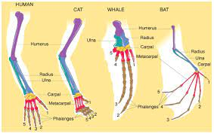
Prove It! 600
Similar forearms in vertebrates (organisms with backbones) are an example of this line of evidence
Comparative anatomy
Board

Slide 13
Prove It! 800
Differences in these act as a molecular clock to measure the time since two species diverged.
DNA sequences (genes)
Board

Slide 14
Prove It! 1000
As long as populations are isolated from each other, they will evolve different structures/appearances due to a build up of these
(Random) mutations
Board

Slide 15
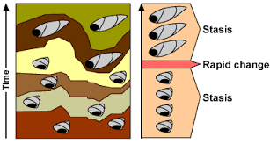
PE: but not in the gym! 100
This is a method to explain how macroevolution occurs without intermediate fossils
Punctuated Equilibrium
Board

Slide 16
PE: but not in the gym! 200
This small sub-population exists alongside the main population
Peripheral population
Board

Slide 17
PE: but not in the gym! 400
This must occur for populations/species to evolve separately
Isolation
Board

Slide 18
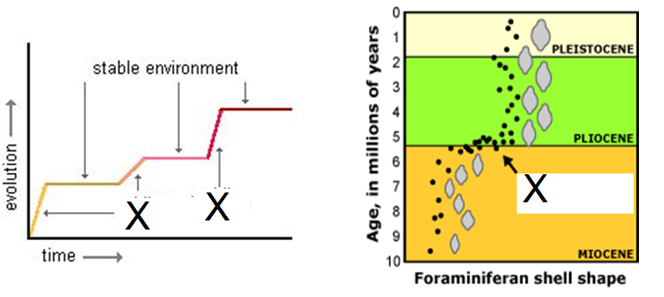
PE: but not in the gym! 600
What is happening at ‘X’ on these diagrams?
Period of rapid evolutionary change due to change in environment
Board

Slide 19
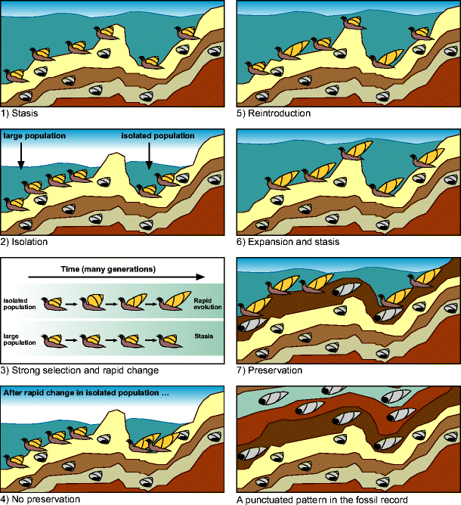
PE: but not in the gym! 800
Why is there little preservation of intermediate fossils in the punctuated equilibrium model?
Small population size, small area, short time Board

Slide 20
PE: but not in the gym! 1000
The name of the two gentlemen in 1972 who proposed a theory to explain speciation
Eldredge and Gould
Board

Slide 21
It’s all Random! 100
This is the name of Darwin’s boat
HMS Beagle
Board

Slide 22
It’s all Random! 200
When a random natural disaster or event causes a decrease in the population, potentially losing genes from the gene pool
Genetic drift
Board

Slide 23
It’s all Random! 400
AKA: mating with ones like you
Assortative mating (non-random mating is an okay but less great answer)
Board

Slide 24
It’s all Random! 600
When the average/middle is better than either of the extremes in a population
Stabilizing selection
Board

Slide 25
It’s all Random! 800
When one extreme variation is favoured over the intermediate
Directional selection
Board

Slide 26
It’s all Random! 1000
Type of evolution responsible for creating new species
Macro-evolution / Speciation
Board

Slide 27
“I will survive…” 100
Mutations can cause this in a population
New traits, variation, good/bad/neutral changes
Board

Slide 28
“I will survive…” 200
This is referred to as all the genes/alleles in a population
Gene pool
Board

Slide 29
“I will survive…” 400
Those who contribute the most and best genes to the next generation are called this
The fittest
Board

Slide 30
“I will survive…” 600
Theory that states parents pass on traits to offspring who look similar and different (proposed by Darwin)
Descent with modification or gradualism
Board

Slide 31
“I will survive…” 800
Changes in the amount (frequency) of each gene present from generation to generation indicate this is occurring
Evolution
Board

Slide 32
“I will survive…” 1000
If a male mates with the most females but is sterile, is he the most fit? Explain.
No, he has to contribute the MOST and BEST genes to the next generation
Board

