Slide 1
Phylum Mollusca
The Soft Bodies
27-4 pg. 701

Slide 2
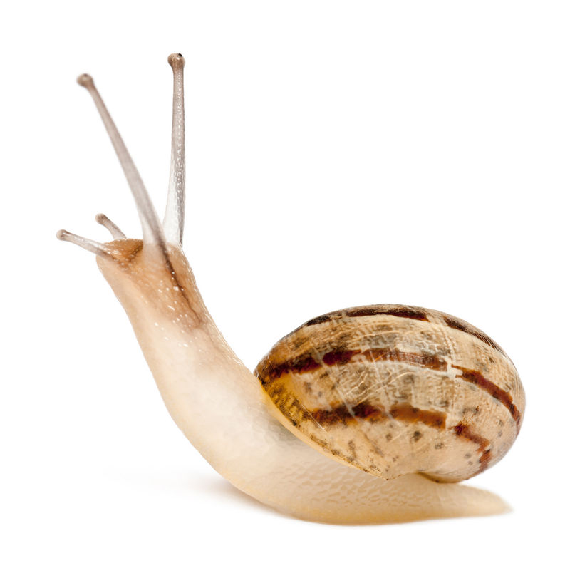
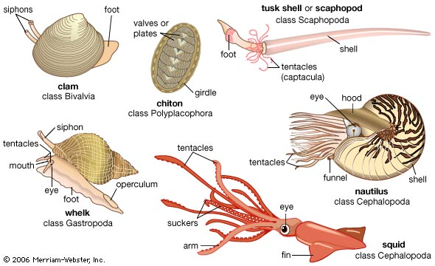
Objectives
State why Mollusks are more advanced than Nematodes
What is the basic body plan of mollusks
Describe the 3 defining characteristics of Mollusks
Describe the 4 Classes and example animals

Slide 3
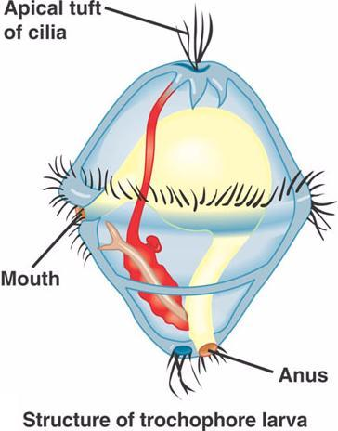
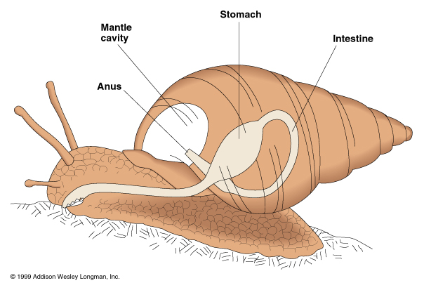
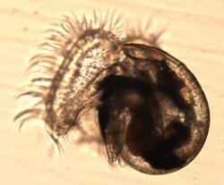
What is a Mollusk?
Name comes from the Latin word ‘molluscus’ which means ‘soft’
Mollusks typically have an internal or external shell
Studies show that mollusks share common ancestor of annelids because of their larval stage (trochophore)
Example animals include snails, slugs, clams, squids, and octopi

Slide 4
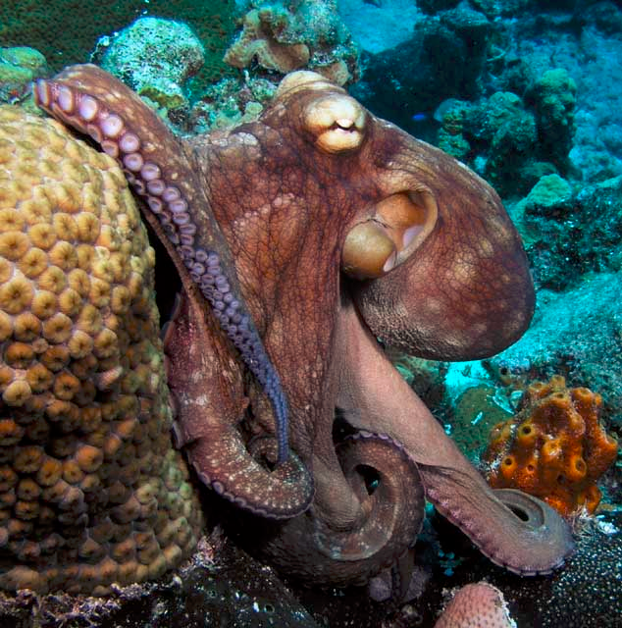
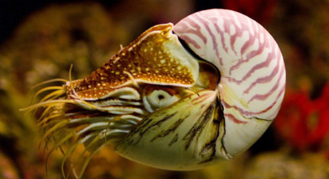
What is a Mollusk?
Mollusks are the second largest phyla in the Animalia kingdom
There are three defining characteristics
Large ventral muscular foot
Visceral mass located dorsal to the foot
Tissue layer called “mantle” covers the visceral mass
**Many also have a shell although they are lost in some species

Slide 5
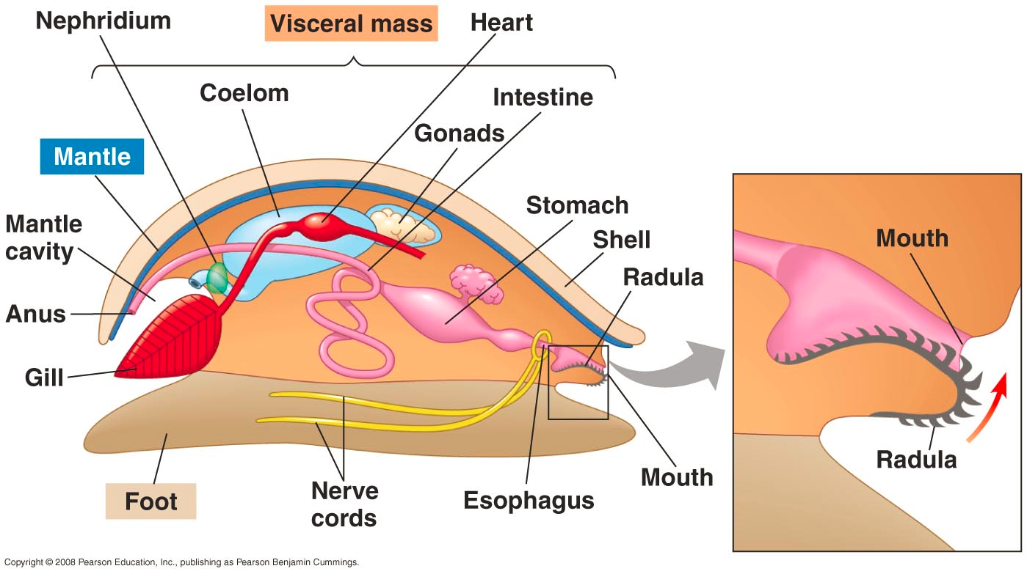
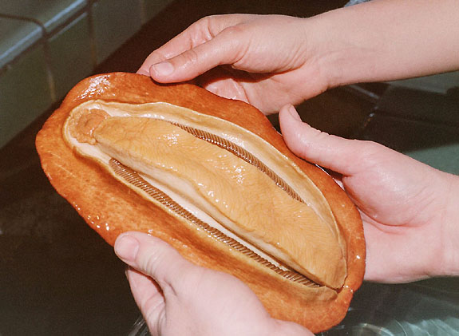
Body Plan
The muscular foot
This ‘foot’ can take many forms, including
flat structures for crawling
Spade-shaped for burrowing
Tentacles for capturing prey
Mantle
A thin layer of tissue that covers most of the mollusks body

Slide 6
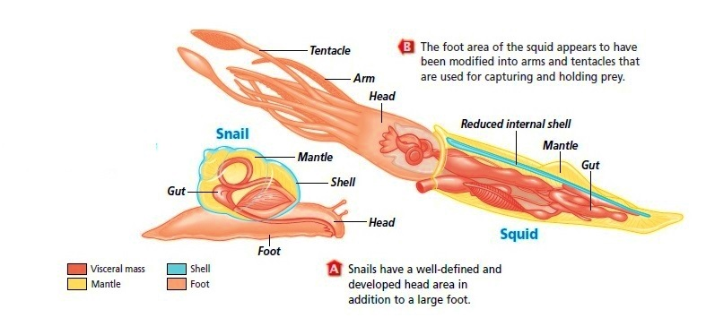

Slide 7
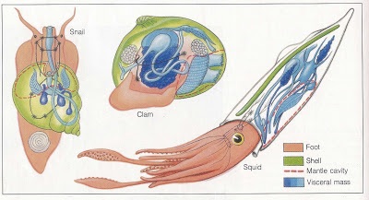

Slide 8
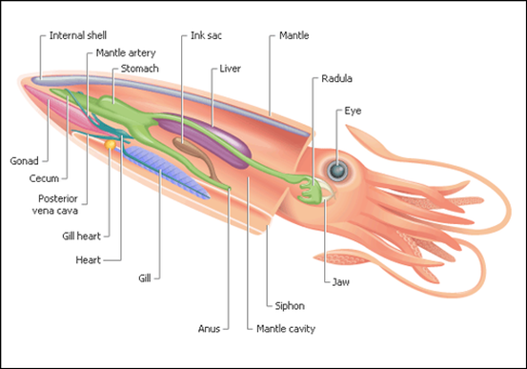
Body Plan
Visceral Mass
Below the mantle which contains the internal organs
Shell
Is made by glands in the mantle that secrete calcium carbonate
Ones that do not have a shell has simply been reduced or lost (ie. Slugs)

Slide 10
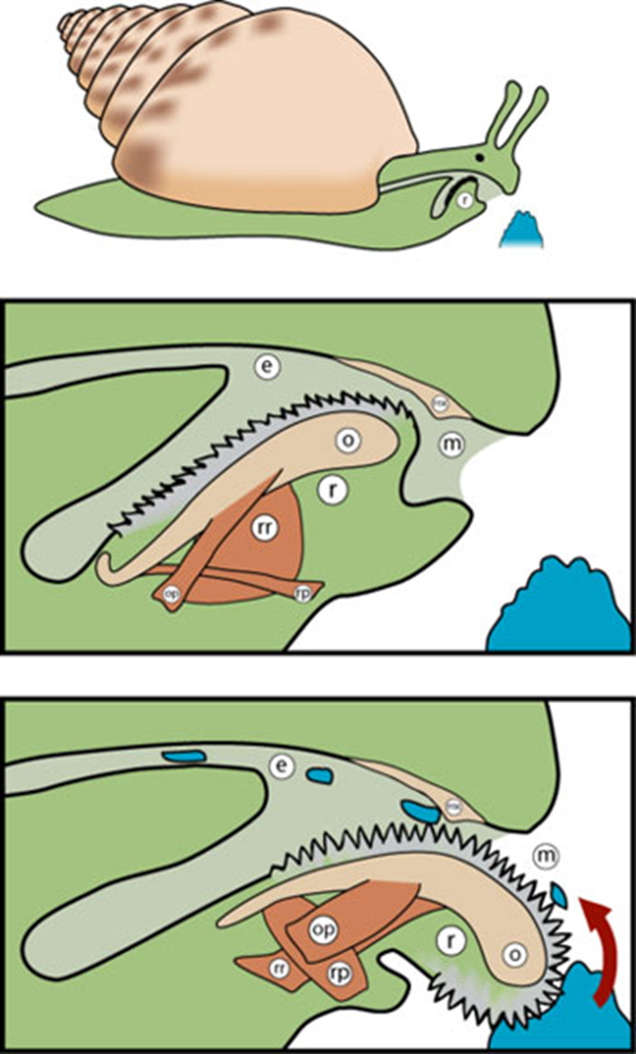
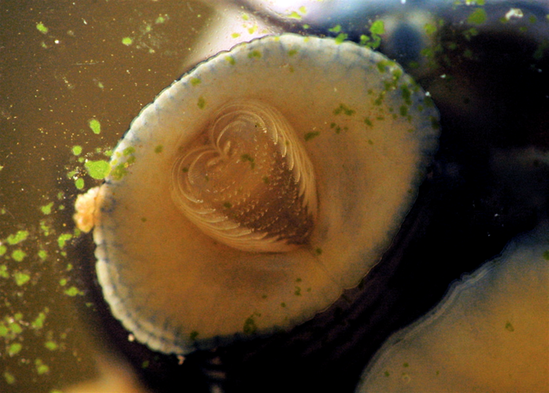
Feeding
Because mollusks are so diverse, they feed in a variety of different ways
Some are herbivores, carnivores, filter feeders, detrivores, or parasites
Some mollusks, like snails and slugs have a radula
A radula is a tongue shaped structure which have hundreds of tiny teeth attached
These radula are used to scrape algae off rocks, drill through shells and tear up and swallow prey’s soft tissue

Slide 11
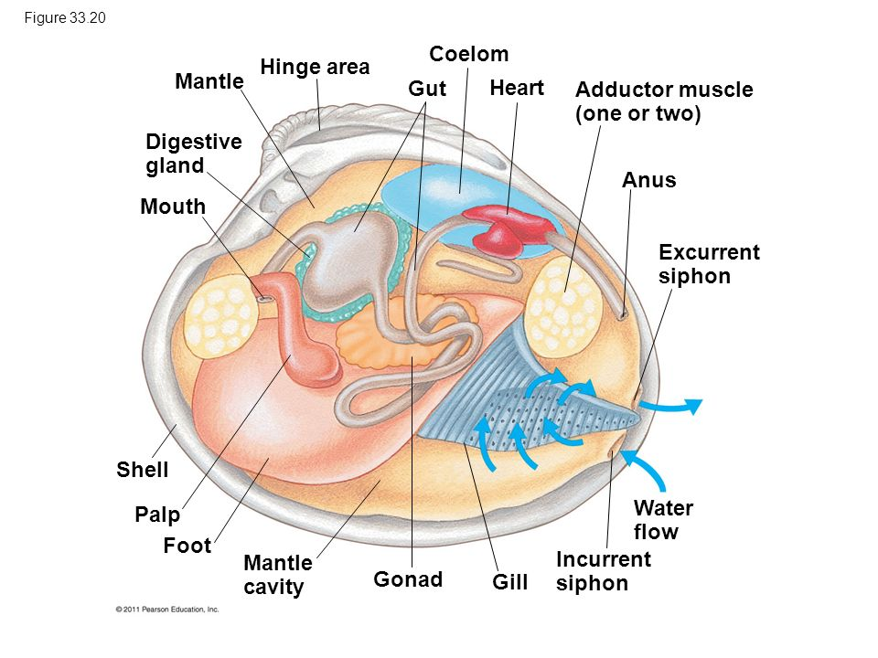
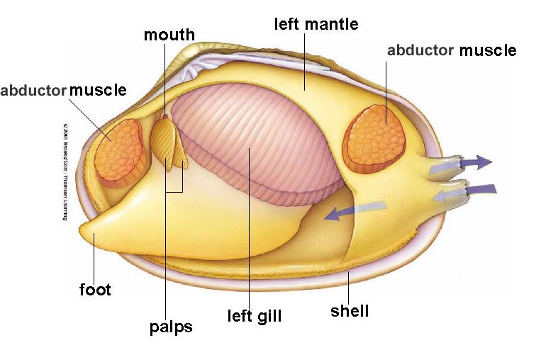
Feeding
Octopi and sea slugs use their sharp jaws to eat prey
Some octopi produce poisons
Clams, oysters, and scallops filter feed using the water around them
In clams and other mollusks, water is filtered over the gills for respiration but also for feeding. A siphon structure allows food particles to get stuck on the mucus of the gills
There are tiny cilia that then move the food into the mouth.

Slide 12
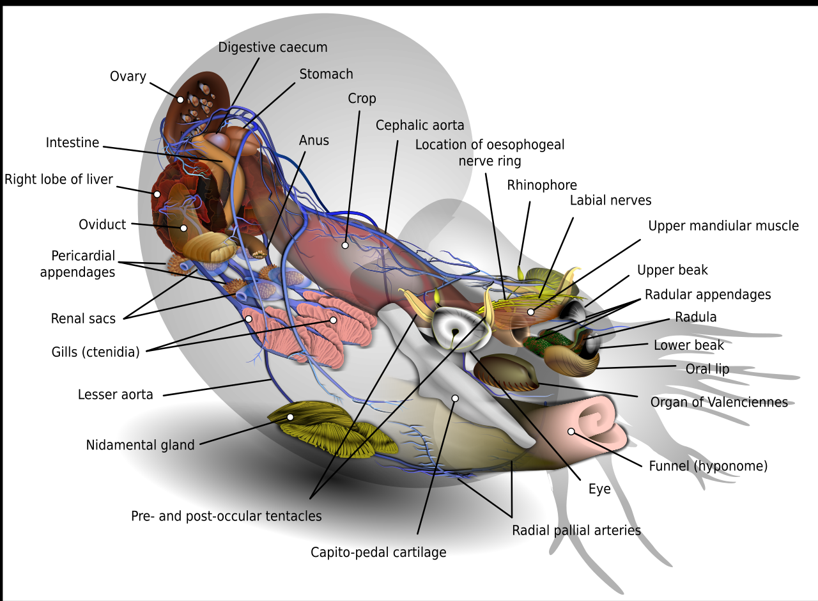
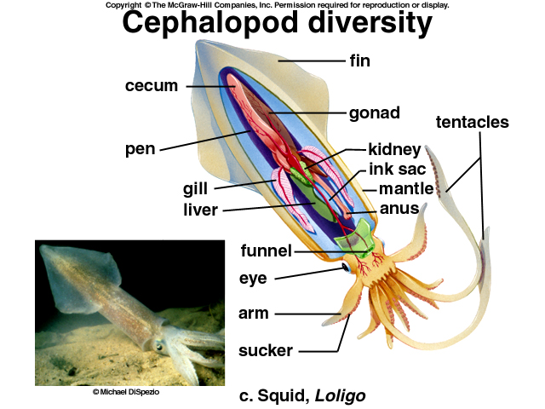
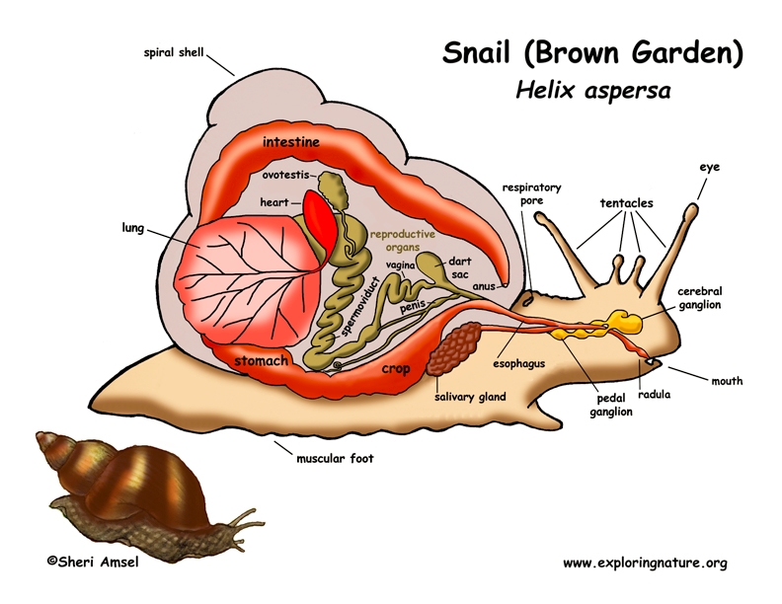
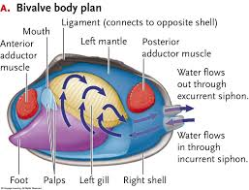
Respiration
Aquatic mollusks such as snails, clams, and octopi typically breathe using gills inside their mantle cavity
Slugs on the other hand, use their mantle cavity that has a large surface area lined with blood vessels - must be kept moist!

Slide 13
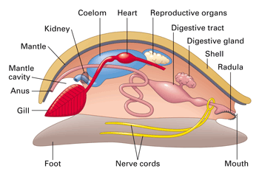
Circulation
Oxygen and nutrients are delivered to all parts the body by a circulatory system
Their system is either open or closed
Open - Blood is pumped by a simple heart through blood vessels into a large sinus (saclike space)
This sinus allows the diffusion of oxygen and carbon dioxide with the gills

Slide 14
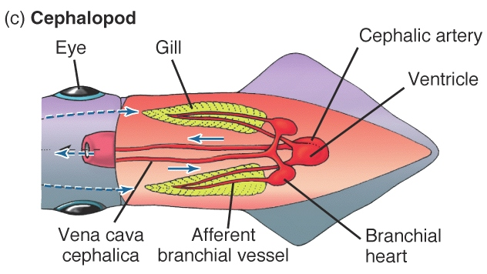
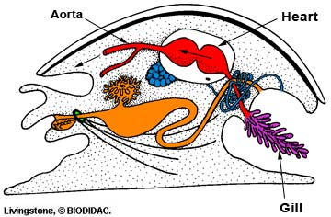
Circulation
Open circulatory systems work well with slow moving mollusks (snails and clams) because they don’t require a lot of oxygen
Faster moving mollusks, like octopi and squid, require more oxygen quickly and therefore have a closed circulatory system.

Slide 15
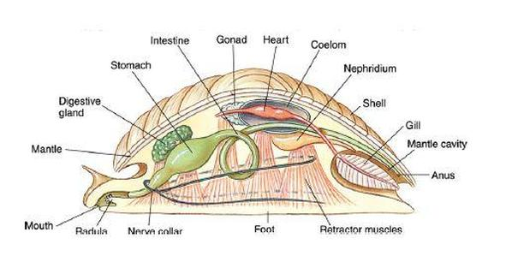
Excretion
Cells of the body release nitrogen-containing waste into the blood to form ammonia
Tube-shaped nephridia remove ammonia from the blood and release it out of the body

Slide 16
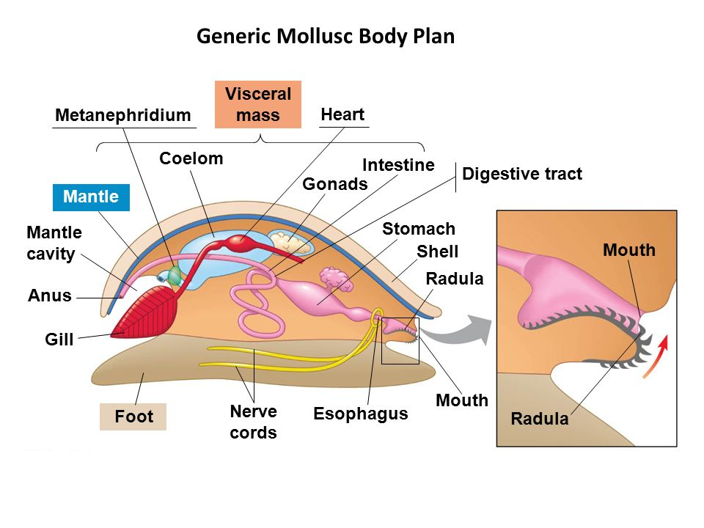
Response
The complexity varies in the phylum Mollusca
Clams and other two-shelled mollusks have simple nervous system because they are fairly inactive burrowing in sand and mud
They have simple sense organs (chemical receptors & eyespots), few nerve cords and small ganglia

Slide 17
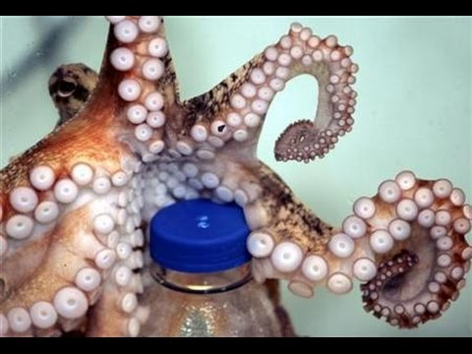
Response
In contrast, octopi have quite complex nervous systems
A well developed brain allows them to learn and to remember things for longer periods and can be more intelligent than some vertebrates
Octopi can perform complex tasks like opening a jar
CBC Video
Video

Slide 18
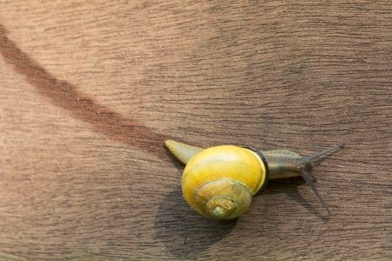
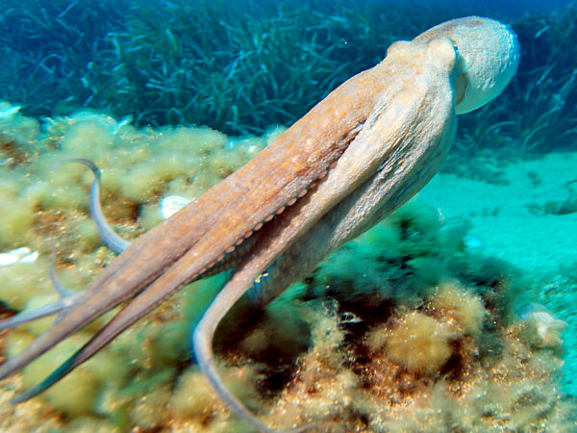
MOvement
Mucus secreted at the base of the foot for animals like snails
Octopi use jet propulsion to draw water into their mantle and force water out of their siphon to create a type of jet propulsion

Slide 19
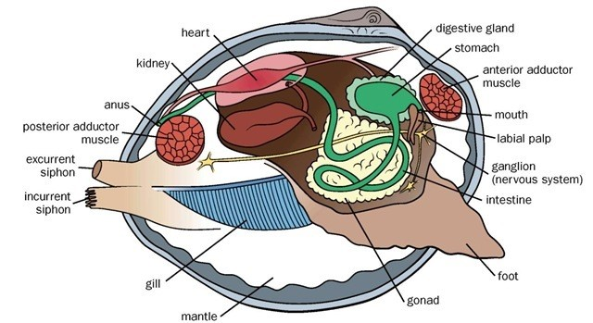
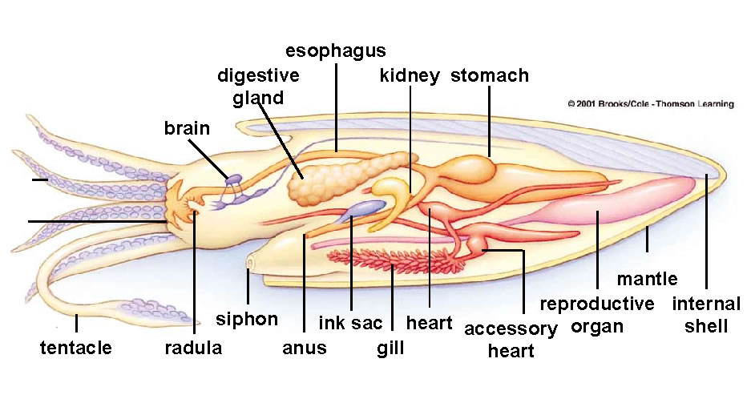
Reproduction
Snails and two-shelled mollusks reproduce sexually by external fertilization
Once fertilized, the egg becomes a free-swimming larvae
In tentacle mollusks and certain snails, fertilization takes place inside of the female
Some can be hermaphroditic

Slide 21
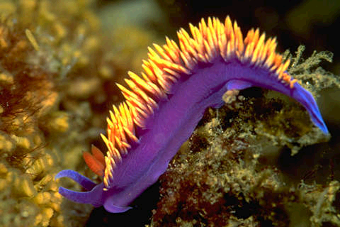
Class Gastropoda
Gastropoda = “stomach foot”
Largest class.
May or may not have a shell (slugs)
Live in fresh, salt water, and land
Contains single spiral shell
Well developed senses
Includes snails, slugs & nudibranchs
Nudibranch
Banana Slug

Slide 22
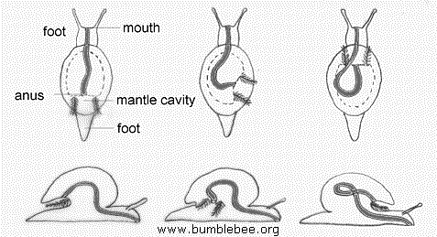
torsion: rotation of digestive system

Slide 23
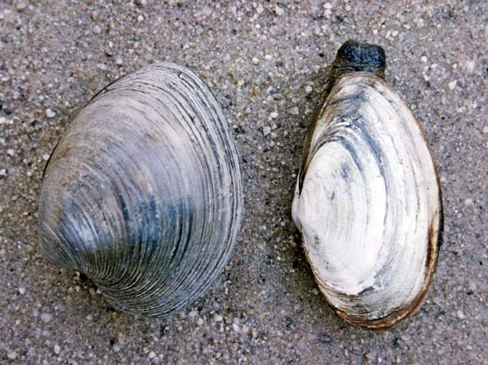
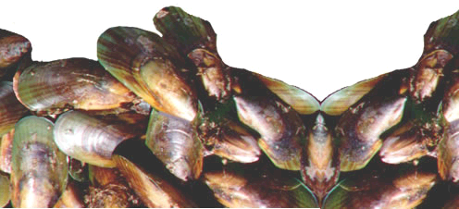
Class Bivalvia
Contain 2 hinged shells (valves)
Filter feeders, sessile
Use gills for respiration & filter feeding
Includes: clams, oysters, scallops, mussels
Clams
Mussels

Slide 24
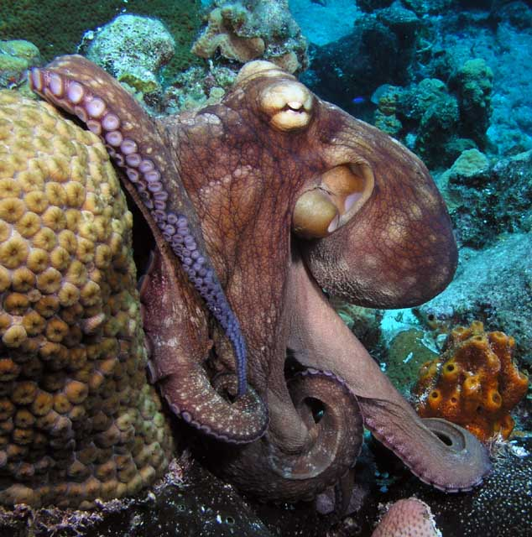
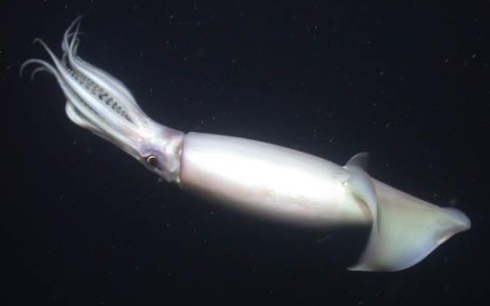
Class Cephalopoda
Octopus
These are the most highly evolved invertebrates
Have complex eyes
Capable of learning
Very motile predators - largest invertebrate
Shell greatly reduced
Squid

Slide 25
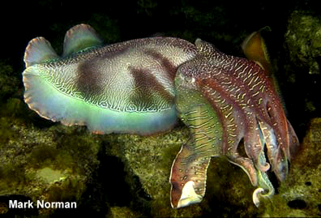
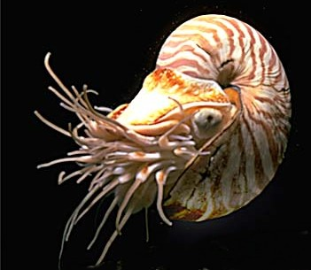
Class Cephalopoda
The cuttlefish and nautilus
Cuttlefish

