Slide 1
PlatyHelminthes AKA: The Flatworms
Kingdom: Animalia
Phylum: Platyhelminthes
Lower Invertebrates
27-1 pg. 683

Slide 2
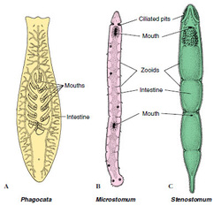
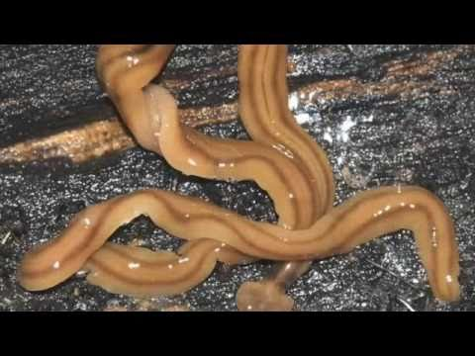
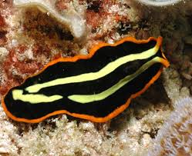
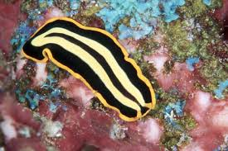
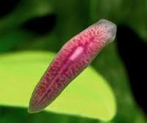
Objectives
Describe some of the advancements Platyhelminthes have over Cnidarians
Describe the five characteristics that distinguish phylum Platy (body plan and structure)
Describe the 3 classes and example animals
Describe the parasitic worm (enters, lives, hosts, effects)

Slide 3
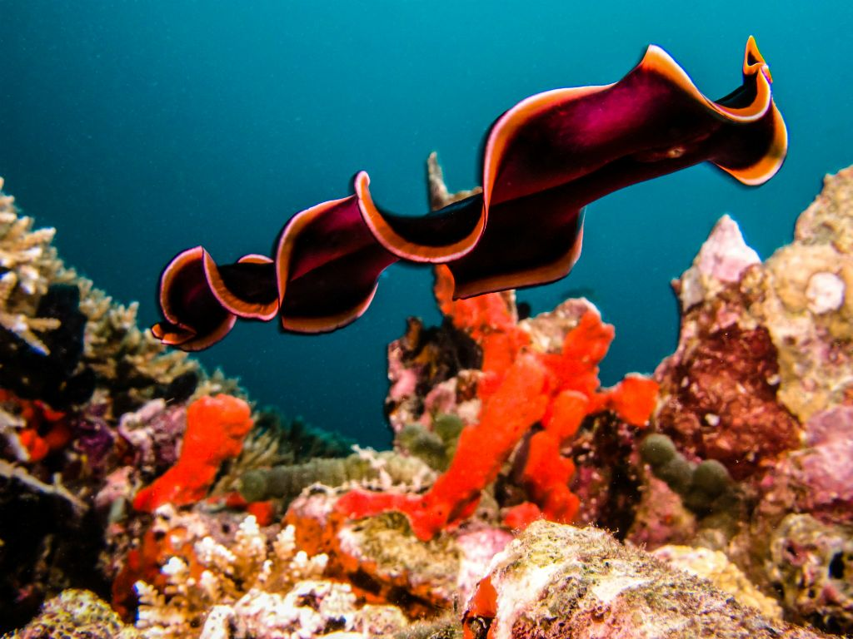
Phylum Platyhelminthes: What is a flatworm?
Soft, flattened worms that have tissues and internal organ systems
They are the simplest animal to have three germ layers
Bilateral symmetry
Cephalization
Pseudobiceros gloriosus

Slide 4
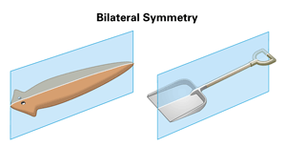
Symmetry
Platyhelminthes have bilateral symmetry
This means they have two well formed sides that can be identified as left and right
With bilateral symmetry we start to see the development of cephalization
Most Platyhelminthes exhibit enough cephalization to have what we know as a ‘head’

Slide 5
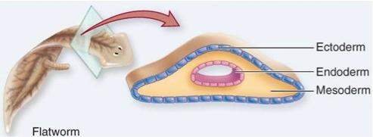
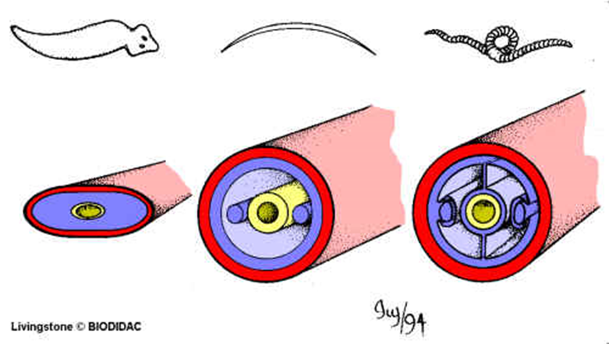
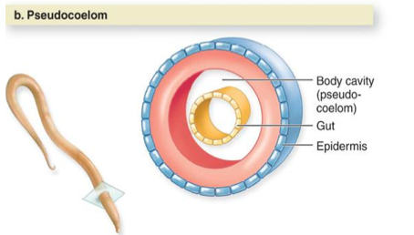
Germ Layers
Platyhelminthes are known as triploblastic
Ectoderm, mesoderm & endoderm
Flatworms are known as acoelomates, meaning ‘without coelom’
No coelom forms from the mesoderm layer

Slide 6
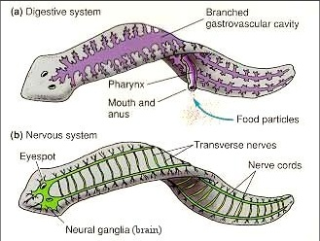
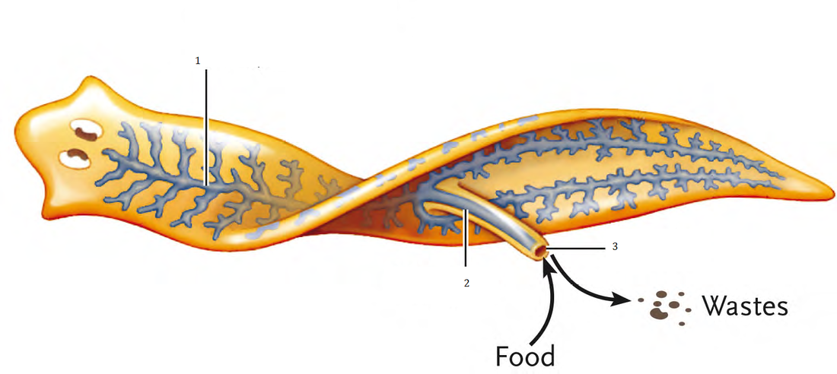
Feeding
Free-living flatworms have organ systems for digestion, excretion, response, and reproduction
Parasitic species are typically simpler in structure than their free-living relatives
Eg. Flukes
Free-living flatworms can be carnivorous that feed on tiny aquatic animals or scavenge on dead animals

Slide 7
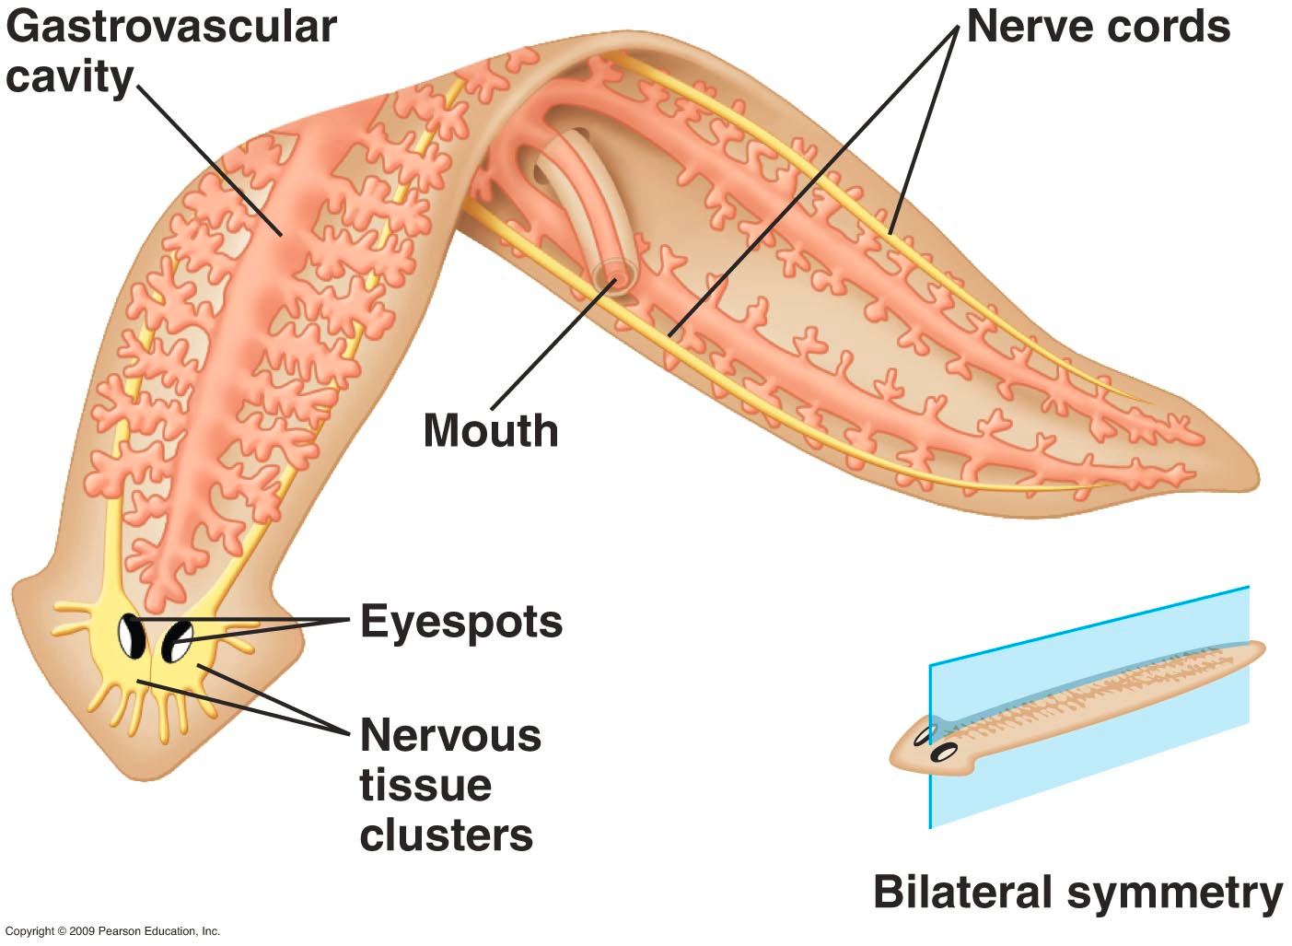
Feeding
Pharynx
Like Cnidarians, flatworms have a digestive cavity with a single opening, a mouth, through which both food and wastes pass through.
There is a muscular tube, called the pharynx
The pharynx extends out of the mouth and then pumps food into the digestive cavity
Digested food then diffuses from the gastrovascular cavity into body tissues.

Slide 8
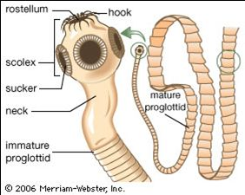
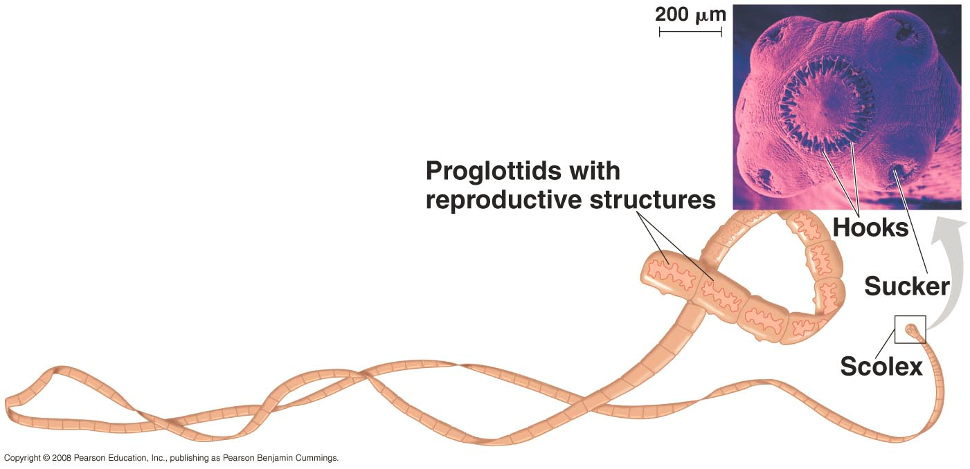
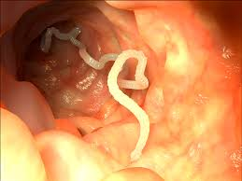
Parasitic Feeding
Parasitic worms feed on blood, tissue fluids, or pieces of cells within the host’s body
Therefore, they do not have a complex digestive system.
Eg. Tapeworms – have no digestive tract at all and absorb pre-digested nutrients from the host through their body wall

Slide 9
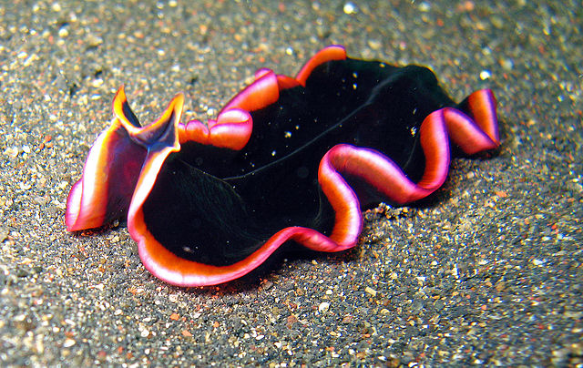
Respiration, Circulation and Excretion
Because flatworms bodies are so flat and thin, many of them do not need a circulatory system to transport nutrients around their bodies
Flatworms rely on diffusion to transport oxygen and nutrients to their internal tissues
Flatworms have no gills or other respiratory organs, no heart, blood vessels or blood.

Slide 10
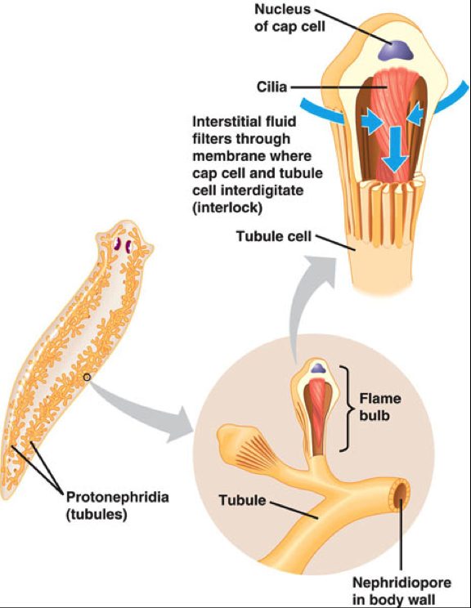
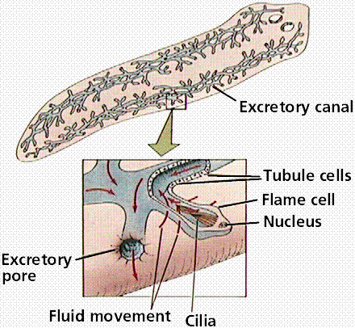
Respiration, Circulation, Excretion
Some flatworms have flame cells that function in excretion
Flame cells are specialized cells that filter and remove metabolic wastes such as ammonia and excess water from the body
Many flame cells are joined together to form a network of tubes that empties into the outside environment through tiny pores in the animal’s skin

Slide 11
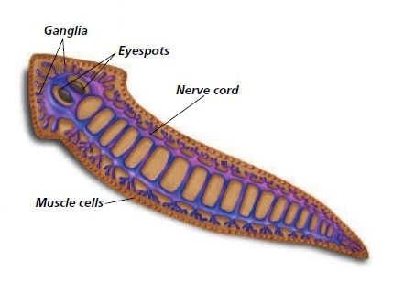
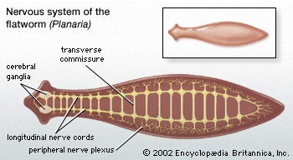
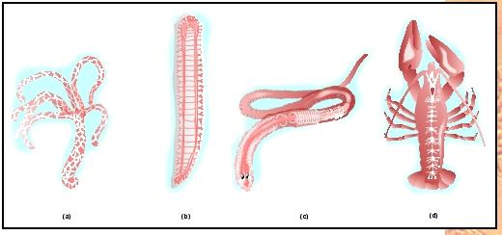
Response
Flatworms have more complete structures for detecting and responding to external stimuli than those of cnidarians and sponges
In free-living flatworms, a head encloses several ganglia that control the nervous system
Two long nerve cords run from the ganglia along both sides of the body, creating a nerve ladder

Slide 12
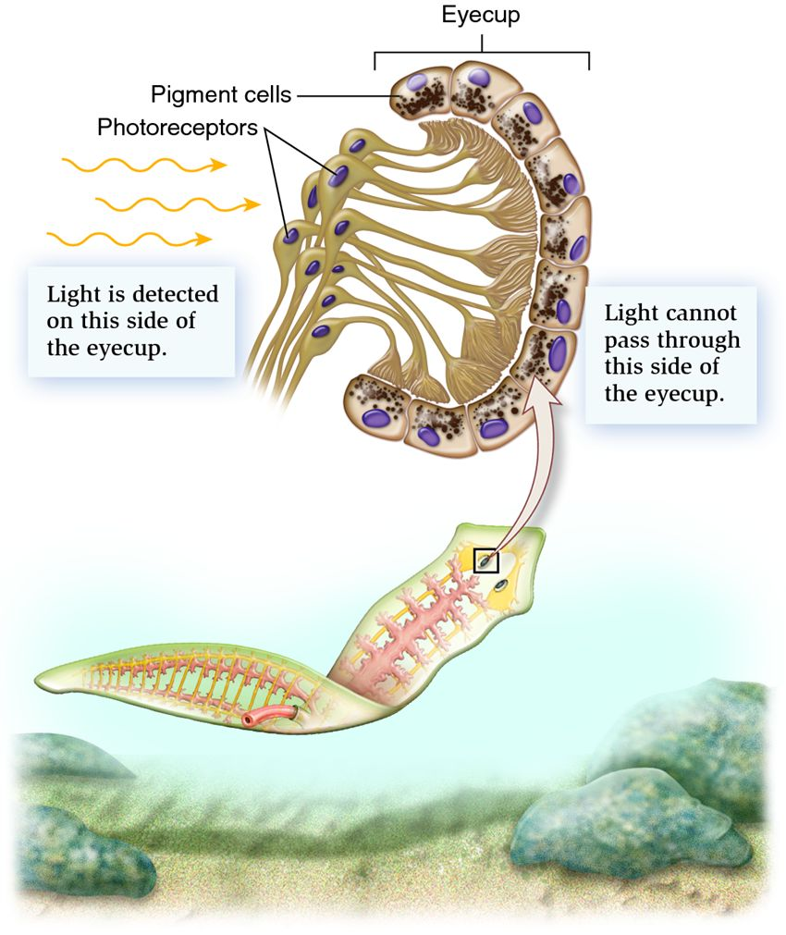
Response
Along with the nerve ladder, flatworms can have an eyespot, or a group of cells called ocelli that can detect changes in the amount of light in their environment
They also have cells that can detect external stimuli like chemicals in the water and direction of water flow
These cells are usually scattered throughout the body
Parasitic flatworms typically lack these features

Slide 13
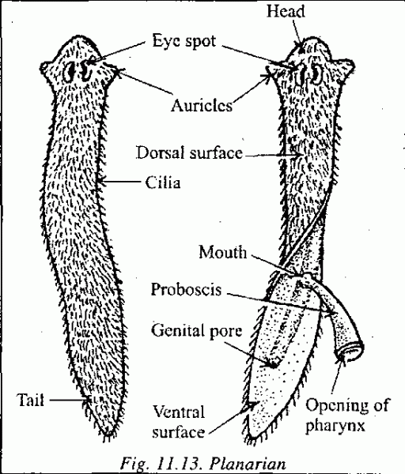
MOvement
Free-living flatworms typically move in two ways
Cilia on their epidermal cells help them glide through water and over bottoms of streams and ponds
Muscle cells controlled by the nervous system allow them to twist and turn

Slide 14
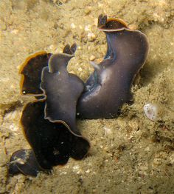
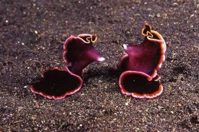
Reproduction
Most flatworms are hermaphroditic
They reproduce both sexually and asexually
Asexually – split by fission and grow into a new organism
Sexually - they join up with another flatworm and deliver sperm to one another
Penis-Fencing! NatGeo video
Parasitic flatworms have a complex sexual reproduction cycle

Slide 15
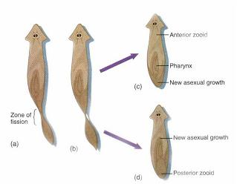

Slide 16
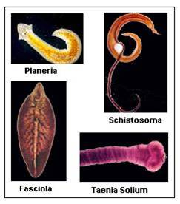
Groups of Platyhelminthes
A very diverse group of worms ranging from marine to fresh water and parasitic to free-living

Slide 17
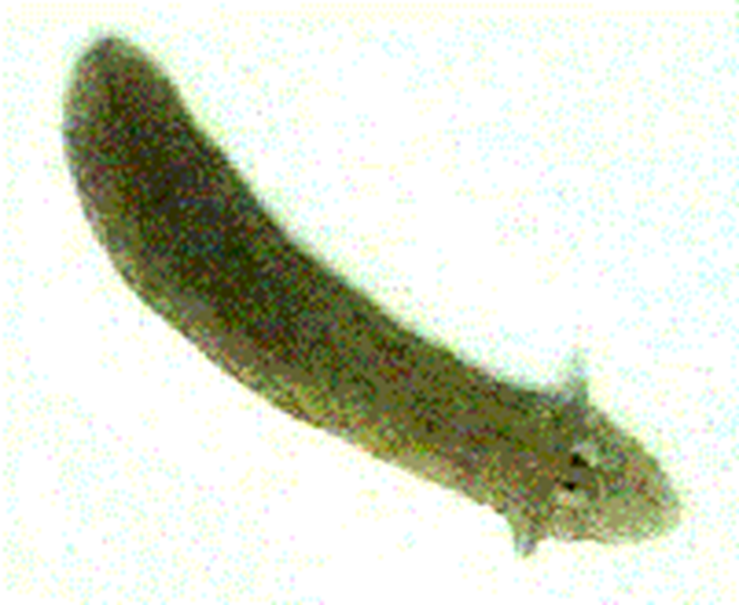
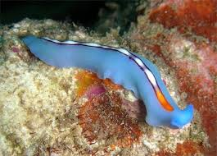
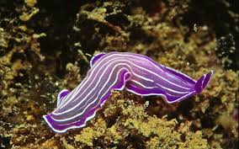
Class Turbellaria
Includes the Planaria, a fresh water flatworm
Named due to the turbulence in the water their cilia cause when they swim
Also includes many marine varieties

Slide 18
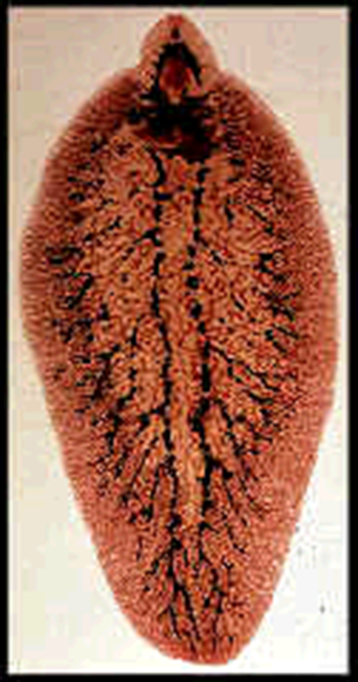
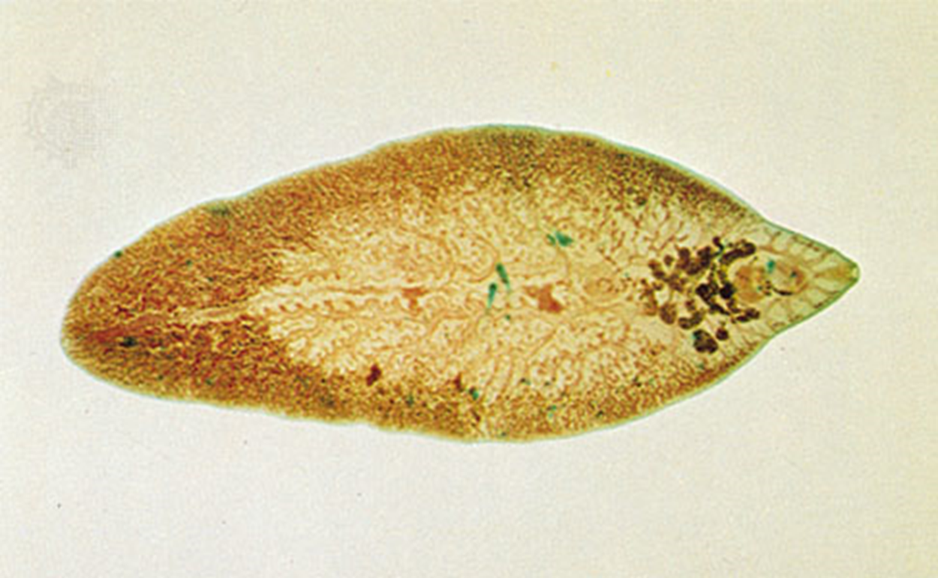
Class Trematoda – The Flukes
Includes the parasitic flukes
Include liver, blood, lung, heart, and intestinal flukes
Many have intermediate hosts like this liver fluke (i.e. sheep, cow, fish etc)
Fasciola hepatica (Liver Fluke)

Slide 19
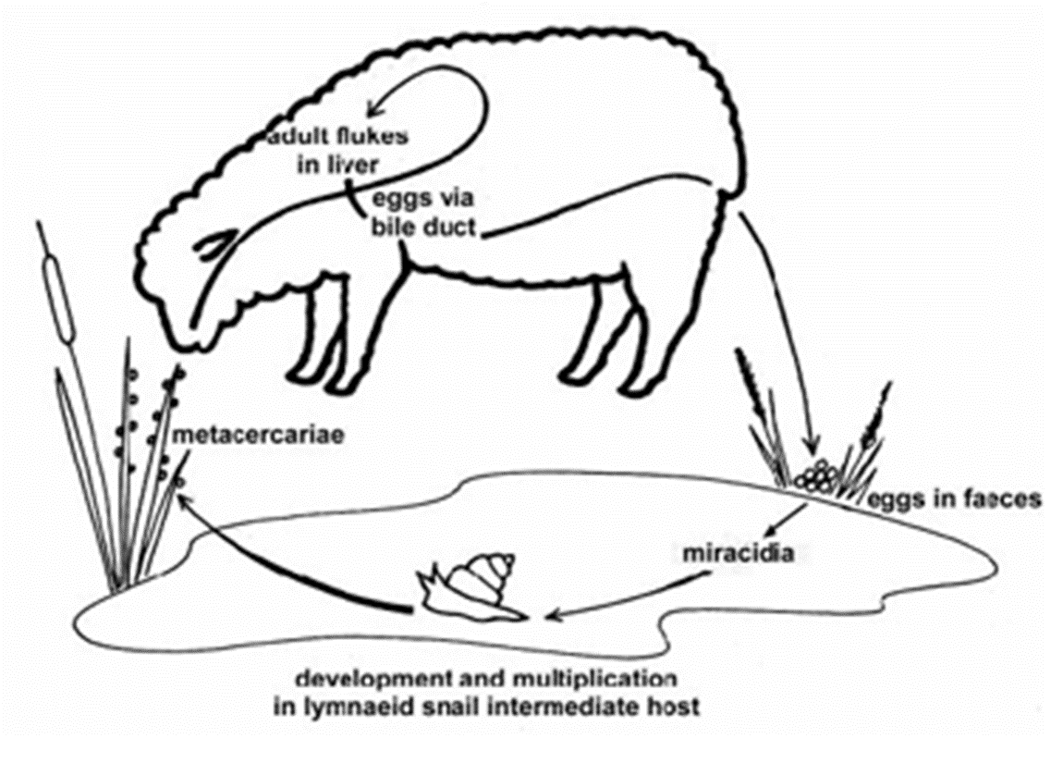
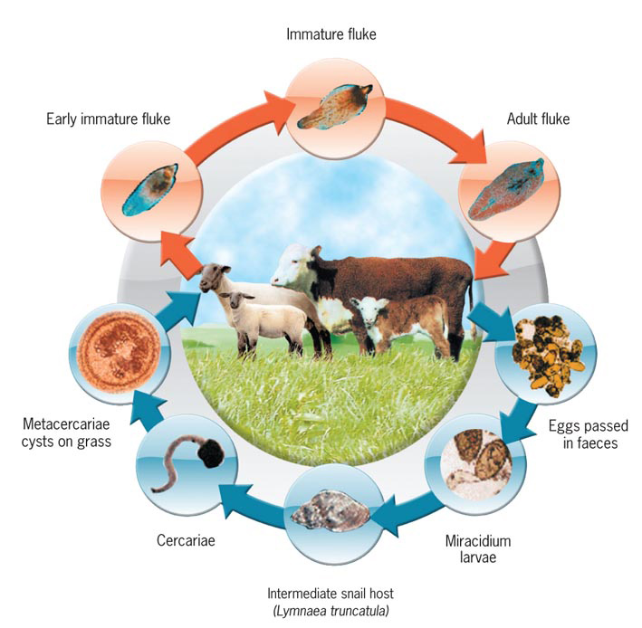
Fasciola hepatica Life Cycle

Slide 20
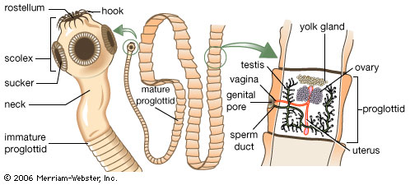
Class Cestoda - TapeWorms
Classical endoparasite
highly evolved to its habitat such as hooks to attach to intestinal wall
Human tapeworms can grow up to 20 m long!
Taenia sp.

Slide 21
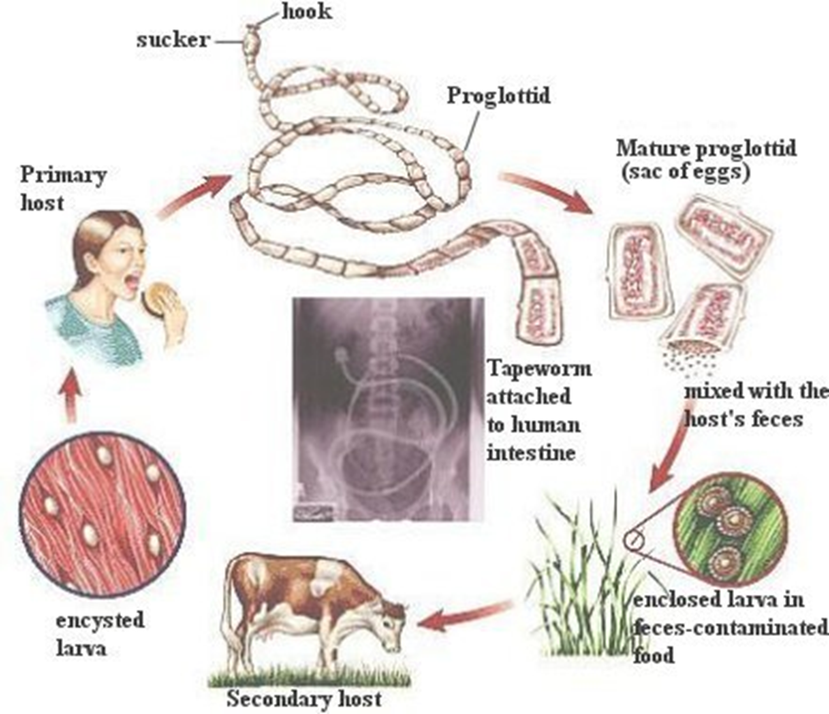

Slide 22
Tapeworms
Pork Tapeworm video
Monsters Inside Me
How long can tapeworm be?

