Slide 1
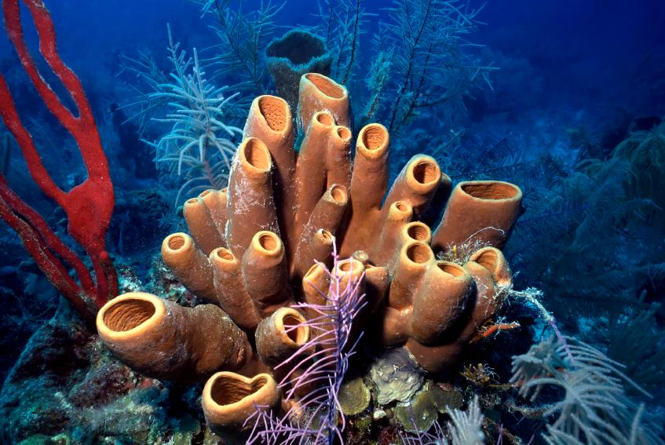
Life Sciences 11
Phylum Porifera:
The Sponges
Chapter 26-2: pg. 664

Slide 2
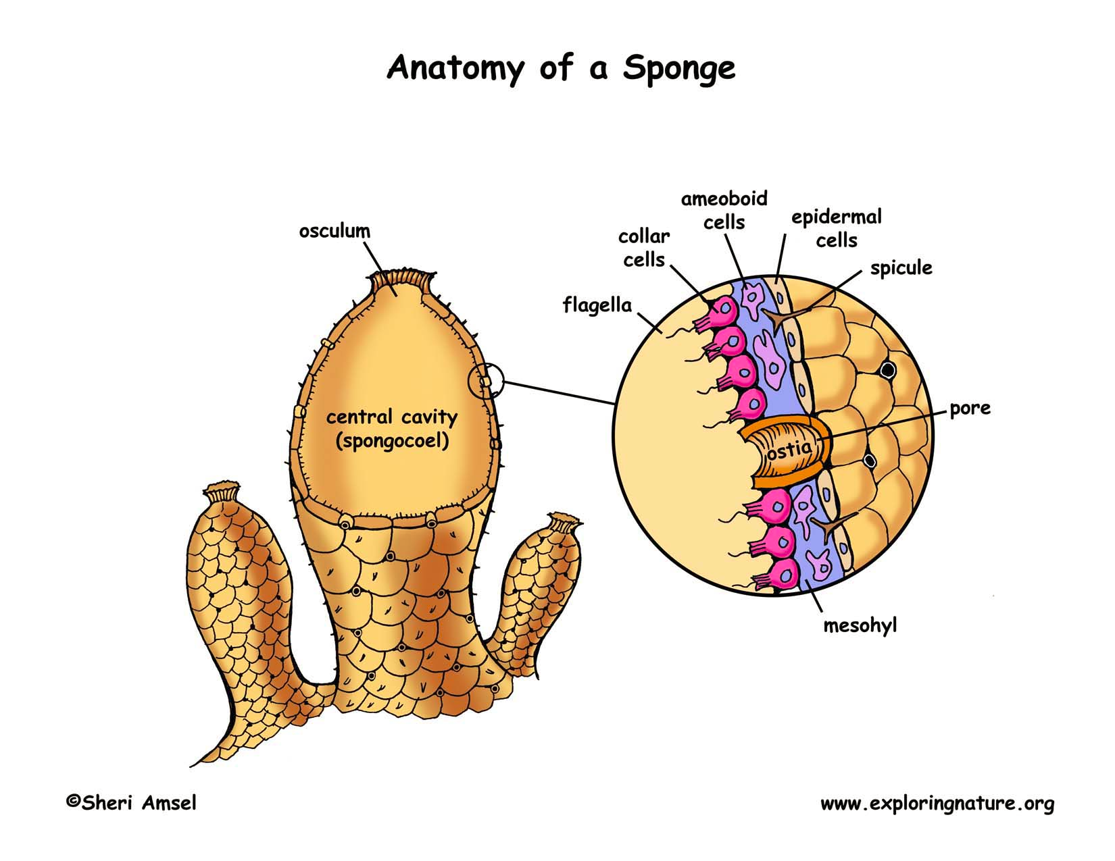
Objectives
Describe the body plan of a typical sponge (each cell’s role within the sponge)
Water’s role in sponge survival
Describe how a typical sponge reproduces and obtains nutrients

Slide 3
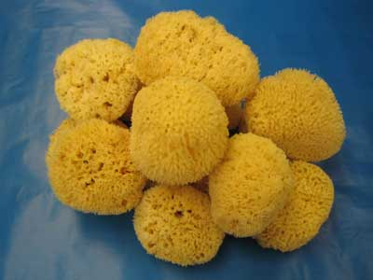
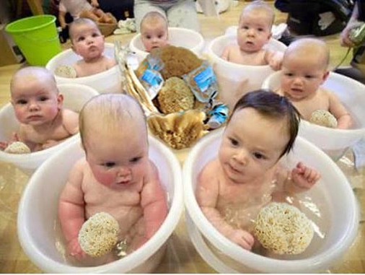
Phylum Porifera = Sponges
Porifera = ‘pore bearers’
One of the simplest and most unusual animals
Have been on earth for at least 540 million years
Most of them live in the ocean – sessile
Most commonly used by humans for natural sponges for bathing

Slide 4
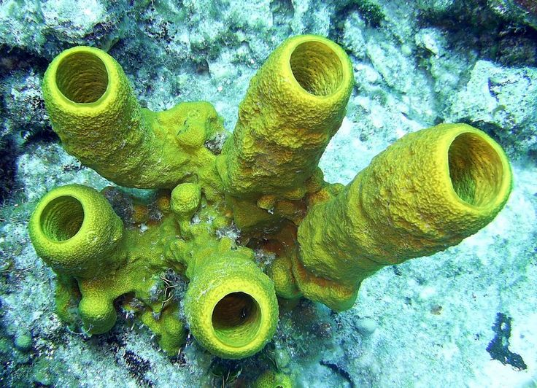
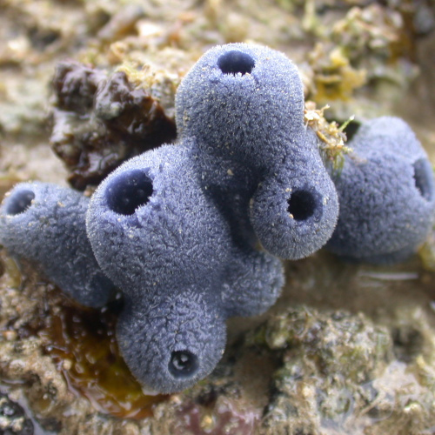
Phylum Porifera
They are considered animals because they are multicellular, heterotrophic and their cells have no cell walls
This phylum represents the first experiment in multi-cellularity for animals
There are specialized cells, but they do no work cooperatively together - not tissues
Simplest and most primitive animals
Have changed little since they evolved

Slide 5
Body Plan
Sponges are asymmetrical, have no front or back ends, and no left or right sides
Think of a large cylindrical water pump
Choanocytes (collar cells) are specialized cells that use flagella to move water through the sponge
Water exits the sponge through the osculum, large hole at the top
This movement of water is for feeding, respiration, circulation, and excretion
Archaeocytes (amoebocytes) are motile cells which have a variety of functions including delivering nutrients to other cells and creating eggs for sexual reproduction

Slide 6
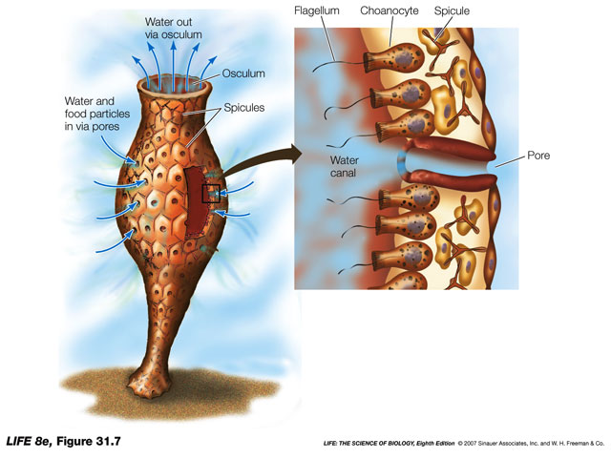
Anatomy

Slide 7
Anatomy

Slide 8
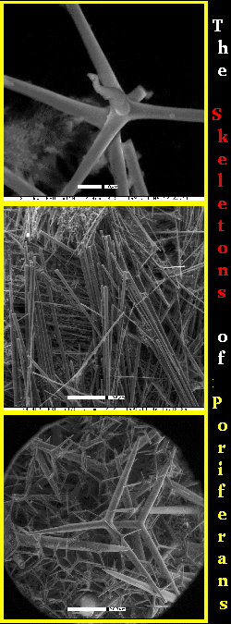
Body Plan
Sponges have a simple skeleton
In harder sponges, the skeleton is make up of spiny spicules
A spicule is a spike-shaped structure made up of chalklike calcium carbonate or glass-like silica
Softer sponges have an internal skeleton made up of spongin, a network of flexible protein fibres
Glass-like sponge spicules

Slide 10
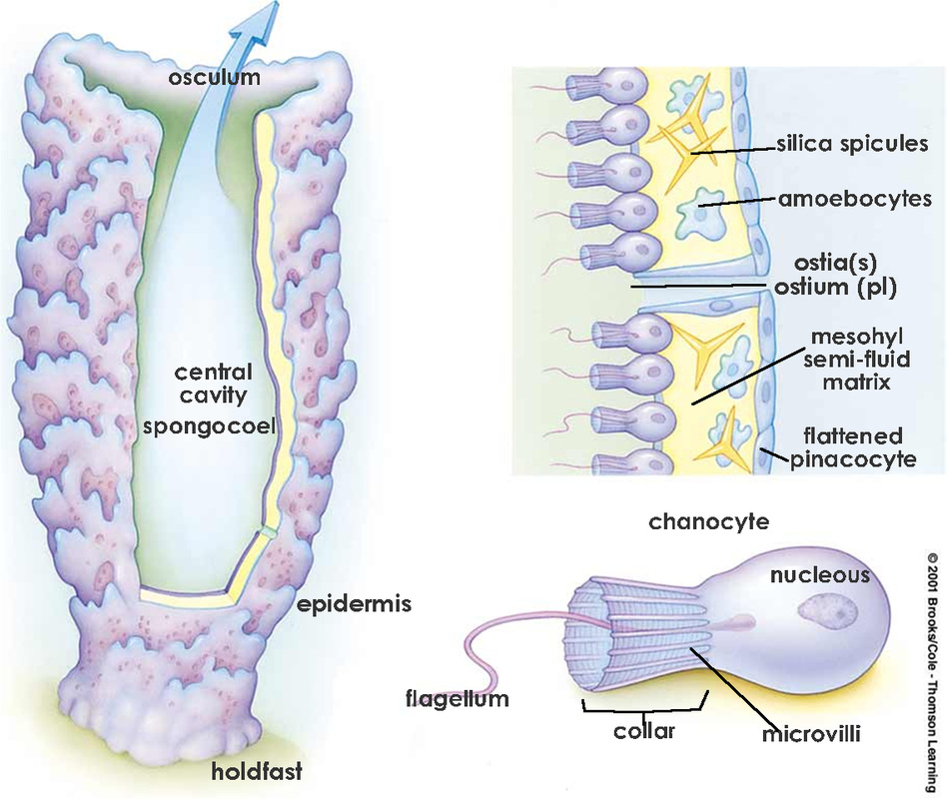
Feeding, Respiration, Circulation, and Excretion
The movement of water through their bodies is to carry out body functions
Sponges are filter feeders which means they filter food particles from the water using their choanocytes.
Oxygen from the water diffuses into cells and waste products like carbon dioxide and ammonia diffuse out of cells into the central cavity and out the osculum

Slide 11
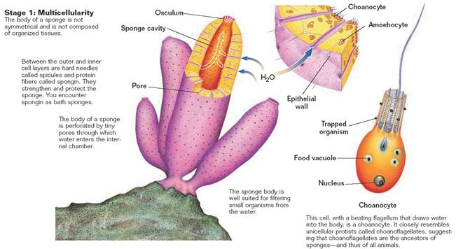

Slide 12
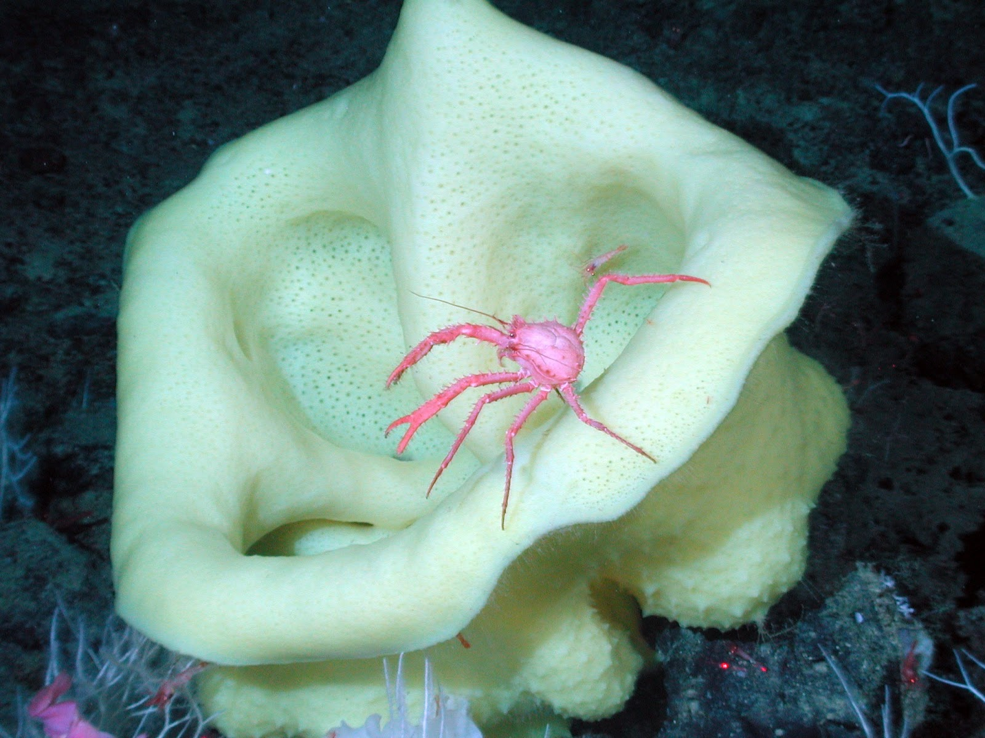
Response
Sponges do not have a central nervous system that would allow them to respond to their environment however, some sponges create toxins that are unpalatable or poisonous to potential predators.

Slide 13
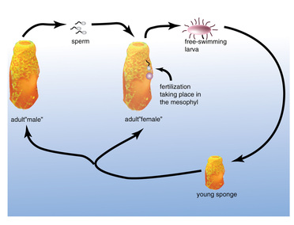
Reproduction
Sponges can reproduce either sexually or asexually
Sexual - Internal fertilization (sperm + egg = zygote → larva)
Larvae are motile and move to a different location

Slide 14
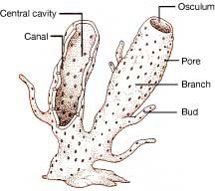
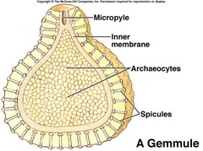
Reproduction
Asexual – budding: a new sponge clone forms on the side and eventually forms a clone
- gemmules: in unfavourable conditions, the sponge can surround archaeocytes in spicules forming a gemmule which can survive the harsh conditions then regrow the sponge

Slide 15
Water Flow Animation!
Go to website: Water Flow
http://www.biology.ualberta.ca/courses.hp/zool250/animations/Porifera.swf

