Slide 1
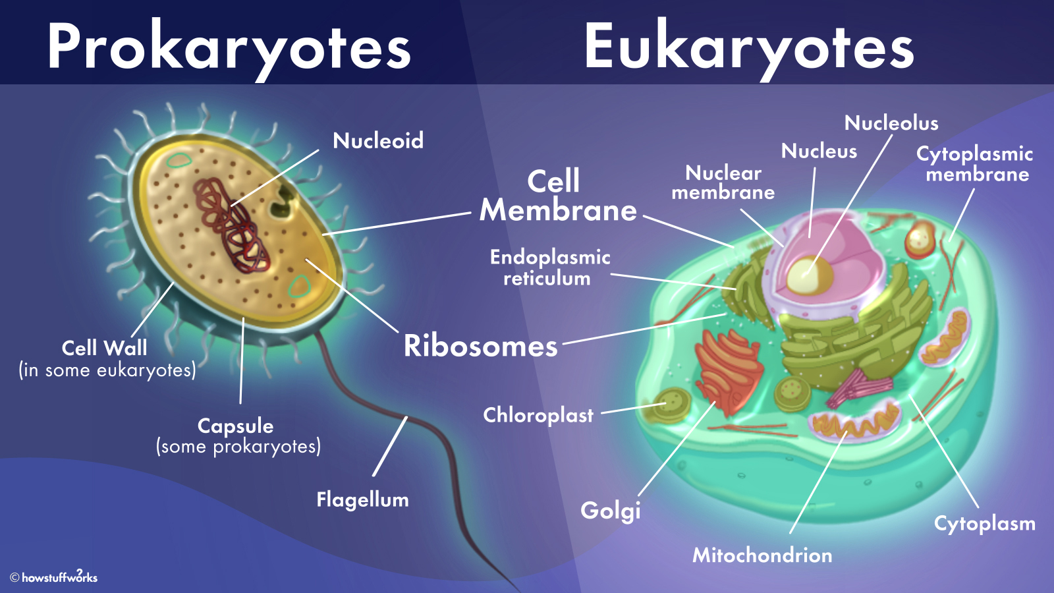
vs

Slide 2
Neuron (Brain Cell)

Slide 3
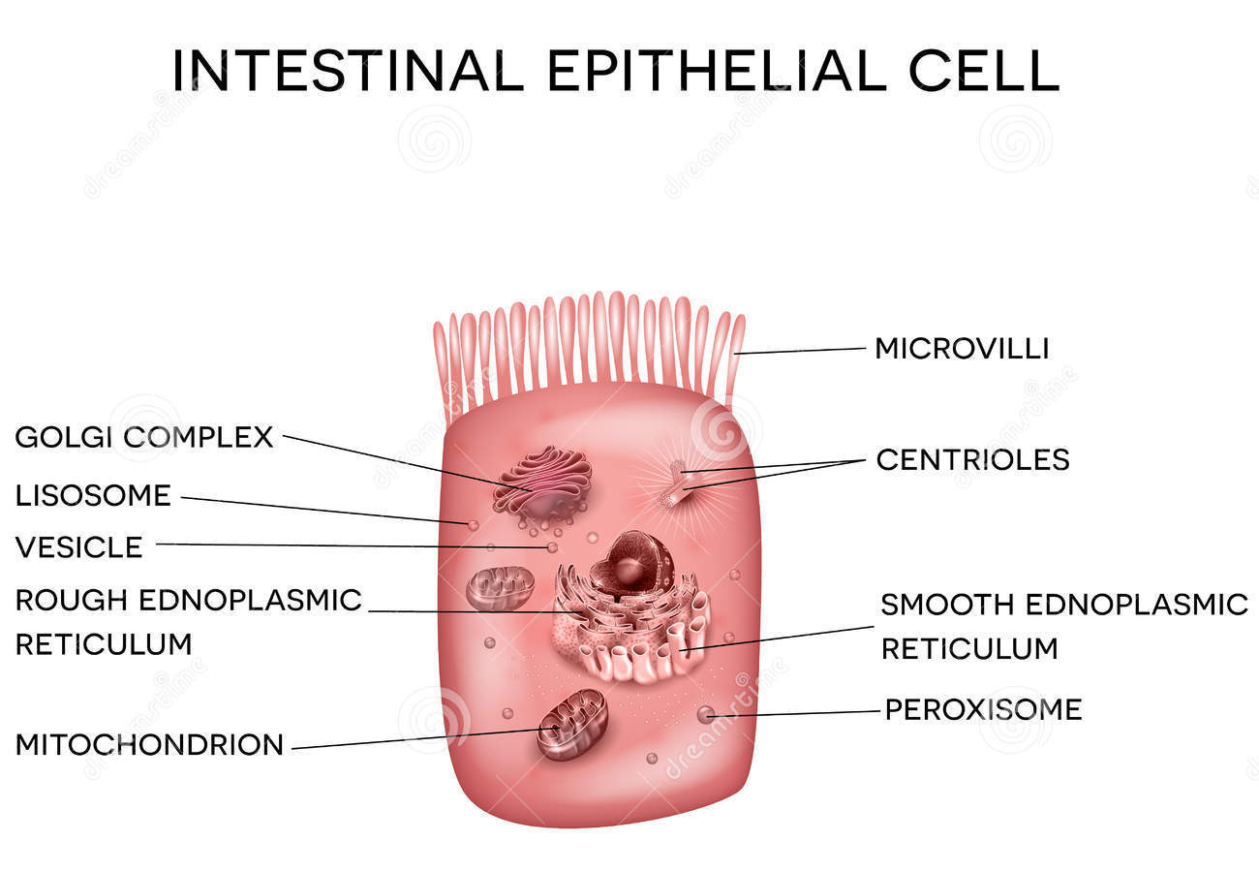

Slide 6
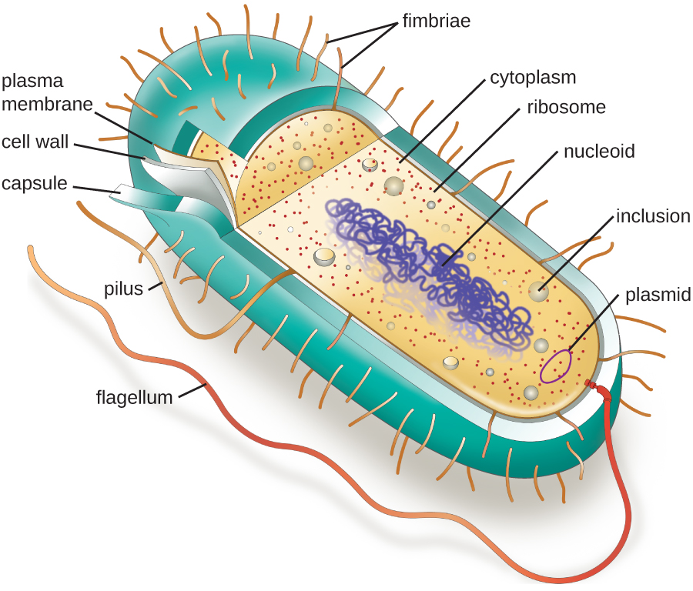

Slide 7
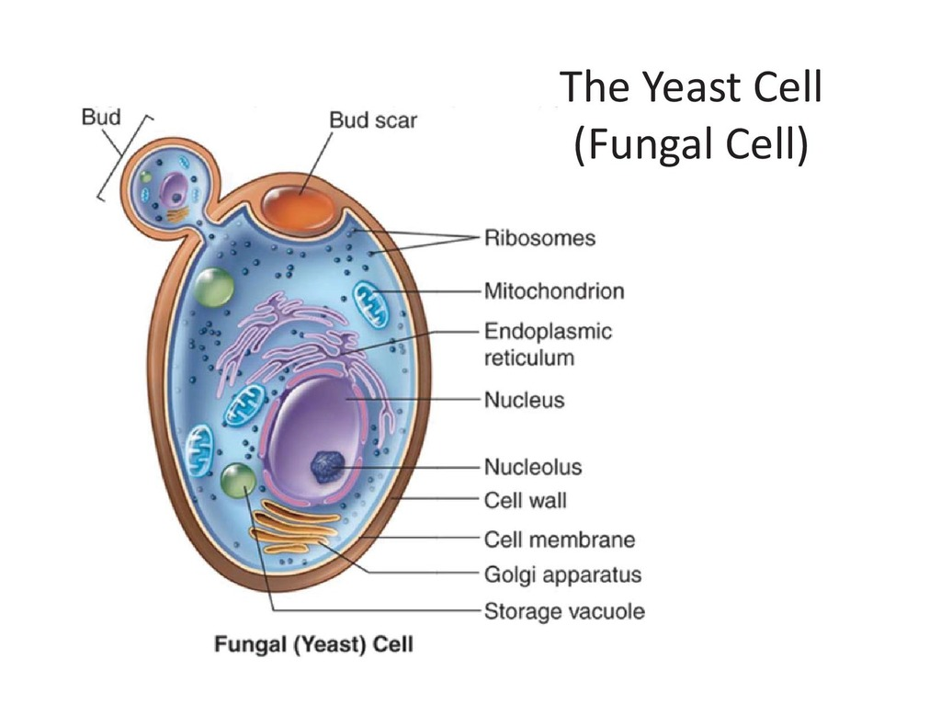

Slide 8
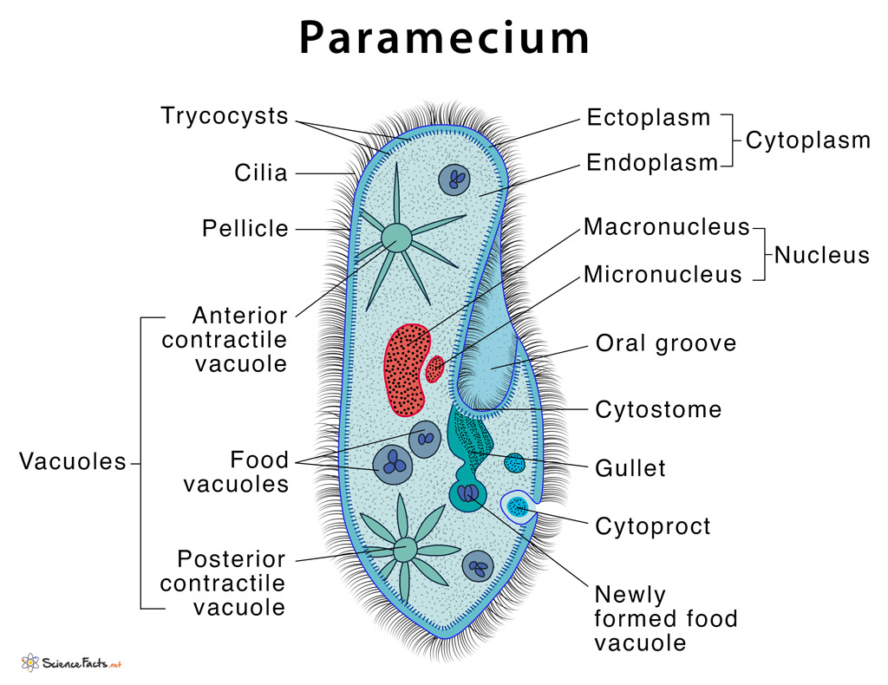

Slide 13
Cells are far more complex, diverse, and interesting than your textbook portrays them to be!
Plus, they communicate with each other! Check out AP Biology to find out how!

