Slide 1
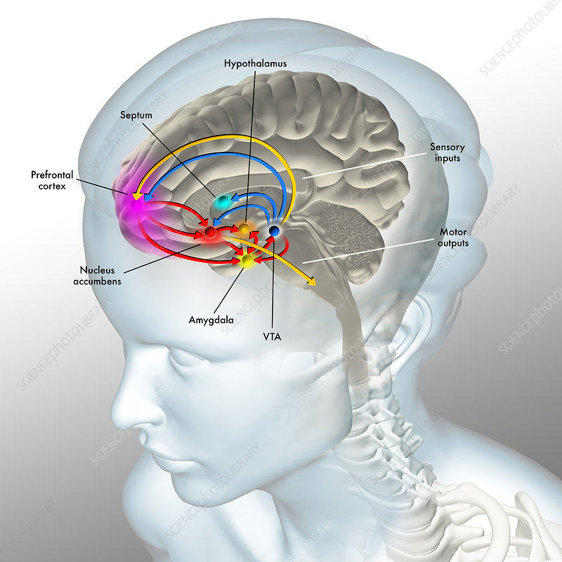
The Neuroscience of Pleasure
By David J. Linden

Slide 2
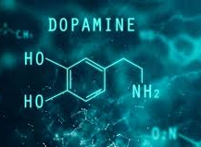
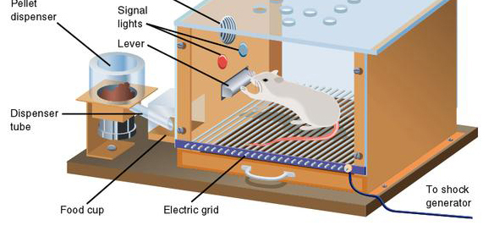
Skinner Box
In the 1930s, the psychologist B. F. Skinner devised the operant conditioning chamber, or “Skinner box,” in which a lever press by an animal triggered either a reinforcing stimulus, such as delivery of food or water, or a punishing stimulus, such as a painful foot shock. Rats placed in a Skinner box will rapidly learn to press a lever for a food reward and to avoid pressing a lever that delivers the shock.

Slide 3
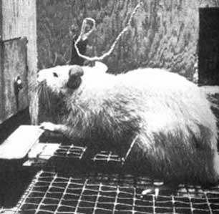
Pleasure Center
In the 1950s, the psychologists James Olds and Peter Milner modified the chamber so that a lever press would deliver direct brain stimulation through deep implanted electrodes. What resulted was perhaps the most dramatic experiment in the history of behavioral neuroscience: Rats would press the lever as many as 7,000 times per hour to stimulate their brains. This was a pleasure center, a reward circuit, the activation of which was much more powerful than any natural stimulus.

Slide 4
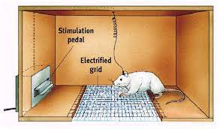
Self-Stimulating
A series of subsequent experiments revealed that rats preferred pleasure circuit stimulation to food (even when they were hungry) and water (even when they were thirsty).
Self-stimulating male rats would ignore a female in heat and would repeatedly cross foot-shock-delivering floor grids to reach the lever.
Female rats would abandon their newborn nursing pups to continually press the lever.
Some rats would self-stimulate as often as 2000 times per hour for 24 hours, to the exclusion of all other activities. They had to be unhooked from the apparatus to prevent death by self-starvation. Pressing that lever became their entire world.

Slide 5
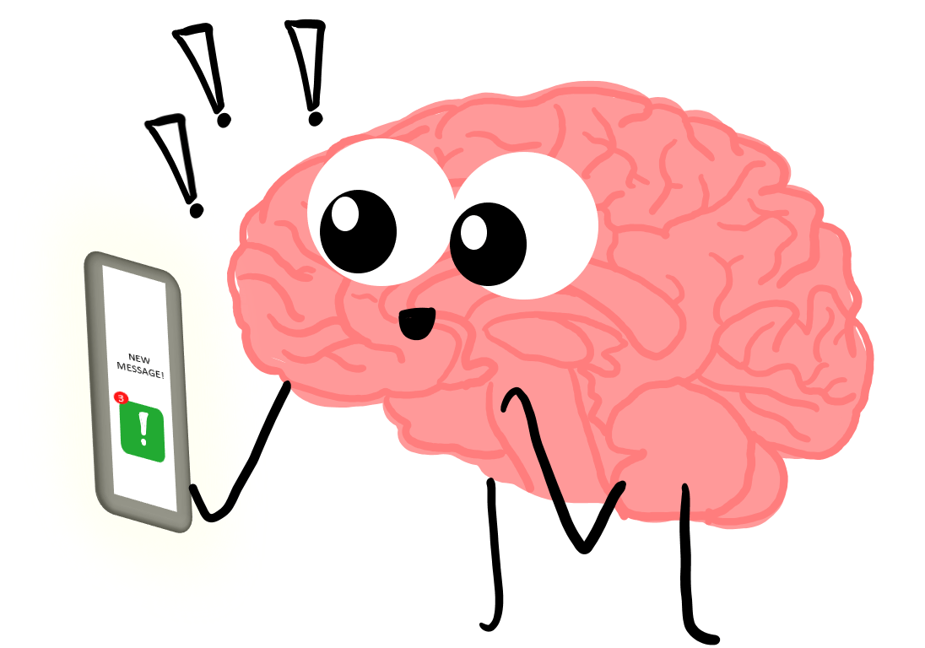
Brain Chemical
Further work was done to systematically vary the placement of the electrode tips and thereby map the reward circuits of the brain. These experiments revealed that stimulation of the outer (and upper) surface of the brain, the neocortex, produced no reward — the rats continued to press the lever at chance levels.
However, deep in the brain, there was not just a single discrete location underlying reward. Rather, a group of interconnected structures, all deep within the brain and distributed along the midline comprised the reward circuit. A chemical neurotransmitter in the brain called dopamine was found to be the "drug" released by the brain to make it feel happy.

Slide 7
But Those are Just Dumb Rats …
Gamers Are Dying in Taiwan's Internet Cafes
Girl starved to death while parents raised virtual child in online game
New Jersey teen caught on video attacking teacher in classroom
Boy, 16, 'killed his mother with his friend's help' after she confiscated his cell phone

Slide 8
Addicted?
Excerpt from the article “Addictive Design of Social Media Apps”
Before exploring the implications of the addictive nature of social media, we need to understand the business model of social media companies and how it incentivizes them to design their mobile apps in a way that actively, and often inconspicuously, encourages addictive user behavior. Social media companies are built on the idea of engaging the attention of users for as long and as frequently as possible. This user attention is then sold to advertisers for revenue. Since most social media platforms are free, they make profit by primarily relying on the revenue generated from advertisers (Haynes, 2019). Thus, it is imperative for social media apps to be designed in such a way that users remain hooked to their screens. To do so, social media platforms have leveraged a number of design techniques and exploited some fundamental psychological and neurological principles to turn vulnerable users into addicts or junkies. Dopamine, a neurochemical that is created in various parts of the brain is one of the key reasons why users get addicted to mobile phones and social media apps.
- Anukriti Sharma

