Slide 1
Vaccines

Slide 2
These two boys had been exposed to the same smallpox source. One had been vaccinated, the other hadn’t.

Slide 3
How We Conquered Smallpox

Slide 4
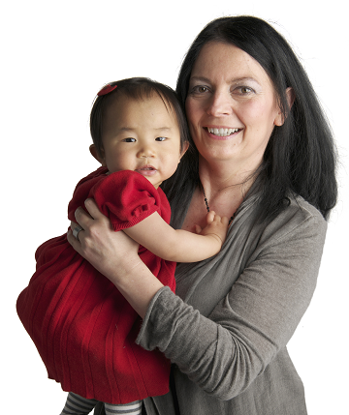
Immunizations save lives
Immunizations (vaccinations, shots) have saved the lives of more babies and children than any other medical intervention in the last 50 years.
When you get immunized, you are protected against illness and serious harm such as meningitis, pneumonia, paralysis, deafness, seizures, brain damage or even death.
Notes:
4
4
Presenter notes:
Immunization is the only protection against some diseases
Immunizations save lives. When you immunize your baby, you're protecting him or her against illness and serious harms such as meningitis, pneumonia, paralysis, deafness, seizures, brain damage and even death.
Did you know? Immunization has saved the lives of more babies and children than any other medical intervention in the last 50 years.
4

Slide 5
BC’s childhood immunization program is one of the best in the world.
Free vaccines are provided to protect you against these vaccine preventable diseases:
Diphtheria
Pertussis
Tetanus
Polio
Influenza
Rotavirus
Hepatitis B
Measles
Mumps
Rubella
Haemophilus influenzae type B
Meningococcal disease
Pneumococcal disease
Varicella
Notes:
5
5
Presenter notes:
BC’s childhood immunization program is one of the best in the world.
In the first 2 years of life, babies are given several vaccines to protect them against these 14 different vaccine-preventable diseases: Diphtheria, Pertussis (Whooping cough), Tetanus, Polio, Haemophilus influenzae type b (HIB), Hepatitis B, Meningococcal disease, Pneumococcal disease, Rotavirus , Measles, Mumps, Rubella (German Measles), Varicella (Chickenpox) and Influenza. These vaccines are free.
Other vaccines may be recommended for your baby. Check with your health care provider for more information.
5

Slide 11
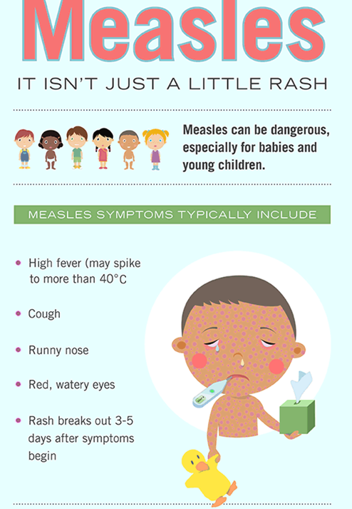

Slide 12
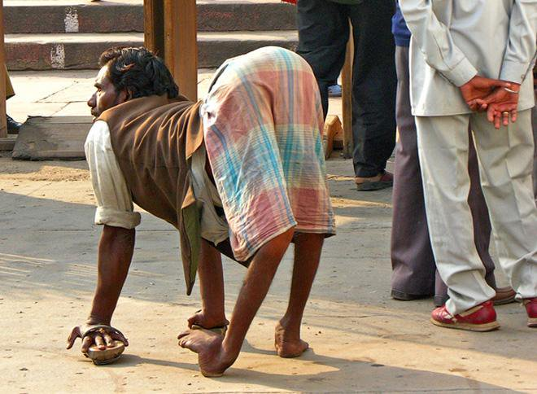
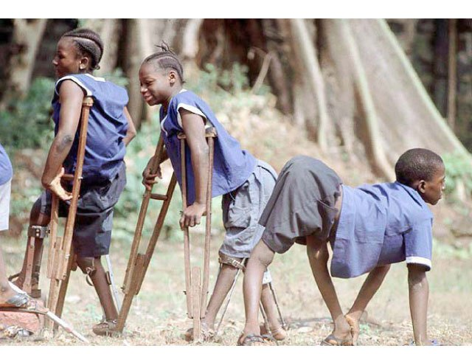
This is what polio looks like. You've never seen it because we #vaccinate against it.

Slide 13
How Do Vaccines Work?

Slide 14
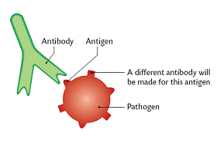
Vaccines
A vaccine is a preventative measure. They work by triggering your body to start an immune response against a disease before you ever get the disease. The goal is to make you immune to the disease so you will never get it.
A pathogen (a foreign invader such as a virus or bacteria) has specific identifying markers unique to it called antigens.

Slide 15
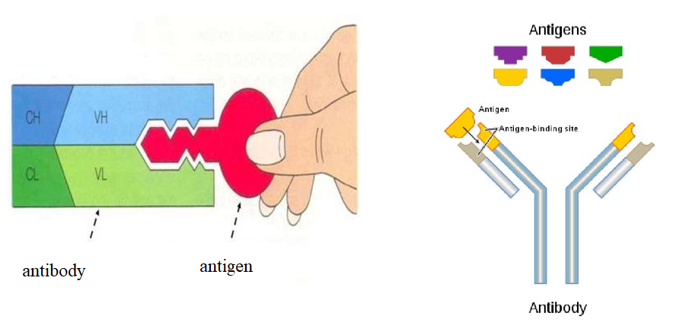
Vaccines
Antigens (antibody generators) are specific to each type of virus or bacteria
Once your body has encountered a specific pathogen with antigens on it, it will begin to produce antibodies to fight the infection.
The antibodies are highly specific and their shape allows them to attach like a lock and a key to specific foreign antigens

Slide 16
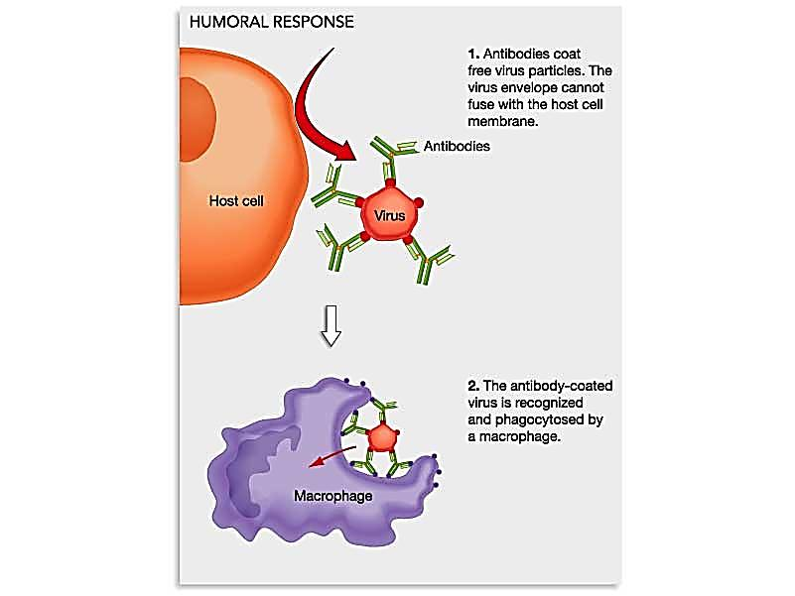
Antibodies Attaching to Antigen

Slide 17
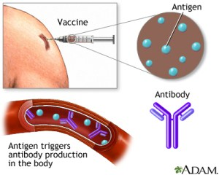
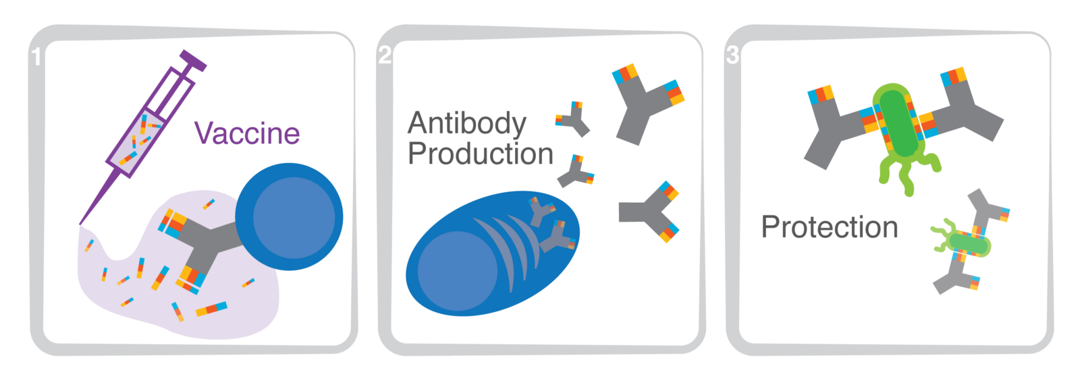
Vaccines
After the infection is over, memory cells are produced which remember the antigen structure.
Your body is now immune to getting this same disease again as it is able to recognize the virus or bacteria (by its antigen) and is already prepared to fight with premade antibodies.
You are protected from future infection! This protection is called immunity.
A vaccine is a safe way to cause your body to produce antibodies and memory cells against a specific virus or bacteria (by its antigen), protecting you if you ever encounter it.

Slide 18
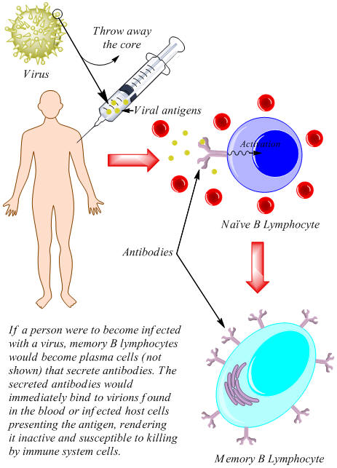

Slide 19
How Does a Vaccine Work?

Slide 20
ASAP on Antivaxxers

Slide 21
Measles Herd Immunity Simulation
Spread the Word to Protect the Herd
Measles simulation – The Guardian

Slide 22
Spread the Word to Protect the Herd
When lots of people in an area are vaccinated, fewer people get sick. Then fewer germs are around to spread from person to person.
This concept is called herd immunity, or community immunity.
When you vaccinate somebody, you protect them from getting infected, but you also prevent them from transmitting the disease to other people.
Herd immunity protects people who can't get vaccinated because their immune system is weak and vaccines might make them sick. This includes babies, people with vaccine allergies, and anyone with an immune-suppressing disease like HIV or cancer.
Often the people we need to protect with herd immunity are most vulnerable to serious disease.
https://www.vinceandassociates.com/blog/herd-immunity-explained-by-gif/

Slide 23
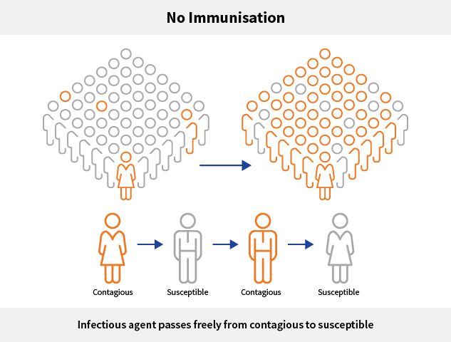

Slide 24
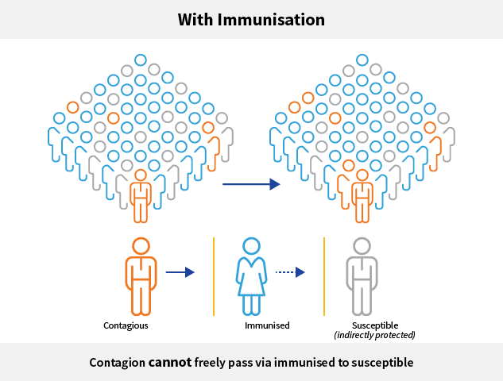

Slide 26
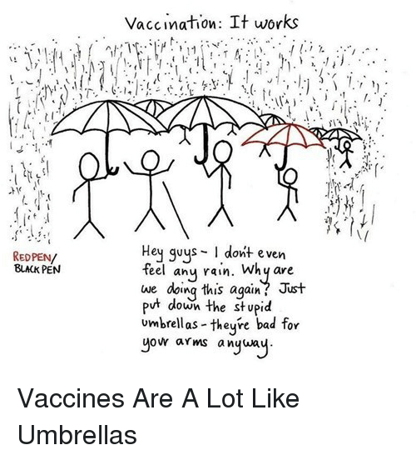

Slide 27
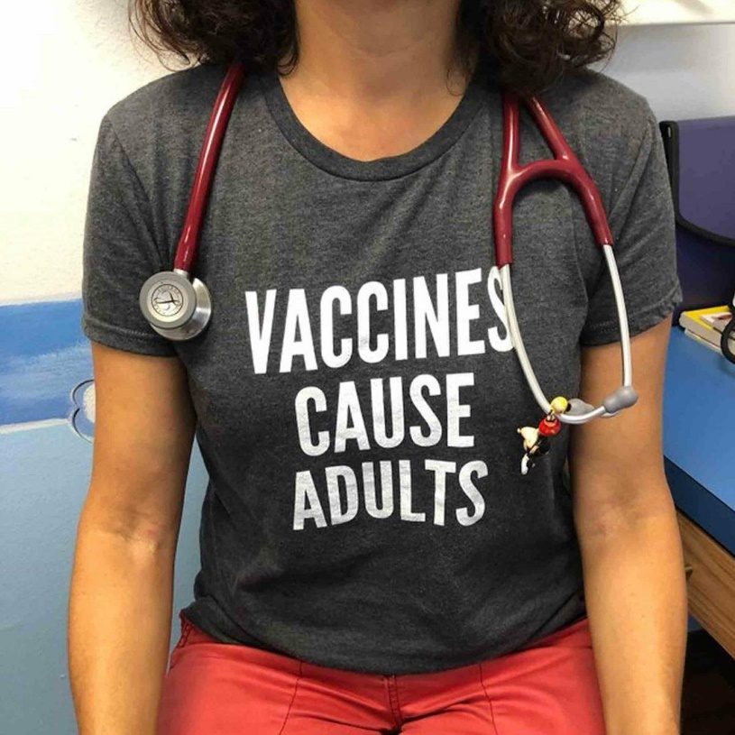
Who can answer my questions about immunization?
Your doctor, public health nurse or primary health care provider is your best source for questions about immunization.
Notes:
27
27
Presenter notes:
Your doctor, public health nurse or primary health care provider is your best source for information about immunizing your child.
27

Slide 28
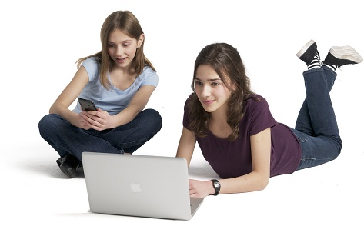
A word about online information
When you look online for information about vaccines, it’s important to be aware that not all sources are accurate. For the same reason we get legal advice from lawyers and take our cars to mechanics, it’s important to get your immunization information from reliable sources. If you are concerned about what you read, speak to your health care provider.
Notes:
28
28
The internet has a lot of great information about immunization – but there is also misinformation and some of it can be harmful if used to make health decisions. It’s important to make sure you are getting your information from trustworthy places. It’s always a good idea to talk about the information you read on the Internet with your child’s health care provider before making any health decisions.
More information:
A parent’s guide to immunization information on the Internet (from Canadian Pediatric Society) -http://www.caringforkids.cps.ca/handouts/immunization_information_on_the_internet
28

Slide 29
What are some reliable websites?
Here is a list of reliable websites:
.
ImmunizeBC.ca: www.immunizebc.ca
Canadian Pediatric Society: http://www.caringforkids.cps.ca/
Immunize Canada: www.immunize.cpha.ca
Public Health Agency of Canada: http://www.phac-aspc.gc.ca/im/
Notes:
29
29
Presenter notes:
The internet has a lot of great information about immunization – but there is also misinformation and some of it can be harmful if used to make health decisions. It’s important to make sure you are getting your information from trustworthy places. Here is a list of reliable websites where you can find credible science-based information about immunization:
ImmunizeBC: www.immunizebc.ca
Canadian Pediatric Society: http://www.caringforkids.cps.ca/
Immunize Canada: www.immunize.cpha.ca
HealthLinkBC Files – Child Immunization Series: http://www.healthlinkbc.ca/healthfiles/Series.stm#ChildImm
It’s always a good idea to talk about the information you read on the Internet with your child’s health care provider before making any health decisions.
Video: This is a great place to show video: A Change of Heart (3 min): http://www.youtube.com/watch?v=4PeME5ZMZLI. Vancouver's Tyson and Dawn Wozniak tell their story about how, as "natural parents," they decided not vaccinate their first child. But when their second child arrived, they did more research - and had a change of heart.
More information:
A parent’s guide to immunization information on the Internet (from the Canadian Pediatric Society) -http://www.caringforkids.cps.ca/handouts/immunization_information_on_the_internet
29

Slide 30
Ethan Lindenberger

