Slide 1
Vaccines
Microbiology:
Lesson 2 - Vaccines

Slide 2
Objectives
By the end of this lesson you should be able to:
Explain what a vaccine is and how they work
Draw and differentiate between pathogens, antigens and antibodies
Explain the concept of herd immunity

Slide 3
These two boys had been exposed to the same smallpox source. One had been vaccinated, the other hadn’t.

Slide 4
How We Conquered Smallpox

Slide 5
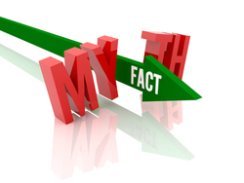
Myths & Facts

Slide 6
Myth!
Most diseases that we are vaccinated against are not serious.
FACTS: All of the diseases that children are vaccinated against are serious. They can all cause serious illness, complications and death, even with the best medical care. Many of these diseases also have no cure.
Measles outbreaks still happen. Complications occur in about 10% of cases. For every 1,000 cases of measles, 1 or 2 of those people will die.
Pertussis (“whooping cough”) kills between 1 and 4 babies in Canada every year. About 1 in 400 babies who survive pertussis has permanent brain damage.
Tetanus kills 10% or more of its victims.

Slide 7
We don’t need vaccines because no one gets these diseases anymore.
Myth!
FACT: These diseases still exist, even if they are rare. Thanks to vaccine programs, all vaccine-preventable diseases have declined in Canada. But when immunization rates drop, these diseases can come back.
Many of the vaccine-preventable diseases that are uncommon in Canada still occur in other parts of the world. With travel and immigration, there is a real risk of these diseases being brought into Canada. Any child who is not vaccinated is at risk when infections are “imported”.

Slide 8
If so many other people are vaccinated, I don’t need vaccines.
Myth!
FACT: Yes, they do. Relying on actions of other parents to protect your unvaccinated behind only works if everyone else is vaccinated. If many parents take this attitude, fewer children will be immunized and diseases will start to spread quickly. And when it comes to tetanus, whether other people are vaccinated makes no difference to your safety. Tetanus is caused when bacteria from the soil get into a wound.

Slide 9
Myth!
It’s better to get vaccines one at a time.
FACT: Thanks to combination vaccines, your child can get protection from many different diseases with one injection (shot). Examples include MMR (measles, mumps, rubella) and the 5-in-1 vaccine (diphtheria, tetanus, pertussis, polio, Hib disease). Studies show that combination vaccines are safe and effective. There is no reason for your child to get the vaccines one at a time. Getting more than one vaccine at once also means no delay in protection, fewer medical visits and fewer needles (which can be less traumatic).

Slide 10
Fact!
Vaccines are adequately tested for safety.
Vaccines are safe and effective. Like all medicines, vaccines must go through many steps before Health Canada approves them for use. Vaccines must prove to be safe and effective at preventing the diseases they target. Once a vaccine is in use, Canadian health authorities continue to monitor for side effects. Serious side effects to vaccines are very rare. Vaccines are among the most strictly tested and controlled of all medicines as they are given to all children.

Slide 11
Myth!
The MMR vaccine causes autism.
FACT: No, the MMR vaccine does not cause autism. There is no scientific evidence to support this claim.
Much of the controversy over the MMR vaccine and autism came from a single paper published in 1998 that suggested a link. The report has been found to be fraudulent, and was withdrawn by the journal that published it. Many large scientific studies around the world have found no link between the MMR vaccine and autism.
There is no evidence to link any other vaccines to autism. The number of children with autism seems to have increased in recent years. This is because the diagnosis of autism now includes children with milder symptoms who would not have been included in the past. There is also greater public awareness of autism, and more parents are seeking help. Scientists recently found a gene linked to autism.

Slide 12
Myth!
Thimerosal in vaccines causes autism.
FACT: There is no evidence linking thimerosal (a preservative once used in vaccines) to autism or any other developmental disorder. Also, thimerosal has not been used in infant and childhood vaccines for many years. Yet the numbers of children with autism continued to increase, even after thimerosal stopped being used in vaccines.

Slide 14
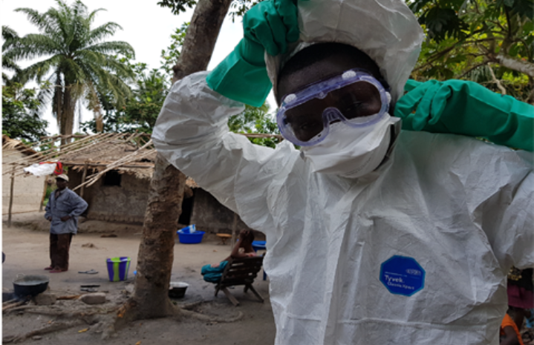

Slide 15
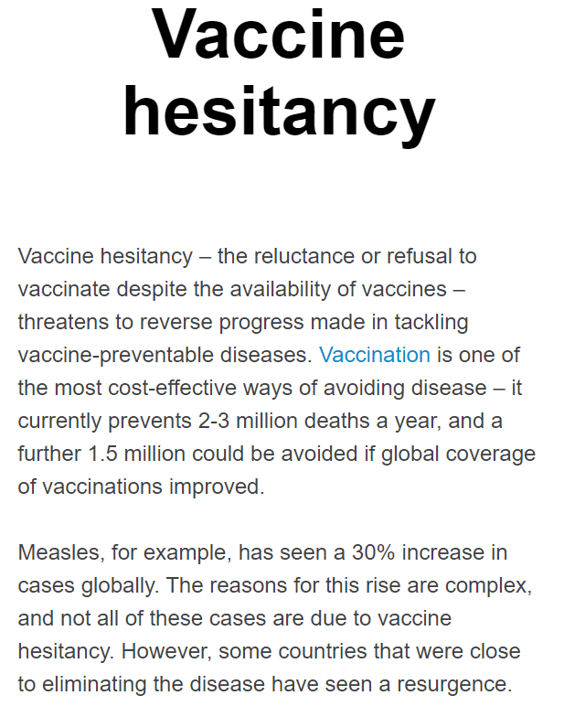

Slide 27
Toronto Public Health is campaigning to have outspoken television host Jenny McCarthy dismissed from 'The View' for her outspoken views on vaccinations.

Slide 28
Jenny McCarthy’s Controversial ‘View’

Slide 29
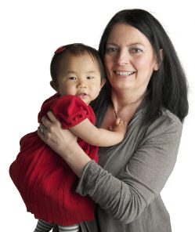
Immunizations save lives
Immunizations (vaccinations, shots) have saved the lives of more babies and children than any other medical intervention in the last 50 years.
When you get immunized, you are protected against illness and serious harm such as meningitis, pneumonia, paralysis, deafness, seizures, brain damage or even death.
Notes:
29
29
Presenter notes:
Immunization is the only protection against some diseases
Immunizations save lives. When you immunize your baby, you're protecting him or her against illness and serious harms such as meningitis, pneumonia, paralysis, deafness, seizures, brain damage and even death.
Did you know? Immunization has saved the lives of more babies and children than any other medical intervention in the last 50 years.
29

Slide 30
BC’s childhood immunization program is one of the best in the world.
Free vaccines are provided to protect you against these vaccine preventable diseases:
Diphtheria
Pertussis
Tetanus
Polio
Influenza
Rotavirus
Hepatitis B
Measles
Mumps
Rubella
Haemophilus influenzae type B
Meningococcal disease
Pneumococcal disease
Varicella
Notes:
30
30
Presenter notes:
BC’s childhood immunization program is one of the best in the world.
In the first 2 years of life, babies are given several vaccines to protect them against these 14 different vaccine-preventable diseases: Diphtheria, Pertussis (Whooping cough), Tetanus, Polio, Haemophilus influenzae type b (HIB), Hepatitis B, Meningococcal disease, Pneumococcal disease, Rotavirus , Measles, Mumps, Rubella (German Measles), Varicella (Chickenpox) and Influenza. These vaccines are free.
Other vaccines may be recommended for your baby. Check with your health care provider for more information.
30

Slide 36
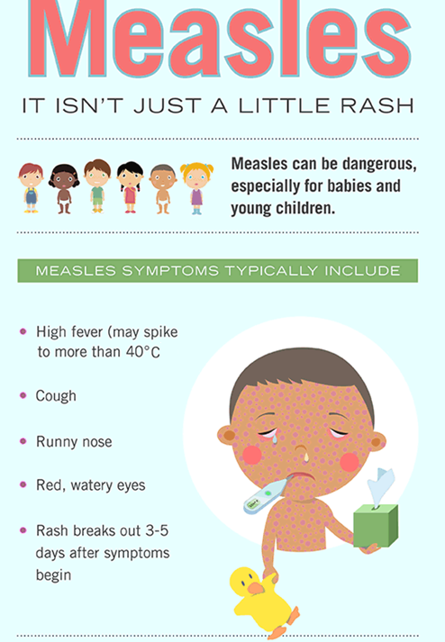

Slide 37
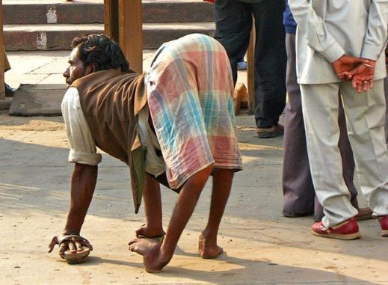
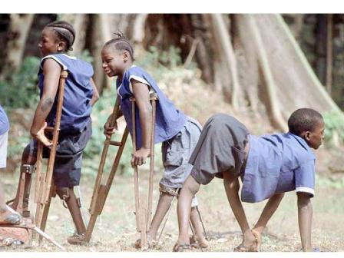
This is what polio looks like. You've never seen it because we #vaccinate against it.

Slide 38
How Do Vaccines Work?

Slide 39
Do vaccines work?
Think about it: As the 2014 Ebola outbreak raged in West Africa, no vaccine was available, so thousands of people became very sick and more than 9,000 died.
In the case of measles, in the decade before 1963 when a vaccine became available, nearly all children got measles by the time they were 15. Up to 4 million people in the United States were infected each year, 400-500 people died, 48,000 were hospitalized, and 4,000 suffered encephalitis, or swelling of the brain.
Now, two doses of measles vaccine are about 97 percent effective at preventing measles if someone is exposed to the virus. Vaccines work!

Slide 40
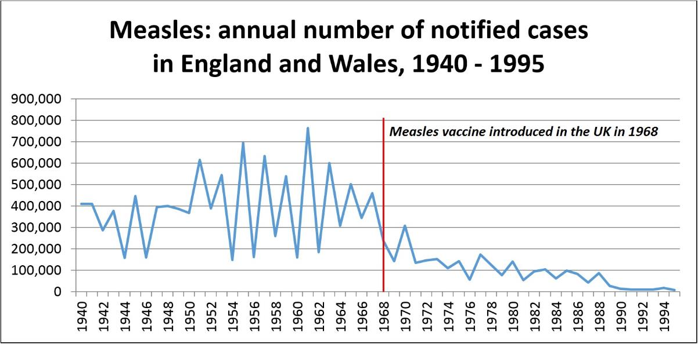

Slide 41
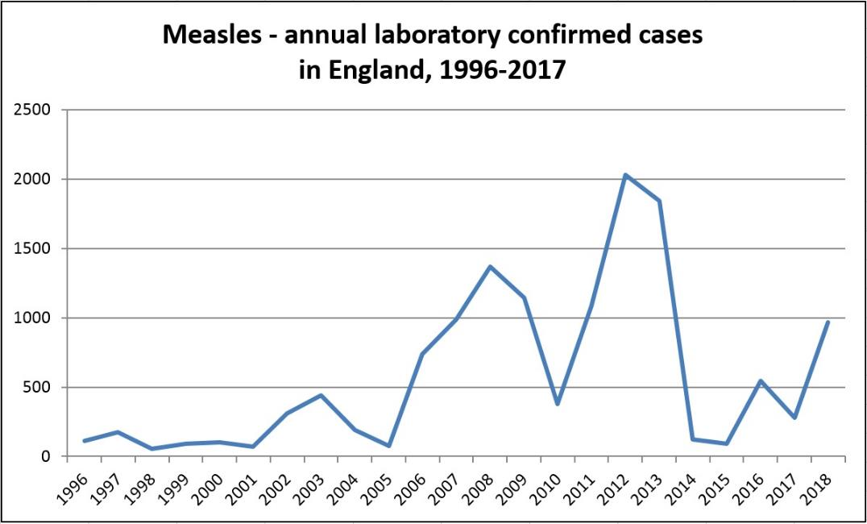

Slide 42
ASAP on Antivaxxers

Slide 46
Immune Response
The reason you do not get infected with the same virus multiple times is due to your body’s adaptive immune response. Your main defense is your antibodies which are like heat-seeking missiles that directly target a specific virus.
After learning the virus structure and how to make antibodies against it, your body creates memory cells which allow your immune system to remember specific infections and quickly produce large numbers of antibodies against the infection.

Slide 47
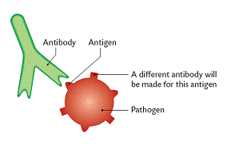
Vaccines
A vaccine is a preventative measure. They work by triggering your body to start an immune response against a disease before you ever get the disease. The goal is to make you immune to the disease so you will never get it.
A pathogen (a foreign invader such as a virus or bacteria) has specific identifying markers unique to it called antigens.

Slide 48
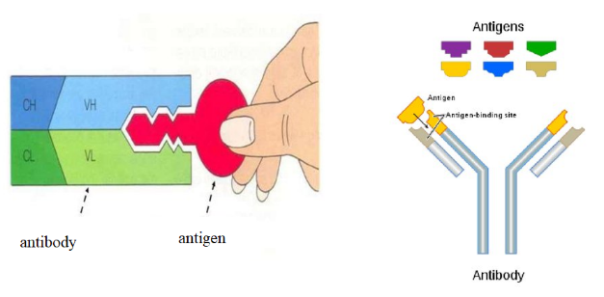
Antigens (antibody generators) are specific to each type of virus or bacteria.
Once your body has encountered a specific pathogen with antigens on it, it will begin to produce antibodies to fight the infection.
The antibodies are highly specific and their shape allows them to attach like a lock and a key to specific foreign antigens.

Slide 49
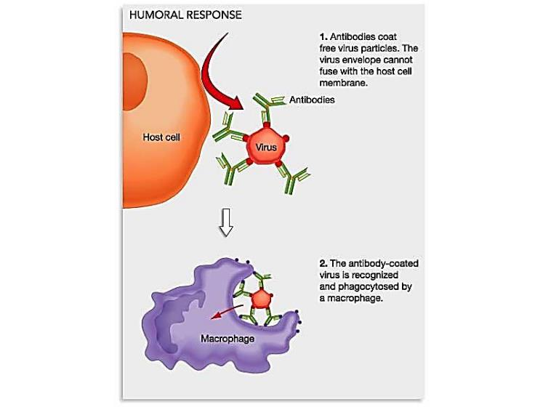
Antibodies Attaching to Antigen

Slide 50
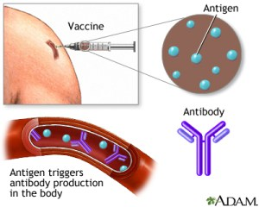
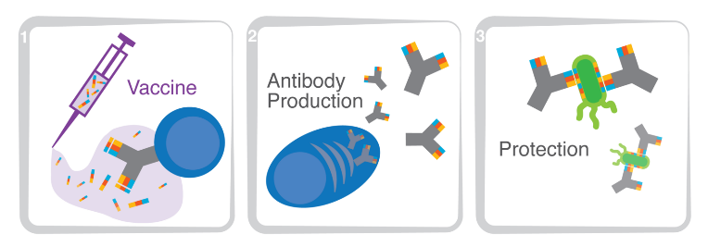
After the infection is over, memory cells are produced which remember the antigen structure.
Your body is now immune to getting this same disease again as it is able to recognize the virus or bacteria (by its antigen) and is already prepared to fight with premade antibodies.
You are protected from future infection! This protection is called immunity.
A vaccine is a safe way to cause your body to produce antibodies and memory cells against a specific virus or bacteria (by its antigen), protecting you if you ever encounter it.
A vaccine essentially teaches your immune system how to fight against specific infections.

Slide 51
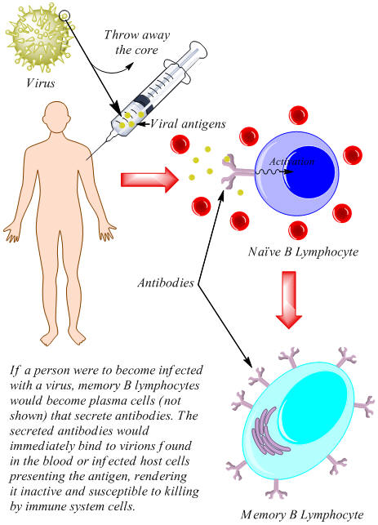

Slide 52
How Does a Vaccine Work?

Slide 55
Measles Herd Immunity Simulation
Spread the Word to Protect the Herd
Measles simulation – The Guardian

Slide 56
Spread the Word to Protect the Herd
When lots of people in an area are vaccinated, fewer people get sick. Then fewer germs are around to spread from person to person.
This concept is called herd immunity, or community immunity.
When you vaccinate somebody, you protect them from getting infected, but you can also help prevent them from transmitting the disease to other people.
Herd immunity protects people who can't get vaccinated because their immune system is weak and vaccines might make them sick. This includes babies, people with vaccine allergies, and anyone with an immune-suppressing disease like HIV or cancer.
Often the people we need to protect with herd immunity are most vulnerable to serious disease.

Slide 57
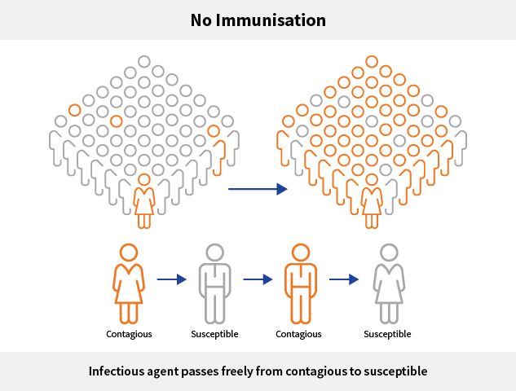

Slide 58
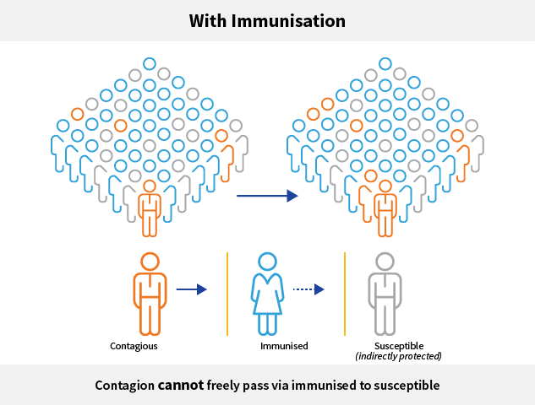

Slide 60
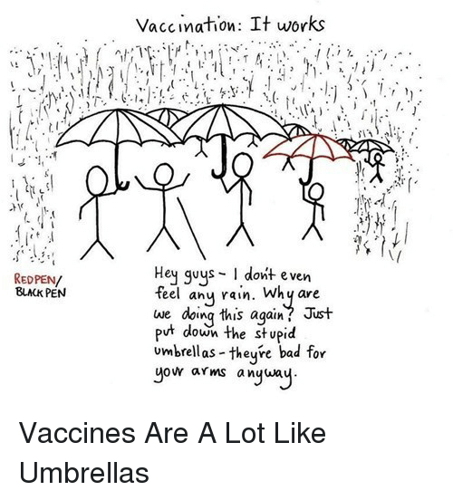

Slide 62
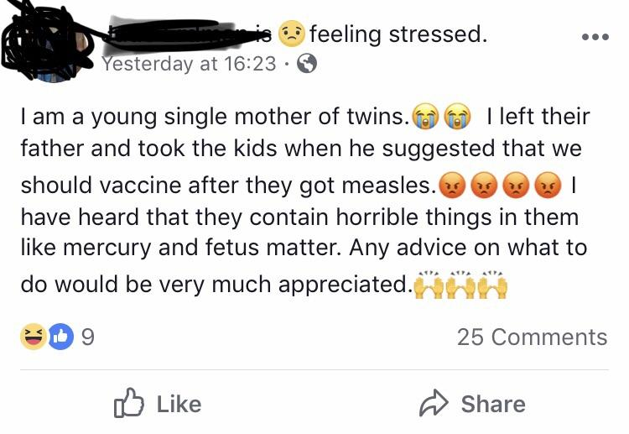

Slide 63
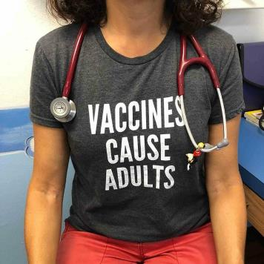
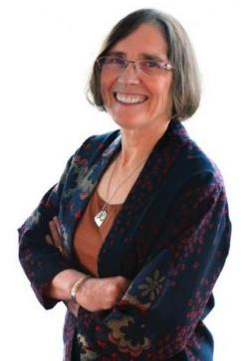
Who can answer my questions about immunization?
Your doctor, public health nurse or primary health care provider is your best source for questions about immunization.
Notes:
63
63
Presenter notes:
Your doctor, public health nurse or primary health care provider is your best source for information about immunizing your child.
63

Slide 64
A word about online information
When you look online for information about vaccines, it’s important to be aware that not all sources are accurate. For the same reason we get legal advice from lawyers and take our cars to mechanics, it’s important to get your immunization information from reliable sources. If you are concerned about what you read, speak to your health care provider.
Notes:
64
64
The internet has a lot of great information about immunization – but there is also misinformation and some of it can be harmful if used to make health decisions. It’s important to make sure you are getting your information from trustworthy places. It’s always a good idea to talk about the information you read on the Internet with your child’s health care provider before making any health decisions.
More information:
A parent’s guide to immunization information on the Internet (from Canadian Pediatric Society) -http://www.caringforkids.cps.ca/handouts/immunization_information_on_the_internet
64

Slide 65
What are some reliable websites?
Here is a list of reliable websites:
.
ImmunizeBC.ca: www.immunizebc.ca
Canadian Pediatric Society: http://www.caringforkids.cps.ca/
Immunize Canada: www.immunize.cpha.ca
Public Health Agency of Canada: http://www.phac-aspc.gc.ca/im/
Notes:
65
65
Presenter notes:
The internet has a lot of great information about immunization – but there is also misinformation and some of it can be harmful if used to make health decisions. It’s important to make sure you are getting your information from trustworthy places. Here is a list of reliable websites where you can find credible science-based information about immunization:
ImmunizeBC: www.immunizebc.ca
Canadian Pediatric Society: http://www.caringforkids.cps.ca/
Immunize Canada: www.immunize.cpha.ca
HealthLinkBC Files – Child Immunization Series: http://www.healthlinkbc.ca/healthfiles/Series.stm#ChildImm
It’s always a good idea to talk about the information you read on the Internet with your child’s health care provider before making any health decisions.
Video: This is a great place to show video: A Change of Heart (3 min): http://www.youtube.com/watch?v=4PeME5ZMZLI. Vancouver's Tyson and Dawn Wozniak tell their story about how, as "natural parents," they decided not vaccinate their first child. But when their second child arrived, they did more research - and had a change of heart.
More information:
A parent’s guide to immunization information on the Internet (from the Canadian Pediatric Society) -http://www.caringforkids.cps.ca/handouts/immunization_information_on_the_internet
65

Slide 66
Ethan Lindenberger

Slide 67
Some Further Reading
It’s old news that vaccines don’t cause autism. But a major new study aims to refute skeptics again
8 Things everyone should know about measles
Pinterest, Facebook, and YouTube are cracking down on fake vaccine news
Facebook Swears It's Going to Do a Better Job at Not Spreading Dangerous Anti-Vaccine Content
Vaccine Hesitancy Almost Cost the US its Measles Elimination Status
Washington declared a public health emergency over measles. Thank vaccine-refusing parents.
Research fraud catalyzed the anti-vaccination movement. Let’s not repeat history.
Confirmed: No Link Between Autism and Measles Vaccine, Even for 'At Risk' Kids
Anti-Vaccine Movement Joins Ebola, Drug Resistance on List of Top Global Threats
Wakefield study linking MMR vaccine, autism uncovered as complete fraud

Slide 68
Can you …
… explain what a vaccine is and how they work?
… draw, explain, and differentiate between pathogens, antigens and antibodies?
… explain the concept of heard immunity?

