Slide 1
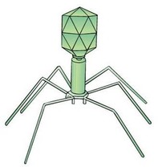

Slide 2
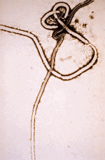
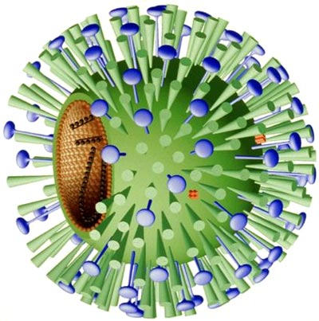
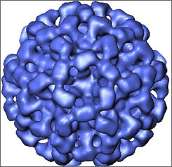
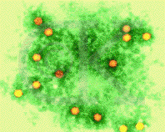
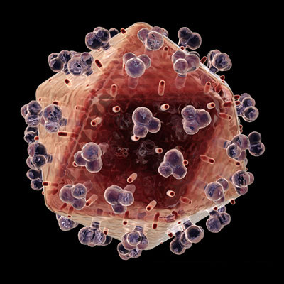
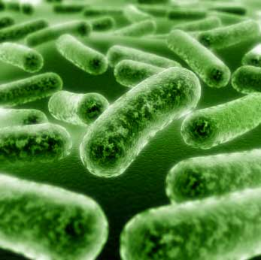
Ebola
Dengue Fever
Influenza
Mumps
Rabies
Polio
HIV

Slide 3
Did You Know…
Viruses are considered the smallest of all microorganisms to exist on earth.
Viruses may remain inactive (dormant) until it encounters a living host cell.
Viruses exist in many different shapes, sizes, and colors.
Evidence shows viruses existed over billions of years ago.
Viruses contain genetic material that can be altered according to the host.
Viruses are considered parasites and can infect any living cell of almost every species.
Plant viruses only infect plants & animal viruses only infect animals.
Viruses may be classified as mild or deadly.
Viruses are too small to be seen with a light microscope.
Your body contains a virus right now!

Slide 4
Life Sciences 11
Microbiology:
Viruses

Slide 5
Objectives
By the end of the lesson you should be able to:
Classify viruses as living or non-living
Describe the structure of a virus
Explain how a virus infects a host
Compare and contrast the lytic and lysogenic cycles of viral reproduction
Describe different types of viruses
Explain human responses to viral infections

Slide 6
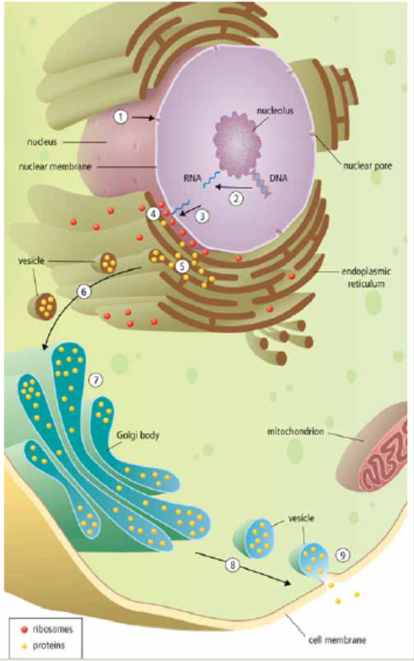

Slide 7
Introduction
Viruses are not included in any of the Domains or Kingdoms of life.
Why?

Slide 8
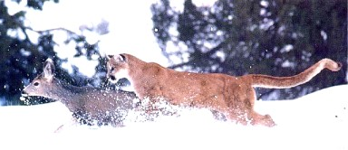
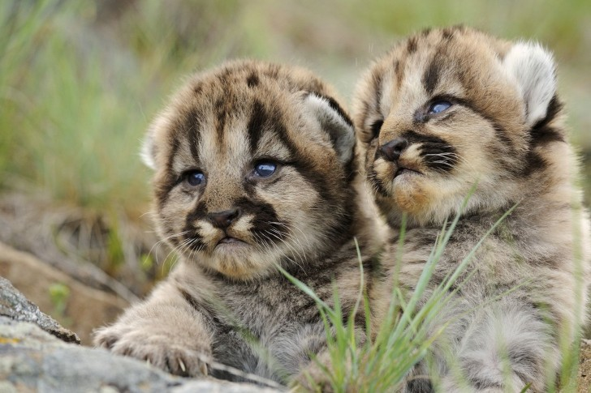
The 8 Characteristics of Life (Review)
1. All life is made up of at least one or more cells
2. All life must obtain and use materials and energy (metabolism)
3. All life grows - increasing its biomass as it develops
4. All life reproduces itself

Slide 9
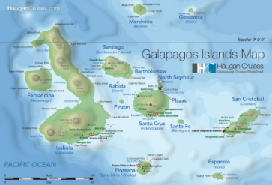
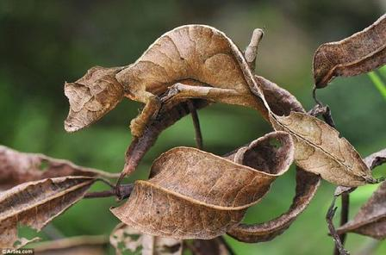
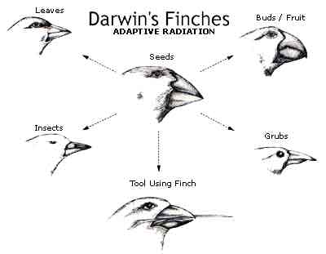
The 8 Characteristics of Life
5. All life responds to its environment
6. All life adapts - evolves - to survive in its environment over generations
7. All life maintains homeostasis (stable internal environment)
8. All life is based on a universal genetic code

Slide 10
Viruses…..Life?
They do not fit all of the characteristics of life
Viruses are not cells and do not contain cytoplasm or any other cell organelles
They can’t do any of the chemistry of life (metabolism) by themselves
They can be crystallized like salt, rehydrated, and still be infectious

Slide 11
Viruses…..Life?
Viruses contain DNA/RNA…which can mutate and evolve just like ours!
Viruses cause diseases which can be contagious
Viruses can reproduce, but not by themselves - they force a host cell to help!
Video: Are viruses alive?

Slide 12
So what are viruses?
They are very tiny particles (seen only with an electron microscope) that have some of the properties of life.
Definition: an infective agent that typically consists of a nucleic acid molecule in a protein coat, is too small to be seen by light microscopy, and is able to multiply only within the living cells of a host.

Slide 13
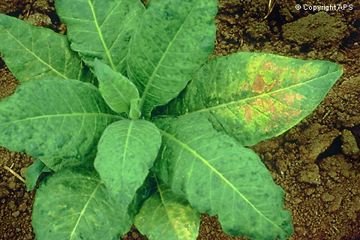
Discovery of Viruses
By Dimitre Ivanowski - experimented with Tobacco Mosaic Disease
Knew a pathogen was involved but couldn’t see it!
Did 3 experiments

Slide 14
Experiments:
1: Extracted juice from diseased leaves and spread on healthy leaves
- Healthy leaves became diseased!
2: Boiled the diseased juice then placed it on healthy leaves
- Healthy leaves did not become diseased
3: Passed the unboiled diseased juice through a fine porcelain filter (too small for any life, even smallest bacteria, to get through) then place filtrate onto healthy leaves
- Healthy leaves became diseased!

Slide 15
Martinus Beijerinck
Suggested that tiny particles in the juice caused the disease
Called these particles viruses from the Latin word for poison

Slide 16
Wendell Stanley’s Experiment:
Left the filtrate sitting out overnight and water evaporated away and crystals formed. Added water back to dissolve the crystals and placed this solution on healthy leaves
- Healthy leaves became diseased!

Slide 17
Experimental Conclusions:
Ivanowski
1. Disease was contagious
2. Disease was caused by something living
3. Disease caused by a small new life form
Stanley
1. Disease caused by something a non-living because it could be crystallized and all life dies without water

Slide 18
Virus Structure
All consist of a protein coat (called a capsid) surrounding a nucleic acid core
All are parasitic
Structure of viruses are highly variable but all have the same basic layout

Slide 19
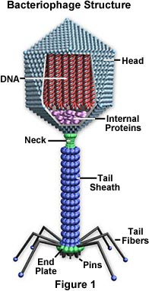
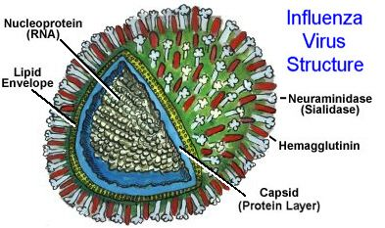
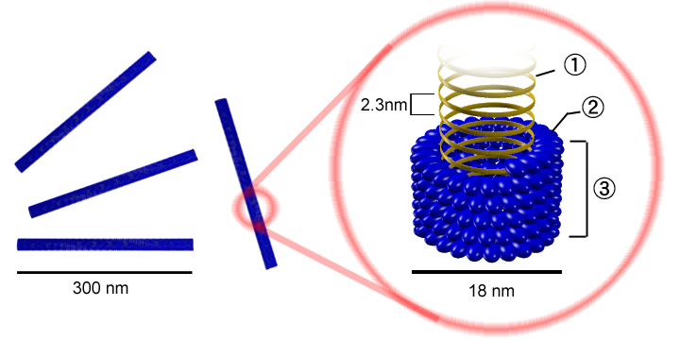
Virus Structure
Protein capsid

Slide 20
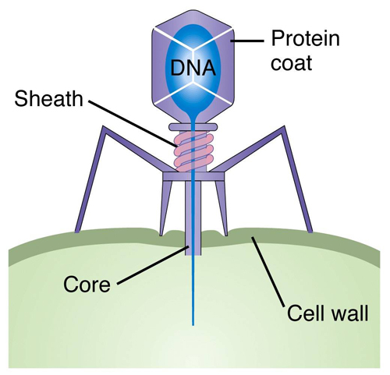
How do viruses infect?
The virus lands on the cell then pierces its cell wall with its tail and inserts its genetic material (DNA or RNA)
The now empty virus coat is useless - like an empty egg shell
Virus Video – Amoeba Sisters

Slide 21
“Life” Cycles:
Viruses reproduce in two ways:
1. The Lytic Cycle: This results in the death of the host cell by Lysis (to burst) as the virus uses the host cell to make copies of itself
2. The Lysogenic Cycle: This results in the viral DNA being inserted into the host DNA
- The new genes are called a Provirus (prophage if inserted into a bacterium)

Slide 22
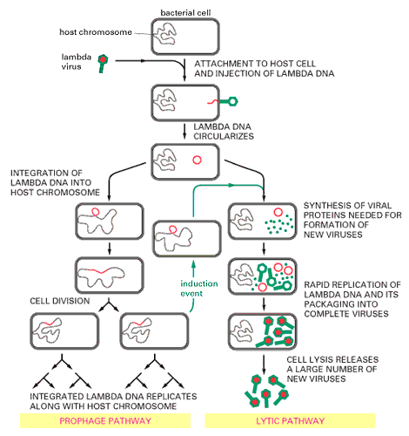
Life Cycles:
PG. 481
Lysogenic Lytic

Slide 23
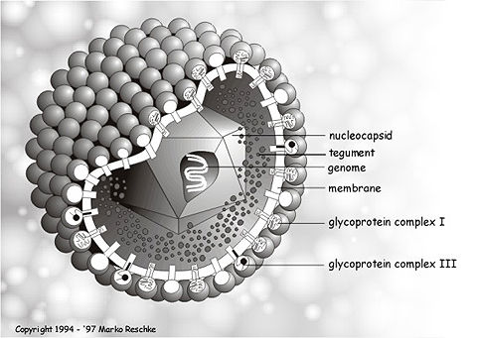
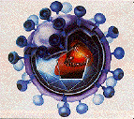
Viral Diversity
Herpes Virus
Viruses can use either DNA or RNA as their genetic material
Two examples of viral diversity are Enveloped Viruses and Retroviruses
HIV (AIDS)

Slide 24
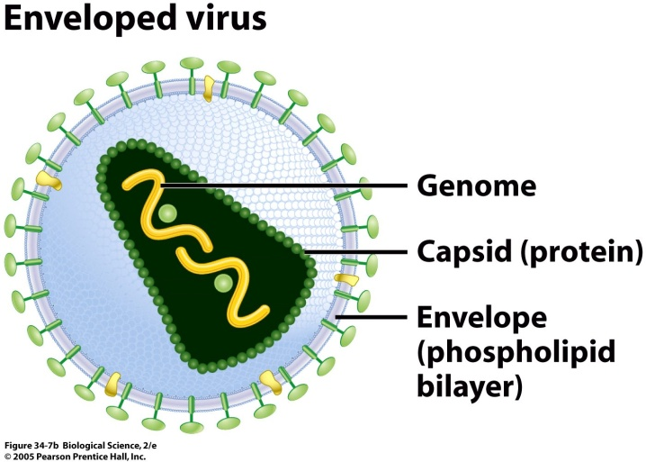
Viral Diversity
Retro Viruses
RNA acts as a template to make DNA (copied backwards)
Mutate quickly due to being single stranded (Ex: HIV)
Enveloped Viruses
Some viruses have an outer membrane (captured from past host) called a viral envelope
Helps them enter host cell by fusing envelope to cell membrane – acts like camouflage
(Ex: HIV, chickenpox)

Slide 25
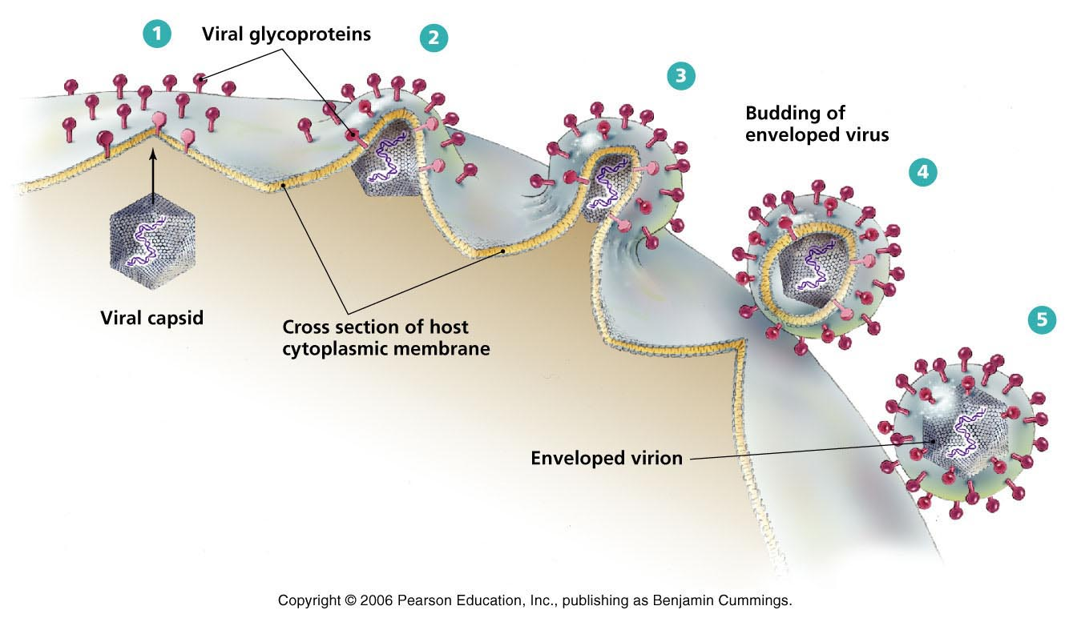

Slide 26
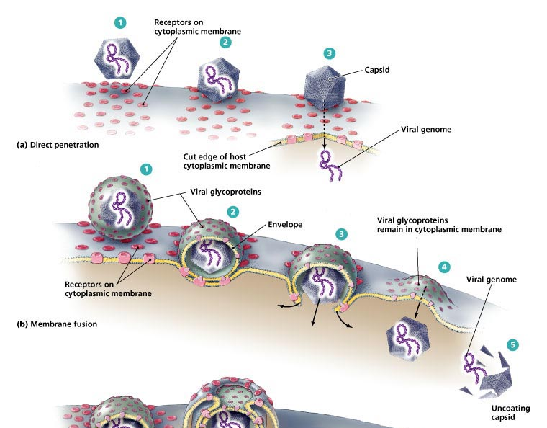

Slide 27
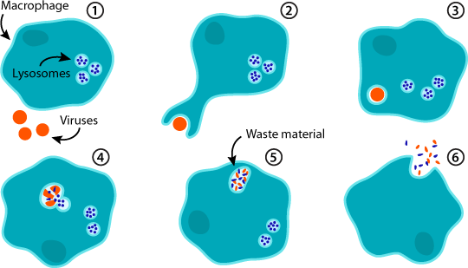
Responses to Viral Infections
1. Phagocytosis video
The host’s white blood cells can “eat” the virus particle by engulfing and destroying it with enzymes in their lysosomes

Slide 28
Responses to Viral Infections
2. Immune System Responses:
A. Interferon:
A protein made by an infected host cell before it dies
Signals other cells to defend against the virus
Activates immune cells to kill virus

Slide 29
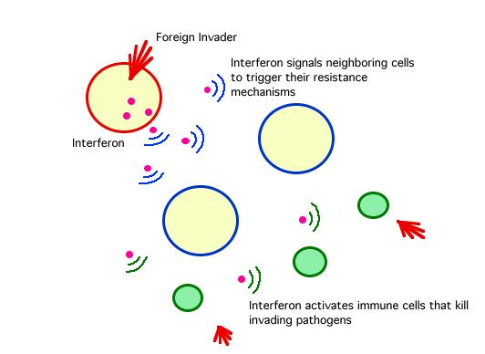

Slide 30
Responses to Viral Infections
2. Immune System Responses:
A. Interferon:
A protein made by an infected host cell before it dies
Signals other cells to defend against the virus
Activates immune cells to kill virus
B. Antibodies:
Highly specific proteins made by White Blood Cells
Attach to virus, clump them together (deactivating them) and making them easy to be destroyed by other WBC.

Slide 31
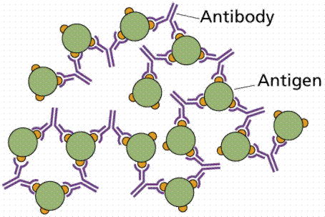

Slide 32
Virus
Top 5 Deadliest Viruses Video
Virus review video
Virus Video – Amoeba Sisters

